Slide 1
In pairs, predict what the following code does
1 2 3 4 5 6 7 | def write_text_file(): file=open("days.txt",’w’) file.write("Monday\n") file.write("Tuesday\n") file.write("Wednesday\n") file.close() write_text_file()

Slide 2
Writing to text files

Slide 3
Learning objectives
Write programs that write data to text files
Write programs that append data to text files

Slide 4
Storing data
Sometimes we need to store data and information in our programs. To do this we can use files that allow us to save work between sessions.
There are all sorts of file types for storing different media such as music, pictures, movies and documents
We are going to learn to write to text files

Slide 5
Writing to files
To write to files there are 3 steps:
Open the file for writing
Write to the file
Close the file

Slide 6
Download the code, run and modify
1 2 3 4 5 6 7 | def write_text_file(): file=open("days.txt",’w’) file.write("Monday\n") file.write("Tuesday\n") file.write("Wednesday\n") file.close() write_text_file()
Does the code do as you expected?
Download the code from write-days.py
Add in the remaining days of the week
What happens if you remove the \n on lines 3-5.
What does “w” do on line 2?
What is the name of the file?
What happens if the file exists?
What happens if the file does not exist?

Slide 7
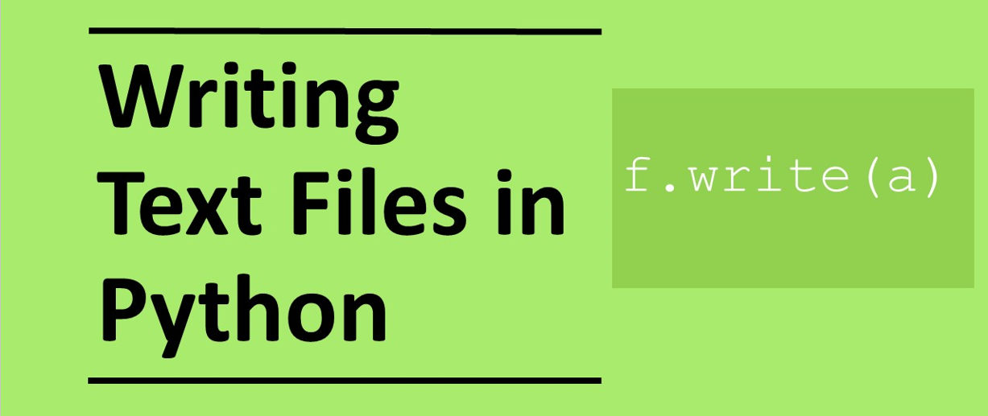

Slide 8
Open file
Whatever we are doing to a file whether we are reading, writing or adding to or modifying a file we first need to open it using:
open(filename,access_mode)
There are a range of access modes depending on what we want to do to the file, the principal ones are given below:
file=open(“file.txt”,’r’) Opens a file for reading only, there will be an error if the file does not exist
file=open(“file.txt”,’w’) Opens a file for writing only, create the file if it does not exist, and overwrites the file if it does already exist
file=open(“file.txt”,’a’) Append to the end of a file, creates the file if it does not already exist

Slide 9
Open the file for writing
Name of file
1 2 3 4 5 6 7 | def write_text_file(): file=open("days.txt",’w’) file.write("Monday\n") file.write("Tuesday\n") file.write("Wednesday\n") file.close() write_text_file()

Slide 10
Open the file for writing
We need to specify the access mode to be ‘w’.
The ‘w’ means open a file for writing only.
Warning: If the file already exists everything will be overwritten.
If the file does not exist, one will be created.
1 2 3 4 5 6 7 | def write_text_file(): file=open("days.txt",’w’) file.write("Monday\n") file.write("Tuesday\n") file.write("Wednesday\n") file.close() write_text_file()

Slide 11
Writing to the file
1 2 3 4 5 6 7 | def write_text_file(): file=open("days.txt",’w’) file.write("Monday\n") file.write("Tuesday\n") file.write("Wednesday\n") file.close() write_text_file()
Now that we have opened the file we can write to it.
We can add content to a file using the write method.
Write allows us to add a string to the file.
At the end of each string we include “\n” so that each day is written to a separate line. IN this example each day of the week will be on on a separate line.

Slide 12
Writing to the file
1 2 3 4 5 6 7 | def write_text_file(): f1=open("days.txt",’w’) f2=open(“months.txt",’w’) f1.write("Monday\n") f1.write("Tuesday\n") f1.write("Wednesday\n") f2.write(“January\n") f1.close() f2.close() write_text_file()
Now that we have opened the file we can write to it.
We can add content to a file using the write method.
Write allows us to add a string to the file.
At the end of each string we include “\n” so that each day is written to a separate line. IN this example each day of the week will be on on a separate line.

Slide 13
Close file
1 2 3 4 5 6 7 | def write_text_file(): file=open("days.txt",’w’) file.write("Monday\n") file.write("Tuesday\n") file.write("Wednesday\n") file.close() write_text_file()
Once we have written to the file we need to close the file using the close method
You can view the file in a text editor (eg Notepad) to check that it has been written correctly.

Slide 14
Modify the code
1 2 3 4 5 6 7 | def write_text_file(): file=open("days.txt",’w’) file.write("Monday\n") file.write("Tuesday\n") file.write("Wednesday\n") file.close() write_text_file()
Change the access specifier “w” to “a”. Run the code. What happens?
Add in the remaining days of the week.
Change the name of the file

Slide 15
Procedure for writing a list to a file
1 2 3 4 5 6 7 8 | def write_text_file(data,file,end=“”): f=open(file,“w") for i in data: text=i+end f.write(text) f.close() data=[“Mon”,”Tue”,”Wed”] write_text_file(data,“days.txt“,”\n”)
This is a general procedure for writing a list to a text file. It can be used in many situations.

Slide 16
Writing to a file
1 2 3 4 5 6 7 8 | def write_text_file(data,file,end=“”): f=open(file,“w") for i in data: text=i+end f.write(text) f.close() data=[“Mon”,”Tue”,”Wed”] write_text_file(data,“days.txt“,”\n”)
Access mode “” means write to the the file
Create a new file if one does not exist.
Overwrites the file if it does already exist

Slide 17
Writing to a file
1 2 3 4 5 6 7 8 | def write_text_file(data,file,end=“”): f=open(file,“w") for i in data: text=i+end f.write(text) f.close() data=[“Mon”,”Tue”,”Wed”] write_text_file(data,“days.txt“,”\n”)
File to append to. This is the parameter name.
In this example the file is called “greeting.txt”

Slide 18
Writing to a file
1 2 3 4 5 6 7 8 | def write_text_file(data,file,end=“”): f=open(file,“w") for i in data: text=i+end f.write(text) f.close() data=[“Mon”,”Tue”,”Wed”] write_text_file(data,“days.txt“,”\n”)
List to write to file

Slide 19
Procedure for writing a list to a file
1 2 3 4 5 6 7 8 | def write_text_file(data,file,end=“”): f=open(file,“w") for i in data: text=i+end f.write(text) f.close() data=[“Mon”,”Tue”,”Wed”] write_text_file(data,“days.txt“,”\n”)
Go through each item in the list

Slide 20
Writing to a file
1 2 3 4 5 6 7 8 | def write_text_file(data,file,end=“”): f=open(file,“w") for i in data: text=i+end f.write(text) f.close() data=[“Mon”,”Tue”,”Wed”] write_text_file(data,“days.txt“,”\n”)
Adds end of line character if needed to append onto the end of the line so that the text is appended onto the next line in the file if end=“\n”

Slide 21
Writing to a file
1 2 3 4 5 6 7 8 | def write_text_file(data,file,end=“”): f=open(file,“w") for i in data: text=i+end f.write(text) f.close() data=[“Mon”,”Tue”,”Wed”] write_text_file(data,“days.txt“,”\n”)
Write list item to file

Slide 22
Modify the code
1 2 3 4 5 6 7 8 | def write_text_file(data,file,end=“”): f=open(file,“w") for i in data: text=i+end f.write(text) f.close() data=[“Mon”,”Tue”,”Wed”] write_text_file(data,“days.txt“,”\n”)
Change the access specifier “w” to “a”. Run the code. What happens?
Change the name of the output file to months.txt
Use the months of the year for the data list

Slide 23
Alternative procedure for appending text to files
1 2 3 4 5 7 8 9 10 | def append_text(text,file,end=“”): text=text+end f=open(file,"a") f.write(text) f.close() text=“Hello” append_text(text,“greeting.txt“,”\n”) text=“World” append_text(text,“greeting.txt“,”\n”)
To add a line to a file that already exists, we can use a generalised routine

Slide 24
Appending lines
1 2 3 4 5 7 8 9 10 | def append_text(text,file,end=“”): text=text+end f=open(file,"a") f.write(text) f.close() text=“Hello” append_text(text,“greeting.txt“,”\n”) text=“World” append_text(text,“greeting.txt“,”\n”)
Adds end of line character if needed to append onto the end of the line so that the text is appended onto the next line in the file if end=“\n”

Slide 25
Appending lines
1 2 3 4 5 7 8 9 10 | def append_text(text,file,end=“”): text=text+end f=open(file,"a") f.write(text) f.close() text=“Hello” append_text(text,“greeting.txt“,”\n”) text=“World” append_text(text,“greeting.txt“,”\n”)
Access mode “a” means append to the end of a file if it exists.
Create a new file if one does not exist.

Slide 26
Appending lines
1 2 3 4 5 7 8 9 10 | def append_text(text,file,end=“”): text=text+end f=open(file,"a") f.write(text) f.close() text=“Hello” append_text(text,“greeting.txt“,”\n”) text=“World” append_text(text,“greeting.txt“,”\n”)
File to append to. This is the parameter name.
In this example the file is called “greeting.txt”

Slide 27
Appending lines
1 2 3 4 5 7 8 9 10 | def append_text(text,file,end=“”): text=text+end f=open(file,"a") f.write(text) f.close() text=“Hello” append_text(text,“greeting.txt“,”\n”) text=“World” append_text(text,“greeting.txt“,”\n”)
Text to append to file

Slide 28
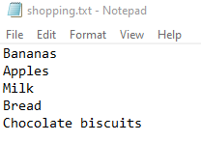
Make
Write a program that generates a shopping list
Asks the user for 5 items on a shopping
The items are entered in one at a time
The items are added to a file
Each item is on a different line
Use the append_text routine or write_text_file routine

