Slide 1
Starter: Introducing CSV files
Open up spreadsheet software
Add the following data - student names with marks for different assessments
Save as CSV (Comma Separated Value)
Open the file in a text editor
Explain how the data are structured

Slide 2
Writing CSV files

Slide 3
Learning objectives
Explain what CSV files are
Write multicolumn data to CSV files

Slide 4
CSV (Comma Separated Values) files
CSV files are text files
CSV files can contain multiple columns as well as rows
Each value on each line is separated by a comma
CSV files can be read and created by spreadsheets in addition to text editors

Slide 5
CSV or text files
Just to be clear CSV are text files
Using the standard approaches to reading and writing text files that we have looked can be rather limited when we have multicolumn (two dimensional) data
Reading and writing a two-dimensional list to a file is quite common and so we need a better approach for accomplishing this task
CSV files allow us to handle multicolumn data

Slide 6
In pairs, predict what the following code is doing
1 2 3 4 5 6 7 8 9 10 11 12 | def write_csv(data,file): f=open(file,'w') for line in data: for item in line: item=str(item)+"," f.write(item) f.write("\n") f.close() text=[['Bart', 'Simpson', 12, 17, 18], ['Nelson', 'Muntz', 15, 16, 19], ['Ralf', 'Wiggum', 23, 10, 10]] write_csv(text,"springfield_elementary_students.csv")

Slide 7
Run and investigate the code
1 2 3 4 5 6 7 8 9 10 11 12 | def write_csv(data,file): f=open(file,'w') for line in data: for item in line: item=str(item)+"," f.write(item) f.write("\n") f.close() text=[['Bart', 'Simpson', 12, 17, 18], ['Nelson', 'Muntz', 15, 16, 19], ['Ralf', 'Wiggum', 23, 10, 10]] write_csv(text,"springfield_elementary_students.csv")
Discuss with your neighbour what each line of code is doing
Add a comment above each line of code explaining what it is doing
Download the code from write_csv.py

Slide 8
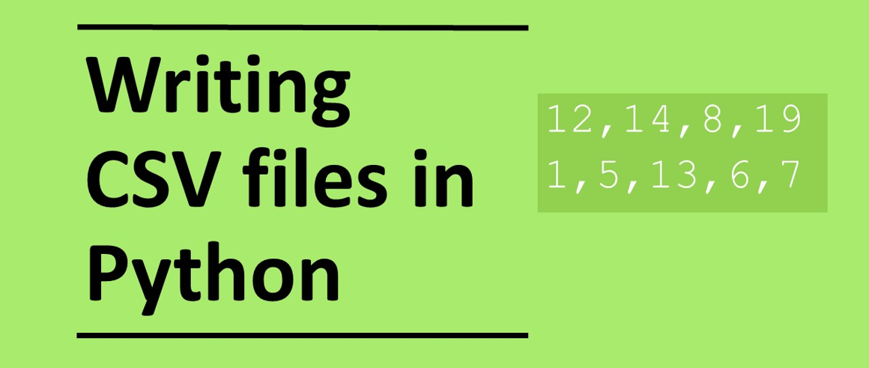

Slide 9
Investigating the code
1 2 3 4 5 6 7 8 9 10 11 12 | def write_csv(data,file): f=open(file,'w') for line in data: for item in line: item=str(item)+"," f.write(item) f.write("\n") f.close() text=[['Bart', 'Simpson', 12, 17, 18], ['Nelson', 'Muntz', 15, 16, 19], ['Ralf', 'Wiggum', 23, 10, 10]] write_csv(text,"springfield_elementary_students.csv")
Creating the two-dimensional dataset

Slide 10
Investigating the code
1 2 3 4 5 6 7 8 9 10 11 12 | def write_csv(data,file): f=open(file,'w') for line in data: for item in line: item=str(item)+"," f.write(item) f.write("\n") f.close() text=[['Bart', 'Simpson', 12, 17, 18], ['Nelson', 'Muntz', 15, 16, 19], ['Ralf', 'Wiggum', 23, 10, 10]] write_csv(text,"springfield_elementary_students.csv")
Calling the write_csv subroutine with 2 parameters including the two-dimensional list and the name of csv file to create

Slide 11
Investigating the code
Defining the write_csv subroutine
1 2 3 4 5 6 7 8 9 10 11 12 | def write_csv(data,file): f=open(file,'w') for line in data: for item in line: item=str(item)+"," f.write(item) f.write("\n") f.close() text=[['Bart', 'Simpson', 12, 17, 18], ['Nelson', 'Muntz', 15, 16, 19], ['Ralf', 'Wiggum', 23, 10, 10]] write_csv(text,"springfield_elementary_students.csv")

Slide 12
Investigating the code
1 2 3 4 5 6 7 8 9 10 11 12 | def write_csv(data,file): f=open(file,'w') for line in data: for item in line: item=str(item)+"," f.write(item) f.write("\n") f.close() text=[['Bart', 'Simpson', 12, 17, 18], ['Nelson', 'Muntz', 15, 16, 19], ['Ralf', 'Wiggum', 23, 10, 10]] write_csv(text,"springfield_elementary_students.csv")
Open the file for writing

Slide 13
Investigating the code
1 2 3 4 5 6 7 8 9 10 11 12 | def write_csv(data,file): f=open(file,'w') for line in data: for item in line: item=str(item)+"," f.write(item) f.write("\n") f.close() text=[['Bart', 'Simpson', 12, 17, 18], ['Nelson', 'Muntz', 15, 16, 19], ['Ralf', 'Wiggum', 23, 10, 10]] write_csv(text,"springfield_elementary_students.csv")
Iterate through each line at a time

Slide 14
Investigating the code
1 2 3 4 5 6 7 8 9 10 11 12 | def write_csv(data,file): f=open(file,'w') for line in data: for item in line: item=str(item)+"," f.write(item) f.write("\n") f.close() text=[['Bart', 'Simpson', 12, 17, 18], ['Nelson', 'Muntz', 15, 16, 19], ['Ralf', 'Wiggum', 23, 10, 10]] write_csv(text,"springfield_elementary_students.csv")
Iterate through each item in a record, accessing each data value at a time.

Slide 15
Investigating the code
1 2 3 4 5 6 7 8 9 10 11 12 | def write_csv(data,file): f=open(file,'w') for line in data: for item in line: item=str(item)+"," f.write(item) f.write("\n") f.close() text=[['Bart', 'Simpson', 12, 17, 18], ['Nelson', 'Muntz', 15, 16, 19], ['Ralf', 'Wiggum', 23, 10, 10]] write_csv(text,"springfield_elementary_students.csv")
Convert the value to a string and append a comma

Slide 16
Investigating the code
1 2 3 4 5 6 7 8 9 10 11 12 | def write_csv(data,file): f=open(file,'w') for line in data: for item in line: item=str(item)+"," f.write(item) f.write("\n") f.close() text=[['Bart', 'Simpson', 12, 17, 18], ['Nelson', 'Muntz', 15, 16, 19], ['Ralf', 'Wiggum', 23, 10, 10]] write_csv(text,"springfield_elementary_students.csv")
Write the value to file

Slide 17
Investigating the code
1 2 3 4 5 6 7 8 9 10 11 12 | def write_csv(data,file): f=open(file,'w') for line in data: for item in line: item=str(item)+"," f.write(item) f.write("\n") f.close() text=[['Bart', 'Simpson', 12, 17, 18], ['Nelson', 'Muntz', 15, 16, 19], ['Ralf', 'Wiggum', 23, 10, 10]] write_csv(text,"springfield_elementary_students.csv")
Put a new line character at the end of each line otherwise all the data will be written to a single line in the file

Slide 18
Investigating the code
1 2 3 4 5 6 7 8 9 10 11 12 | def write_csv(data,file): f=open(file,'w') for line in data: for item in line: item=str(item)+"," f.write(item) f.write("\n") f.close() text=[['Bart', 'Simpson', 12, 17, 18], ['Nelson', 'Muntz', 15, 16, 19], ['Ralf', 'Wiggum', 23, 10, 10]] write_csv(text,"springfield_elementary_students.csv")
Close the file

Slide 19
Modify the code
1 2 3 4 5 6 7 8 9 10 11 12 | def write_csv(data,file): f=open(file,'w') for line in data: for item in line: item=str(item)+"," f.write(item) f.write("\n") f.close() text=[['Bart', 'Simpson', 12, 17, 18], ['Nelson', 'Muntz', 15, 16, 19], ['Ralf', 'Wiggum', 23, 10, 10]] write_csv(text,"springfield_elementary_students.csv")
Remove line 7. What happens? Put line 7 back in again
From line 5 remove +",” What happens? Put it back in again.
Change the name of the csv file.
Add an additional column and row such that the data set is now
Bart Simpson 12 17 18 7
Nelson Muntz 15 16 19 8
Ralf Wiggum 23 10 10 9
Lisa Simpson 0 0 0 10

