Slide 1
Web Frameworks

Slide 2
Learning objectives
Write code that allows a client to interact with the server-side processing through web forms
Create a calculator app
Write an app that can add and select data from a database via web forms
Create a contacts list app

Slide 3
Create Calculator App

Slide 4
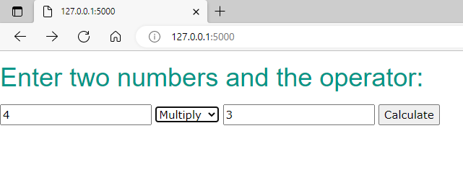
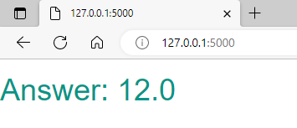
Calculator App
Put all the following pieces of code together to create the calculator app.
Create the correct folder structure and make sure all those files are in the correct place.
Don’t forget to include the w3.css CSS framework.

Slide 5
app.py
from flask import Flask, render_template, request
from calculator import *
app = Flask(__name__)
@app.route('/', methods=['GET', 'POST'])
def calculate():
if request.method == 'POST':
num1=float(request.form['num1'])
num2=float(request.form['num2'])
operator=str(request.form['operator'])
obj=Calculator(num1,num2,operator)
return render_template("result.html",answer=obj.get_result())
return render_template("calculate.html")
if __name__ == '__main__':
app.run()
Investigate this code by adding in comments

Slide 6
app.py
from flask import Flask, render_template, request
# import another Python file with the calculator routines
from calculator import *
app = Flask(__name__)
@app.route('/', methods=['GET', 'POST'])
def calculate():
if request.method == 'POST’:
# set the values to variables when the user enters
# the values in box
num1=float(request.form['num1'])
num2=float(request.form['num2’])
# Select operator and set to a variable
operator=str(request.form['operator'])
obj=Calculator(num1,num2,operator)
# When we post the data we return the result at result.html
return render_template("result.html",answer=obj.get_result())
return render_template("calculate.html")
if __name__ == '__main__':
app.run()
Investigate this code by adding in comments

Slide 7
calculator.py - Incomplete
class Calculator():
def __init__(self,x,y,operator):
self.x=x
self.y=y
self.operator=operator
if operator=="add":
self.result=self.add()
elif operator=="subtract":
self.result=self.subtract()
def get_result(self):
return self.result
def add(self):
return self.x + self.y
def subtract(self):
return self.x - self.y
Add in operations for multiply and divide

Slide 8
calculator.py
class Calculator():
def __init__(self,x,y,operator):
self.x=x
self.y=y
self.operator=operator
if operator=="add":
self.result=self.add()
elif operator=="subtract":
self.result=self.subtract()
elif operator=="multiply":
self.result=self.multiply()
elif operator=="divide":
self.result=self.divide()
def get_result(self):
return self.result
def add(self):
return self.x + self.y
def subtract(self):
return self.x - self.y
def multiply(self):
return self.x * self.y
def divide(self):
return self.x / self.y

Slide 9
calculate.html
<html>
<head>
<link rel="stylesheet" href="{{ url_for('static', filename='w3.css') }}">
</head>
<body>
<h1 class="w3-sans-serif w3-text-teal">
Enter two numbers and the operator:
</h1>
<form action="" method="post">
<input type="text" name="num1" value="{{request.form.num1 }}">
<select name="operator">
<option value="add">Add</option>
<option value="subtract">Subtract</option>
<option value="divide">Divide</option>
<option value="multiply">Multiply</option>
</select>
<input type="text" name="num2" value="{{request.form.num2 }}">
<input type="submit" value="Calculate">
</form>
</body>
</html>

Slide 10
result.html
<html>
<head>
<link rel="stylesheet" href="{{ url_for('static', filename='w3.css') }}">
</head>
<body>
<h1 class="w3-sans-serif w3-text-teal">
Answer: {{ answer }}
</h1>
</body>
</html>

Slide 11
Create Contacts App

Slide 12
Interacting with a database
We can use Flask to allow us to interact with a database through a website
We are going to create a contact list f friends that includes name, email and phone number.
The user can add contacts and get the email and phone of a friend when they enter their name.
The basic code is already written, but you will need to place each file in the correct directory

Slide 13
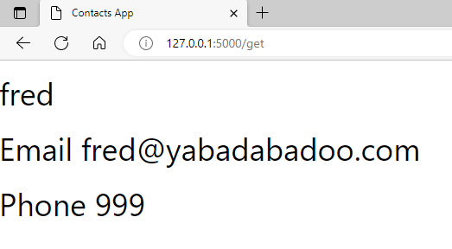
show_contact.html
<html>
<head>
<title>Contacts App</title>
<link rel="stylesheet" href="{{ url_for('static', filename='w3.css') }}"> </head>
<body>
<h1> {{name}} </h1>
<h1> Email {{email}} </h1>
<h1> Phone {{phone}} </h1>
</body>
</html>

Slide 14
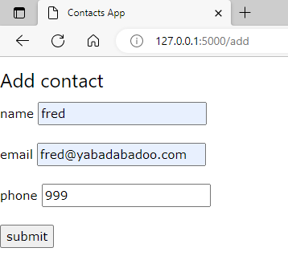
add_contact.html
<html>
<head>
<title>Contacts App</title>
<link rel="stylesheet" href="{{ url_for('static', filename='w3.css') }}">
</head>
<body>
<form action = "{{ url_for('add_contact') }}" method = "POST">
<h3>Add contact</h3>
name <input type = "text" name = "name" /><br><br>
email <input type = "text" name = "email" /><br><br>
phone <input type = "text" name = "phone" /><br><br>
<input type = "submit" value = "submit" /><br> </form> </body></html>

Slide 15
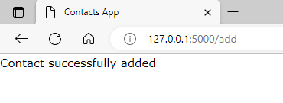
contact_successful.html
<html>
<head>
<title>Contacts App</title>
<link rel="stylesheet" href="{{ url_for('static', filename='w3.css') }}">
</head>
<body>
<p>Contact successfully added</p>
</body>
</html>

Slide 16
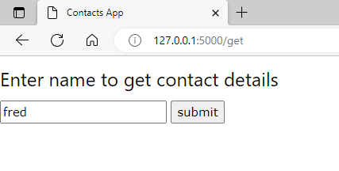
get_contact.html
<html>
<head>
<title>Contacts App</title>
<link rel="stylesheet" href="{{ url_for('static', filename='w3.css') }}">
</head>
<body>
<h3>Enter name to get contact details</h3>
<form action="{{ url_for('get_contact') }}" method="post">
<input type="text" name="name">
<input type = "submit" value = "submit" /><br>
</form>
</body>
</html>

Slide 17
app.py 1
from flask import Flask, render_template, request, redirect, url_for, request
import sqlite3 as sql
import os
app = Flask(__name__)
dbname="contacts.db"
def createDatabase():
c = sql.connect(dbname)
c.execute("DROP TABLE IF EXISTS contacts")
c.execute("CREATE TABLE contacts(name TEXT,email TEXT,phone TEXT)")
c.commit()
c.close()
return "Database created"
Create the database, and reset the table each time we set the server

Slide 18
app.py 2
@app.route('/add', methods=['GET', 'POST'])
def add_contact():
if request.method == 'POST':
if not os.path.exists(dbname):
createDatabase()
name = request.form['name']
email = request.form['email']
phone = request.form['phone']
conn = sql.connect(dbname)
db = conn.cursor()
db.execute("INSERT INTO contacts (name,email,phone) VALUES (?,?,?)",(name,email,phone))
conn.commit()
conn.close()
return render_template("contact_successful.html")
return render_template('add_contact.html')
Add the contact details to the database using SQL INSERT INTO operation

Slide 19
app.py 3
@app.route('/get', methods=['GET', 'POST'])
def get_contact():
if request.method == 'POST':
name = request.form['name']
conn = sql.connect(dbname)
cursor = conn.cursor()
c=cursor.execute("SELECT phone, email FROM contacts WHERE name=?",(name,))
row=c.fetchall()
phone=row[0][0]
email=row[0][1]
conn.commit()
conn.close()
return render_template("show_contact.html",name = name, email=email, phone=phone)
return render_template('get_contact.html')
if __name__ == '__main__':
app.run()
Get the contact details of a friend using using SQL SELECT operation

