Slide 1
In pairs, predict what the following code does
1 2 3 4 5 6 7 8 | from matplotlib import pyplot as plt def pie_chart(data,labels,title): plt.pie(data, labels = labels, autopct='%d%%') plt.title(title) plt.show() subject=['Maths','Spanish','Computing','History','Geography','PE'] responses=[9, 31, 43, 18, 23, 15] pie_chart(responses,subject,"Favourite Subject")

Slide 2
Visualising data

Slide 3
Learning objectives
Use a module called matplotlib
Produce a range of plots to visualise data
Pie charts
Scatter Plots
Line Plots
Bar Charts

Slide 4
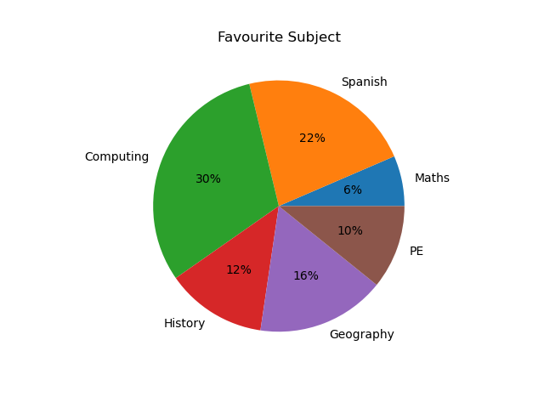
Download, run, investigate and modify the code
Download the code code/pie_chart.py
Run the code to produce a pie plot like the one here
Add a comment on each line of code, explaining what is happening

Slide 5
Investigate the code
1 2 3 4 5 6 7 8 | from matplotlib import pyplot as plt def pie_chart(data,labels,title): # Plot the pie chart # autopct adds a percentage to each wedge plt.pie(data, labels = labels, autopct='%d%%’) # add the title plt.title(title) # Display the plot plt.show() subject=['Maths','Spanish','Computing','History','Geography','PE'] responses=[9, 31, 43, 18, 23, 15] pie_chart(responses,subject,"Favourite Subject")

Slide 6
Modify the code
Food | £25
Entertainment | £20
Clothes | £17
Travel | £30
Miscellaneous | £7
Modify the code to use the following data on monthly student expenditure
1 2 3 4 5 6 7 8 | from matplotlib import pyplot as plt def pie_chart(data,labels,title): plt.pie(data, labels = labels, autopct='%d%%') plt.title(title) plt.show() category=[‘food’,’Entertainment',’Clothes’,’Travel’,’Misc.’] spending=[25, 20, 17, 30, 7] pie_chart(category,spending,“Spending by category (Pounds)")

Slide 7
In pairs, predict what the following code draws
1 2 3 4 5 6 7 8 10 11 12 | def bar_chart(data,labels,filename,title,xlbl,ylbl): plt.bar(labels,data) plt.ylabel(ylbl) plt.xlabel(xlbl) plt.title(title) fig = plt.gcf() fig.savefig(filename+'.png', format='png') plt.close(fig) country=['China','France','Russia','USA','UK'] population=[1410, 68, 133, 343, 67] bar_chart(population,country,\ "bar_population","Population","Country","Pop. (million)")

Slide 8
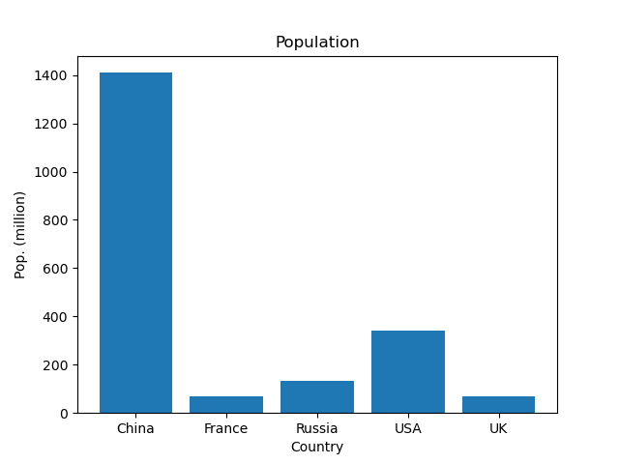
Download, run, investigate and modify the code
Download the code code/bar_chart.py
Run the code to produce a plot like the one here
In what ways do the pie chart code and the bar chart code differ
Modify the code to use the following data on UK electricity production
Nuclear | 5 GigaWatts
Wind | 15 GigaWatts
Gas | 10 GigaWatts
Coal | 1 GigaWatts
Solar | 1 GigaWatts
Hydro | 1 GigaWatts
Other | 10 GigaWatts

Slide 9
Investigate the code
1 2 3 4 5 6 7 8 10 11 12 | def bar_chart(data,labels,filename,title,xlbl,ylbl): # Plotting a bar chart plt.bar(labels,data) plt.ylabel(ylbl) plt.xlabel(xlbl) plt.title(title) # Creating an image file fig = plt.gcf() fig.savefig(filename+'.png', format='png') plt.close(fig) country=['China','France','Russia','USA','UK'] population=[1410, 68, 133, 343, 67] bar_chart(population,country,\ "bar_population","Population","Country","Pop. (million)")

Slide 10
In pairs, predict what the following code draws
1 2 3 4 5 6 | from matplotlib import pyplot as plt import random x = [random.randint(1,100) for i in range(100)] y = [random.randint(1,100) for i in range(100)] plt.scatter(x, y, color='green', marker='x') plt.show()

Slide 11
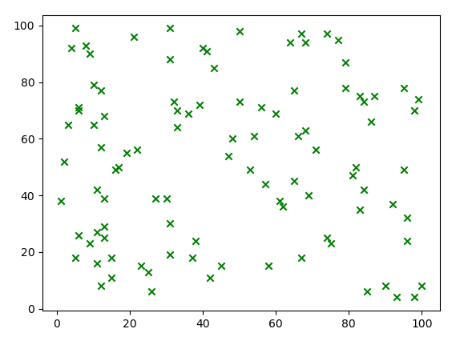
Download, Run, Modify
Download the code code/scatter_plot.py
Run the code to produce a plot like the one here
Modify the code to have a subroutine similar as for bar_chart.py and pie_chart.py
Add a title to the chart: random plot
Add label for the x axis: x random value
Add label for the y axis: y random value
Add code so that it produces a PNG image file
Change the colour and shape of the green crosses, to red dots
Use https://matplotlib.org/ to help
Example markers:
. | , | + | o | v | ^ | < | >

Slide 12
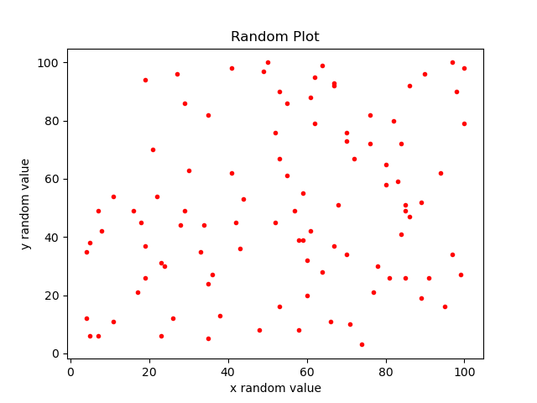
Example code
1 2 3 4 5 6 7 8 9 10 11 12 13 | from matplotlib import pyplot as plt import random def plot_scatter(x,y): plt.scatter(x, y, color='red', marker='.') plt.title("Random Plot") plt.xlabel("x random value") plt.ylabel("y random value") fig = plt.gcf() fig.savefig('scatter.png', format='png') plt.close(fig) x = [random.randint(1,100) for i in range(100)] y = [random.randint(1,100) for i in range(100)] plot_scatter(x,y)

Slide 13
In pairs, predict what the following code draws
1 2 3 4 5 6 7 | import matplotlib.pyplot as plt year=[2010,2011,2012,2013,2014,2015,2016,2017,2018] temperature=[9.0,10.7,9.8,9.7,10.9,10.3,10.3,10.6,10.6] plt.title("UK Temperature") plt.xlabel("Year") plt.ylabel("Temperature") plt.plot(year,temperature) plt.show()

Slide 14
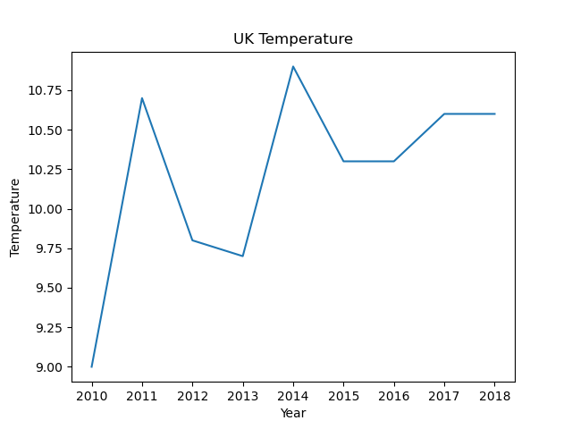
In pairs, predict what the following code draws
Download the code code/line chart.py
Run the code to produce a plot like the one here

Slide 15
Homework: Modify the code
Read in the file mean_annual_uk_temperature.csv from
https://www.gov.uk/government/collections/digest-of-uk-energy-statistics-dukes
Put the plotting code into a subroutine similar to pie_chart.py
Produce a line plot of the data
Create a PNG image file
Use your own formatting, eg change the font, font size, colour. Don’t use the default settings. Use https://matplotlib.org/ to help

