Slide 1
In pairs, predict what the following code draws
1 2 3 4 5 6 8 | from turtle import * def shape(): for c in ["red","green","blue","yellow"]: color(c) forward(100) left(90) shape()

Slide 2
Drawing shapes with Turtle

Slide 3
Learning objectives
Draw basic shapes using turtle module in Python
Explain the coordinate system
Use For loops to draw complex shapes
Use loops inside loops (nested loops)

Slide 4
Copy and run the code. Does it do as you expected?
1 2 3 4 5 6 8 | from turtle import * def shape(): for c in ["red","green","blue","yellow"]: color(c) forward(100) left(90) shape()
Download the code from: shapes.py

Slide 5
Investigate the code
1 2 3 4 5 6 8 | from turtle import * def shape(): for c in ["red","green","blue","yellow"]: color(c) forward(100) left(90) shape()
Investigate the code by adding in comments:
Explain what is happening on line 1
How may iterations does the loop make?
How could you make the loop iterate more times?
What are the different colours on line 3 doing?
What shape is being drawn?
On line 5 what does 100 mean
On line 6 what does the 90 mean

Slide 6
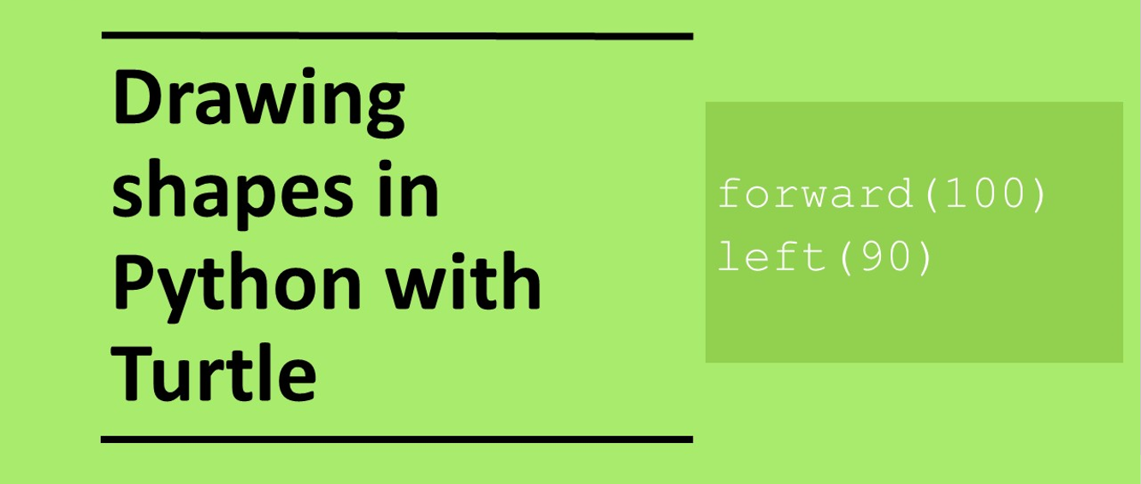

Slide 7
Modify the code
1 2 3 4 5 6 8 | from turtle import * def shape(): for c in ["red","green","blue","yellow"]: color(c) forward(100) left(90) shape()
Modify the code to draw an octagon with different colour slides

Slide 8
Common Turtle commands
forward(100) # Move forward 100 steps
left(90) # Turn left 90 degrees
right(90) # Turn right 90 degrees
speed(10) # Set speed of turtle
shape("turtle") # Set shape of turtle
color(“blue”) # Set colour of turtle
pensize(6) # Set line thickness
penup() # Remove pen from paper so no line drawn
pendown() # Put pen on paper
fillcolor(“red”) # Set Colour to fill in shape
begin_fill() # Begin shape fill
end_fill() # End shape fill
goto(50,60) # Move turtle to x, y position 50,60
circle(50) # Draw circle with radius 50 pixels

Slide 9
Turtle coordinate system
+y
-x
[0,0]
+x
Right(90)
Left(90)
-y

Slide 10
Example how to fill a shape with color
1 2 3 4 5 6 7 8 9 | from turtle import * def shape(): begin_fill() fillcolor("purple") for i in range(4): forward(100) left(90) end_fill() shape()

Slide 11
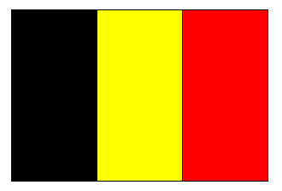
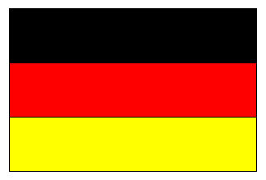
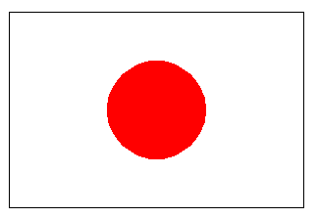
Make: Draw the flag of France, Germany or Belgium, or Japan

Slide 12
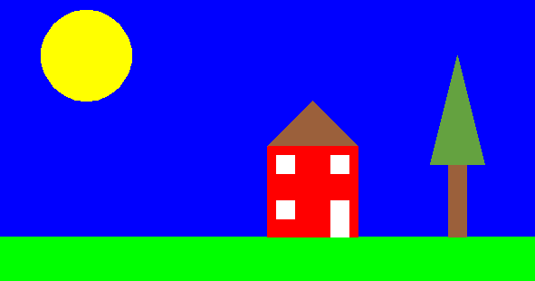
Make 2: Draw the following picture

Slide 13
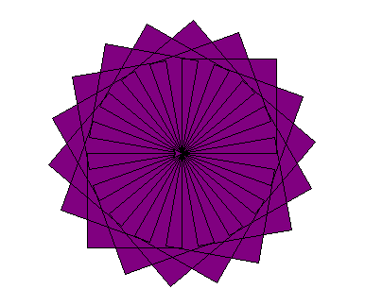
Making patterns: Example code using nested for loops
1 2 3 4 5 6 7 8 9 10 11 | from turtle import * def shape(): begin_fill() fillcolor("purple") for j in range(18): for i in range(4): forward(100) left(90) left(20) end_fill() shape()

Slide 14
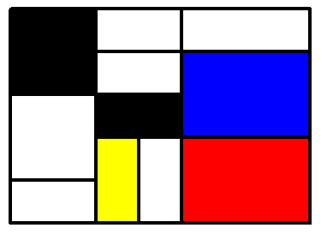
Try to reproduce some Mondrain Art

Slide 15
Modify the code using different shapes to create different patterns and colours
1 2 3 4 5 6 7 8 9 10 11 | from turtle import * def shape(): begin_fill() fillcolor("purple") for j in range(18): for i in range(4): forward(100) left(90) left(20) end_fill() shape()
Download the code from: patterns.py
Change these numbers.
How do they relate to one and other?

Slide 16
Plenary: show exemplar work

