Slide 1
Test Driven Development

Slide 2
Learning objectives
Use command line arguments
Use standard input
Perform doctests
Perform Unit Tests
Perform Unit tests with mock

Slide 3
Doctests

Slide 4
Code to perform tests on
def add(a,b):
return a+b
def multiply(a,b):
return a*b
def isEven(a):
if a % 2 == 0:
return "Number is even"
else:
return "Number is odd"
def isOdd(a):
if a % 2 == 0:
odd=False
else:
odd=True
return odd
Open a file called doctest/math_tool.py that contains this Python code
We are going to carry out unit testing on these functions to demonstrate how unit testing works.

Slide 5
Doctests
Doctests look like tests you might carry out during Python interactive shell sessions.
>>> from math_tool import add
>>> add(6,5)
11
In the code this will look like a docstring:
"""
>>> add(6,5)
11
"""

Slide 6
Doctest example: math_tool_doctest.py
import doctest
import sys
from math_tool import *
def add_test():
"""
>>> add(6,5)
11
>>> add("two"," apples")
'two apples'
"""
def isOdd_test():
"""
>>> isOdd(6)
False
"""
if __name__ == "__main__":
doctest.testmod(verbose=True)
Open a file called doctest/math_tool_doctest.py that contains this Python code
We are going to carry out unit testing on these functions to demonstrate how unit testing works.
Run the code

Slide 7
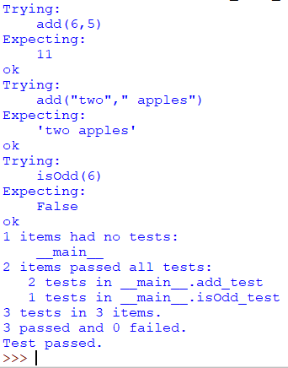
Output of doctests
This is the verbose output for successfully run doctests.
By default if tests are successful no output is generated Hence we use verbose = True
doctest.testmod(verbose=True)

Slide 8
Create your own tests
def isOdd_test():
"""
>>> isOdd(6)
False
>>> isOdd(5)
True
"""
def isEven_test():
"""
>>> isEven(4)
'Number is even'
>>> isEven(5)
'Number is odd'
"""
def multiply_test():
"""
>>> multiply(4,4)
16
"""
Modify doctest/math_tool_doctest.py to perform additional tests for the isEven and multiply functions. Also ensure that isOdd has been completely tested.

Slide 9
Doctest - alternative method
It is possible to create a separate file that includes the doctests.
Create a new file called math_tool.txt that has the following content.
>>> from math_tool import isEven, isOdd, add
>>> isEven(4)
Number is even
>>> isEven(5)
Number is odd
>>> add(6,5)
11
>>> add("two"," apples")
'two apples’
>>> isOdd(6)
False
>>> isOdd(5)
True
Run from the command prompt type:
C\:python -m doctest math_tool_doctest.txt -v

Slide 10
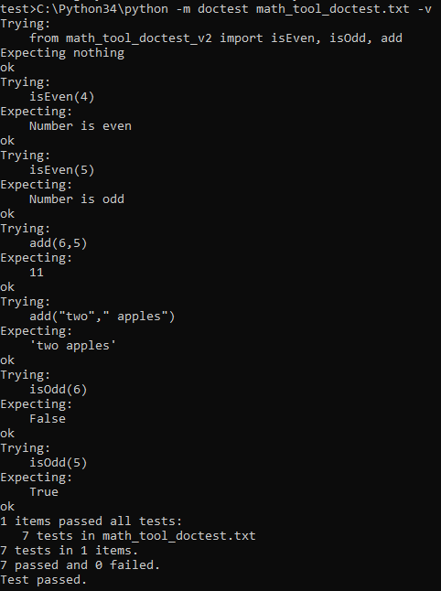
Output of doctest
This is the verbose output for successfully run doctests using the alternative method.

Slide 11
Command Line arguments

Slide 12
Testing User Input
You know the situation.
You are testing and debugging your application that takes a lot of user input.
You repeatedly enter the same data over and over.
It can get very tedious continuously entering user input after each change you make to your code.
And you wander there has got to be a better way.
The good new is that there is ☺

Slide 13
Standard input
animal.txt
You will need access to the command prompt.
Unfortunately, lots of schools disable access for students for security reasons
But it should work on your home computers if you have one
We can avoid repeatedly entering data by using a text file.
On the command prompt we run the following each time we wish to perform a run through of the whole code:
C:\> python animal.py < animal.txt
aadrvark
elephant
animal.py
print("Enter animal")
animal1=input()
print(animal1)
print("Enter animal")
animal2=input()
print(animal2)

Slide 14
Command line arguments
We can avoid interactively inputting data by using command line arguments.
During testing all the user input with sys arguments
Open the code called command_line/command_line_arguments.py
Run the program the usual way by typing F5.
import sys
def add(x,y):
return x+y
sys.argv=["command_line_arguments_v2",2,3]
# x = int(input(Enter num 1))
# y = int(input(Enter num 2))
x=sys.argv[1]
y=sys.argv[2]
print(add(x,y))
print ("Argument 1 (Program name):\t", sys.argv[0])
print ("Argument 2:\t\t\t", sys.argv[1])
print ("Argument 3:\t\t\t", sys.argv[2])

Slide 15
Command line arguments – alternative method
Create a file called arg_test.py
Add the code and save file:
Open up the windows command prompt
Navigate to the folder where the Python code we wan to run is located. eg
N:\> C:
C:\> cd
where/my/python/code/is.py
To run the program type the following into the windows command prompt type:
C:\> python arg_test 1 2
import sys
def add(x,y):
return x+y
x=sys.argv[1]
y=sys.argv[2]
print(add(x,y))
print ("Argument 1 (Program name):\t", sys.argv[0])
print ("Argument 2:\t\t\t", sys.argv[1])
print ("Argument 3:\t\t\t", sys.argv[2])

Slide 16
Unit Testing

Slide 17
Unit testing
Unit testing is the testing of individual components of our application such as functions and methods.
We already know that testing code is an integral part of the software development cycle.
Test driven development requires us to write testing code along side the code it
Test driven development follows the following cycle.
Write the tests for the code you want to write
Write the code
Run the test code. If the test fails modify the code and repeat the tests until the code passes the tests.

Slide 18
Unit testing
def add(a,b):
return a+b
def isOdd(a):
if a % 2 == 0:
odd=False
else:
odd=True
return odd
def division(a,b):
try:
c=a/b
except TypeError:
print("Type error")
except ZeroDivisionError:
print("Zero division error")
finally:
return a/b
Unit testing requires us to write a separate testing code in order to test our modules. Here we are going to test the subroutines in unittest/math_tools_v2.py

Slide 19
Unit testing
import unittest
import math_tool_v2
class Test(unittest.TestCase):
def test_add_6_3(self):
result=math_tool.add(6,3)
self.assertEqual( result, 9)
def test_add_7_3_a(self):
result=math_tool.add(7,3)
self.assertNotEqual( result, 9)
def test_isOdd_true(self):
result=math_tool.isOdd(4)
self.assertFalse(result)
def test_isOdd_false(self):
result=math_tool.isOdd(3)
self.assertTrue(result)
def test_bool(self):
result=math_tool.isOdd(3)
self.assertIsInstance(result,bool)
def test_error_message_if_both_args_not_numbers(self):
self.assertRaises(TypeError, math_tool.division, 'two', 'three')
def test_error_message_divide_by_zero(self):
self.assertRaises(ZeroDivisionError, math_tool.division, 2, 0)
if __name__ == '__main__':
unittest.main()
We are going to use a Python file called unittest/test_math_tools.py.
In pairs predict what this code does
Run the code. Does it do as you expected
Investigate this code by adding comments to each line

Slide 20
Unit testing – Importing modules
We need to import the unittest module. This comes packaged as standard, so there is no need to install anything.
import unittest
We also need to import the application we plan to test. On our case this will by math_tool_v2.
import math_tool_v2

Slide 21
Unittest framework
Create a class that inherits unittest.TestCase.
class Test(unittest.TestCase):
Within class we will add our tests, but first we add the following to the end of our testing code:
if __name__ == '__main__’:
unittest.main()

Slide 22
Unittest asserts
We can use asserts to check the various components of our code based on the returned values from each module that we would expect. Here are a list of different assert tests. This list is by no means an exhaustive but does represent the main ones.
assertEqual( x, y) Checks whether the two x and y values are equal
assertNotEqual( x, y ) Checks whether the two values are not equal
assertFalse(Boolean_value) Checks whether the Boolean value is False
assertTrue(Boolean_value) Checks whether the Boolean values is True
assertIsInstance(x,datatype_of_x) Checks the datatype of x
assertRaises(error_type, module, arguments) Checks that module with arguments rases error_type

Slide 23
The methods
# Checks whether the two values are equal
def test_add_6_3(self):
result=math_tool.add(6,3)
assertEqual( result, 9)
# Checks whether the two values are not equal
def test_add_7_3_a(self):
result=math_tool.add(7,3)
assertNotEqual( result, 9)
# Checks whether the values is False
def test_isOdd_true(self):
result=math_tool.isOdd(4)
assertFalse(result)
# Checks whether the values is True
def test_isOdd_false(self):
result=math_tool.isOdd(3)
assertTrue(result)
# Checks the datatype
def test_bool(self):
result=math_tool.isOdd(3)
assertIsInstance(result,bool)
# Checks that an error is raised
def test_error_message_if_both_args_not_numbers(self):
assertRaises(TypeError, math_tool.division, 'two', 'three’)
Now we add the following methods to our code

Slide 24
The final unit testing code should look like:
import unittest
import math_tool
class Test(unittest.TestCase):
# Checks whether the two values are equal
def test_add_6_3(self):
result=math_tool.add(6,3)
assertEqual( result, 9)
# Checks whether the two values are not equal
def test_add_7_3_a(self):
result=math_tool.add(7,3)
assertNotEqual( result, 9)
# Checks whether the values is False
def test_isOdd_true(self):
result=math_tool.isOdd(4)
assertFalse(result)
# Checks whether the values is True
def test_isOdd_false(self):
result=math_tool.isOdd(3)
assertTrue(result)
# Checks the datatype
def test_bool(self):
result=math_tool.isOdd(3)
assertIsInstance(result,bool)
# Checks that an error is raised
def test_error_message_if_both_args_not_numbers(self):
assertRaises(TypeError, math_tool.division, 'two', 'three’)
# Checks that an error is raised
def test_error_message_divide_by_zero(self):
assertRaises(ZeroDivisionError, math_tool.division, 2, 0)
if __name__ == '__main__’:
unittest.main()

Slide 25
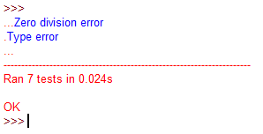
Test Output
Our test output should look something like this if all is well

Slide 26
Unittest with Mock
We may wish to test modules that do not return values, but we wish to test whether the printed output is what we expect. In order to do this we need to use mock we need to import mock as well as io and unittest modules.
import io
import unittest
import unittest.mock
We test a function called hello . This time we incorporate it into the same testing code so we do no need to import a module that includes the code
def hello():
print ("Hello World")

Slide 27
Unittest framework
As before we need to create a class that inherits unittest.TestCase.
class TestHello(unittest.TestCase):
Within class we will add our tests, but first we add the following to the end of our testing code:
if __name__ == '__main__’:
unittest.main()

Slide 28
Main testing code
class TestHello(unittest.TestCase):
@unittest.mock.patch('sys.stdout', new_callable=io.StringIO)
def assert_stdout(self, mock_stdout):
hello()
assertEqual(mock_stdout.getvalue(), 'Hello World\n’)
def test_hello(self):
assert_stdout()

Slide 29
The complete code how to test print output using mock
import io
import unittest
import unittest.mock
def hello():
print ("Hello World")
class TestHello(unittest.TestCase):
@unittest.mock.patch('sys.stdout', new_callable=io.StringIO)
def assert_stdout(self, mock_stdout):
hello()
assertEqual(mock_stdout.getvalue(), 'Hello World\n’)
def test_hello(self):
assert_stdout()
if __name__ == '__main__’:
unittest.main()
unittest/hello.py

