Slide 1
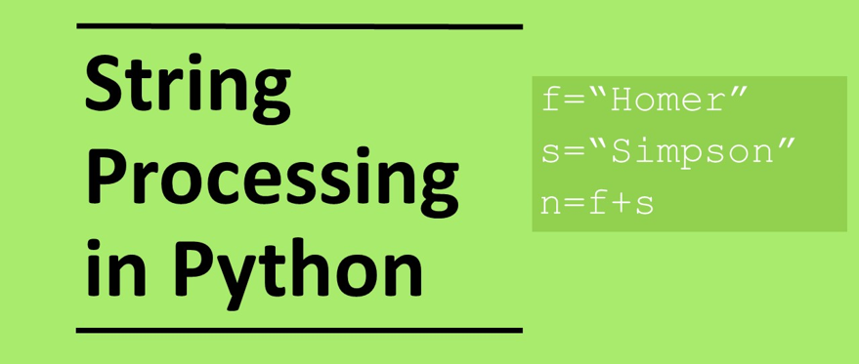

Slide 2
Processing Strings

Slide 3
Learning objectives
Be able to process strings
Using substrings
Using string methods

Slide 4
Concatenating strings
Concatenation allows us to merge strings
a=“hello ”
b=“world”
c=a+b
print(c)
>> hello world

Slide 5
String expressions
print("Ho " * 3)
>> Ho Ho Ho

Slide 6
Relational operators on strings: Recap
Relational operators can be applied to strings and compared based on their alphabetic position or more strictly their ASCII value
animal = “aardvark” < “zebra”
print(animal)
>> True
“aardvark” come before “zebra” alphabetically therefore it has a lower value so the expression is true
"A" < "a“
>> True
The ASCII value for “A” is 65 and the value for “a” is 97
“catalogue" < “catfish“
>> True

Slide 7
Strings as lists
Strings can behave as lists where each character in a string can be considered an element in a list
If there is more than 1 of the same character the position of the first character is returned.
animal = “aardvark”
print(animal[3])
>> d
Index position
0 | 1 | 2 | 3 | 4 | 5 | 6 | 7
a | a | r | d | v | a | r | k

Slide 8
Strings in for loops
For loops can be applied to a string that iterates over each of the characters
for i in “aardvark”:
print(i)
a
a
r
d
v
a
r
k

Slide 9
Question 1: What do the following output?
x="2" y="3" print(x+y) Output: | mammal=“Koala” print(mammal[2]) Output:
a="Hello" b="World" print(a+b) Output: | print(“cat” > “dog”) Output:
print(“Boom " * 5) Output: | print(len("aardvark")) Output:

Slide 10
Question 1: What do the following output?
x="2" y="3" print(x+y) Output: 23 | mammal=“Koala” print(mammal[2]) Output: a
a="Hello" b="World" print(a+b) Output: HelloWorld | print(“cat” > “dog”) Output: False
print(“Boom " * 5) Output: Boom Boom Boom Boom Boom | print(len("aardvark")) Output: 8

Slide 11
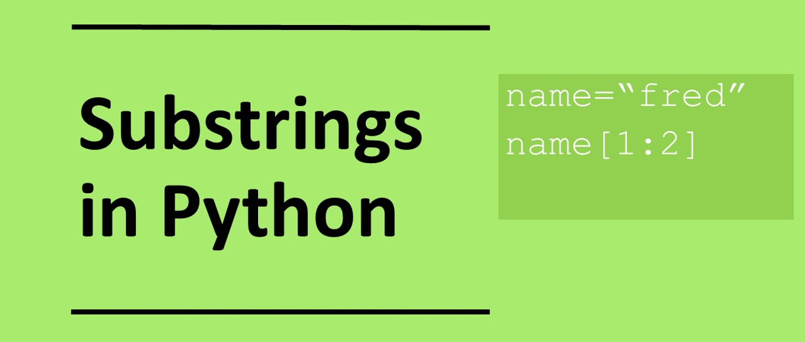

Slide 12
substrings
We can select parts of a string by using sub strings. Let us take the string below: student=“Harry Potter” | To print out characters 2-4: print(student[2:5]) >> rry
To print out the first two characters: print(student[0:2]) >> Ha | To print out the last 3 characters: print(student[-3:]) >> Ter
To print out the first three characters: print(student[:3]) >> Har | To print out a middle set of characters: print(student[4:-3]) >> y Pot A negative value is taken from the end of the string.

Slide 13
Question 2
Given: student=“Ron Weasley”
What is output for each statement?
print(student[1:3])
print(student[:2])
print(student[3:7])
print(student[-4:])
print(student[2:-3])
print(len(student))

Slide 14
Question 2
Given: student=“Ron Weasley”
What is output for each statement?
print(student[1:3]) | on
print(student[:2]) | Ro
print(student[3:7]) | Wea
print(student[-4:]) | Sley
print(student[2:-3]) | N Weas
print(len(student)) | 11

Slide 15
Question 2
Given: student=“Hermione Granger”
Use substrings to outpuy the following
H
m
mione
Her
anger
one G

Slide 16
Question 2
Given: student=“Hermione Granger”
Use substrings to outpuy the following
H | print(student[0])
m | print(student[3])
mione | print(student[3:8])
Her | print(student[0:3])
anger | print(student[-5:])
one G | print(student[5:-6])

Slide 18
String methods
To return the position of a character we can use index : s = “Hello World" s.index(‘o’) Output: 4 | To create a string form list elements b=['hello', 'world'] "".join(b) Output: 'helloworld’
Convert all letters to uppercase a="hello" b=a.upper() print(b) Output: HELLO | A string can be split into a list with 1 word for each element a="hello world" b=a.split() print(b) Output: ['hello', 'world']
Convert all letters to lowercase a="HELLO" b=a.lower() print(b) Output: hello | To string characters at the end and beginning of a string a="Hello world\n" c=a.strip("\n") print(c) Output: Hello world

Slide 19
Question 3
Given: student=“Ron Weasley”
What is output for each statement?
print(student.upper())
print(student.lower())
print(student.split())
print(student.index(“e”))

Slide 20
Question 3
Given: student=“Ron Weasley”
What is output for each statement?
print(student.upper()) | RON WEASLEY
print(student.lower()) | ron weasley
print(student.split()) | [“Ron”,”Weasley”]
print(student.index(“e”)) | 5

Slide 21
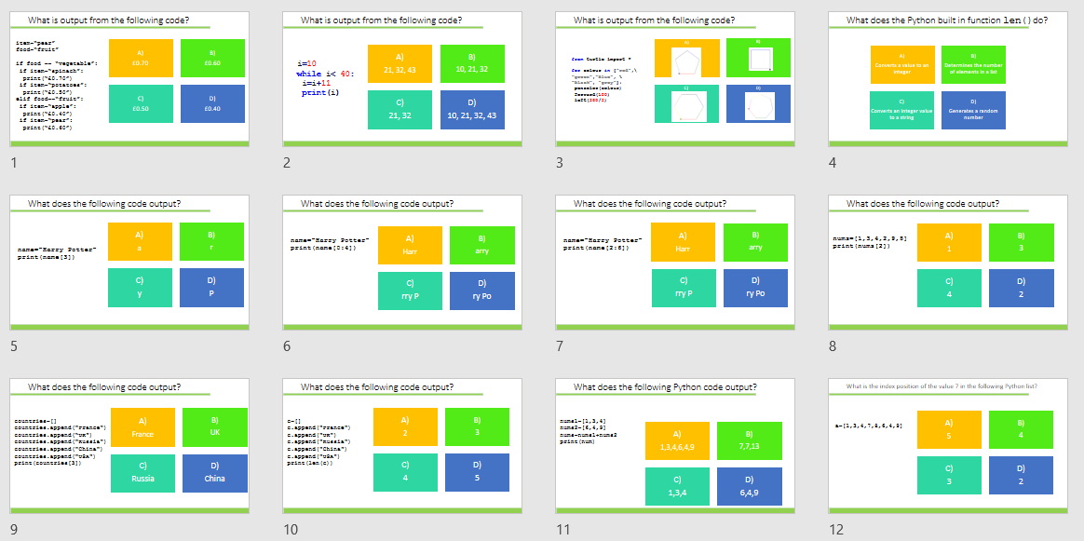
Homework
Complete task:
Python coding: List and string processing GCSE
Alternatively use:
diagnostic-questions-python-set4.pptx

