Slide 1
Simulations

Slide 2
Learning objectives
Explain what a simulation is
Explain the underlaying mathematical principles of 5 model simulations:
Predator-Prey Model
Pandemic Model
Global carbon cycle model
Daisy World: a planetary model for homeostasis
MONIAC: a macroeconomic model
Explore these models in Python

Slide 3
What is a simulation?
A simulation is the automation (coded up as a computer program) of an abstract mathematical model that is itself a representation of nature.
The code allows us to conduct all manner of experiments by modifying variables and changing components that help us get a better understanding of the system that we are studying.
Simulations often have a spatial and dynamic time component to demonstrate how a process evolves
We can test the accuracy of the model by comparing its output with observations
All models are an idealised representation and assume that reality that contain assumptions to make them simpler.
No model is perfect, but the closer the model output is to observations the better it is (assuming the observations themselves are reliable and only have small error)

Slide 4
Predator Prey model

Slide 5
Predator Prey Model
The predator prey model demonstrates how the relationship in numbers between two species changes over time
In the predator-prey model the following assumptions are made:
Predators and prey cannot succumb to disease (or even old age for that matter)
The prey has unlimited food supply

Slide 6
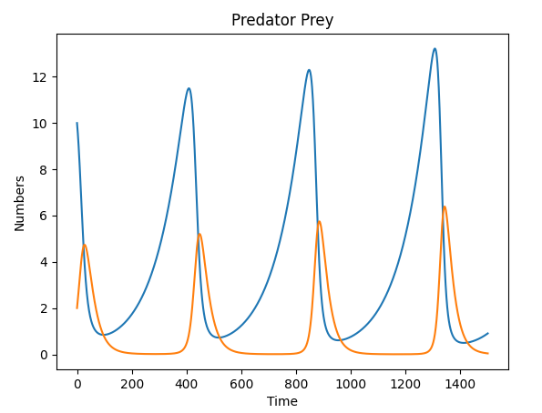
Predator-Prey Model - Scenarios
When there is a high number of predators, the number of prey will decrease
When the number of prey is low, the number of predators will decrease
When the number of predators is low, the number of prey will increase
When the number of prey is high, the numbers of predators will increase

Slide 7
Lotka-Volterra Equations
$$\frac{dx}{dt}=αx−βxy$$
$$\frac{dy}{dt}=δxy−γy$$
$x$is the number of prey
$y$ is the number of predators
$α$ is the birth rate of the prey constants
$β$ is the predation rate
$δ$ is the birth rate of predators
$γ$ is the death rate from starvation of the predators
dxdt = alpha * x - beta * x * y
dydt = delta * x * y - gamma * y

Slide 8
Time stepping – Euler Equations
$$y_{t} =\frac{dy}{dt}dt+ y_{t−1}$$
$$x_{t} =\frac{dx}{dt}dt+ x_{t−1}$$
These are the Euler equations and determine the change the predator and prey populations between one time step and the next.
y[t] = dydt * dt + y[t-1]
x[t] = dxdt * dt + x[t-1]

Slide 9
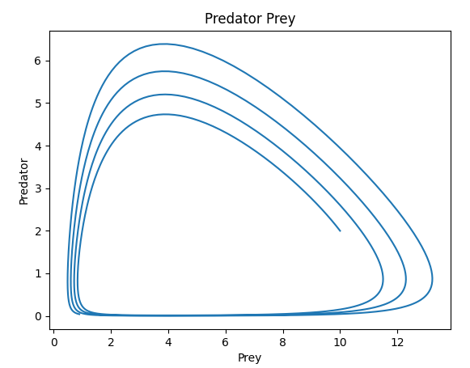
Explore the model
Download the code from: pedator_prey_model/predatorPrey.py
Run and Investigate the code
Make changes to the parameters
alpha
beta
gamma
delta
x0
y0
T
dt
Plot and analyse the outputs

Slide 10
Global Carbon Cycle

Slide 11
Global carbon cycle and climate change
The impact of atmospheric carbon on the Earth’s natural greenhouse and its consequent impact on temperatures is a very prescient issue.
We can use a carbon cycle model to help us understand what is going on with the Earth’s climate system
We are using a 4 box model that contains reservoirs for the atmosphere, land, surface ocean and deep ocean with fluxes between each of these. We are particularly interested in the atmospheric store of CO2.

Slide 12
Carbon Cycle Model
Atmosphere (600 GT)
Respiration and
Anthropogenic emissions
Photosynthesis
Ocean Uptake Flux
Ocean degassing
Biosphere: Land and plants (3000 GT)
Surface Ocean (1000 GT)
Upwelling and Biopump
Downwelling
Deep Ocean (35000 GT)
Rodhe and Bjorkstrom 1979 Tellus, 31, 265-279

Slide 13
Atmosphere as a bath tub analogy
In: Respiration,
Ocean degassing
Anthropogenic emissions
If flow of water (carbon) in from tap is greater than flow out through plug then water (carbon) in bath will rise
Homeostasis: If flow of water (carbon) in from tap is the same as the flow out through plug then water (carbon) in bath will stay same
Out: Photosynthesis and ocean uptake

Slide 14
Mathematical principles
The volume of carbon in each store is given by M. The change in carbon between the current time step and the next is given by:
$$M_{t+1}=M_{t}+dM$$
Where
$\frac{dM}{dt}=$ $F_{in}−F_{out}$
Where F are the fluxes. For example for the atmosphere input fluxes are respiration and industrial emissions and output flux will be photosynthesis.
Lets now code up these mathematical principles to produce our model.

Slide 15
Initial Values of stores
from math import *
# Step Time (dt)
dt = 1.0
years = 100
# Carbon store in PPM. 380 is approx. current level
initialAtmosCarbon = 380
# Initial values (Gt) of Carbon reservoir stores
atmosCarbonStore = initialAtmosCarbon * PPM2GT
surfaceOceanCarbonStore = 1000.0
terrestrialBiosphereCarbonStore = 3000.0
deepOceanCarbonStore = 35000.0

Slide 16
Initial Values of fluxes (Gt/yr)
# Flux coefficients
atmosCarbonCoeff=0.15
oceanDegassingCoeff = 1e-25
oceanDegassingCoeffPow= 9.0
photosynthesisCoeff = 16.4
oceabDegassingCoeffPow =0.2
respirationCoeff = 0.019
upwellingAndBiopumpCoeff = 0.00129
downwellingCoeff = 0.0450
# Initial values of fluxes (Gt/yr)
oceanCarbonUptakeFlux = atmosCarbonStore *atmosCarbonCoeff
oceanDegassingFlux = oceanDegassingCoeff * pow(surfaceOceanCarbonStore, oceanDegassingCoeffPow)
photosynthesisFlux = photosynthesisCoeff * pow(atmosCarbonStore,oceabDegassingCoeffPow)
respirationFlux = respirationCoeff * terrestrialBiosphereCarbonStore
upwellingAndBiopumpFlux = upwellingAndBiopumpCoeff * deepOceanCarbonStore
downwellingFlux = downwellingCoeff * surfaceOceanCarbonStore

Slide 17
Update model at each timestep
for i in range(years):
atmosCarbonStore = atmosCarbonStore + (respirationFlux + oceanDegassingFlux + anthropogenic_emissions - photosynthesisFlux - oceanCarbonUptakeFlux) * dt
surfaceOceanCarbonStore = surfaceOceanCarbonStore + (oceanCarbonUptakeFlux + upwellingAndBiopumpFlux - oceanDegassingFlux -downwellingFlux) * dt
deepOceanCarbonStore = deepOceanCarbonStore + (downwellingFlux - upwellingAndBiopumpFlux) * dt
terrestrialBiosphereCarbonStore = terrestrialBiosphereCarbonStore + (photosynthesisFlux - respirationFlux) * dt
oceanCarbonUptakeFlux = atmosCarbonStore[i] * 0.15
oceanDegassingFlux = 1e-25 * math.pow(surfaceOceanCarbonStore,9.0)
photosynthesisFlux = 16.4 * math.pow(atmosCarbonStore[i],0.2)
respirationFlux = 0.019 *terrestrialBiosphereCarbonStore
upwellingAndBiopumpFlux = 0.00129 * deepOceanCarbonStore
downwellingFlux = 0.0450 * surfaceOceanCarbonStore
print (i, atmosCarbonStore/PPM2GT)

Slide 18
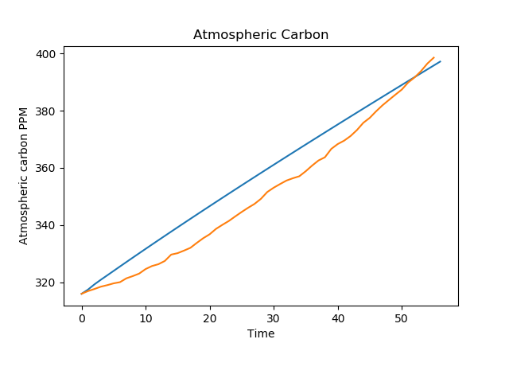
Example output
Output shows model calculated atmospheric co2 concentrations (blue line) against observations of co2 concentrations at Mauna Lao in Hawaii (orange line) from 1959 (0) to 2014 (56).
Although the model is not a perfect fit to the observations it is still useful.

Slide 19
Things to try
Add code to the model to produce various plots
Code up using OOP
Use range of IPCC carbon emission scenarios to predict future concentrations of atmospheric Carbon Dioxide
At the moment the model does a timestep per year. Do monthly time steps to show variation in atmospheric carbon concentrations across the year
Split the land and ocean into 5 degree cells and find out fluxes for each region.

Slide 20
Epidemic Model
pandemic_model/epidemic.py

Slide 21
Epidemic model
This link explains the mathematical principles:
watch from 22:05.
How to get lucky | The Royal Institution: Science Lives Here (rigb.org)

Slide 22
Epidemiology model: Assumptions
Write a code that can model an epidemic.
Inputs include population size,
R value – the average number of people 1 infected person will infect.
A well mixed population – at each time step an individual can infect any other individual
An infected person is only infectious for 1 time step after the they recover and become immune and cannot be reinfected.
Run the program across multiple time steps and plot out the values of number of infected people, and number of immune people.

Slide 23
R=2, population=100
Time
Time
step1
Time
step2
Time
step3
Time
step4
Time
Step n
Infected 1 2 4 8
Immune 0 1 3 7
Not infected 99 98 96 92

Slide 24
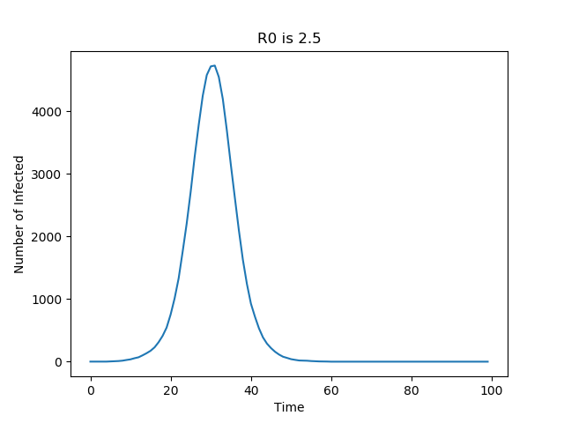

Slide 25
Daisy World
daisy_world/daisy_world.py

Slide 26
Daisy World
James Lovelock put forward the idea that the Earth was a self-regulating system that supported life in a delicate and balanced equilibrium
Lovelock suggested that if we humans mess around too much with the Earth’s climate the Earth will no longer be able to regulate itself with catastrophic consequences for humanity
This is known as the Gaia hypothesis
To demonstrate how this idea worked Watson and Lovelock proposed the model of the Daisy World, which we will explore now
Watson and Lovelock (1983) DOI: 10.3402/tellusb.v35i4.14616

Slide 27
Daisy World
Imagine a world that only has two types of life. Black daisies and white daisies.
Black daisies have the effect of absorbing sunlight thereby having a warming effect
White daisies have the effect of reflecting sunlight thereby cooling the planet. So white daisies have high albedo (reflectivity) and black daisies have low albedo.
Bare ground where there are no daisies present have a medium albedo.
Over time daisies are born and then die.
The birth rate of the daisies is influenced by the temperature of the planet.
Lets look at the equations of the model.

Slide 28
Equations for Daisy world
The effective temperature of the planet is given by:
$$T_{e}={\left(LS\left(\frac{1−A}{σ}\right)\right)}^{\frac{1}{4}}$$
Where L is 1 and S is 1000 and refer to the intensity of solar radiation.
σ is Stefan’s constant 5.67032e-8
A is the planetary albedo given by
$A=a_{g}$ $A_{g}+$ $a_{b}$ $A_{b}+$ $a_{w}$ $A_{w}$
$A_{i}$ is the albedo of the ground, black and white daisies. Albedo ranges from 0 to 1, good values are $A_{g}=0.5, A_{b}=0.25 and A_{w}=0.75$. $a_{i}$is the area covered by bare ground, black daisies and white daisies. Note that:
$a_{g}+$ $a_{b}+$ $a_{w}=1$

Slide 29
Equations for Daisy World
Rearranging we get:
$a_{g}=1.0−$ $a_{b}−$ $a_{w}$
The change in area is given by
$\frac{{da}_{b,w}}{dt}=$ $a_{b,w}(a_{g}β_{b,w}−γ)$
Where $β$is the birth rate and $γ$ is the death rate which is a constant. The birth rate is given by:
$β_{b,w}=1−$ 0.003265(22.5$−$ ${T_{b,w})}_{}$
Where:
$T_{b,w}=q$($A− A_{b,w}$) +$T_{e}$
and q=20
Using these equations let us code up the Daisy World model

Slide 30
Code for Daisy World
import math
# change these values to run different experiments
area_black=0.25
area_white=0.25
area_ground = 1.0 - area_black - area_white
alb_white=0.75
alb_black=0.25
alb_ground=0.5
death_rate=0.3
S =1000
L=1.0
# Constants
ABSOLUTE_ZERO=273.15
sigma = 5.67032e-8
q=20
steps=500
# Initialise values
alb_planet = area_black * alb_black + area_white * alb_white + area_ground * alb_ground
t_planet=(L*S*(1-alb_planet)/sigma)**0.25

Slide 31
Code for Daisy World continued
for i in range(steps):
area_ground = 1.0 – area_white – area_black
t_black = q * (alb_planet - alb_black) + t_planet
t_white = q * (alb_planet - alb_white) + t_planet
if t_black >= 278.15 and t_black <= 313.15 and area_black >= 0.01:
birth_rate_black = 1.0 - 0.003265 * (22.5 + ABSOLUTE_ZERO + - t_black)**2
if t_white >= 278.15 and t_white <= 313.15 and area_white >= 0.01:
birth_rate_white = 1.0 - 0.003265 * (22.5 + ABSOLUTE_ZERO - t_white)**2
d_area_black = area_black * (area_ground * birth_rate_black - death_rate)
d_area_white = area_white * (area_ground * birth_rate_white - death_rate)
area_black = area_black + d_area_black
area_white = area_white + d_area_white
area_ground = 1.0 - area_black - area_white
alb_planet = area_black * alb_black + \
area_white * alb_white + area_ground * alb_ground
t_planet=(L*S*(1-alb_planet)/sigma)**0.25
print(area_black,area_white,area_ground,alb_planet,t_planet)

Slide 32
Things to try
Change the variables and see what outputs you get
Add code to the model to produce various plots
Integrate this model with a spatial model akin to Conway’s “The Game of Life”. This would make an excellent computing project

Slide 33
MONIAC

Slide 34
MONIAC
moniac/moniac.py

Slide 35
MONIAC Macro economic model
In the 1950s a mechanical model was built from pipes, valves and reservoirs and used water to simulate the flow of money around the economy.
Here we will recreate a simple version of the model using bits instead of water to show the flow of money around a country’s economy.
A. W. Phillips, 1950 Mechanical Models in Economic Dynamics Economica, 17(67) (1950), 283-305.

Slide 36
MONIAC schematic
Income
Taxes
Savings
Domestic Balances
Consumer
Spending
Investments
Government spending
Domestic Expenditure
Imports
Foreign Balances
Exports
Gross Domestic Product
Transaction Balances

Slide 37
Formulas
$$taxes=taxRate ∗income$$
$$disposableIncome=income−taxes$$
$$savings=savingsRate∗disposableIncome$$
$$consumerSpending=income−taxes−savings$$
$$domesticExpenditure=consumerSpending+governmentSpending+investments$$
$$grossDomesticProduct=domesticExpenditure+exports−imports$$

Slide 38
Formulas
$$\frac{d privateBalances}{dt}=savings−investments$$
$$privateBalances=d privateBalances+privateBalances$$
$$\frac{d foreignBalances}{dt}=exports−imports$$
$$foreignBalances=d foreignBalances+foreignBalances$$
$$governmentBalances=taxes−governmentSpending$$

Slide 39
MONIAC Code
YEARS=20
GNI_TO_GDP_RATE=0.95
# Default figures in billions of
# pounds based on 2015 UK economy
income=1900.0
taxRate=0.3
savingsRate=0.08
governmentSpending=732.0
exports=133.0
imports=218.0
investments=200.0
privateBalances=0.0
foreignBalances=0.0
transactionBalances=0.0
governmentBalances=0.0

Slide 40
MONIAC code continued
for i in range(YEARS):
taxes = taxRate * income
disposableIncome = income - taxes
savings = savingsRate * disposableIncome
consumerSpending = income - taxes - savings
domesticExpenditure=consumerSpending+governmentSpending+investments
grossDomesticProduct = domesticExpenditure + exports - imports
privateBalances = savings - consumerSpending + privateBalances
foreignBalances = exports - imports + foreignBalances
governmentBalances = taxes - governmentSpending
income = grossDomesticProduct * GNI_TO_GDP_RATE
transactionBalances = grossDomesticProduct - income + transactionBalances
print(i, grossDomesticProduct)

Slide 41
Things to try
Change the variables and see what outputs you get
Add code to the model to produce various plots
Add sub-components, eg there are a variety of tax rates for capital gains, income tax, VAT and so on, or split the economy into different sectors (eg manufacturing, finance)

