Slide 1
Predict what is output in each case
1 | A=1 B=2 if A < B: print (“Hello”) elif A > B: print (“Wagwan”) else: print (“Hi”) |  | 3 | x=4 y=4 if x < y: print (“x is smaller than y”) elif x > y: print (“x is larger than y”) else: print(“x is the same as y”)
2 | i=9 j=3 if i < j: print (“i is smaller than j”) elif i > j: print (“i is larger than j”) else: print(“j is the same as i”) |  | 4 | A=1 B=2 C=3 if ((A>B) and (C<B)): print (“Hello”) else if ((A>B) and (C>B)): print (“Wagwan”) else if ((A<B) and (C<B)): print (“Hi”) else: print (“Hello”)

Slide 2
Predict what is output in each case
1 | A=1 B=2 if A < B: print (“Hello”) elif A > B: print (“Wagwan”) else: print (“Hi”) |  | 3 | x=4 y=4 if x < y: print (“x is smaller than y”) elif x > y: print (“x is larger than y”) else: print(“x is the same as y”)
2 | i=9 j=3 if i < j: print (“i is smaller than j”) elif i > j: print (“i is larger than j”) else: print(“j is the same as i”) |  | 4 | A=1 B=2 C=3 if ((A>B) and (C<B)): print (“Hello”) else if ((A>B) and (C>B)): print (“Wagwan”) else if ((A<B) and (C<B)): print (“Hi”) else: print (“Hello”)
Hello
i is larger than j
x is the same as y
Hi

Slide 3
Alternative starter
All students stand in the back of the classroom
Each student given a playing card
Teacher gives out a variety of instructions: eg
students with a card value of 6 or less go to the front of the class otherwise go to back
students with a card value greater than 9 and red go to the front of the class, otherwise go to the back of the class
Instructions can get more elaborate and have multiple groups going to different places in the room

Slide 4
Selection

Slide 5
Learning objectives
Explain that selection is related to decisions in programming
Use relational operators
Use if …. Else if ….and Else programming constructs

Slide 6
In pairs, predict what the following code does?
1 2 3 4 5 6 7 8 | def quiz(): print(“Which city is the capital of France?”) answer=input() if (answer == “Paris“): print ("Well done!") else: print (“Wrong, the answer is Paris") quiz()

Slide 7
Copy the code and run. Does is perform as expected?
1 2 3 4 5 6 7 8 | def quiz(): print(“Which city is the capital of France?”) answer=input() if (answer == “Paris“): print ("Well done!") else: print (“Wrong, the answer is Paris") quiz()
Download the code from quiz.py

Slide 9
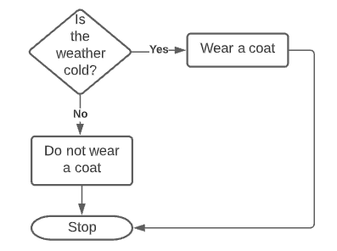
Selection
Nearly every complex computer program makes decisions. Every day we make choices too. Consider this, if it is cold you might want to wear a coat, but if is hot you will not, so in pseudocode this might be expressed as:
If the weather is cold
Wear a coat
Otherwise
Do not wear a coat
In programming selection allows us to make these decisions

Slide 10
Selection
Selection represents a decision in the code according to some condition. So if the condition is met then the block of code is either executed or it is not. Often alternative blocks of code are executed according to some condition. An integral part of selection are relational and Boolean operators that we have already looked at.
If some condition is true
do something
else if some other condition it true
do something else
else
do this thing instead

Slide 11
Investigate the code
1 2 3 4 5 6 7 8 | def quiz(): print(“Which city is the capital of France?”) answer=input() if (answer == “Paris“): print ("Well done!") else: print (“Wrong, the answer is Paris") quiz()
Identify the procedure name
Identify the variable
Identify the relational statement
What is the difference between == and =?
If the user puts in the answer “paris” with a lower case p what is output?
What is the problem with this? What could you do to fix it?

Slide 12
Investigate the code
1 2 3 4 5 6 7 8 | def quiz(): print(“Which city is the capital of France?”) answer=input() if (answer == “Paris“): print ("Well done!") else: print (“Wrong, the answer is Paris") quiz()
Procedure
Variable
= means assign to the variable
== tests whether the two values the same

Slide 13
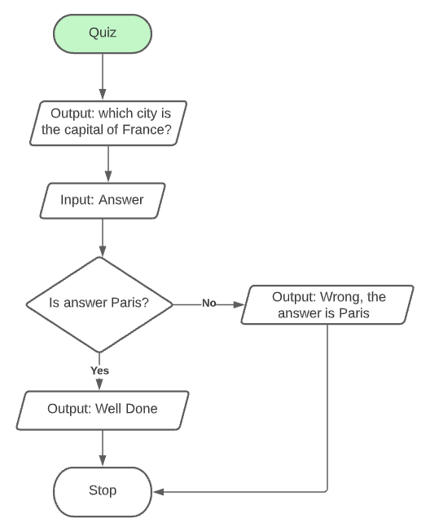
Investigate the code
1 2 3 4 5 6 7 8 | def quiz(): print(“Which city is the capital of France?”) answer=input() if (answer == “Paris“): print ("Well done!") else: print (“Wrong, the answer is Paris") quiz()

Slide 14
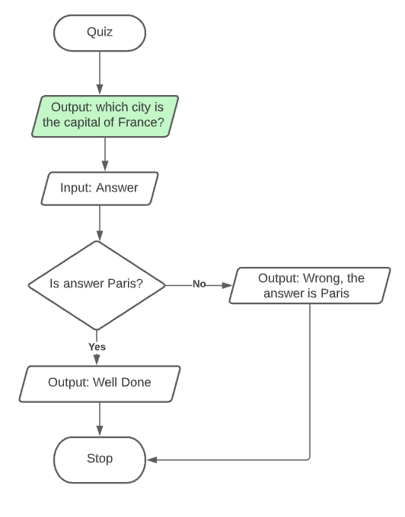
Investigate the code
1 2 3 4 5 6 7 8 | def quiz(): print(“Which city is the capital of France?”) answer=input() if (answer == “Paris“): print ("Well done!") else: print (“Wrong, the answer is Paris") quiz()

Slide 15
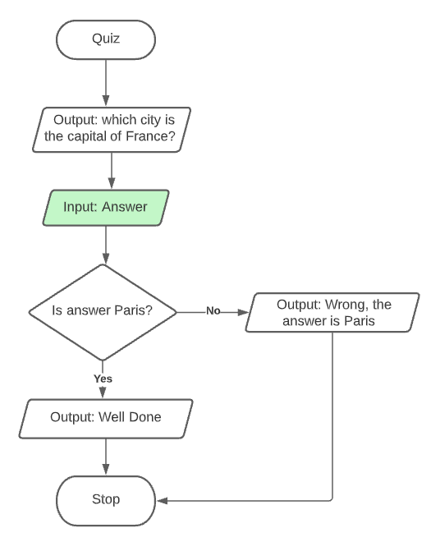
Investigate the code
1 2 3 4 5 6 7 8 | def quiz(): print(“Which city is the capital of France?”) answer=input() if (answer == “Paris“): print ("Well done!") else: print (“Wrong, the answer is Paris") quiz()

Slide 16
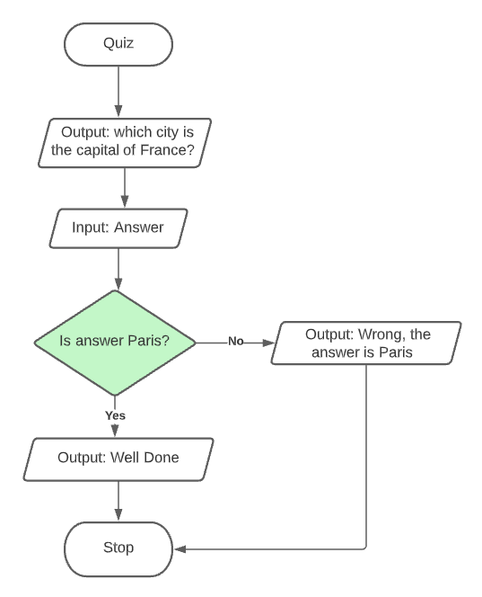
Investigate the code
1 2 3 4 5 6 7 8 | def quiz(): print(“Which city is the capital of France?”) answer=input() if (answer == “Paris“): print ("Well done!") else: print (“Wrong, the answer is Paris") quiz()

Slide 17
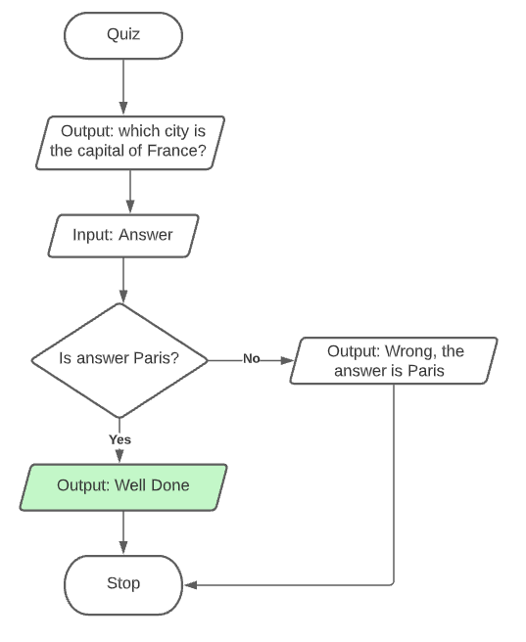
Investigate the code
1 2 3 4 5 6 7 8 | def quiz(): print(“Which city is the capital of France?”) answer=input() if (answer == “Paris“): print ("Well done!") else: print (“Wrong, the answer is Paris") quiz()
If the user entered Paris

Slide 18
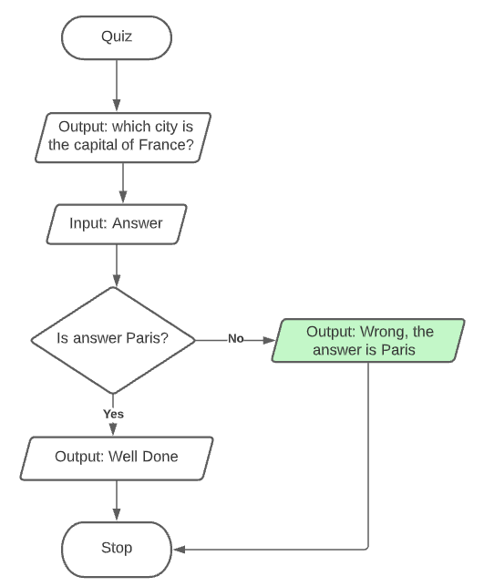
Investigate the code
1 2 3 4 5 6 7 8 | def quiz(): print(“Which city is the capital of France?”) answer=input() if (answer == “Paris“): print ("Well done!") else: print (“Wrong, the answer is Paris") quiz()
If the user entered any value other than Paris

Slide 19
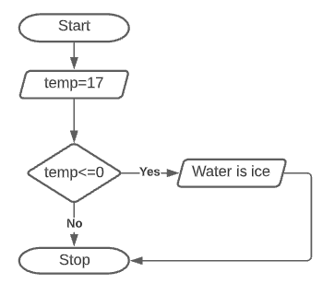
If Clause
The simplest form of selection in Python contains an if clause only so this would be:
temperature = 17
if temperature <= 0:
print (“Water is solid (ice)”)
The relational operator temperature <= 0 is used to determine whether the print statement is executed or not.
In this example the statement is not executed because temperature is greater than 0.
In Python you need to complete the if clause with a colon (:).
The statements within the if construct need to be indented.

Slide 20
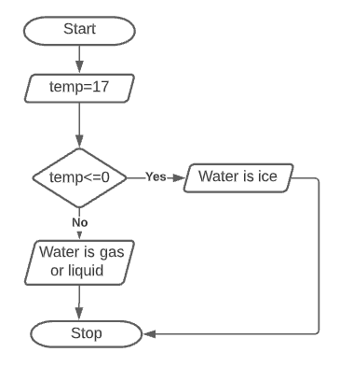
If.. Else..
It is good practice to be explicit when the condition has not been met (i.e. temperature is greater than 0).
We can also include the else clause.
temperature = 17
if temperature <= 0:
print (“Water is solid (ice)”)
else:
print (“Water is either liquid or gas (steam)”)

Slide 21
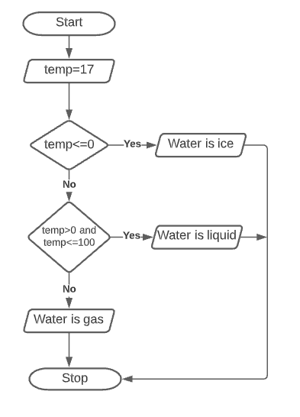
If .. elif .. else
A more complex construct now uses if, elif (else if) and else clauses.
We can have as many elif clauses as we want
Notice for line 4 we have both Boolean and relational operator working together.
temperature = 17
if temperature <= 0:
print (“Water is solid (ice)”)
elif temperature > 0 and temperature <=100:
print (“Water is liquid”)
else:
print (“Water is gas (steam)”)

Slide 22
Modify
Extend the quiz so that it asks the user a series of 6 questions.
Allow multiple answers to questions eg Both paris and Paris are correct
if (answer == “Paris“ or answer==“paris”):
Get the program to total up the score out of 10. You will have to increment a variable that keeps score e.g.
score=score+1
Example solution: quiz-with-score.py

Slide 23
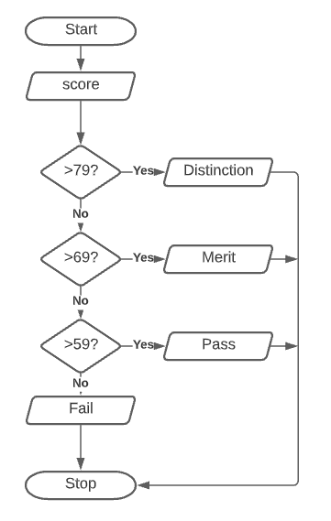
Make
Write a program:
that asks the mark of a score on a test paper.
outputs the grade of the students according to the following criteria
80-100 Distinction
70 – 79 Merit
60-69 Pass
0-59 Fail

Slide 24
Make
Write a program:
that asks the mark of a score on a test paper.
outputs the grade of the students according to the following criteria
80-100 Distinction
70 – 79 Merit
60-69 Pass
0-59 Fail
print(“Enter mark:”)
mark=int(input())
if(mark>=80):
print(“Distinction")
elif(mark>=70 and mark<80):
print(“Merit")
elif(mark>=60 and mark<70):
print(“Pass")
else:
print(“Fail")

Slide 25
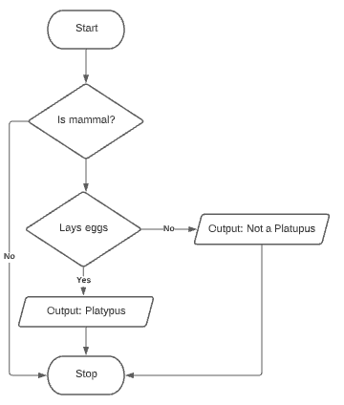
Nested selection
if “animal”==“mammal”:
if “lays_eggs” == True:
print(“Platypus”)
else:
print(“Not a Platypus”)
With nested selection we can have if statements inside if statements

Slide 26
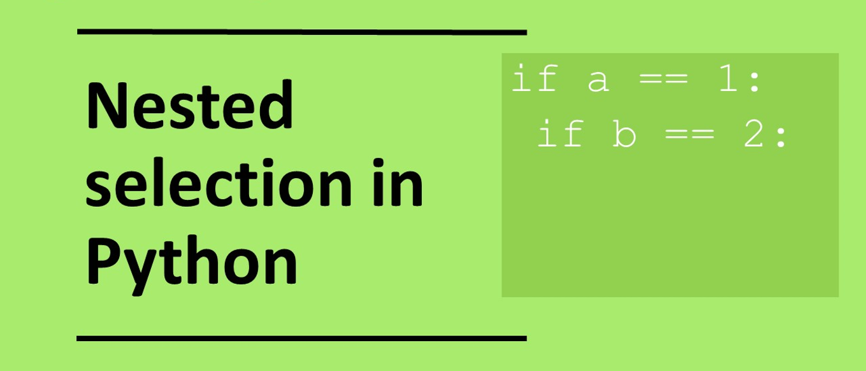

Slide 27
Plenary: Nested selection
if num1<num2:
if (num3>num4):
print(“a”)
else:
print(“d”)
elif num1>num2:
if (num3==num4):
print(“b”)
else:
print(“e”)
else:
if (num3<num4):
print(“c”)
else:
print(“f”)
What is output when the variables have the following values?
num1=2, num2=2, num3=2, num4=2
num1=2, num2=3, num3=4, num4=5
num1=5, num2=4, num3=3, num4=2
num1=5, num2=2, num3=1, num4=1
num1=2, num2=3, num3=2, num4=3
f
d
e
b
d

Slide 28
Plenary: Nested selection
if num1<num2:
if (num3>num4):
print(“a”)
else:
print(“d”)
elif num1>num2:
if (num3==num4):
print(“b”)
else:
print(“e”)
else:
if (num3<num4):
print(“c”)
else:
print(“f”)
What is output when the variables have the following values?
num1=2, num2=2, num3=2, num4=2
num1=2, num2=3, num3=4, num4=5
num1=5, num2=4, num3=3, num4=2
num1=5, num2=2, num3=1, num4=1
num1=2, num2=3, num3=2, num4=3
f
d
e
b
d

Slide 29
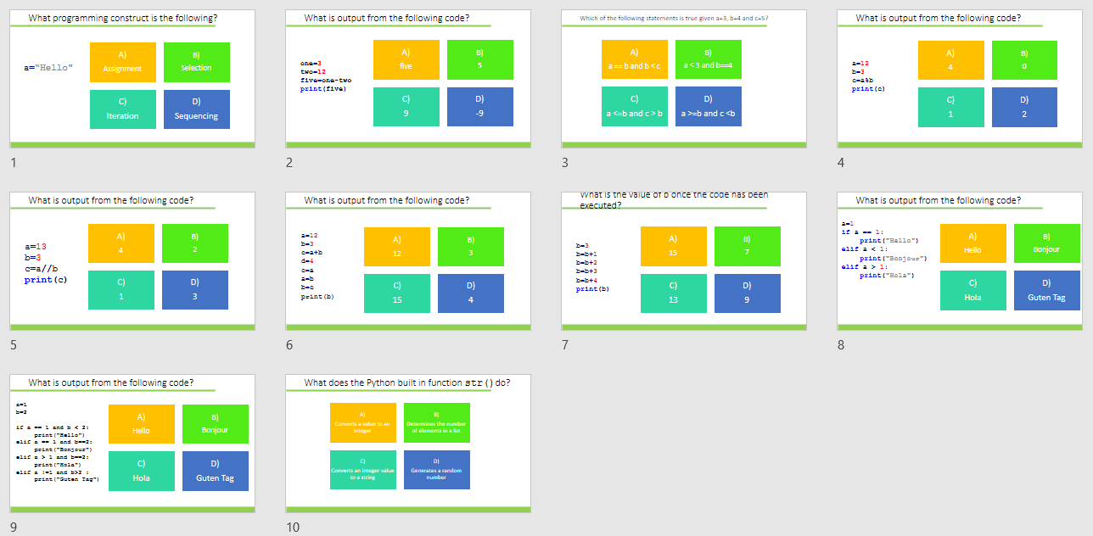
Homework
Complete task:
Python coding: selection, operators, assignment GCSE
Alternatively use:
diagnostic-questions-python-set3.pptx

