Slide 1
In pairs, discuss what is output
1 2 3 4 5 6 7 | def sub(): print(x) x=11 print(x) global x x=10 sub()

Slide 2
Download and run the code. Does it do as you expected?
scope.py
1 2 3 4 5 6 7 | def sub(): print(x) x=11 print(x) global x x=10 sub()

Slide 3
Variable Scope

Slide 4
Learning objectives
Explain what variable scope is and the difference between local and global variables.

Slide 5
Variable scope
The scope of a variable determines which parts of a program can access and use that variable.
There are global variables and local variables.

Slide 6
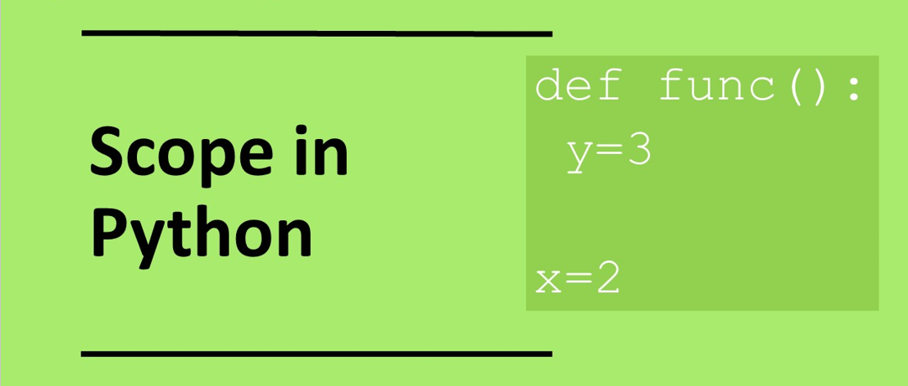

Slide 7
Local Variables
A local variable can only be accessed within the subroutine in which it has been defined.
There is no way of modifying or changing a local variable outside its scope.
Local variables are not accessible outside a subroutine unless they are returned.
def sub():
x=11 # This is a local variable
# defined inside the subroutine
print(x)
sub()

Slide 8
Global Variable
A global variable can be used anywhere in a program
They can be accessed outside and inside any subroutines
Normally they are defined outside all subroutines
In Python it is possible to define a global variable inside a subroutine using the global keyword
def sub():
global y # This is a global variable
y = 3 # defined inside the subroutine
print(x,y)
global x
x=11 # This is a global variable
# defined outside the subroutine
sub()

Slide 9
Local versus Global Variables
A global variable is good for defining a constant ie any value that does not change during the running of the program.
For values that do change it is preferrable to use local variables
For global variables there is a chance that one part of the code may unintentionally modify the value used in another part of the program
Global variables exist throughout the running of the whole program. This is an inefficient use of memory resources.
Local variables are defined only when they are needed so have less demand on memory.
Local variables only exist within the subroutine, so once the subroutine has executed, that memory occupied by the variable can be freed up to be reused for another purpose.

Slide 10
Worked Example
What values are output?
Line 2: _________
Line 4: _________
What lines are the local and global variables on?
Local variable:_________
Global variable: ________
1 2 3 4 5 6 7 | def sub(): print(x) x=11 print(x) global x x=10 sub()

Slide 11
Worked Example
1 2 3 4 5 6 7 | def sub(): print(x) x=11 print(x) global x x=10 sub()
What values are output?
Line 2: 10
Line 4: 11
What lines are the local and global variables on?
Local variable: 3
Global variable: 5

Slide 12
Question 1
What value is output on line 2?
_________
Is the variable global or local?
_________
1 2 3 4 5 | def sub(): print(x) global x x=10 sub()

Slide 13
Question 2
What value is output on line 5?
_________
What lines are the local and global variables on?
Local variable:_________
Global variable: ________
1 2 3 4 5 6 | def sub(): x=11 global x x=10 sub() print(x)

Slide 14
Question 3
What values are output?
_________
What lines are the global defined on?
_________
_________
1 2 3 4 5 6 7 | def sub(): global x x=11 global x x=10 sub() print(x)

Slide 15
Question 1 - solution
What value is output on line 2?
10
Is the variable global or local?
global
1 2 3 4 5 | def sub(): print(x) global x x=10 sub()

Slide 16
Question 2 - solution
What value is output on line 5?
10
What lines are the local and global variables on?
Local variable: 2
Global variable: 3
1 2 3 4 5 6 | def sub(): x=11 global x x=10 sub() print(x)

Slide 17
Question 3 - solution
What values are output?
11
What lines are the global variables defined on?
3, 4
1 2 3 4 5 6 7 | def sub(): global x x=11 global x x=10 sub() print(x)

Slide 18
Passing and returning values to functions
Ideally we want to pass and return values from functions so that our code becomes more robust
1 2 3 4 5 | def square(): x=x*x x=10 square() print(x)
1 2 3 4 5 6 | def square(x): x=x*x return x x=10 x=square(x) print(x)

Slide 19
Question 4
Make the following code more robust:
1 2 3 4 5 6 | def double(): x=x*2 global x x=5 double() print(x)

Slide 20
Question 5
Make the following code more robust:
1 2 3 4 5 6 | def add(): z=x+y global x,y x=5 y=4 add() print(z)

Slide 21
Question 4 – Example solution
Make the following code more robust:
1 2 3 4 5 6 | def double(x): x=x*2 return x x=5 x=double(x) print(x)
1 2 3 4 5 6 | def double(): x=x*2 global x x=5 double() print(x)

Slide 22
Question 5 – Example solution
Make the following code more robust:
1 2 3 4 5 6 7 8 | def add(): global z z=x+y global x x=5 y=4 add() print(z)
1 2 3 4 5 6 | def add(x,y): z=x+y return z x=5 y=4 z=add(x,y) print(z)

