Slide 1
In pairs predict what the following code will output
1 2 3 4 5 6 7 8 | import random def routine(): selected=random.randint(1,6) print(selected) while True: print(“Roll”) input() routine()

Slide 2
Random Number Generator

Slide 3
Learning objectives
Generate random numbers
Know how to import modules
Use choice, randint, random, randrange functions from the random module

Slide 4
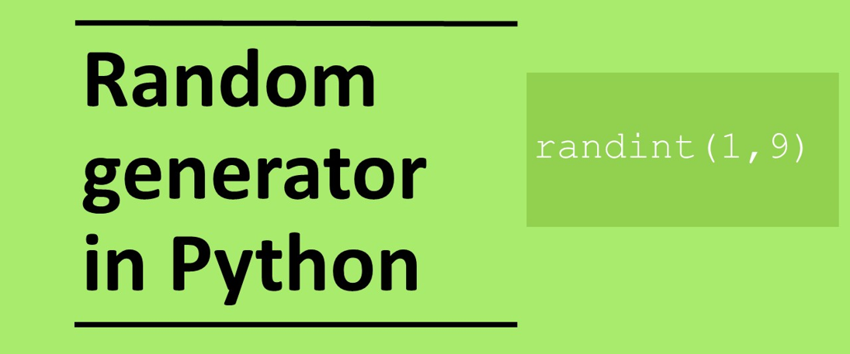

Slide 5
Copy the code into you editor and run the program a few times
1 2 3 4 5 6 7 8 | import random def routine(): selected=random.randint(1,6) print(selected) while True: print(“Roll”) input() routine()
Answer the questions by adding comments to your code
What did the program output? Is this what you expected?
Does the program give the same output every time you run it?
What is the input function doing. What happens if you remove it?
What is import random doing?
Write a comment above each line explaining what each line does.
What does the code do as a whole?
What does while True do?
What is the main problem with the program?
Download the code from die-roll.py

Slide 6
Using the random function
The random function is a very useful function that is used in many places in programming. We rely on randomness in games of chance including card games or games that use dice. In addition many natural phenomena appear random for instance in weather so randomness is especially useful for solving complex mathematical problems.
In Python to use the random function you need to first import the random package. Packages contain additional functions that are not part of standard Python.
import random
num=random.randint(1,10)
randint will select a value between the low value and the high value in this case 1 and 10 respectively
print(num)

Slide 7
Investigating the code
1 2 3 4 5 6 7 8 | import random def routine(): selected=random.randint(1,6) print(selected) while True: print(“Roll”) input() routine()
Import a module called random
Define a subroutine
Randomly choose an integer between the low value and high value which in this case is 1 and 6 using randint function from the random module and assign to variable called choice
Output the randomly selected integer
Loop forever
Wait for user input
Call the subroutine

Slide 8
Modules
Modules contain additional functionality that are not part of standard Python. There are thousands of modules, but likely ones you will use soon are:
random – package that contains function for generating random numbers (we will use these today)
math – package that contains lots of mathematical functions including log, sin, cos
datetime – package that contains lots of date and time routines.
time – for timing running of programs for instance
To use a package, at the top of the program write
import module
or
from module import function

Slide 9
Two ways to import modules
import module
Import entire module with all functions and need to reference module and function when calling
from module import function
Imports only the function that is required
import random def routine(): selected=random.randint(1,6) print(selected) routine() | from random import randint def routine(): selected=randint(1,6) print(selected) routine()
What is the difference between these two pieces of code?

Slide 10
Modify the code
1 2 3 4 5 6 7 8 | import random def routine(): selected=random.randint(1,6) print(selected) while True: print(“Roll”) input() routine()
Now modify the code:
Change the name of the subroutine to something sensible
Use the alternative method for importing the module and function
Modify the print statement to output: “The random number is: ” [number]
Have the program select a random integer between 1 and 100
Extension: Get the program to stop when the user enters “stop”. You will need to use the break statement

Slide 11
Random choice function
Randomly selects an item from a list
choice(list)
Example: Randomly selects either red, green or blue. There is an equal chance (i.e. 1 in 3 chance) of each being selected.
import random
print(random.choice([“red”,“green”,“blue”]))

Slide 12
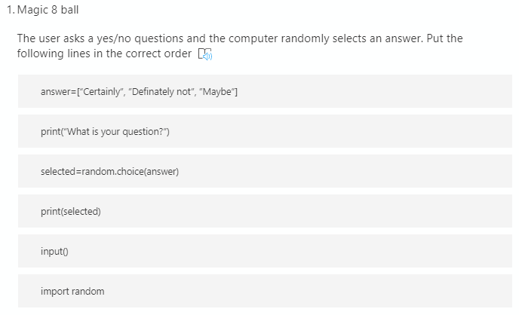
Parson’s problem: Magic 8 ball
The user asks a yes/no questions and the computer randomly selects an answer. Put the following lines in the correct order
http://bit.ly/pp-magic-8-ball

Slide 13
Parson’s problem: Magic 8 ball
1 2 3 4 5 6 | import random print(“What is your question?”) input() answer=[“Certainly”, ”Definately not”, ”Maybe”] selected=random.choice(answer) print(selected)

Slide 14



Make: Create a rock paper scissors game
Computer randomly select rock paper or scissors
Ask the user to select rock, paper or scissors
Identify who wins (paper beats rock, scissors beat paper and rock beats scissors)
Extension:
Keep playing the game until the user no longer wishes to play
Keep a score of who is winning: user or computer or draw
Adapt the game to play rock, paper, scissors, lizard, spock

Slide 15
Partially complete rock, paper, scissors
import random
computer=random.choice["rock"]
print("Enter ….")
# get user input
if user=="rock" and computer=="paper":
print("Computer wins")
elif user=="rock" and computer=="rock":
print("Draw")

Slide 16
import random
computer=random.choice["rock","paper","scissors"]
print("Enter rock, paper or scissors:")
user=input()
if user=="rock" and computer=="paper":
print("Computer wins")
elif user=="rock" and computer=="rock":
print("Draw")
elif user=="rock" and computer=="scissors":
print("You win")
elif user=="scissors" and computer=="paper":
print("You win")
elif user=="scissors" and computer=="rock":
print("Computer wins")
elif user=="scissors" and computer=="scissors":
print("Draw")
elif user=="paper" and computer=="paper":
print("Draw")
elif user=="paper" and computer=="rock":
print("You win")
elif user=="paper" and computer=="scissors":
print("Computer wins")

Slide 17
Extension: Guessing game
Write a program for a guessing game. The computer selects a random integer between 1 and 100. The user tries to guess the number. The computer informs the user if the number is too high or too low. The user keeps guessing until the guess is correct. The computer counts the number of guesses.
Extension:
The program tells the user how many guesses they have had.
The user has the option to play again
Find out what is the most effective strategy for playing the guessing game?

Slide 18
Guessing game
import random
x=random.randint(1,100)
n=0
guess=0
while guess!=x:
guess=int(input("Guess a number between 1 and 100?: "))
if (guess > x):
print(guess, "is too high")
if (guess < x):
print(guess, "is too low")
if guess==x:
print("Well done! the answer was ", x)

Slide 19
Additional Slides for extension

Slide 20
Random range function
Randomly select integers between the low and high values with intervals of step.
randrange(low,high,step)
Example: Randomly select integers between with intervals of 3 between 2 and 10, so the possible values are 2,5,8
import random
print(random.randrange(2,10,3))

Slide 21
Randrange questions
What are the possible values that can be output give the following?
randrange(1,100,10)
randrange(2,19,4)
randrange(0,21,2)
What parameters would randrange take to output the possible random values:
1,4,7,10,13
9,11,13,15,17
2,9,16

Slide 22
Randrange answers
What are the possible values that can be output give the following?
randrange(1,100,10) 1,11,21,31,41,51,61,71,81,91
randrange(2,19,4) 2,6,10,14,18
randrange(0,21,2) 0,2,4,6,8,10,12,14,16,18,20
What parameters would randrange take to output the possible random values:
1,4,7,10,13 randrange(1,14,3)
9,11,13,15,17 randrange(9,2,18)
2,9,16 randrange(2,17,7)

Slide 23
Random Function
Code up the following lines of code and run a few times.
What is the code doing?
import random
print(random.random())

Slide 24
Random real numbers
Print real random number between 0 and 1
import random
print(random.random())

