Slide 1
In pairs, predict what the following code is doing
1 2 3 4 5 | name=“Fred Flintstone” print(“Hello”,name) print() print(“I hope you are well”) print(“Goodbye”)
For more help, please visit www.exampaperspractice.co.uk
© 2025 Exams Papers Practice. All Rights Reserved

Slide 2
Output

Slide 3
Learning Objective
Predict the output of a Python program
Know how to use the print function to produce output
Know how to debug a program
For more help, please visit www.exampaperspractice.co.uk
© 2025 Exams Papers Practice. All Rights Reserved

Slide 4


Python programming
We will use Python 3.
Python is a high-level textual programming language.
If you have used Scratch you will already be familiar with some of the concepts presented here such as selection (if else) and iteration (loops) albeit in block form.
To write our programs we will use the IDLE interactive development environment (IDE).
For more help, please visit www.exampaperspractice.co.uk
© 2025 Exams Papers Practice. All Rights Reserved

Slide 5
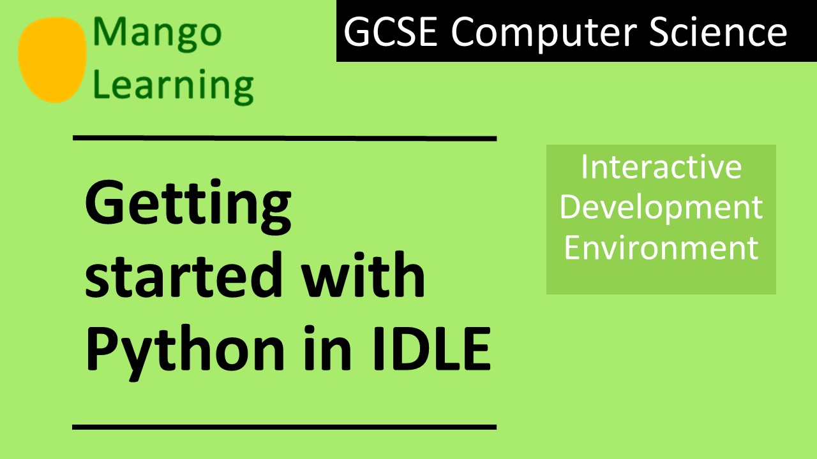
Demonstration (click on the image)
For more help, please visit www.exampaperspractice.co.uk
© 2025 Exams Papers Practice. All Rights Reserved

Slide 6
Interactive Development Environment
An IDE is an app that helps us to write, edit, debug and run computer codes, and have the following among other things:
Editor – Allows you to write and edit programs
Error diagnostics – Tells you where there are syntax and run time errors are in your program
Run time environment – Can track and execute instructions step-by-step.
Translator – Converts the high-level language into machine code that computers understand
For more help, please visit www.exampaperspractice.co.uk
© 2025 Exams Papers Practice. All Rights Reserved

Slide 7
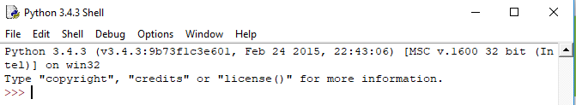
IDE interactive shell
Open up IDLE. You should see the interactive shell similar to below.
For more help, please visit www.exampaperspractice.co.uk
© 2025 Exams Papers Practice. All Rights Reserved

Slide 8
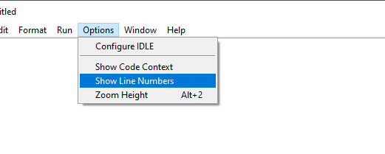
Configuring IDLE: Add line numbers
It is really useful to configure IDLE to show the line numbers.
Open up the editor and go to Options | Show Line Numbers
For more help, please visit www.exampaperspractice.co.uk
© 2025 Exams Papers Practice. All Rights Reserved

Slide 9
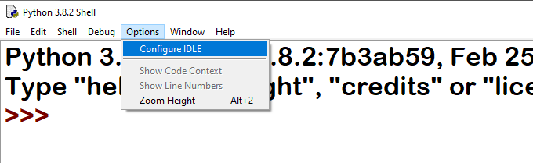
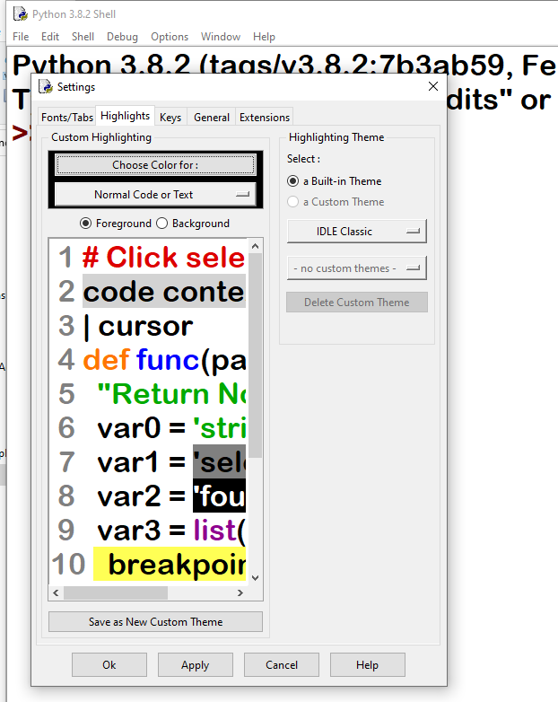
Configuring IDLE: Colour coding
You can modify the color coding for different programming constructs to help with editing and debugging code
Go to Options | Configure IDLE
Select Highlights
For more help, please visit www.exampaperspractice.co.uk
© 2025 Exams Papers Practice. All Rights Reserved

Slide 10
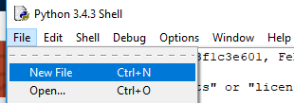
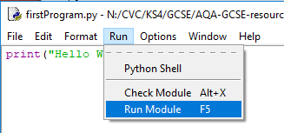
Writing your first program
1) In the Python shell go to File | New Window
2) In the new window write:
print (“Hello World”)
3) Go to File | Save and name the program firstProgram.py
4) To run the program Press the F5 key. Alternatively go to Run Module| Python Shell. The output should appear on the interactive shell.
Congratulations! You have now written your first program using Python
For more help, please visit www.exampaperspractice.co.uk
© 2025 Exams Papers Practice. All Rights Reserved

Slide 11
Output
Output is data that has been processed by a computer and then sent to other devices.
In Python output is generated by using the print function.
In this case information is sent from the computer to the monitor
The output is displayed in the interactive shell
For more help, please visit www.exampaperspractice.co.uk
© 2025 Exams Papers Practice. All Rights Reserved

Slide 12
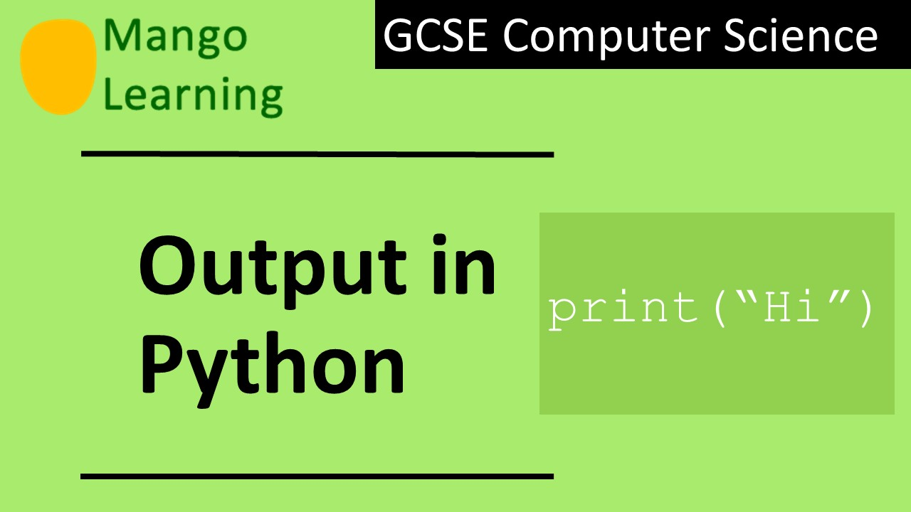
For more help, please visit www.exampaperspractice.co.uk
© 2025 Exams Papers Practice. All Rights Reserved

Slide 13
Print function
print is a built-in function that can take up to 255 arguments.
An argument is a value that is provided as input to a function.
Each argument is separated by a comma.
Arguments are contained in brackets
The following statement has 3 arguments:
The arguments are in speechmarks because they are string data types
print(“Harry Potter”, “and”, “Ron Weasley”)
For more help, please visit www.exampaperspractice.co.uk
© 2025 Exams Papers Practice. All Rights Reserved

Slide 14
Anatomy of a function
Name of function
(identifier)
print(“Harry Potter”, “and”, “Ron Weasley”)
identifier(argument1, argument2, argument3)
Argument 1
Argument 2
Argument 3
Commas
Brackets
For more help, please visit www.exampaperspractice.co.uk
© 2025 Exams Papers Practice. All Rights Reserved

Slide 15
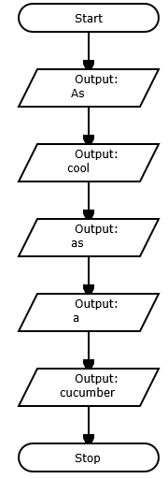
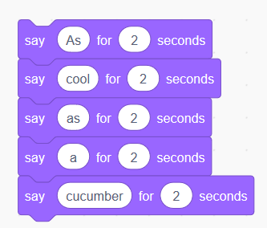
Sequencing
We can add as many print operations to our program as we like. The statements are run in sequence one-by-one starting at the top of the program. These are the simplest types of programs where one instruction is run at a time in order from top to bottom.
print (“As”)
print (“cool”)
print (“as”)
print (“a”)
print (“cucumber”)
For more help, please visit www.exampaperspractice.co.uk
© 2025 Exams Papers Practice. All Rights Reserved

Slide 16
Copy the code into the Python IDLE editor and run
1 2 3 4 5 | name=“Fred Flintstone” print(“Hello”,name) print() print(“I hope you are well”) print(“Goodbye”)
Does the code do as you expected?
You can download a copy of the
code from:
1-output.py
Debugging checklist
Have you put in the closing brackets?
Have you put in speech marks?
Have you spelt everything correctly?
Are your commas in the right place?
For more help, please visit www.exampaperspractice.co.uk
© 2025 Exams Papers Practice. All Rights Reserved

Slide 17
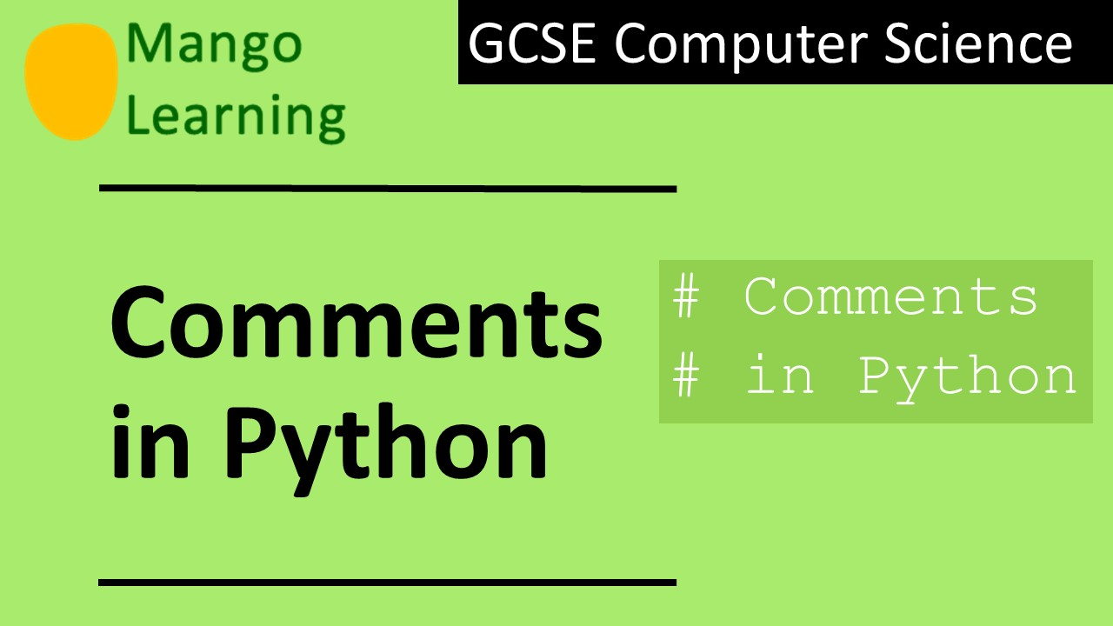
For more help, please visit www.exampaperspractice.co.uk
© 2025 Exams Papers Practice. All Rights Reserved

Slide 18
Commenting code
Comments are lines in you code that the program does not execute. Commenting code is very helpful because it helps you and others to understand the program. In Python a commented line begins with a hash #
# This is a comment.
# The program will ignore these lines.
At the top of every program that you write it is good practice to write your name, the date and a short description of what the program does at the top of the file. For example: you might write.
# A program that outputs “Hello World”
# Author: WG
# Date: Friday 6th April 2021
For more help, please visit www.exampaperspractice.co.uk
© 2025 Exams Papers Practice. All Rights Reserved

Slide 19
Investigate the code
1 2 3 4 5 | name=“Fred Flintstone” print(“Hello”,name) print() print(“I hope you are well”) print(“Goodbye”)
Add comments into the code when you answer each of the questions
What line is a variable assigned
What is output on line 2?
What is happening on line 3?
What happens when you remove the bracket )at the end of line 4
In what order are the statements run?
For more help, please visit www.exampaperspractice.co.uk
© 2025 Exams Papers Practice. All Rights Reserved

Slide 20
Investigate the code
# This is an assignment # The variable is called name name=“Fred Flintstone” # prints out Hello Fred Flintstone print(“Hello”,name) # prints out a blank line print() print(“I hope you are well”) print(“Goodbye”)

Slide 21
Modify the code
1 2 3 4 5 | name=“Fred Flintstone” print(“Hello”,name) print() print(“I hope you are well”) print(“Goodbye”)
Line 1: Change “Fred Flintstone” to “Homer Simpson”
Swap lines 2 and 5. What happens?
Line 1 and Line 2: Change the name variable to character
Line 2: Change greeting from “Hello” to “Bonjour”
Line 4: Add in another blank line
Change “Goodbye” to “Adios”

Slide 22
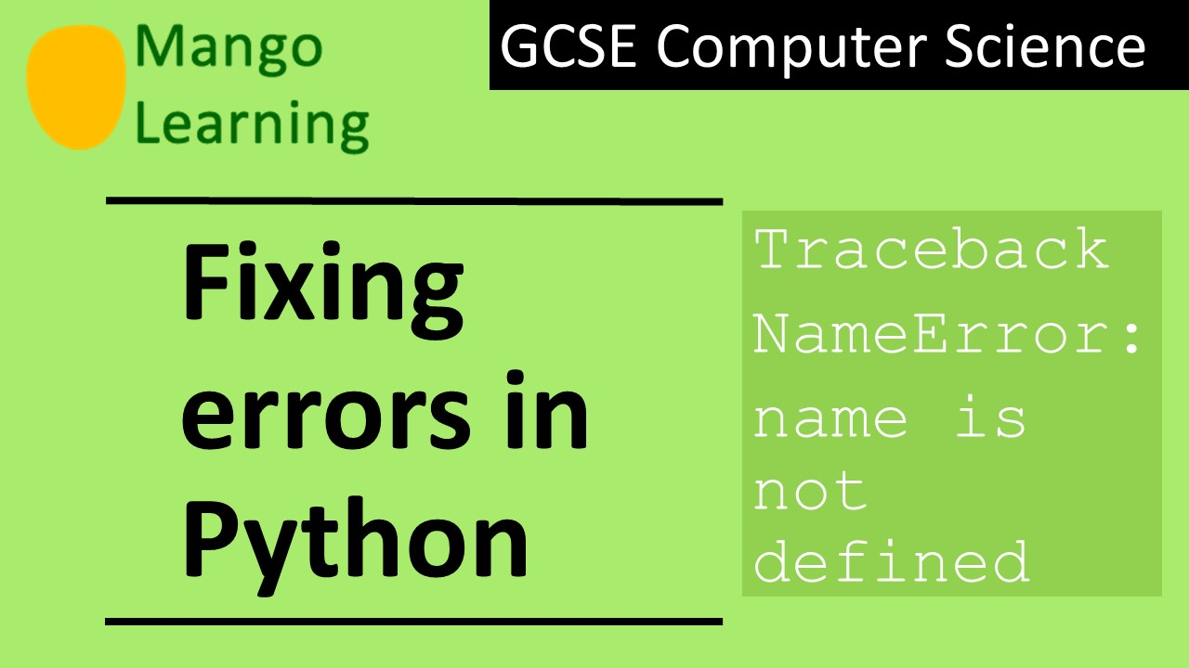

Slide 23
Debugging
If you program does not work it is highly likely that you have made a syntax error. Syntax errors are typographical mistakes that the programmer has made. When the code gets translated for the computer to understand you will get an error message. Sometimes the message is useful, sometimes it is not!
When you are writing programs especially as they get more complex it is very difficult not to make syntax errors, so it is worth learning to understand the error messages so you can fix them more easily. As you get more experienced you will learn to interpret the error messages more easily.

Slide 24
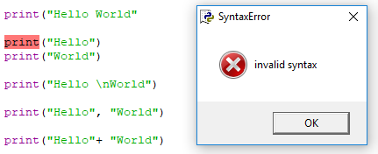
Common syntax errors (1)
Forgotten bracket. You get the message “invalid syntax” in a popup box along with the line after the line with the error being highlighted in red.

Slide 25
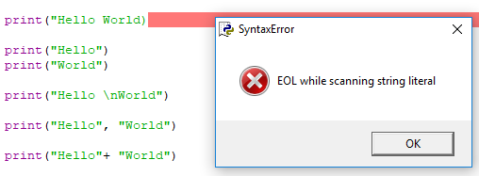
Common syntax errors (2)
Forgotten speech mark. You get the message “EOL while scanning string literal” in a pop up box along with the line of the error being highlighted in red.

Slide 26
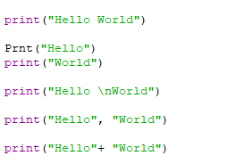
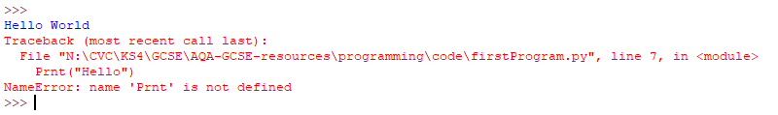
Common syntax errors (3)
Misspell function name. We have misspelled “print”. In the shell we get a message telling us where and what the problem is.

Slide 27
Find the 5 errors in the following code
print("Invictus")
print()
print("Out of the night that covers me,")
print("Black as the Pit from pole to pole")
print("I thank whatever gods may be")
print("For my unconquerable soul.")
print()
print("In the fell clutch of circumstance"
print("I have not winced nor cried aloud.")
print "Under the bludgeonings of chance")
PRint("My head is bloody, but unbowed.")
print()
print("Beyond this place of wrath and tears)
print("Looms but the Horror of the shade,")
print("And yet the menace of the years")
print("Finds, and shall find, me unafraid.")
print()
print("It matters not how strait the gate,")
prnt("How charged with punishments the scroll.")
print("I am the master of my fate:")
print("I am the captain of my soul.")
print()
print("William Ernest Henley")
Download the broken code from:
1-poem-invictus.py

Slide 28
Find the 5 errors in the following code
print("Invictus")
print()
print("Out of the night that covers me,")
print("Black as the Pit from pole to pole")
print("I thank whatever gods may be")
print("For my unconquerable soul.")
print()
print("In the fell clutch of circumstance"
print("I have not winced nor cried aloud.")
print "Under the bludgeonings of chance")
PRint("My head is bloody, but unbowed.")
print()
print("Beyond this place of wrath and tears)
print("Looms but the Horror of the shade,")
print("And yet the menace of the years")
print("Finds, and shall find, me unafraid.")
print()
print("It matters not how strait the gate,")
prnt("How charged with punishments the scroll.")
print("I am the master of my fate:")
print("I am the captain of my soul.")
print()
print("William Ernest Henley")
Download the broken code from:
1-poem-invictus.py

Slide 29
Make
Output the following sentence: “The cat sat on a mat” with one word on each line using a sequence of print statements.
print(“The”)
print(“cat”)
print(“sat”)
print(“on”)
print(“a”)
print(“mat”)

Slide 30
Make: Write a program that outputs the following poem
Dreams
Hold fast to dreams
For if dreams die
Life is a broken-winged bird
That cannot fly.
Hold fast to dreams
For when dreams go
Life is a barren field
Frozen with snow
Langston Hughes
Make sure you include the blank lines.
To help you, you can download the words from:
1-poem-dreams.py

Slide 31
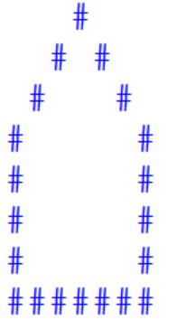
Write a program that outputs the following house shape
Make: Have fun creating ASCII Art
Extension: Create you own ASCII Art

Slide 32
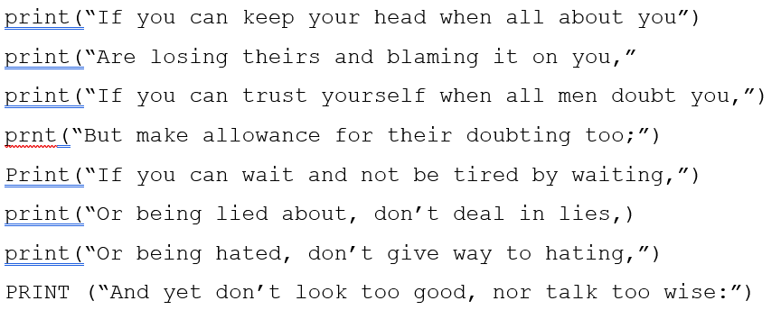
Plenary
Correct the mistakes in the following Python code:
correct-the-mistakes.docx

