Slide 1
Numbers

Slide 2
Learning objectives
Explain the history of numbers
Describe natural numbers, integers, rational numbers, irrational numbers, real numbers, ordinal numbers and cardinal numbers

Slide 3
History of numbers
In different parts of the world and at different times, different number systems were developed
Numbers emerged as a means of counting, time keeping for tracking monthly and annual cycles, for geometry and later for astronomy.
Unary number system (base-1) is used for tallying scores, and there is evidence from bone markings that this system was used by the earliest humans.

Slide 4
History of numbers
The Ancient Greeks around 300bc used a decimal base system but without zero
Zero was considered sacrilegious in many societies so was ignored and even feared. Even Pythagoras himself tried to crush zero.
The Mayans around 1200bc used base-20.
Babylonians in what we consider modern day Iraq around 1500bc had base-60

Slide 5
History of numbers
The modern-day base-10 system that includes 0 as a number owes its roots to the Arabic tradition in India from around 300bc.
As empires grew and fell and trade routes expanded this system spread into Western culture and became adopted worldwide
But even today there are some remote tribes including the Piraha tribe in Amazon that have a counting system of 1, 2 and many.

Slide 6
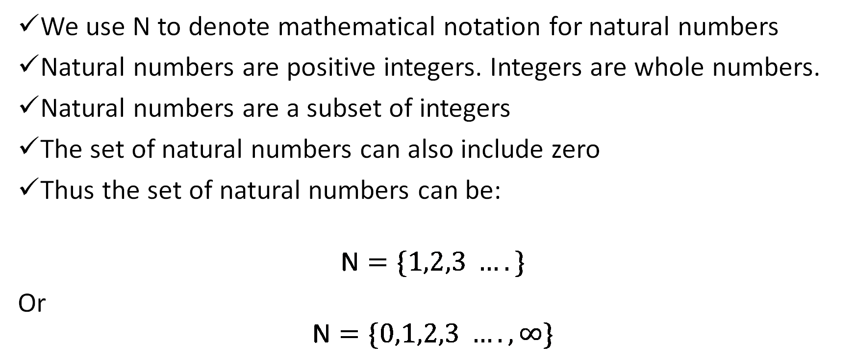
Natural numbers
We use N to denote mathematical notation for natural numbers
Natural numbers are positive integers. Integers are whole numbers.
Natural numbers are a subset of integers
The set of natural numbers can also include zero
Thus the set of natural numbers can be:
$$\text{N}=\{1,2,3 ….\}$$
Or
$$\text{N}=\{0,1,2,3 ….,∞\}$$

Slide 7
Cardinal and ordinal numbers
Natural numbers are used for counting and ordering. More formally we use the terms cardinal and ordinal.
Cardinal numbers are used for counting. Tells us how many things there are
Ordinal numbers are used for ordering. Gives the position of items in a list. For instance in the list A where A = {“apple”,”banana”,”orange”}, the first item is “apple”, the second is “banana” and the third is “orange”

Slide 8
Cardinal versus Ordinal
Cardinal | Ordinal
1 | First
2 | Second
3 | Third
4 | Forth
5 | Fifth
6 | Sixth
7 | Seventh

Slide 9
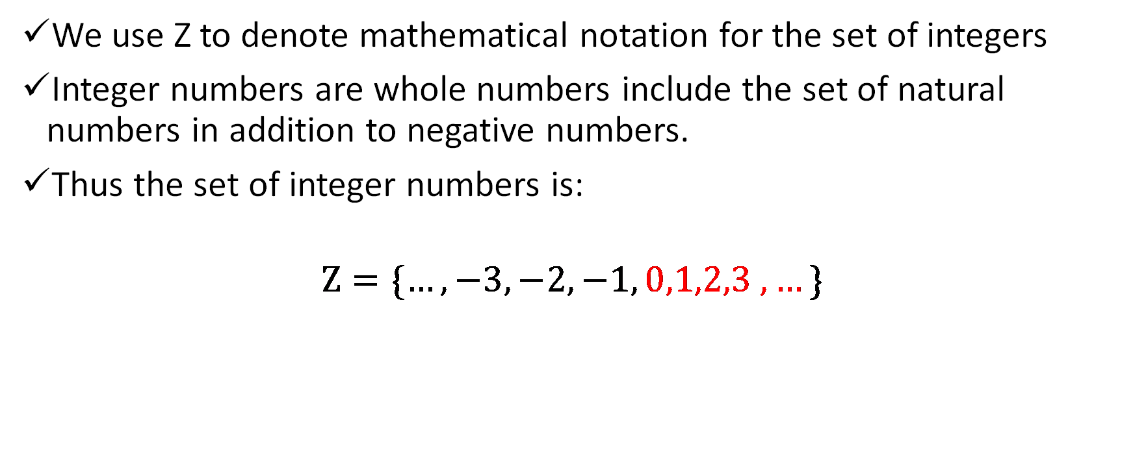
Integer numbers
We use Z to denote mathematical notation for the set of integers
Integer numbers are whole numbers include the set of natural numbers in addition to negative numbers.
Thus the set of integer numbers is:
$$\text{Z}=\{…,−3, −2, −1, 0,1,2,3 ,…\}$$

Slide 10
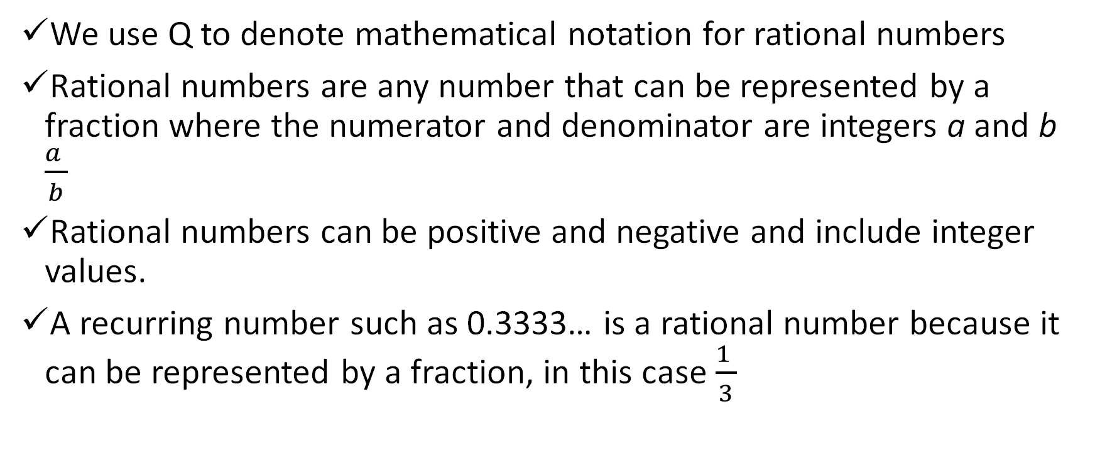
Rational numbers
We use Q to denote mathematical notation for rational numbers
Rational numbers are any number that can be represented by a fraction where the numerator and denominator are integers a and b $\frac{a }{b}$
Rational numbers can be positive and negative and include integer values.
A recurring number such as 0.3333… is a rational number because it can be represented by a fraction, in this case $\frac{1 }{3}$

Slide 11
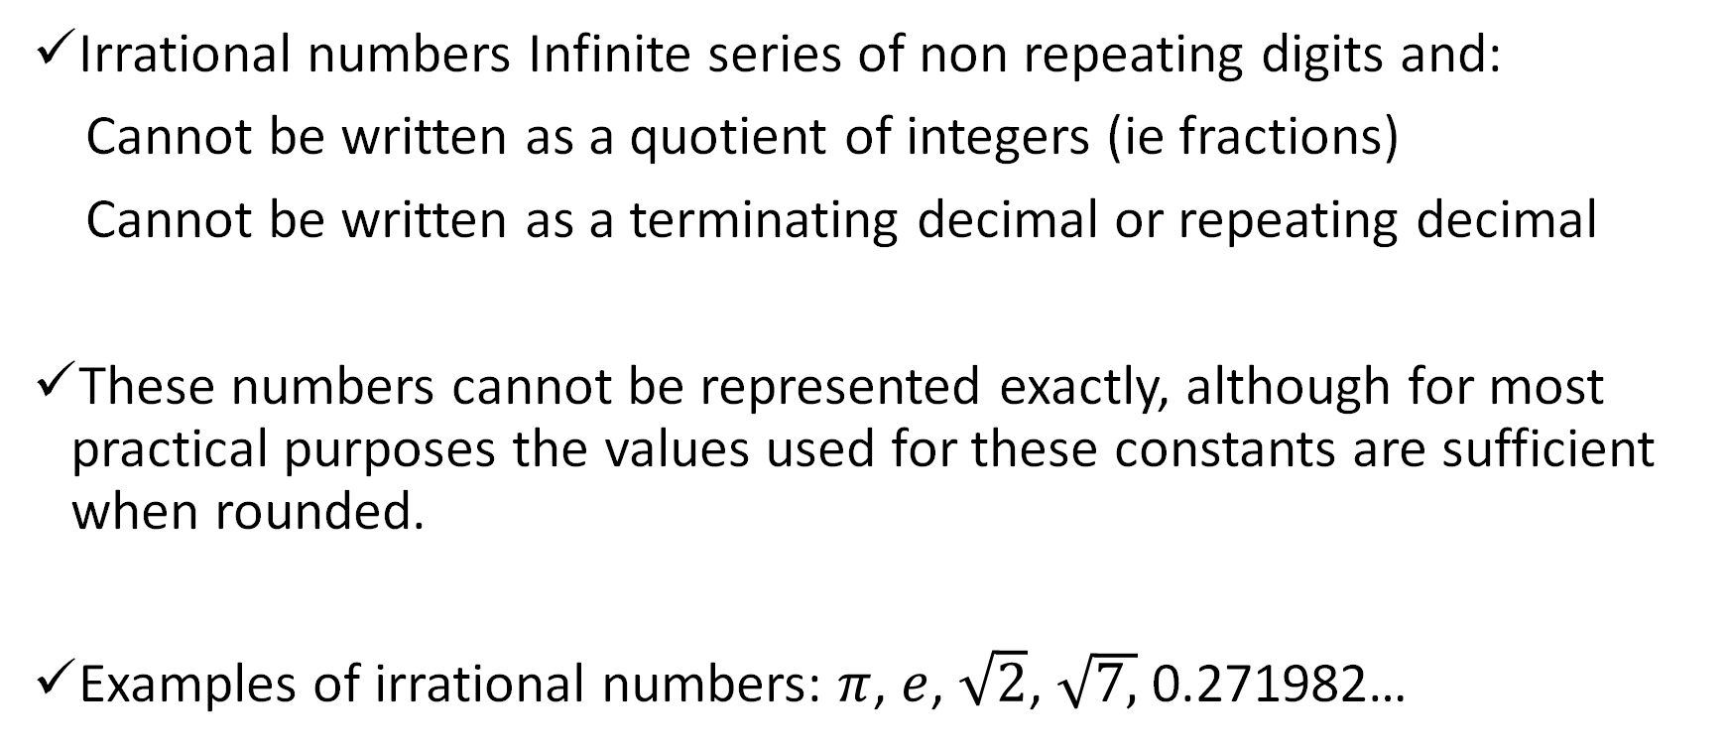
Irrational numbers
Irrational numbers Infinite series of non repeating digits and:
Cannot be written as a quotient of integers (ie fractions)
Cannot be written as a terminating decimal or repeating decimal
These numbers cannot be represented exactly, although for most practical purposes the values used for these constants are sufficient when rounded.
Examples of irrational numbers: $π$, $e$, $\sqrt{2}$, $\sqrt{7,}$ 0.271982…

Slide 12
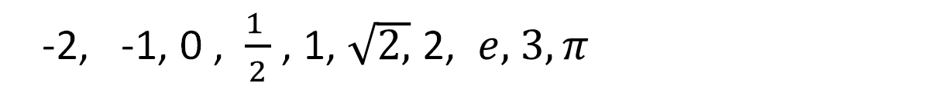
Real numbers
The set of real numbers R includes both rational and irrational numbers.
Real numbers are uses for the measurement of continuous values. Eg measuring length or weight.
-2, -1, 0 , $\frac{1 }{2}$ , 1, $\sqrt{2,}$ 2, $e,$ $3, π$

Slide 13
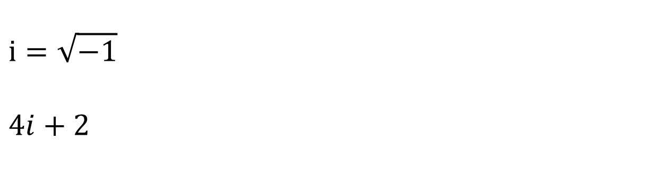
Complex numbers
The set of complex numbers C includes all real and imaginary numbers.
$$i=\sqrt{−1}$$
$$4i+2$$

Slide 14
Relation between number sets
Real numbers R
Irrational numbers
Rational numbers Q
Integer numbers Z
Natural numbers N

Slide 15
Data types in Computer science
Understanding the number system is important in the context of computer science because we need to be clear what data type we are using to represent the different types of data that we have.
For instance:
natural numbers are referred to as unsigned integer data type.
integer numbers are referred to as signed integer data type.
Real numbers are referred to as floating point data types

Slide 16
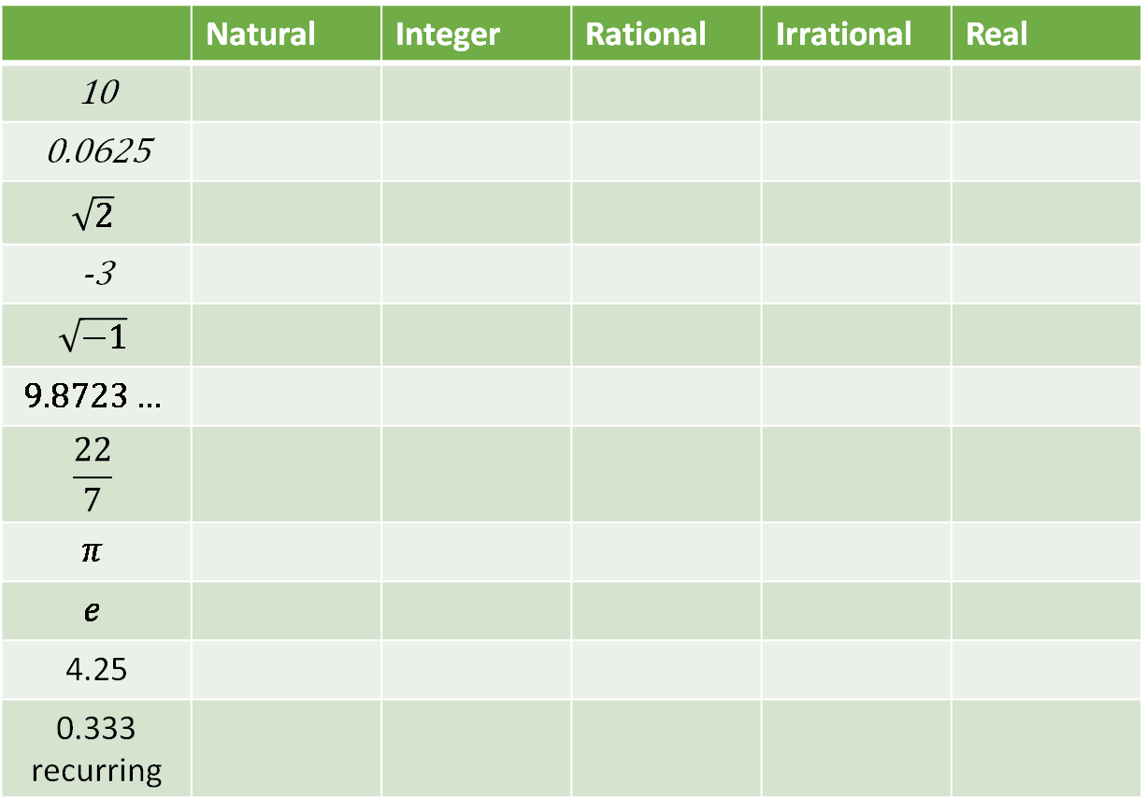
Exercise: Natural, Integer, rational, irrational, real, complex
 | Natural | Integer | Rational | Irrational | Real
10
0.0625
$$\sqrt{2}$$
-3
$$\sqrt{−1}$$
$$9.8723…$$
$$\frac{22}{7}$$
$$π$$
$$e$$
4.25
0.333 recurring

Slide 17
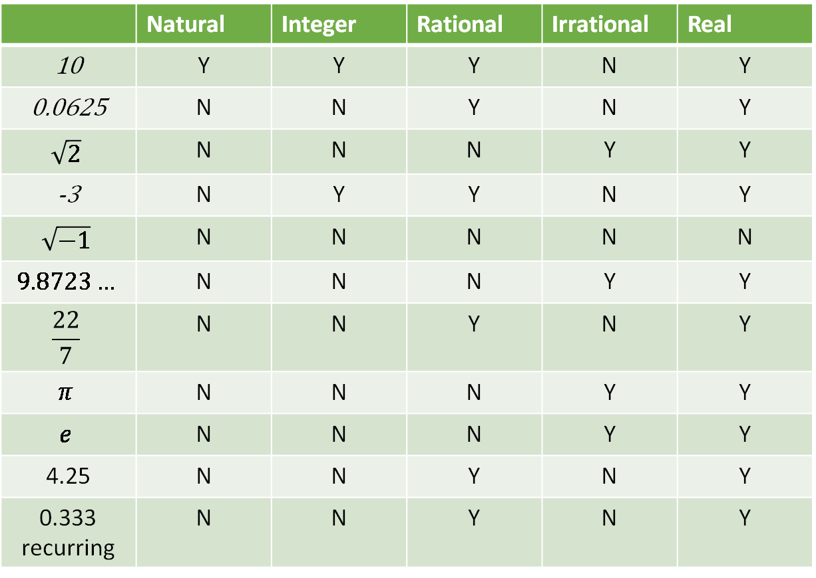
Exercise: Natural, Integer, rational, irrational, real, complex
 | Natural | Integer | Rational | Irrational | Real
10 | Y | Y | Y | N | Y
0.0625 | N | N | Y | N | Y
$$\sqrt{2}$$ | N | N | N | Y | Y
-3 | N | Y | Y | N | Y
$$\sqrt{−1}$$ | N | N | N | N | N
$$9.8723…$$ | N | N | N | Y | Y
$$\frac{22}{7}$$ | N | N | Y | N | Y
$$π$$ | N | N | N | Y | Y
$$e$$ | N | N | N | Y | Y
4.25 | N | N | Y | N | Y
0.333 recurring | N | N | Y | N | Y

Slide 18
Past Paper Questions on Number Systems
AQA Paper 2 AS June 2018 Q1
AQA Paper 2 AS June 2018 Q1
AQA Paper 2 AS June 2017 Q1
AQA Paper 2 AS June 2016 Q1
AQA Paper 2 AS Specimen Q1
AQA Paper 2 AS Specimen additional 2017 Q1

Slide 19
Plenary
Explain and give one example of each of the following:
Natural number
integer
Rational number
irrational number
real number

Slide 20
Extra Questions
Explain the difference between the set of natural numbers and the set of integers.
Explain the difference between rational and irrational numbers.

Slide 21
Extra Questions: Answers
Explain the difference between the set of natural numbers and the set of integers.
  Natural numbers are positive integers 0 or greater, so natural numbers are a subset of integers
Explain the difference between rational and irrational numbers.
  Rational numbers can be represented by fractions, irrational numbers cannot

