Slide 1
In pairs, discuss what the following outputs
1 2 3 4 5 | def sub(): for hours in range (12): for mins in range (60): print (hours, mins) sub()

Slide 2
Nesting Constructs

Slide 3
Learning objectives
Explain what nesting is
Examine common nesting scenarios:
loops inside loops
while if construct

Slide 4
Nesting
Nesting arises when one programming construct appears inside another.
For instance, we have already looked at nested if statements where one if statement appears inside another
if i==1:
if j==2:
print(“hello”)

Slide 6
In pairs, trace the following code
1 2 3 4 5 | def sub(): for i in range (3): for j in range (2): print (i*j) sub()
i | j | output

Slide 7
In pairs, trace the following code
1 2 3 4 5 | def sub(): for i in range (3): for j in range (2): print (i*j) sub()
i | j | output
0

Slide 8
In pairs, trace the following code
1 2 3 4 5 | def sub(): for i in range (3): for j in range (2): print (i*j) sub()
i | j | output
0 | 0

Slide 9
In pairs, trace the following code
1 2 3 4 5 | def sub(): for i in range (3): for j in range (2): print (i*j) sub()
i | j | output
0 | 0 | 0

Slide 10
In pairs, trace the following code
1 2 3 4 5 | def sub(): for i in range (3): for j in range (2): print (i*j) sub()
i | j | output
0 | 0 | 0
 | 1

Slide 11
In pairs, trace the following code
1 2 3 4 5 | def sub(): for i in range (3): for j in range (2): print (i*j) sub()
i | j | output
0 | 0 | 0
 | 1 | 0

Slide 12
In pairs, trace the following code
1 2 3 4 5 | def sub(): for i in range (3): for j in range (2): print (i*j) sub()
i | j | output
0 | 0 | 0
 | 1 | 0
1

Slide 13
In pairs, trace the following code
1 2 3 4 5 | def sub(): for i in range (3): for j in range (2): print (i*j) sub()
i | j | output
0 | 0 | 0
 | 1 | 0
1 | 0

Slide 14
In pairs, trace the following code
1 2 3 4 5 | def sub(): for i in range (3): for j in range (2): print (i*j) sub()
i | j | output
0 | 0 | 0
 | 1 | 0
1 | 0 | 0

Slide 15
In pairs, trace the following code
1 2 3 4 5 | def sub(): for i in range (3): for j in range (2): print (i*j) sub()
i | j | output
0 | 0 | 0
 | 1 | 0
1 | 0 | 0
 | 1

Slide 16
In pairs, trace the following code
1 2 3 4 5 | def sub(): for i in range (3): for j in range (2): print (i*j) sub()
i | j | output
0 | 0 | 0
 | 1 | 0
1 | 0 | 0
 | 1 | 1

Slide 17
In pairs, trace the following code
1 2 3 4 5 | def sub(): for i in range (3): for j in range (2): print (i*j) sub()
i | j | output
0 | 0 | 0
 | 1 | 0
1 | 0 | 0
 | 1 | 1
2

Slide 18
In pairs, trace the following code
1 2 3 4 5 | def sub(): for i in range (3): for j in range (2): print (i*j) sub()
i | j | output
0 | 0 | 0
 | 1 | 0
1 | 0 | 0
 | 1 | 1
2 | 0

Slide 19
In pairs, trace the following code
1 2 3 4 5 | def sub(): for i in range (3): for j in range (2): print (i*j) sub()
i | j | output
0 | 0 | 0
 | 1 | 0
1 | 0 | 0
 | 1 | 1
2 | 0 | 0

Slide 20
In pairs, trace the following code
1 2 3 4 5 | def sub(): for i in range (3): for j in range (2): print (i*j) sub()
i | j | output
0 | 0 | 0
 | 1 | 0
1 | 0 | 0
 | 1 | 1
2 | 0 | 0
 | 1

Slide 21
In pairs, trace the following code
1 2 3 4 5 | def sub(): for i in range (3): for j in range (2): print (i*j) sub()
i | j | output
0 | 0 | 0
 | 1 | 0
1 | 0 | 0
 | 1 | 1
2 | 0 | 0
 | 1 | 2

Slide 22
Download the code and run
Download and run nested_for.py
Line 2: Change the number iterations to a 24
Line 4: Add a new for loop that completes 60 iterations using at iterator called seconds
Change the print statement so that it includes seconds variable
1 2 3 4 5 | def sub(): for hours in range (12): for mins in range (60): print (hours, mins) sub()

Slide 23
Download the code and run
Download and run nested_for.py
Line 2: Change the number iterations to a 24
Line 4: Add a new for loop that completes 60 iterations using at iterator called seconds
Change the print statement so that it includes seconds variable
1 2 3 4 5 6 | def sub(): for hours in range (24): for mins in range (60): for seconds in range (60): print (hours, mins, seconds) sub()

Slide 24
While if constructs
Another common nested situation is when there is a selection statement inside a loop.
Often such a pattern is used to break out of the loop using the break clause
while condition
if condition
break

Slide 25
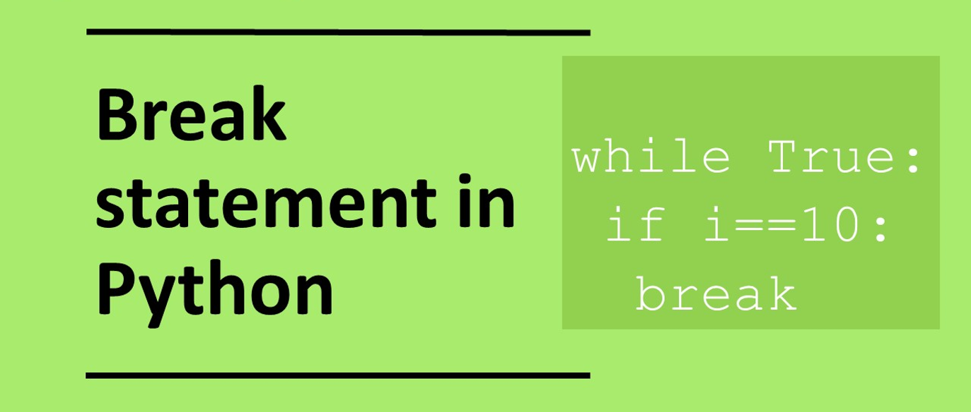

Slide 26
Task: Convert the following pseudocode to Python
SUBROUTINE while_if_break()
i←0
WHILE True:
OUTPUT i
IF i > 10
BREAK
ENDIF
i ← i+1
ENDWHILE
ENDSUBROUTINE
while_if_break()
This code outputs the all integers between 0 and 11.

Slide 27
Solution to previous slide
def while_if_break():
i=0
while True:
print(i)
if i>10:
break
i=i+1
while_if_break()
while_if_break.py

