Slide 1
In pairs predict what the following code does
1 2 3 4 5 6 7 | from microbit import * def run(): while True: display.scroll("Hello World") display.show(Image.HAPPY) sleep(1000) run()

Slide 2
Programming the Microbit for output using Python

Slide 3
Learning objective
Explain what the Microbit is and its main features
Use the Microbit LED sensors for output

Slide 4
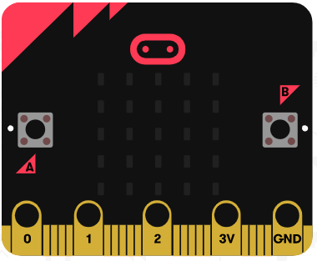
What is the Microbit
The Microbit is a small programmable computer that uses ARM processor
25 LED display grid
Buttons
Pins

Slide 5
Input, output and sensors
Accelerometer – Motion sensor
Compass
Light sensor
Radio and blue tooth transmitter and receiver
Pins to interact with additional hardware
A 25 LED light display arranged as a square
Two input buttons

Slide 6
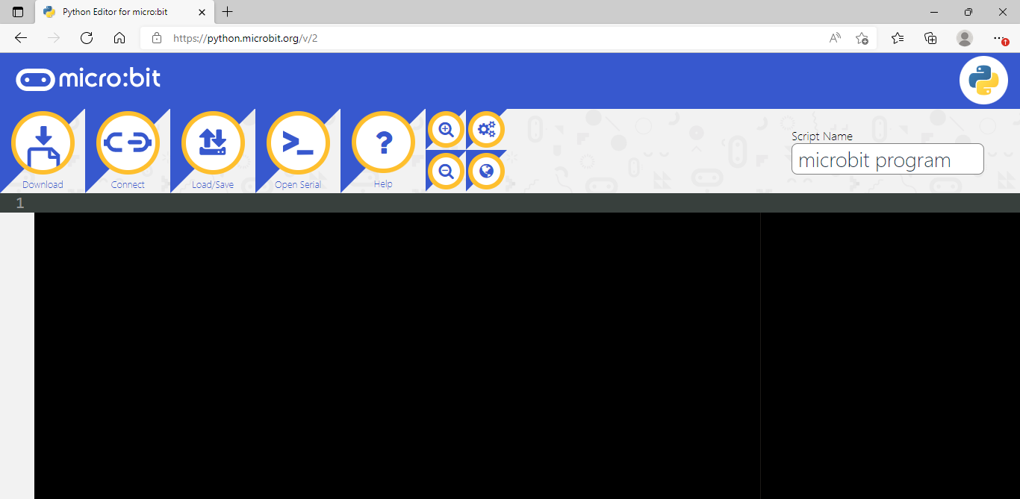
Code editor
The Python code editor for the Microbit is at:
https://python.microbit.org/v/2

Slide 7
Programming the Microbit
Attach the Microbit to your computer via the Micro USB cable.
On the Python code editor click download to create the hex file.
Drag the hex file onto the Microbit drive. While the programming is copying across a red light will flash on the Microbit.
The program will run automatically once it has been flashed to the Microbit

Slide 8
Run: Does it do what you expected it to do?
1 2 3 4 5 6 7 | from microbit import * def run(): while True: display.scroll("Hello World") display.show(Image.HAPPY) sleep(1000) run()
Download the code from:
microbit-output.py

Slide 9
Investigate
1 2 3 4 5 6 7 | from microbit import * def run(): while True: display.scroll("Hello World") display.show(Image.HAPPY) sleep(1000) run()
Line 1: What is this line doing?
Line 3: What is the purpose of while True:
Line 4 and 5: What is the difference between scroll and show. Why does the message need to scroll?
Line 6: Explain what sleep operation is doing. What does the 1000 mean? What do you think would happen if it was removed?
Explain what the code is doing as a whole

Slide 10
Investigate
1 2 3 4 5 6 7 | from microbit import * def run(): while True: display.scroll("Hello World") display.show(Image.HAPPY) sleep(1000) run()
Need to import microbit package to use functions for Microbit

Slide 11
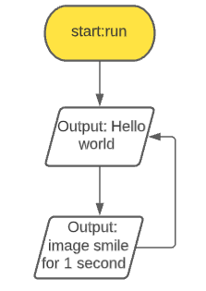
Investigate
1 2 3 4 5 6 7 | from microbit import * def run(): while True: display.scroll("Hello World") display.show(Image.HAPPY) sleep(1000) run()
Run the subroutine

Slide 12
Investigate
1 2 3 4 5 6 7 | from microbit import * def run(): while True: display.scroll("Hello World") display.show(Image.HAPPY) sleep(1000) run()
Program loops (runs) forever

Slide 13
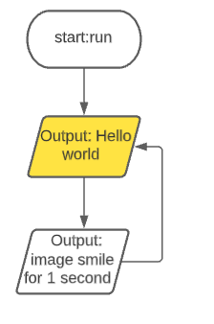
Investigate
1 2 3 4 5 6 7 | from microbit import * def run(): while True: display.scroll("Hello World") display.show(Image.HAPPY) sleep(1000) run()
Displays scrolling message on the LED grid. The message scrolls because it is too long to be shown all at the same time

Slide 14
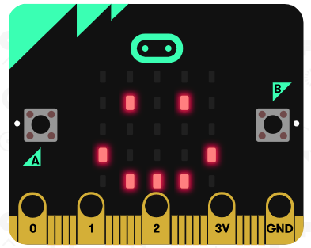
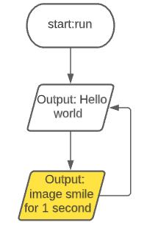
Investigate
1 2 3 4 5 6 7 | from microbit import * def run(): while True: display.scroll("Hello World") display.show(Image.HAPPY) sleep(1000) run()
Displays the image of a happy face.

Slide 15
Investigate
1 2 3 4 5 6 7 | from microbit import * def run(): while True: display.scroll("Hello World") display.show(Image.HAPPY) sleep(1000) run()
sleep ensures the image is displayed for 1000 milliseconds which is 1 second, otherwise the image will not display long enough to be seen

Slide 16
Modify
Change the message from “Hello World” to “Bonjour”
Swap line 6 and line 5. What happens? Swap back when you are done.
Change the image: There are lots of built-in images on the next slide
Change the value of sleep to 0.5 seconds from 1 second
Add an additional scrolling messages saying “Guten Tag”
Create your own image. Each LED has a corresponding value between 0 and 9, where 9 is the maximum brightness of the LED and 0 does not emit light
display.show(Image(‘00600:’
‘03930:’
‘69996:’
‘03930:’
‘00600'))

Slide 17
Built-in images
Image.HEART
Image.HEART_SMALL
Image.HAPPY
Image.SMILE
Image.SAD
Image.CONFUSED
Image.ANGRY
Image.ASLEEP
Image.SURPRISED
Image.SILLY
Image.FABULOUS
Image.MEH
Image.YES
Image.NO
Image.CLOCK12
Image.CLOCK11
Image.CLOCK10
Image.CLOCK9
Image.CLOCK8
Image.CLOCK7
Image.CLOCK6
Image.CLOCK5
Image.CLOCK4
Image.CLOCK3
Image.CLOCK2
Image.CLOCK1
Image.ARROW_N
Image.ARROW_NE
Image.ARROW_E
Image.ARROW_SE
Image.ARROW_S
Image.ARROW_SW
Image.ARROW_W
Image.ARROW_NW
Image.TRIANGLE
Image.TRIANGLE_LEFT
Image.CHESSBOARD
Image.DIAMOND
Image.DIAMOND_SMALL
Image.SQUARE
Image.SQUARE_SMALL
Image.RABBIT
Image.COW
Image.MUSIC_CROTCHET
Image.MUSIC_QUAVER
Image.MUSIC_QUAVERS
Image.PITCHFORK
Image.XMAS
Image.PACMAN
Image.TARGET
Image.TSHIRT
Image.ROLLERSKATE
Image.DUCK
Image.HOUSE
Image.TORTOISE
Image.BUTTERFLY
Image.STICKFIGURE
Image.GHOST
Image.SWORD
Image.GIRAFFE
Image.SKULL
Image.UMBRELLA
Image.SNAKE

Slide 18
Make
Write code that alternates displaying between an angry face and a confused face every 2 seconds
Extension: Create a sequence of 4 of your own images and alternate between them.

Slide 19
Example: solution
from microbit import * def run(): while True: display.show(Image.ANGRY) sleep(2000) display.show(Image.CONFUSED) sleep(2000) run()

Slide 20
Plenary
Share you code on www.padlet.com
How does you code compare to others’ code?

