Slide 1
In pairs predict what the following code does
1 2 3 4 5 6 7 8 9 10 11 12 13 14 15 16 17 18 | from microbit import * import random answers=[ “Defo”, “No way”, “Certainly”, “Affirmative”, “Probably”, “Maybe”, “I wouldn’t count on it”, “Its evens” ] while True: display.show(“8”) if accelerometer.was_gesture('shake’): display.clear() answer = random.choice(answers) display.scroll(answer)

Slide 2
Input using the Microbit buttons and the accelerometer

Slide 3
Learning objectives
Use the buttons for input
Use the accelerometer
Apply the random function

Slide 4
Run: Does the code do what you expected it to do
1 2 3 4 5 6 7 8 9 10 11 12 13 14 15 16 17 18 | from microbit import * import random answers=[ “Defo”, “No way”, “Certainly”, “Affirmative”, “Probably”, “Maybe”, “I wouldn’t count on it”, “Its evens” ] while True: display.show(“8”) if accelerometer.was_gesture('shake’): display.clear() answer = random.choice(answers) display.scroll(answer)
Download the code from: microbit-accelerometer.py

Slide 5
Investigate and Modify
1 2 3 4 5 6 7 8 9 10 11 12 13 14 15 16 17 18 | from microbit import * import random answers=[ “Defo”, “No way”, “Certainly”, “Affirmative”, “Probably”, “Maybe”, “I wouldn’t count on it”, “Its evens” ] while True: display.show(“8”) if accelerometer.was_gesture('shake’): display.clear() answer = random.choice(answers) display.scroll(answer)
What is the purpose of the list?
Explain what the accelerometer is doing
Explain what random.choice is doing
What does display.clear() do?
What does the while True: loop do?
Overall what is the code doing
Add additional answers to the list
Use a different gesture. Other gestures include: faceup, left, right

Slide 6
Investigate
1 2 3 4 5 6 7 8 9 10 11 12 13 14 15 16 17 18 | from microbit import * import random answers=[ “Defo”, “No way”, “Certainly”, “Affirmative”, “Probably”, “Maybe”, “I wouldn’t count on it”, “Its evens” ] while True: display.show(“8”) if accelerometer.was_gesture('shake’): display.clear() answer = random.choice(answers) display.scroll(answer)
This is a Magic 8 ball, that you ask yes and no questions and it tells you your fortune.
Ask a yes/no question
Shake the microbit
Microbit randomly selects answer from a list

Slide 7
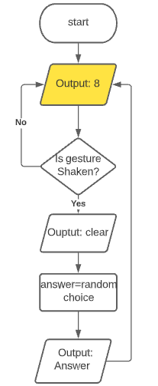
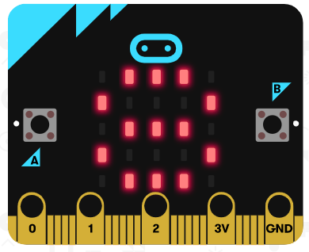
Investigate
1 2 3 4 5 6 7 8 9 10 11 12 13 14 15 16 17 18 | from microbit import * import random answers=[ “Defo”, “No way”, “Certainly”, “Affirmative”, “Probably”, “Maybe”, “I wouldn’t count on it”, “Its evens” ] while True: display.show(“8”) if accelerometer.was_gesture('shake’): display.clear() answer = random.choice(answers) display.scroll(answer)

Slide 8
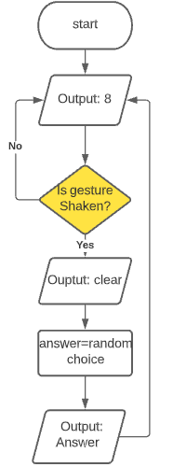
Investigate
1 2 3 4 5 6 7 8 9 10 11 12 13 14 15 16 17 18 | from microbit import * import random answers=[ “Defo”, “No way”, “Certainly”, “Affirmative”, “Probably”, “Maybe”, “I wouldn’t count on it”, “Its evens” ] while True: display.show(“8”) if accelerometer.was_gesture('shake’): display.clear() answer = random.choice(answers) display.scroll(answer)
The accelerometer measures the motion of the Microbit. When the Microbit is shaken the block of code in the if clause is executed

Slide 9
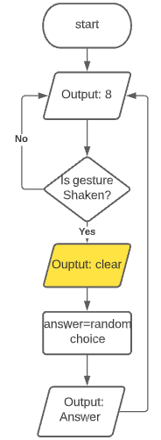
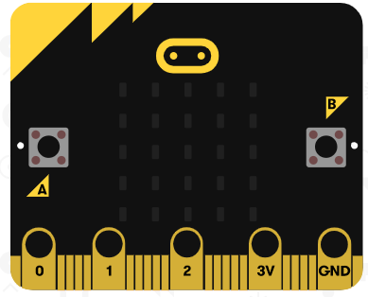
Investigate
1 2 3 4 5 6 7 8 9 10 11 12 13 14 15 16 17 18 | from microbit import * import random answers=[ “Defo”, “No way”, “Certainly”, “Affirmative”, “Probably”, “Maybe”, “I wouldn’t count on it”, “Its evens” ] while True: display.show(“8”) if accelerometer.was_gesture('shake’): display.clear() answer = random.choice(answers) display.scroll(answer)

Slide 10
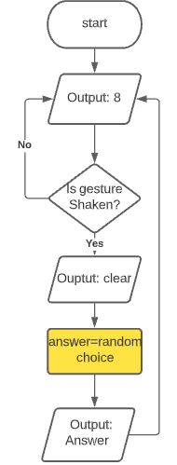
Investigate
1 2 3 4 5 6 7 8 9 10 11 12 13 14 15 16 17 18 | from microbit import * import random answers=[ “Defo”, “No way”, “Certainly”, “Affirmative”, “Probably”, “Maybe”, “I wouldn’t count on it”, “Its evens” ] while True: display.show(“8”) if accelerometer.was_gesture('shake’): display.clear() answer = random.choice(answers) display.scroll(answer)
Randomly selects one of the answers

Slide 11
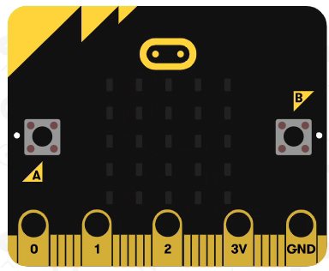
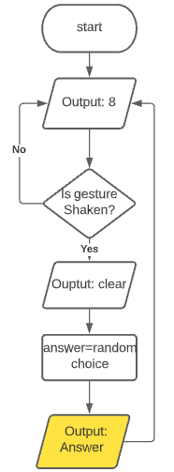
Investigate
1 2 3 4 5 6 7 8 9 10 11 12 13 14 15 16 17 18 | from microbit import * import random answers=[ “Defo”, “No way”, “Certainly”, “Affirmative”, “Probably”, “Maybe”, “I wouldn’t count on it”, “Its evens” ] while True: display.show(“8”) if accelerometer.was_gesture('shake’): display.clear() answer = random.choice(answers) display.scroll(answer)

Slide 12
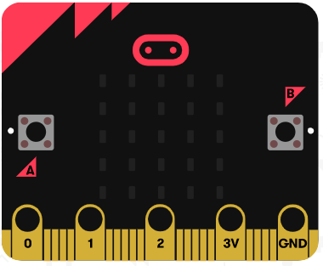
Input using Microbit Buttons
Button A
Button B

Slide 13
Applying button input
What happens when:
Only button A is pressed
Only Bbutton B is pressed
Buttons A and B are pressed together
Neither buttons are pressed
1 2 3 4 5 6 7 8 9 10 11 | from microbit import * while True: if button_a.is_pressed() and not button_b.is_pressed(): display.show(Image.tortoise) pause(2000) elif not button_a.is_pressed() and button_b.is_pressed(): display.show(Image.duck) pause(2000) elif button_a.is_pressed() and button_b.is_pressed(): display.show(Image.butterfly) pause(2000)

Slide 14
Applying button input
What happens when:
Only button A is pressed Tortoise displayed
Only Button B is pressed Duck displayed
Button A and B are pressed together Butterfly displayed
Neither buttons are pressed Nothing displayed
1 2 3 4 5 6 7 8 9 10 11 | from microbit import * while True: if button_a.is_pressed() and not button_b.is_pressed(): display.show(Image.tortoise) pause(2000) elif not button_a.is_pressed() and button_b.is_pressed(): display.show(Image.duck) pause(2000) elif button_a.is_pressed() and button_b.is_pressed(): display.show(Image.butterfly) pause(2000)

Slide 15
Make 1: Dice
Create a dice that randomly displays a value between 1 and 6 when a button is pressed or the Microbit is shaken
Extension: Create a graphical dice with dots using image
from microbit import *
import random
while True:
if accelerometer.was_gesture('shake’):
display.clear()
display.show(random.randint(1, 6))
pause(2000)
display.show(Image(‘90000:’
‘00000:’
‘00900:’
‘00000:’
‘00009'))

Slide 16
Make 2: A step counter
Create a step counter with the following features:
press button_a to display the number of steps
press button_b to reset the number of steps to zero
Shake will cause the number to steps to increase by 1.
from microbit import *
import random
def run():
steps=0
while True:
if accelerometer.was_gesture('shake’):
steps=steps+1
if button_b.is_pressed():
steps=0
if button_a.is_pressed()
display.scroll(steps)
run()

