Slide 1
In pairs, predict what the following code outputs
1 2 3 4 5 6 | def run_code(): countries=["France", "UK", "Russia", "China", "USA”] list_length=len(countries) print(“The length of the list is:”, list_length) print(“ A country from the list:”, countries[2]) run_code()

Slide 2
Lists

Slide 3
Learning objectives
Explain and use Lists and Arrays as data structures
Create lists
Index referencing of items in a list
Use the built-in len function

Slide 4
Lists
Variables only allow us to store single values
Lists and arrays are a data structure that can store multiple values
Data structures are used to help store and organise data within our computer programs. There are lots of ways this is achieved including using Variables and lists.
Lists in Python are represented using square brackets and elements are separated by commas
list_name=[element 1, element 2, …]

Slide 5
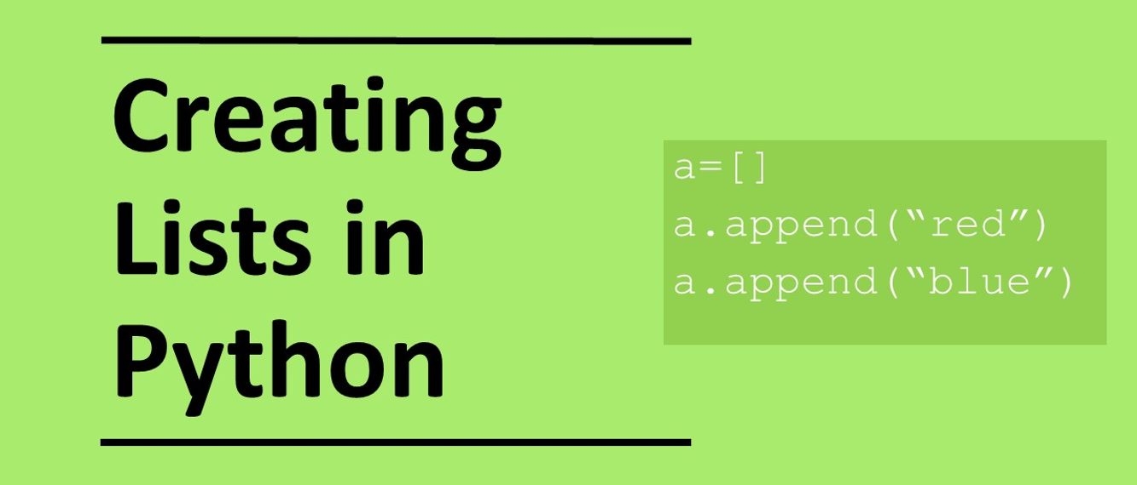

Slide 6
Arrays
Arrays contain elements of the same data type
They can have as many elements as required
Arrays are static data structures. The length of the array cannot be changed.
Elements cannot be added or removed once the array has been created, but values can be changed.
This is a valid array containing 6 integer elements: nums=[5,6,7,1,3,2,3,4]
This is a valid array containing 4 string elements: months=[“Jan”,”Jun”,”Mar”,”Apr”]
This is not a valid array: vals=[“Jan”,”Feb”,5,6]

Slide 7
Lists
Lists can contain elements of different data types
They can have as many elements as required
Arrays are dynamic data structures. The length of the array can be changed.
Elements can be added or removed once the array has been created and values can be changed.
This is a valid list containing 6 integer elements: nums=[5,6,7,1,3,2]
This is a valid list containing 4 string elements: months=[“Jan”,”Feb”,”Mar”,”Apr”]
This is a valid list containing strings and integers with 4 elements: vals=[“Jan”,”Feb”,5,6]

Slide 8
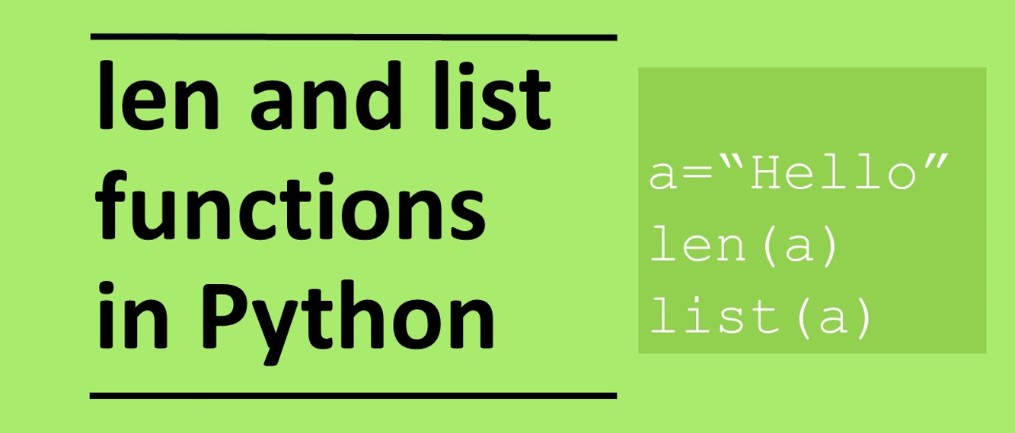

Slide 9
Indexing
In Python and in many other programming languages list/array indexing starts at Zero which can make things slightly confusing
Index 0 1 2 3 4
countries=["France", "UK", "Russia", "China", "USA”]
print(countries[2]) # This will output Russia
Index | How to reference | Value
0 | countries[0] | France
1 | countries[1] | UK
2 | countries[2] | Russia
3 | countries[3] | China
4 | countries[4] | USA

Slide 10
In pairs, predict what the following code outputs
1 2 3 4 | countries=["France", "UK", "Russia", "China", "USA”] list_length=len(countries) print(“The length of the list is:”, list_length) print(“ A country from the list:”, countries[2])
What did the program output?
Is this what you expected?

Slide 11
Copy the code into your editor and run
1 2 3 4 5 6 | def run_code(): countries=["France", "UK", "Russia", "China", "USA”] list_length=len(countries) print(“The length of the list is:”, list_length) print(“ A country from the list:”, countries[2]) run_code()
Debugging checklist
Have you put in the closing brackets?
Have you put in speech marks?
Have you put in colons?
Have you spelt everything correctly?
Are your commas in the right place?
Do you have the correct indentation?
Download the code from:
countries.py
What did the program output?
Is this what you expected?

Slide 12
Investigate the code
1 2 3 4 5 6 | def run_code(): countries=["France", "UK", "Russia", "China", "USA”] list_length=len(countries) print(“The length of the list is:”, list_length) print(“ A country from the list:”, countries[2]) run_code()
Add comments into the code
Identify the lines where the following can be found:
procedure
output
list
variable
What is going on in line 2
What is going on in line 3
Write a comment above each line explaining what each line does.
What does the code do as a whole?

Slide 13
Investigate the code
# define procedure called run_code def run_code(): # List containing 5 elements countries=["France", "United Kingdom", "Russia", "China", "USA“] # Calls the built-in len function to calculate the number of elements in the list which is 5 # Sets the variable list_length with a value of 5 list_length=len(countries) print(“The length of the list is:”, list_length) # Outputs “Russia” the third element in the list print(“ A country from the list:”, countries[2]) #This is calling the procedure run_code run_code()

Slide 14
Modify the code
1 2 3 4 5 6 | def run_code(): countries=["France", "UK", "Russia", "China", "USA”] list_length=len(countries) print(“The length of the list is:”, list_length) print(“ A country from the list:”, countries[2]) run_code()
Line 1 and 6: Change the procedure name to un_countries
Line 2: Add “Republic of Ireland” to the list of countries. What happens to list_length?
Line 5: Output USA instead of Russia.
Line 5: What happens if you use countries[6]
Line 5: Output 3 members from that list
Debugging checklist
Have you put in the closing brackets?
Have you put in speech marks?
Have you put in colons?
Have you spelt everything correctly?
Are your commas in the right place?
Do you have the correct indentation?

Slide 15
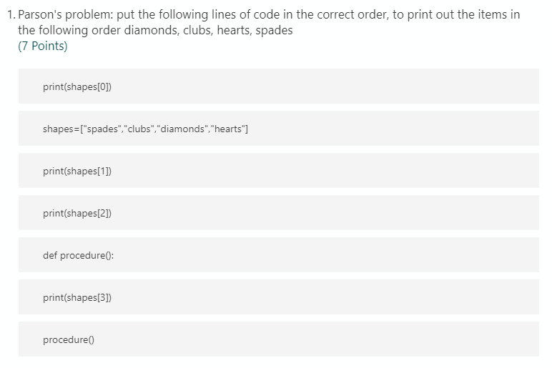
Plenary: Parson’s Problem put the lines in the correct order

