Slide 1
In pairs, predict what the following code does?
1 2 3 4 5 6 7 8 9 10 | def run_code(): colours=[] colours.append(“red”) colours.append(“white”) colours.append(“blue”) list_length=len(colours) print(“The colours of the Union Jack are:”) for i in range(list_length): print(colours[i]) run_code()

Slide 2
List processing

Slide 3
Learning objectives
Modify and manipulate lists in the following ways:
Create empty lists
Create lists from strings
Use list comprehension to create lists
Append values to a list
Remove values from lists
Find index position and values
Concatenate lists
Reverse a list
Sort a list

Slide 4
Copy the code and run. Does the code run as you expected?
1 2 3 4 5 6 7 8 9 10 | def run_code(): colours=[] colours.append(“red”) colours.append(“white”) colours.append(“blue”) list_length=len(colours) print(“The colours of the Union Jack are:”) for i in range(list_length): print(colours[i]) run_code()
Download the code from: list-colours.py

Slide 5
Appending to lists
Previously we create lists in the following way:
colours=[“red”,”white”, “blue”]
An alternative approach is to create an empty list and then append values
colours=[]
colours.append(“red”)
colours.append(“white”)
colours.append(“blue”)
Or
colours=[“red”,”white”]
colours.append(“blue")

Slide 6
Investigate the code. Add in comments into the code
1 2 3 4 5 6 7 8 9 10 | def run_code(): colours=[] colours.append(“red”) colours.append(“white”) colours.append(“blue”) list_length=len(colours) print(“The colours of the Union Jack are:”) for i in range(list_length): print(colours[i]) run_code()
Identify the name of a variable
Identify the name of procedure
Identify the name of a list
Identify the names of 2 built-in functions
Line 2: What does [] do?
Lines 3-5: What does append do?
Line 8: How many iterations are made with this loop?
Line 9: when i=2, what is output?

Slide 7
Investigate the code. Add in comments into the code
Identify the name of a variable i, list_length
Identify the name of procedure run_code
Identify the name of a list colours
Identify the names of 2 built-in functions len, print
Line 2: What does [] do? Create an empty list
Lines 3-5: What does append do? Adds values to a list
Line 8: How many iterations are made with this loop? 3
Line 9: when i=2, what is output? blue
1 2 3 4 5 6 7 8 9 10 | def run_code(): colours=[] colours.append(“red”) colours.append(“white”) colours.append(“blue”) list_length=len(colours) print(“The colours of the Union Jack are:”) for i in range(list_length): print(colours[i]) run_code()

Slide 8
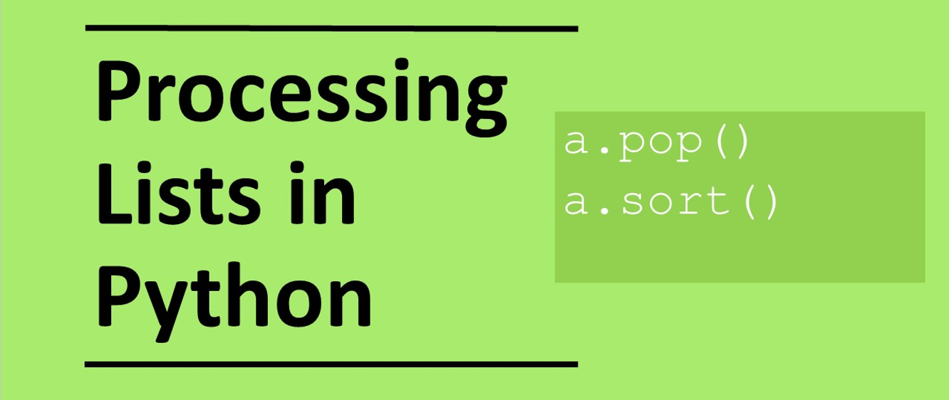

Slide 9
Inserting and removing elements
Returns the value at the given index position index position: Removing items from the list by value Removing items from the list by index position Inserting items in the list Returns index position of the element. Note the element starts from zero | print(colours[2]) colours.remove(“red") colours.pop(2) colours.insert(7, “green") print(colours.index(“blue”))

Slide 10
Modifying the code
1 2 3 4 5 6 7 8 9 10 | def run_code(): colours=[] colours.append(“red”) colours.append(“white”) colours.append(“blue”) list_length=len(colours) print(“The colours of the Union Jack are:”) for i in range(list_length): print(colours[i]) run_code()
Modify the code in the following ways
Append black
Remove white
Remove the item in index position 0
Insert pink into index 1
Use the code below to help you
print(colours[2])
colours.remove(“red")
colours.pop(2)
colours.insert(7, “green")
print(colours.index(“blue”))

Slide 11
Concatenation
concatenating lists
colours_group_1=[“Red", “Green", “Blue"]
colours_group_2=[“white", “black", “yellow”]
colours=colours_group_1+colours_group_2
print(colours)

Slide 12
Modifying the code
1 2 3 4 5 6 7 8 9 10 | def run_code(): colours=[] colours.append(“red”) colours.append(“white”) colours.append(“blue”) list_length=len(colours) print(“The colours of the Union Jack are:”) for i in range(list_length): print(colours[i]) run_code()
Modify the code to concatenate the following list to your existing list:
[“yellow”,”cyan”,”magenta”]
colours_group_1=[“Red", “Green", “Blue"]
colours_group_2=[“white", “black", “yellow”]
colours=colours_group_1+colours_group_2

Slide 13
Manipulating lists
To find out the number of elements in a list: To reverse the elements in a list To order the elements in the list in alphabetical order we can do: | print(len(colours)) colours.reverse() print(colours) colours.sort() print(colours)
Modify the code to output colours in the list in reverse alphabetical order

Slide 14
Make: Dinner selector
Create a program that randomly selects which meal you should have for dinner:
Needs to have a list with 5 of your favourite dishes.
Need to use random to select which dish you will have for your next meal.
insert random
random.choice(list) or random.randint()

Slide 15
Plenary: Write down the output at the end?
shapes=[]
shapes.append("Square")
shapes.append("Triangle")
shapes.append("Circle")
shapes.append("Rectangle")
shapes.append("Parallelogram")
shapes.append("Hexagon")
shapes.remove("Triangle")
shapes.pop(2)
shapes.insert(0, "Pentagon")
shapes.reverse()
shapes.sort()
print(shapes)
print(shapes.index("Circle"))
print(shapes[4])
print(len(shapes))
['Circle', 'Hexagon', 'Parallelogram', 'Pentagon', 'Square']
0
Square
5

Slide 16
Extension slides

Slide 18
List comprehension
List comprehension is a concise way to create lists in Python.
Create a list with 100 elements all with the value 0
a = [ 0 for i in range(100)]
Create a list with 100 elements all with the values ranging from 0 to 99
a = [ i for i in range(100)]
Create a list of even numbers from 0 to 98
a = [ i for i in range(100) if i % 2 == 0]

