Slide 1
JavaScript - Writing

Slide 2
Learning objectives
Write text to the web browser
Use variables
Debug common syntax errors

Slide 3
Prerequisites
You will need to some basic knowledge of HTML
Some understanding of another textual programming language

Slide 4
Server-side and client-side processing
Before we get started with JavaScript it is important to understand the distinction between client-side and server-side processing:
Client side – processing occurs on the user’s computer. The code is downloaded from the server onto the client machine and is then run on the client machine. Normally this is JavaScript run inside a web browser.
Server side – processing occurs on the server, where the data are sent from client to the server and processed on the server.

Slide 5
Why use JavaScript
JavaScript is a widely used language. Billions of computers and mobile phones are connected to the internet. Nearly all these devices have a web browser that facilitates JavaScript.
JavaScript carries out the processing on the web client in contrast to Python (and other languages) which is a server-side script where the processing is carried out on the server.
Learning JavaScript will allow you to understand the distinction between server and client-side scripting
You will likely need to use it when developing web applications using CGI, Flask or other web frameworks.

Slide 6
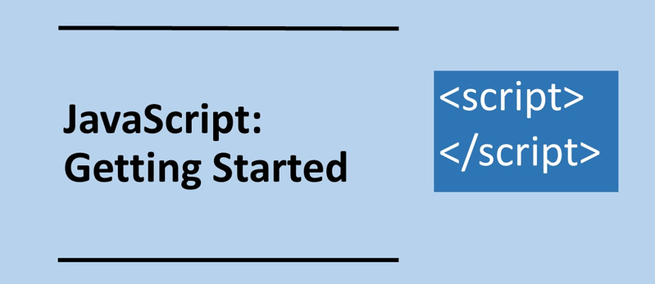

Slide 7
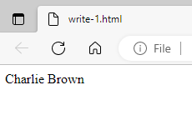
In pairs, predict what the following code does
Download the code from js/write-1.html
Double click on the file to open in a web browser. Does the code do as you expect?
1 2 3 4 5 6 7 8 9 | <html> <body> <script> var name; name = "Charlie Brown"; document.write(name); </script> </body> </html>

Slide 8
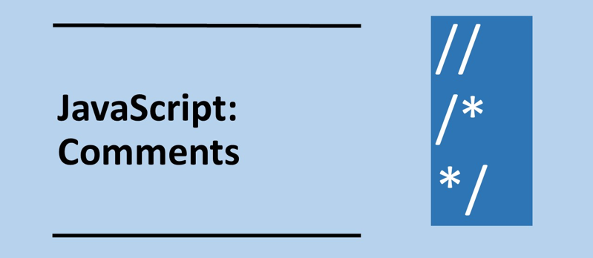

Slide 9
Investigate the code
Answer the following questions by adding comments to the code between the <script> tags
//this is a comment
Identify the variable
Explain what is happening on line 6
1 2 3 4 5 6 7 8 9 | <html> <body> <script> var name; name = "Charlie Brown"; document.write(name); </script> </body> </html>

Slide 10
Investigate the code
1 2 3 4 5 6 7 8 9 | <html> <body> <script> // Declare the variable var name; name = "Charlie Brown"; // Write the contents of // the variable to the web page document.write(name); </script> </body> </html>
Answer the following questions by adding comments to the code between the <script> tags
//this is a comment
Identify the variable
Explain what is happening on line 6

Slide 11
Investigate the code
1 2 3 4 5 6 7 8 9 | <html> <body> <script> var name; name = "Charlie Brown"; document.write(name); </script> </body> </html>
The JavaScript code appears between the opening and closing <script> tags
Every statement ends with a semi colon

Slide 12
Modify the code
Modify the code so you now have two variables: firstname and surname
Write your own name to the web browser
The code below will help you a lot
var firstname;
var surname;
firstname="Charlie ";
surname="Brown";
// Concatenate the string variables
name = firstname+surname;
document.write(name);

Slide 13
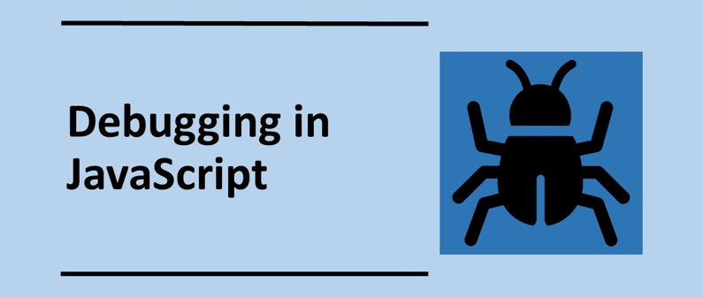

Slide 14
Debugging
To debug JavaScript code in a web browser you will need to access the developer tool to see the errors.
To access these is different in different browsers.
The developer tools in Edge can be accessed in the way shown in this screencast.

Slide 15
Debugging screenshots for Edge

Slide 16
Debugging screenshots for Edge
No Errors
Referencing a variable that does not exist
1 2 3 4 5 6 7 8 9 | <html> <body> <script> var name; name = "Charlie Brown"; document.write(nam); </script> </body> </html>

Slide 17
Debugging screenshots for Edge
Missing speech mark Accessing a function that does not exist
1 2 3 4 5 6 7 8 9 | <html> <body> <script> var name; name = "Charlie Brown; document.write(name); </script> </body> </html>
1 2 3 4 5 6 7 8 9 | <html> <body> <script> var name; name = "Charlie Brown"; document.writ(name); </script> </body> </html>

Slide 18
Debugging screenshots for Edge
Missing bracket
1 2 3 4 5 6 7 8 9 | <html> <body> <script> var name; name = "Charlie Brown"; document.write(name; </script> </body> </html>

Slide 19
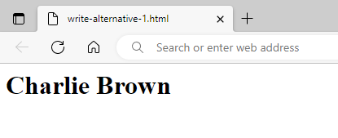
Alternative methods to write to a web page using element ID
<html>
<body>
<h1 id="ex"></h1>
<script>
c = document.getElementById("ex"); c.innerHTML = "Charlie Brown";
</script>
</body>
</html>
Change the contents of an HTML element by specify the ID of the element, which in this example is “ex”
The contents of the element are specified using innerHTML
Modify your code in this manner.

Slide 20
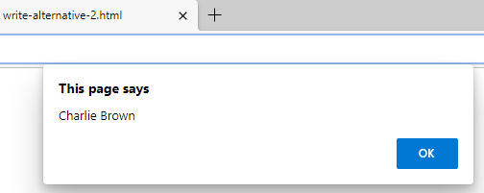
Alternative methods to write to a web page using an alert box
<html>
<body>
<script>
var name;
name = "Charlie Brown";
alert(name);
</script>
</body>
</html>
Modify your code in this manner.

Slide 21
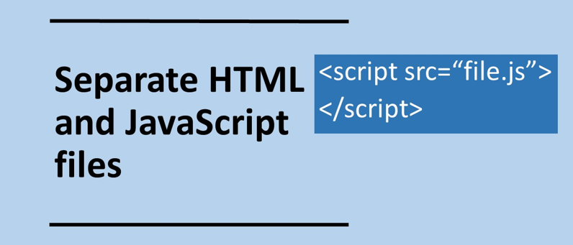

Slide 22
Separate JavaScript file
It is possible to separate the JavaScript from the HTML.
keeping the HTML and javascript separate is good practice as it leads to more organised code.
Create the HTML file below and call it write-seperate.html
Create the JavaScript file as below and call it name.js
View write-seperate.html in web browser
<html>
<body>
<script src="name.js">
</script>
</body>
</html>
var name;
name = "Charlie Brown";
document.write(name);

Slide 23
Separate JavaScript file
From now on we will only present the JavaScript code and not the corresponding HTML.
Method 1: create a file with the following:
Method 2: add the following HTML code at the start and end of your JavaScript.
<html>
<body>
<script src=“javascript_file.js">
</script>
</body>
</html>
<html>
<body>
<script>
javascript goes here
</script>
</body>
</html>

