Slide 1
In pairs, predict what the following code does
greeting.js
1 2 3 4 5 6 7 | <!DOCTYPE html> <html> <body> <script src="greeting.js"> </script> </body> </html>
1 2 3 4 5 6 7 8 9 10 11 1213 14 15 16 17 18 19 | var FirstName, LastName,FullName; var d = new Date(); var n = d.getHours(); FirstName=prompt("What is your first name?"); LastName=prompt("What is your last name?"); FullName=FirstName + " " + LastName if ( n >= 3 && n < 12){ document.write("Good Morning " + FullName); } else if (n>=12 && n<17) { document.write("Good Afternoon "+ FullName); } else if (n>=17 && n<21) { document.write("Good Evening "+ FullName); } else if ((n>=21 && n<=23) || (n < 3)) { document.write("Good night "+ FullName); }
Download the code from js/greeting/greeting.js and js/greeting/greeting.html
Run the code. Does it do as you expected?

Slide 2
JavaScript – Selection

Slide 3
Learning objectives
Using Selection

Slide 4
Selection
Selection allows us to execute different sections of code according to some condition.
We have seen these in lots of places before including Scratch, Python and even spreadsheet.

Slide 5
JavaScript selection
if (condition) { statements; }
if (condition) { statements; } else if (condition){ statements; }

Slide 6
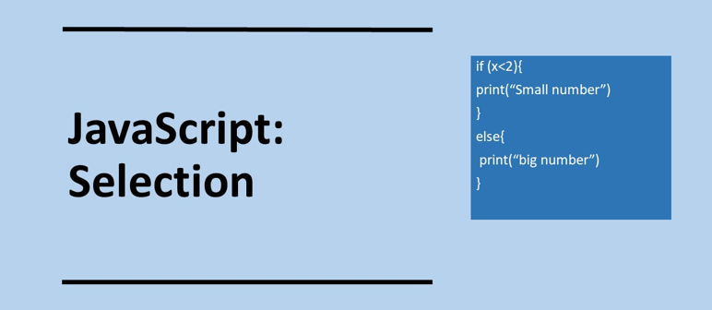

Slide 7
Investigate the code
1 2 3 4 5 6 7 8 9 10 11 1213 14 15 16 17 18 19 | var FirstName, LastName,FullName; var d = new Date(); var n = d.getHours(); FirstName=prompt("What is your first name?"); LastName=prompt("What is your last name?"); FullName=FirstName + " " + LastName if ( n >= 3 && n < 12){ document.write("Good Morning " + FullName); } else if (n>=12 && n<17) { document.write("Good Afternoon "+ FullName); } else if (n>=17 && n<21) { document.write("Good Evening "+ FullName); } else if ((n>=21 && n<=23) || (n < 3)) { document.write("Good night "+ FullName); }
What happens when you load the page?
How does the program know what time of day it is?
What greeting will the user get at 4.40pm?
What greeting will the user get at 5.00pm?
What does && mean in the code?
What does || mean in the code?
Overall what does the code do?

Slide 8
Investigate the code
What happens when you load the page? Prompt boxes appear asking the user for their first name and surname
How does the program know what time of day it is? Using the Date object
What greeting will the user get at 4.40pm? Good Afternoon
What greeting will the user get at 5.00pm? Good Evening
What does && mean in the code? Boolean AND operator
What does || mean in the code? Boolean OR operator
Overall what does the code do? This code asks the user for their firstname and surname and greets the user with the appropriate message for the time of day
1 2 3 4 5 6 7 8 9 10 11 1213 14 15 16 17 18 19 | var FirstName, LastName,FullName; var d = new Date(); var n = d.getHours(); FirstName=prompt("What is your first name?"); LastName=prompt("What is your last name?"); FullName=FirstName + " " + LastName if ( n >= 3 && n < 12){ document.write("Good Morning " + FullName); } else if (n>=12 && n<17) { document.write("Good Afternoon "+ FullName); } else if (n>=17 && n<21) { document.write("Good Evening "+ FullName); } else if ((n>=21 && n<=23) || (n < 3)) { document.write("Good night "+ FullName); }

Slide 9
Operators
&& Boolean AND operator
|| Boolean OR operator
Relational operators are the same as for Python

Slide 10
Modify
Modify the code so that it uses HTML forms to as the user for their name and not prompt
Your JavaScript code will need to be in a function
You will need to use getElementById

Slide 11
Example of modified code
1 2 3 4 5 6 7 8 9 10 11 12 13 14 15 16 17 18 19 20 21 | <!DOCTYPE html> <html> <body> <form action="javascript:timeofday()"> <label for="name"> Enter name </label><br> <input type="text" id="name"> <br> <br> <input type="submit" value="submit"> </form> <script> function timeofday(){ var d = new Date(); var n = d.getHours(); var name = document.getElementById("name").value if (n>=3 && n<12){document.write("Good Morning " + name);} else if (n>=12 && n<17) {document.write("Good Afternoon " + name);} else if (n>=17 && n<21) {document.write("Good Evening " + name);} else if ((n>=21 && n<=23) || (n<3)){document.write("Good Night " + name);} } </script> </body> </html>

Slide 12
Modify 2
From the previous lesson modify js/calculator.html so that you can select any arithmetic operator with radio buttons and perform the appropriate calculation.
1 2 3 4 5 6 7 8 9 10 11 12 13 14 15 16 17 18 19 20 21 | <!DOCTYPE html> <html> <body> <form action="javascript:add()"> <label for="num1"> Enter First Number </label><br> <input type="text" id="num1"> <br> <br> <label for="num2"> Enter Second Number </label><br> <input type="text" id="num2"> <br> <br> <input type="submit" value="Add"> </form> <p>The answer is: </p> <p id="ans"></p> <script> function add() { val1 = parseFloat(document.getElementById("num1").value); val2 = parseFloat(document.getElementById("num2").value); sum = val1 + val2; document.getElementById("ans").innerHTML=sum;} </script> </body> </html>

Slide 13
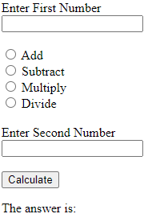
Some Hints
You can determine which of th radio buttons has been checked using the following:
document.getElementById("add").checked == true
This is what you are aiming to achieve

Slide 14
Example of modified code
<!DOCTYPE html> <html> <body> <form action="javascript:calculate()"> <label for="num1"> Enter First Number </label><br> <input type="text" id="num1"> <br> <br> <input type="radio" id="add" name="operator" value="add"> <label for="yes">Add</label><br> <input type="radio" id="subtract" name="operator" value="subtract"> <label for="no">Subtract</label><br> <input type="radio" id="multiply" name="operator" value="multiply"> <label for="yes">Multiply</label><br> <input type="radio" id="divide" name="operator" value="divide"> <label for="no">Divide</label><br> <br> <label for="num2"> Enter Second Number </label><br> <input type="text" id="num2"> <br> <br> <input type="submit" value="Calculate"> </form> <p>The answer is: </p> <p id="ans"></p> <script src="calculator.js"> </script> </body> </html>
calculator.js
function calculate() { val1 = parseFloat(document.getElementById("num1").value); val2 = parseFloat(document.getElementById("num2").value); if (document.getElementById("add").checked == true){ c = val1 + val2;} else if (document.getElementById("multiply").checked == true){ c = val1 * val2;} else if (document.getElementById("subtract").checked == true){ c = val1 - val2;} else if (document.getElementById("divide").checked == true){ c = val1 / val2;} return document.getElementById("ans").innerHTML=c; }

Slide 15
Predict and run
1 2 3 4 5 6 7 8 9 10 11 12 13 14 15 16 17 18 | <!DOCTYPE html> <html> <body> <img id="image" onclick="changeImage()" src="traffic-lights-red.jpg"> <p>Click the traffic light to change colour</p> <script> function changeImage(){ element=document.getElementById('image') if (element.src.match("red")){ element.src="traffic-lights-green.jpg"; } else{ element.src="traffic-lights-red.jpg"; } } </script> </body> </html>
element.src.match checks whether the name of the image file contains the string “red”
Dowload the code from
js/traffic-light/traffic-light.html

Slide 16
Modify 3
Now adapt the traffic lights program to go through the full sequence of light changes not just red to green.
red –> red & amber –> green –> amber -> red

