Slide 1
Fix the bugs in the following code
1 2 3 4 5 6 7 8 9 10 11 12 13 14 15 | <!DOCTYPE html> <html> <body> <h1>Press button for current date and time</h1> <form action="javascript:showDat()"> <input type="submit" value="submit"> </form> <h1 id="dat"></h1> <script> function showDate(){ const d = new Date(); return document.getElementById("date").innerHTML = e; </script> </body> </html>
Download the code from js/date.html
Use the browser’s developer tools to help find the errors

Slide 2
Fixed code
1 2 3 4 5 6 7 8 9 10 11 12 13 14 15 16 | <!DOCTYPE html> <html> <body> <h1>Press button for Date and time</h1> <form action="javascript:showDate()"> <input type="submit" value="submit"> </form> <h1 id="date"></h1> <script> function showDate(){ const d = new Date(); return document.getElementById("date").innerHTML = d; } </script> </body> </html>

Slide 3
JavaScript – Iteration

Slide 4
Learning objectives
Using Iteration

Slide 5
Loops
As we have seen in Python and elsewhere oops allow us to execute the same block of code multiple times without having to repeat the code.
As with Python we have definite (for) loops and indefinite (while) loops

Slide 6
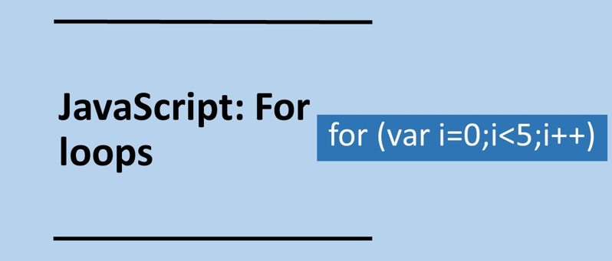

Slide 7
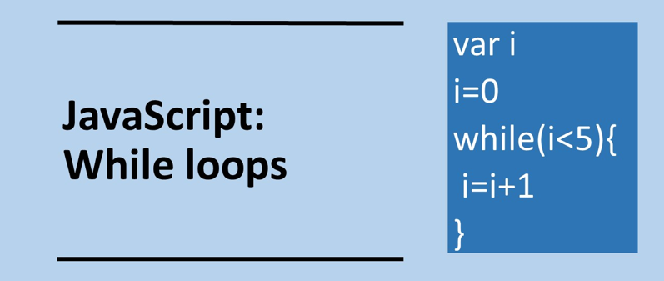

Slide 8

Loops – both the for and while output the same
forloop.js loop.html
for (var i = 0; i < 5; i++){
document.write("Number: " + i + "<br>");
}
<html>
<body>
<script src=“forloop.js"></script>
</body
</html>
whileloop.js
i=0;
while (i<5){
document.write("Number: " + i + "<br>");
i=i+1;
}
<html>
<body>
<script src="whileloop.js"></script>
</body>
</html>
output

Slide 9

counter.html
<html>
<body>
<script>
var x=0;
for (var i=0;i<5;i++){
x=x+i;
document.write("Adder: " + x + "<br>");
}
</html>
</body>
</script>
js/counter.html

Slide 10
for loop
Start End Increment
for (var i = 0; i < 5; i++){
statements;
}

Slide 11
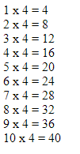
In pairs predict what the following code does
1 2 3 4 5 6 7 8 9 10 11 12 13 | <!DOCTYPE html> <html> <body> <script> var x=0; var times=4; for (var i=1;i<=10;i++){ x=i * times; document.write(i+" x " + times + " = " + x + "<br>"); } </script> </body> </html>
Download the code from js/timeTable.html
Run the code in the web browser. Does it do as you expected?

Slide 12
Things to Try
Add title to the top of the times table
Output the times table from 0 to 12
Output the 7 times table
Output all times tables from 1 to 12. Use a pair of nested for loops to achieve this
Replace the for loops with while loops

Slide 13
Guessing game
Write a program that generates a random whole number (integer) between 1 and 10 then asks the user to guess the number.
Allow the user to continue to enter guesses until the correct number is guessed.
Inform the player whether the guess is too high or too low.
Keeps count of the number of guesses.

Slide 14
Guessing game
<!DOCTYPE html>
<html>
<body>
<script>
var num = Math.floor(Math.random() * 10) +1;
alert("The computer has generated a random number between 1 and 10");
while(guess != num){
var guess = parseInt(prompt("What is your guess?"));
if (guess == num){
alert("Great you Guessed!");}
if (guess > num){
alert("Too high guess again");}
if (guess < num){
alert("Too low guess again");}
}
</script>
</body>
</html>
Example solution:
js/guessing_game.html

