Slide 1
In pairs, discuss what the following code does
1 2 3 4 5 6 7 | print(“Enter password:”) password=input() while password != “abc123”: print("Login failed") print(“Enter password:”) password=input() print("You have successfully logged in")

Slide 2
Iteration using WHILE loops

Slide 3
Learning objectives
Understand what iteration is
Explain the difference between WHILE and FOR loops.
Write programs using WHILE loops

Slide 4
Copy the code into your editor and run
1 2 3 4 5 6 7 | print(“Enter password:”) password=input() while password != “abc123”: print("Login failed") print(“Enter password:”) password=input() print("You have successfully logged in")
Answer these questions, by adding them as comments into your code.
What did the program output? Is this what you expected?
Comment out / remove line 2 what is the effect?
Identify the variable, what data type is it?
Explain why the input function is used twice in the code
What is going on with line 3? How do we get the while loop to stop iterating
What does the code do as a whole?
Download the code from password.py

Slide 5
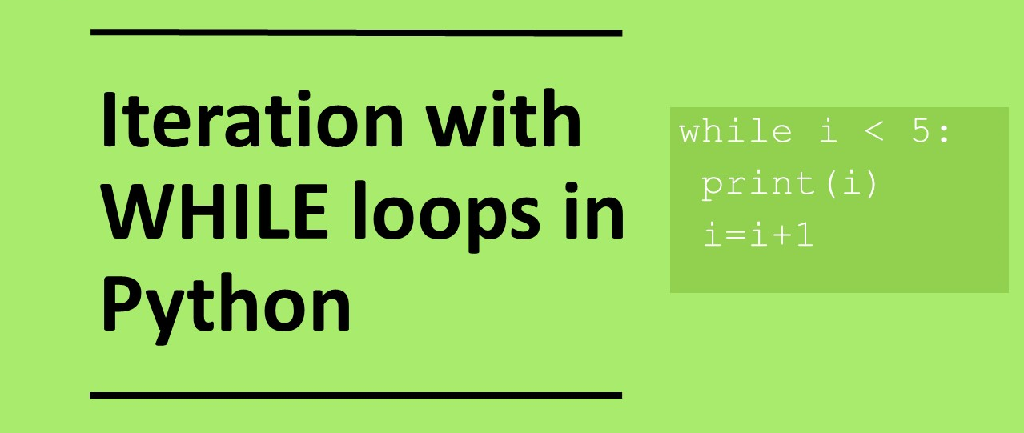

Slide 6
Iteration
Hello World!
Hello World!
Hello World!
Hello World!
Hello World!
Hello World!
Hello World!
Hello World!
Hello World!
Hello World!
Hello World!
Hello World!
Hello World!
Hello World!
Hello World!
Hello World!
Iteration means repeating an action.
WHILE and FOR loops both facilitate iteration but work in different ways.
FOR loops repeat a pre-determined number of times
WHILE loops repeat an indeterminate number of times until some condition is either met or no longer met depending on the logical set up.

Slide 7
What is the difference between a for loop and a while loop?
Both the while and for loop are doing the exact same thing. So why do we need to for loops and while loops?
For loops are used when we know beforehand the number of iterations that we want.
A while loop is used when the we do not know beforehand the number of iterations needed and this varies according to some condition.
While loop
count = 0
while (count < 10):
print(count)
count = count + 1
For loop
for count in range(10):
print(count)

Slide 8
Investigate the Code
Ask the user for input and set to a variable called password
1 2 3 4 5 6 7 | print(“Enter password:”) password=input() while password != “abc123”: print("Login failed") print(“Enter password:”) password=input() print("You have successfully logged in")
While loop that keeps iterating as long as the value we enter does not match “abc123”
remember != means not equal to
This block of code is executed for each iteration

Slide 9
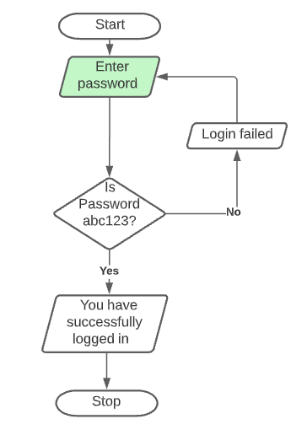
Code Tracing
1 2 3 4 5 6 7 | print(“Enter password:”) password=input() while password != “abc123”: print("Login failed") print(“Enter password:”) password=input() print("You have successfully logged in")
Input entered is: “pass1234”

Slide 10
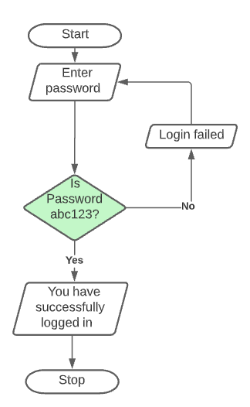
Code Tracing
1 2 3 4 5 6 7 | print(“Enter password:”) password=input() while password != “abc123”: print("Login failed") print(“Enter password:”) password=input() print("You have successfully logged in")
“pass1234”

Slide 11
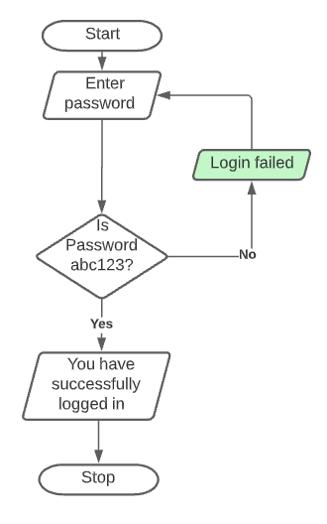
Code Tracing
1 2 3 4 5 6 7 | print(“Enter password:”) password=input() while password != “abc123”: print("Login failed") print(“Enter password:”) password=input() print("You have successfully logged in")

Slide 12
Code Tracing
1 2 3 4 5 6 7 | print(“Enter password:”) password=input() while password != “abc123”: print("Login failed") print(“Enter password:”) password=input() print("You have successfully logged in")
Input entered is: “abc123”

Slide 13
Code Tracing
1 2 3 4 5 6 7 | print(“Enter password:”) password=input() while password != “abc123”: print("Login failed") print(“Enter password:”) password=input() print("You have successfully logged in")
“abc123”

Slide 14
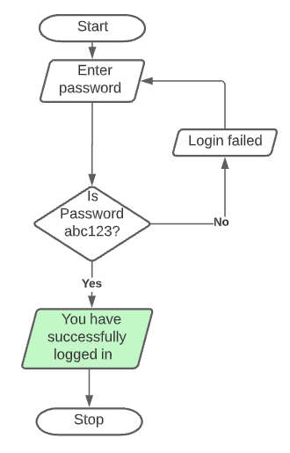
Code Tracing
1 2 3 4 5 6 7 | print(“Enter password:”) password=input() while password != “abc123”: print("Login failed") print(“Enter password:”) password=input() print("You have successfully logged in")

Slide 15
Modify the code
Change the correct password to “pass12345”
Count the number of attempts
  Set variable to 0 at start of program
  add 1 for each iteration with the block
  Output number of attempts at the end
Ask the user to enter their username in addition to the password
while password!=“abc” or username != “fred”:
4. Keep iterating until the username “bart” and password “pass12345” have been entered.
5. Extension: Only allow a maximum of 3 attempts
while (password!=“abc” or username != “fred”) and attempts < 3:

Slide 16
Example
username=input("Enter username: ")
password=input("Enter password: ")
while username != "bart" or password !="pa55word":
print("Login failed")
username=input("Enter username: ")
password=input("Enter password: ")
print("You have successfully logged in")

Slide 17
Parson’s puzzle, put the lines in the correct order
print(“Well done you successfully guessed the cat’s name“) print(“Wrong name. Try again:") print(“Enter the name of the cat”) catName=input() catName=input() while catName != “Bilbo Baggins”:
http://bit.ly/pp-while

Slide 18
Parson’s puzzle, put the lines in the correct order
1 2 3 4 5 6 | print(“Enter the name of the cat”) catName=input() while catName != “Bilbo Baggins”: print(“Wrong name. Try again:") catName=input() print(“Well done you successfully guessed the cat’s name“)

Slide 19
Trace the following code
1 2 3 4 5 | count = 4 while (count < 18): print(count) count = count + 4 print(count)
loop | Count value
Initial value
Value after loop 1
Value after loop 2
Value after loop 3
Value after loop 4
Value after loop 5

Slide 20
Modify the program
Modify the program so that it outputs the following sequence: 11, 16, 21, 26, 31, 36, 41
What changes do you need to make to the program?
How would I modify the program to count downwards?
Modify the program so that it outputs the following sequence: 45, 40, 35, 30, 25, 20
1 2 3 4 5 | count = 4 while (count < 18): print(count) count = count + 4 print(count)

Slide 21
Modify the program
count = 4
while (count < 18):
print(count)
count = count + 4
print(count)
Initial value
End value
Skip
If the operator is plus count up, if the operator is minus counts down

Slide 22
Make your own program: Guess the number
Use a while loop to print out the 2 times table.
i=0
while i<13:
print(i,"x 2 = ",i*2)
i=i+1

Slide 23
Plenary: Match the code with the explanation:
i = 0
while True:
i = i + 1
print(i)
if i >=10:
break
while True:
print(“Hello”)
i=0
while i<51:
if (i%2==0):
print(i)
i=i+1
Outputs only even numbers
Iterates forever
Breaks out of the loop after 10 iterations
Uses nested selection

Slide 24
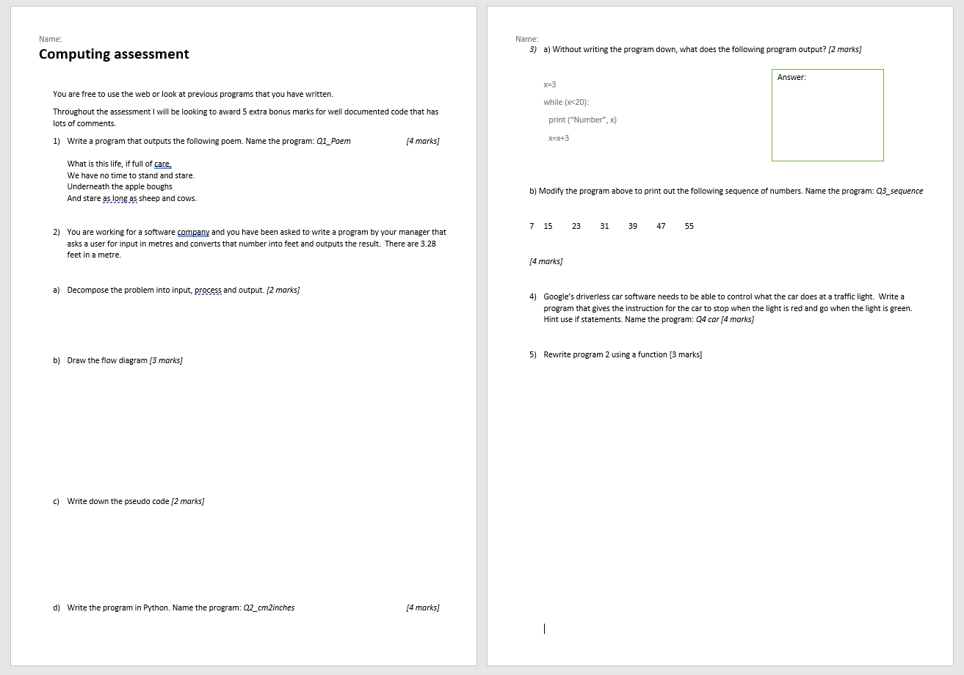
Python Review

