Slide 1
In pairs, predict what the following code does
1 2 3 4 | def table(): for num in range(0,13): print(num, "x 2 =”,num*2) table()

Slide 2
For loops

Slide 3
Learning objectives
Explain what iteration is
Apply for loops in a variety of situations

Slide 4
Copy the code and run
1 2 3 4 | def table(): for num in range(0,13): print(num, "x 2 =”,num*2) table()
Download the code from: table.py
Does the code output what you expected?

Slide 5
Investigate the code
1 2 3 4 | def table(): for num in range(0,13): print(num, "x 2 =”,num*2) table()
How many times does the loop iterate?
What values does the variable num take?
When num=3 what is output?

Slide 6
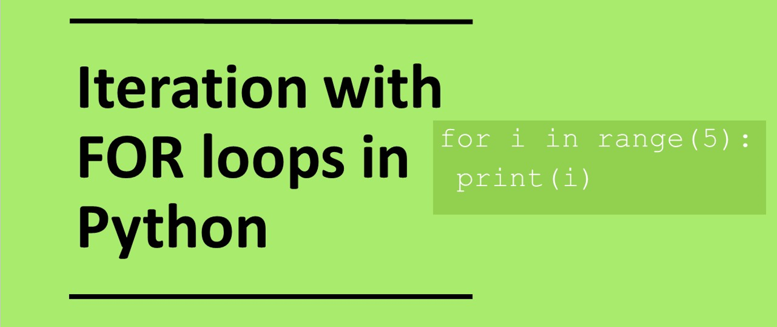

Slide 7
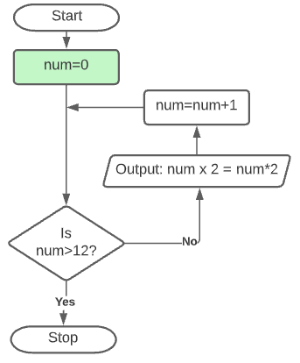
Trace the code
1 2 3 4 | def table(): for num in range(0,13): print(num, "x 2 =”,num*2) table()
num | Output
0

Slide 8
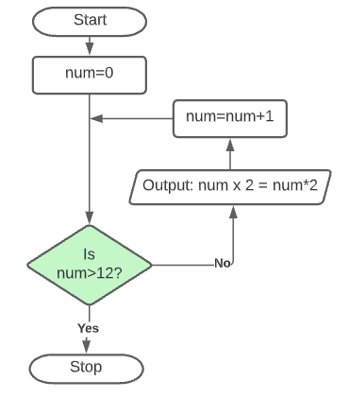
Trace the code
1 2 3 4 | def table(): for num in range(0,13): print(num, "x 2 =”,num*2) table()
num | Output
0

Slide 9
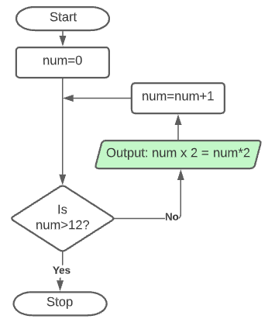
Trace the code
1 2 3 4 | def table(): for num in range(0,13): print(num, "x 2 =”,num*2) table()
num | Output
0 | 0 x 2 = 0

Slide 10
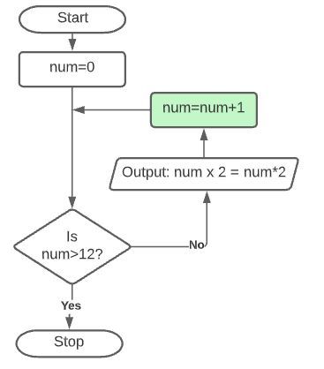
Trace the code
1 2 3 4 | def table(): for num in range(0,13): print(num, "x 2 =”,num*2) table()
num | Output
0 | 0 x 2 = 0
1

Slide 11
Trace the code
1 2 3 4 | def table(): for num in range(0,13): print(num, "x 2 =”,num*2) table()
num | Output
0 | 0 x 2 = 0
1

Slide 12
Trace the code
1 2 3 4 | def table(): for num in range(0,13): print(num, "x 2 =”,num*2) table()
num | Output
0 | 0 x 2 = 0
1 | 1 x 2 = 2

Slide 13
Trace the code
1 2 3 4 | def table(): for num in range(0,13): print(num, "x 2 =”,num*2) table()
num | Output
0 | 0 x 2 = 0
1 | 1 x 2 = 2
2

Slide 14
Trace the code
1 2 3 4 | def table(): for num in range(0,13): print(num, "x 2 =”,num*2) table()
num | Output
0 | 0 x 2 = 0
1

Slide 15
Trace the code
1 2 3 4 | def table(): for num in range(0,13): print(num, "x 2 =”,num*2) table()
num | Output
0 | 0 x 2 = 0
1 | 1 x 2 = 2
2 | 2 x 2 = 4

Slide 16
Trace the code
1 2 3 4 | def table(): for num in range(0,13): print(num, "x 2 =”,num*2) table()
num | Output
0 | 0 x 2 = 0
1 | 1 x 2 = 2
2 | 2 x 2 = 4
….

Slide 17
Trace the code
1 2 3 4 | def table(): for num in range(0,13): print(num, "x 2 =”,num*2) table()
num | Output
0 | 0 x 2 = 0
1 | 1 x 2 = 2
2 | 2 x 2 = 4
….
12

Slide 18
Trace the code
1 2 3 4 | def table(): for num in range(0,13): print(num, "x 2 =”,num*2) table()
num | Output
0 | 0 x 2 = 0
1 | 1 x 2 = 2
2 | 2 x 2 = 4
….
12

Slide 19
Trace the code
1 2 3 4 | def table(): for num in range(0,13): print(num, "x 2 =”,num*2) table()
num | Output
0 | 0 x 2 = 0
1 | 1 x 2 = 2
2 | 2 x 2 = 4
….
12 | 12 x 2 = 24

Slide 20
Loops I
Loops are important concepts in programs because they help in program control. Loops allow certain sections of programs to be repeated.
Loops jump back to the start of a sequence of instructions.
For instance, if you wanted to print out a sequence of numbers you could do:
print(1)
print(2)
print(3)
print(4)
print(5)

Slide 21
Loops II
You could write it out more succinctly using the following:
for i in range(1,6):
print(i)
This code iterates over the values and increments the value of i by 1 each time.
It uses the range function.
The first value is the starting value and the second value is the final value of i=1.
All statements that need to be executed with the loop needs to be indented.

Slide 22
Modify
1 2 3 4 | def table(): for num in range(0,13): print(num, "x 2 =”,num*2) table()
Modify the program to print out the 5 times table to go from
1 X 5 = 1 to 20 x 5 = 100

Slide 23
Make
Write a program that outputs your name 10 times:
for i in range(10):
print(“Grey”)

Slide 24
Understanding the range function
When dealing with integers in for loops we often need to use the range function. The range function has the following input values
1 parameter: range(end_value)
2 parameters: range(start_value, end_value)
3 parameters: range(start_value, end_value, skip)
Try out the following to get a better idea of how the range function works. What is output in each case?
for i in range(10):
print(i)
for i in range(2,5):
print(i)
for i in range(2,25,3):
print(i)
for i in range(25,2,-2):
print(i)

Slide 25
Task
Write a program using a for loop to print out the arithmetic sequence: 1, 3, 5, 7, 9
Modify this code to help you:
for num in range(10,31,3):
print(num)

Slide 26
Questions
What are the values of a,b,c if the output is 0, 7, 14, 21? What range of values can b take?
for num in range(a,b,c):
print(num)
What are the values of x,y,z if the output is 3, 7, 11, 15, 19? What range of values can y take?
for num in range(x,y,z):
print(num)

Slide 27
For loops and strings
Using the for loop it is possible to loop through all the characters in a string.
word=“hello”
for i in word:
print(i)
This would print out:
h
e
l
l
o
for i in "Goodbye":
print(i)
for i in [1,4,5,6,2,3,4,5]:
print(i)

Slide 28
Task
Write a program that prints out each letter in your name individually
name=“Grey”
for i in name:
print(i)

Slide 29
Homework: Convert this pseudocode to Python
number <- 23
prime <- TRUE
FOR i <- 2 TO number
IF number MOD i THEN
prime <- FALSE
IF prime = TRUE
OUTPUT "prime"
ELSE
OUTPUT "not prime"

