Slide 1
Graphical User Interface 4

Slide 2
Learning objectives
Create a quiz using the widgets we that have so far been introduced:
App
Picture
Text
PushButton
TextBox
ButtonGroup
Combo

Slide 3
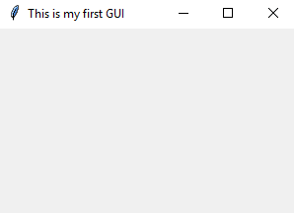
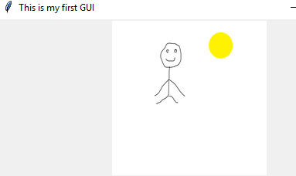
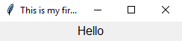
GUIzero widgets 1
Widget | Description | Example syntax | Look
App | Creates our window application using the App widget | app=App(title="This is my firs GUI")
Picture | Add a picture | Picture(app,"pict.png")
Text | Text widgets allow text to be added to the window | Text(app,text="Hello")

Slide 4
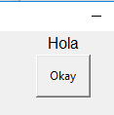
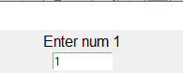


GUIzero widgets 2
Widget | Description | Example syntax | Look
PushButton |  | PushButton(app, text='Okay')
TextBox | Allows user input | num=TextBox(app)
ButtonGroup | allows a choice of options | opts=["add","subtract","multiply"] ButtonGroup(app,options=opts)
Combo | Is a drop down box | opts=["add","subtract","multiply"] Combo(app,options=opts)

Slide 5
Additional GUIzero widgets
Widget | Description
ListBox | Displays list of items from which single and multiple items can be selected
Drawing | Allows images to be created
Box | A container in which to put other widgets for grouping together. It is not visible
Window | Create a new window
Waffle | Displays a grid of squares
TitleBox | A container in which to put other widgets for grouping together. It has a border so is visible
MenuBar | Display menu at top of window
CheckBox | Tick or untick option
Slider | Specify a value within a range

Slide 6
In pairs predict what the following code does
from guizero import *
import random
def question():
num1=random.randint(1,10)
num2=random.randint(1,10)
q.value="What is " + str(num1) + "+" + str(num2) + "?"
global correct_answer
correct_answer=num1+num2
def check():
if int(answer.value)==correct_answer:
c.value="correct"
score=int(s.value)+1
s.value=str(score)
else:
c.value="Incorrect"
question()
app = App(title="Quiz")
q=Text(app)
answer=TextBox(app)
btn = PushButton(app, text='Check answer', command=check)
c=Text(app)
c1=Text(app,"Score: ")
s=Text(app,"0")
question()
app.display()

Slide 7
Run and Investigate:
Download the code from gui-quiz.py
Run the code: Does it do what you expected it to do?
For each line add a comment to the code
Identify the widgets
Explain what each of widgets do
What do the two procedures do?
Overall explain what the code is doing

Slide 8

Modify the code
Modify the code so that it can select a number between 1 and 100.
Change the colour of the label Text widget font to green, the size to 16 and font to “Courier New”. (look at your code from the previous lesson to help you)
Add a picture (again look at code from previous lesson to help)
Add a new Text widget at the top of the window that says “Maths quiz”. Choose your own colour for the text, font size and font.
Modify the operator so the program ramdomly asks not just addition questions, but subtraction and multiplication.
Modify the program so that an additional window comes up (you can checkout https://lawsie.github.io/guizero to help you with this)
Modify the program so that it uses a grid layout

Slide 9
Extension: Use multiple windows
from guizero import *
def open_window():
window.show()
def close_window():
window.hide()
app = App(title="My application")
window = Window(app, title = "Window 2")
window.hide()
PushButton(app, text="open window 2", command=open_window)
PushButton(window, text="close window", command=close_window)
app.display()
This code can be downloaded from gui-multiple-window.py

Slide 10
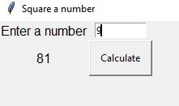
Use grid layout
Instead of the widgets being displayed in the sequence in which they appear in the code, we can place the widgets where we would like within the window.
from guizero import *
def square():
x2.value = int(x.value) * int(x.value)
app = App(title="Square a number", layout="grid")
message1 = Text(app, text="Enter a number", grid=[0,0])
x = TextBox(app, grid=[1,0])
x2 = Text(app, grid=[0,1])
btn = PushButton(app, text='Calculate', command=square, grid=[1,1])
app.display()
This code can be downloaded from gui-layout.py
0,0 Enter a number | 0,1 TextBox
1,0 Calculated value | 1,1 Calculate Button

Slide 11
Make
Write your own program that create a flags quiz. The program randomly selects a picture of a flag display it and the player needs to guess which is the correct country. Use only 3 flags to start with.
Have it so that you can have an additional window.

