Slide 1
In Pairs predict what the following code does
1 2 3 4 5 6 7 8 9 10 11 12 13 14 | from tkinter import * def open_window(): window = Toplevel() window.geometry('300x200') window.title('Top Level Window') Button(window,text='Close',command=window.destroy).pack() window.grab_set() if __name__ == "__main__": app = Tk() app.geometry('300x200') app.title('Main Window') Button(app,text='Open Window',command=open_window).pack() Button(app,text='Exit',command=app.destroy).pack() app.mainloop()
Download the code from code/windows.py
Run the code. Does it do as you predicted?

Slide 2
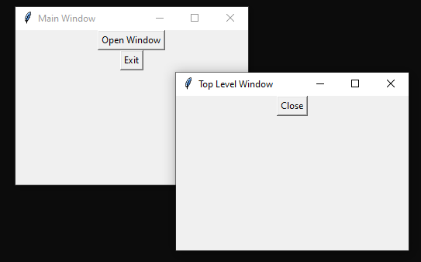
Output of windows.py
The code opens up an additional window

Slide 3
Learning Objectives
Create apps with multiple windows
Create apps that have a menubar

Slide 4
Toplevel Widget
1 2 3 4 5 6 7 8 9 10 11 12 13 14 | from tkinter import * def open_window(): window = Toplevel() window.geometry('300x200') window.title('Top Level Window') Button(window,text='Close',command=window.destroy).pack() window.grab_set() if __name__ == "__main__": app = Tk() app.geometry('300x200') app.title('Main Window') Button(app,text='Open Window',command=open_window).pack() Button(app,text='Exit',command=app.destroy).pack() app.mainloop()
The Toplevel widget creates a separate window

Slide 5
Modify the Unit converter code
Open up code/unit_converter.py
Run and explore the code to ensure you are familiar with it.
Add comments
Modify the code by adding and additional button for miles to Km.
Create an additional window like Km to miles but for miles to Km and allow that calculation to be performed.
Add additional button conversions like Celsius to Fahrenheit, Farenheit to Celcius inches to cm, cm to inches and so on.

Slide 6
unit_converter.py
from tkinter import *
def convert_KM2M(km):
try:
outputVal.set((float(km.get()) * 0.621371))
except:
messagebox.showinfo('Error!','Please enter a number!')
def open_window_k2m():
window = Toplevel()
window.geometry('300x200')
window.title('Miles to KM')
window.grab_set()
value_entry = Entry(window)
Label(window,text='Convert from km to miles').pack()
Label(window, text='Enter distance in km').pack()
value_entry.pack()
Label(window,text='Distance in miles').pack()
Label(window, textvariable=outputVal).pack()
Button(window, text='Convert', command=lambda: convert_KM2M(value_entry)).pack()
Button(window,text='Close',command=window.destroy).pack()
if __name__ == "__main__":
app = Tk()
app.geometry('300x200')
app.title('Unit Converter')
outputVal = StringVar()
Button(app,text='KM to Miles',command=open_window_k2m).pack()
Button(app,text='Exit',command=app.destroy).pack()
app.mainloop()

Slide 7
Callback with a parameter
When we have a callback we use:
command=function
When we have a callback with parameters we use:
command=lambda: function(parameter1, parameter2, ..)).
In the code here we have the callback:
command=lambda: convert_KM2M(value_entry)).

Slide 8
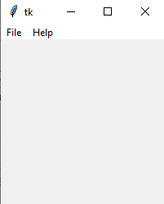
Menubar
1 2 3 4 5 6 7 8 9 10 11 12 13 14 15 16 | from tkinter import * def callback(): pass root = Tk() menubar = Menu(root) filemenu = Menu(menubar, tearoff=0) filemenu.add_command(label="Open", command=callback) filemenu.add_command(label="Save", command=callback) filemenu.add_separator() filemenu.add_command(label="Exit", command=root.destroy) menubar.add_cascade(label="File", menu=filemenu) helpmenu = Menu(menubar, tearoff=0) helpmenu.add_command(label="About", command=callback) menubar.add_cascade(label="Help", menu=helpmenu) root.config(menu=menubar) root.mainloop()
Download the code from code/gui_menubar.py
Run the code.

Slide 9
Menubar
Add a menu to the unit converter code

Slide 10
Reference: Widgets
Widgets are elements of GUIs that display information and can be changed by the user. These are some of the more common the widgets:
Tk – Create the window
Toplevel – Create a separate window
Button – This will create an event to callback a function when clicked
Canvas – enables shapes to be drawn
Labels - displays text and images
Entry - Text boxes for users to enter input
PhotoImage – Allows a picture to be displayed in a label or button widget
Listbox – dropdown list of options
Checkbutton – Allows two choices. Either the button is checked or not
Radiobutton – Multiple choice button
Frame – Allows other widgets to be placed inside
Menu – Creates a menubar at the top of window

