Slide 1
In pairs predict what the following code does
1 2 3 4 5 6 7 8 10 11 | from guizero import * def greeting(): if salutation.value=="Hola": salutation.value="Hello" else: salutation.value="Hola" app = App(title="Greeting") salutation=Text(app, "Hola") PushButton(app, text='Okay', command=greeting) app.display()

Slide 2
Graphical User Interface 2

Slide 3
Learning objectives
Explain what event driven programming is
Use the PushButton widget to run procedures
Explain what a callback function is

Slide 4
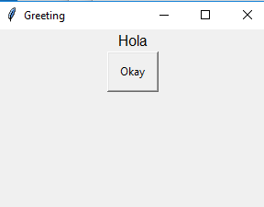
Run and investigate the code
1 2 3 4 5 6 7 8 10 11 | from guizero import * def greeting(): if salutation.value=="Hola": salutation.value="Hello" else: salutation.value="Hola" app = App(title="Greeting") salutation=Text(app, "Hola") PushButton(app, text='Okay', command=greeting) app.display()
Download the code from gui-button.py
What happens when the button is pushed? What happens when the button is pushed again?
Add comments to each line explaining what the code is doing
Explain what the code is doing overall
If the salutation “Hola” is displayed and then the button is pressed then the salutation “Hello” is displayed and vice versa

Slide 5
Programming paradigms
Procedural
Functional
Event driven Programming
Object oriented Programming
Low level programming (Assembly language and machine code)

Slide 6
Event drive programming
Program flow is determined by events such as key press mouse click
There is a main loop listening for events
When an event occurs the callback function is executed

Slide 7
Callback function
A callback function is a function that is passed as an argument to another function
we do not want that function to be executed right away
A callback function will only after the function that it has been pass to as been run itself.
For instance in the example below greeting is a callback function and will only be executed after PushButton has been executed
PushButton(app, text='Okay', command=greeting)

Slide 8
Modify the code
import random
def greeting():
hlist=["Hello", "Bonjour", "Hola",\
"Nihao", "Wagwan"]
h=random.choice(hlist)
salutation.value=h
Import the random package into the code
Replace the greeting subroutine with this one here
Save the new file as gui-greeting.py
Explain what is going on with the modified code. Discuss with you neighbour and be prepared to discuss with the rest of the class
Add your own greetings to the list
The program randomly selects a salutation from the hlist and displays this every time the button is pressed

Slide 9
Modify the code 2:
Create a dice app that randomly selects numbers between 1 and 6
import random
def dice():
hlist=[“1", “2", “3", “4", “5”, “6”]
h=random.choice(hlist)
salutation.value=h

Slide 10
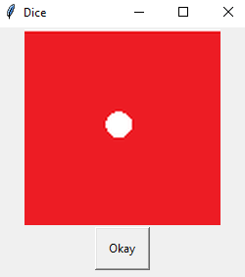
Modify the code 3:
For the dice app have it so that you have a different picture for each randomly selected number.
The images can be downloaded from dice
Modify the code snippets below to help you:
def dice():
# Add the additional images to the list
hlist=["dice/dot1.png”, ...]
h=random.choice(hlist)
p.image=h
# Identify the appropriate size of the image
p=Picture(app)
p.image="dice/dot1.png"
The completed version of the code can be found here
gui-dice.py

