Slide 1
In pairs, predict what the following code does
1 2 3 4 5 6 7 9 10 11 12 13 | from tkinter import * import random def roll(): dice=["dot1.png","dot2.png","dot3.png",\ "dot4.png","dot5.png","dot6.png"] label.image = PhotoImage(file=random.choice(dice)) label['image'] = label.image root = Tk() label = Label(root) button = Button(root, text='Roll', command=roll) button.pack() label.pack() root.mainloop()
Download the folder from code/dice
Run the code. Does it do as you expected

Slide 2
Graphical User Interface - Tkinter

Slide 3
Learning objectives
Use images in graphics
Explore a dice
Use the Canvas widget to draw objects in a window.
Create a moving object

Slide 4
Creating a dice app

Slide 5
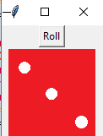
Code for dice app
1 2 3 4 5 6 7 9 10 11 12 13 | from tkinter import * import random def roll(): dice=["dot1.png","dot2.png","dot3.png",\ "dot4.png","dot5.png","dot6.png"] label.image = PhotoImage(file=random.choice(dice)) label['image'] = label.image root = Tk() label = Label(root) button = Button(root, text='Roll', command=roll) button.pack() label.pack() root.mainloop()
This is what you should get when you run the code, but because it is random you may have a different number of dots

Slide 6
Investigate the code
Add comments to the code answering the following questions
Supposing you wanted to adapt the code for a 4-sided dice or a 10-sided dice what would you change?
Identify the callback function and where it occurs
Explain how the roll() subroutine works
Identify the widgets used
Explain what the pack() method does
Explain what the mainloop() method does
1 2 3 4 5 6 7 9 10 11 12 13 | from tkinter import * import random def roll(): dice=["dot1.png","dot2.png","dot3.png",\ "dot4.png","dot5.png","dot6.png"] label.image = PhotoImage(file=random.choice(dice)) label['image'] = label.image root = Tk() label = Label(root) button = Button(root, text='Roll', command=roll) button.pack() label.pack() root.mainloop()

Slide 7
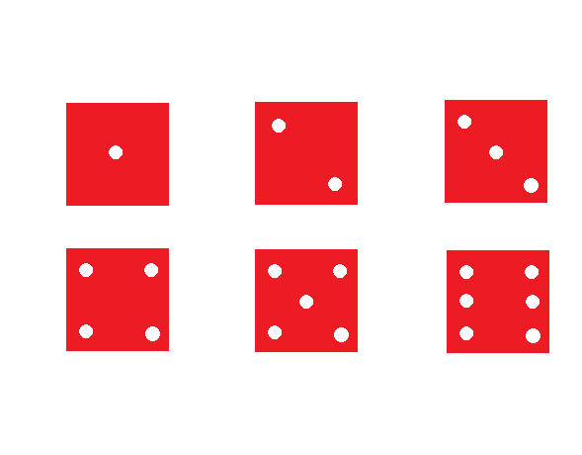
Dice images
Supposing you wanted to adapt the code for a 4-sided dice or a 10-sided dice what would you change?
Six images of dice like the one here have been created. For a 4-sided dice you would remove dot5.png and dot6.png from the list.
For a 10-sided dice you would need to create more images for 7,8,9 and 10 dots and add them to the list. You can easily create them in any graphics package. Save them in png format.
dice=["dot1.png","dot2.png","dot3.png",\
"dot4.png" ,"dot5.png","dot6.png" ]

Slide 8
Investigate the code
Identify the callback function and where it occurs Line 10: roll is the call back function
Explain how the roll subroutine works. Dice is a list of images for the different side of a dice. Each time roll is called it randomly chooses an image from the list and displays in the Label widget
1 2 3 4 5 6 7 9 10 11 12 13 | from tkinter import * import random def roll(): dice=["dot1.png","dot2.png","dot3.png",\ "dot4.png","dot5.png","dot6.png"] label.image = PhotoImage(file=random.choice(dice)) label['image'] = label.image root = Tk() label = Label(root) button = Button(root, text='Roll', command=roll) button.pack() label.pack() root.mainloop()

Slide 9
Investigate the code
Identify the widgets used. Button, Label and PhotoImage. PhotoImage allows an image to be displayed in Label and Button
Explain what the pack() method does. Adds the widgets to the window on top of one another.
Explain what the mainloop() method does. Puts the window in a continuous loop listening for events
1 2 3 4 5 6 7 9 10 11 12 13 | from tkinter import * import random def roll(): dice=["dot1.png","dot2.png","dot3.png",\ "dot4.png","dot5.png","dot6.png"] label.image = PhotoImage(file=random.choice(dice)) label['image'] = label.image root = Tk() label = Label(root) button = Button(root, text='Roll', command=roll) button.pack() label.pack() root.mainloop()

Slide 10
Creating a bouncing ball

Slide 11
Creating a bouncing ball
In this example we are going to create a moving ball.
We will introduce the use of Canvas which allows you to draw objects in a window.
Displaying a moving object means that we need to repeat the following steps:
create the object in a different location to where it was previously,
display the object for a short period of time,
remove the object

Slide 12
Bouncing ball: Set up code
import time
from tkinter import *
# dimensions of canvas
WIDTH=300
HEIGHT=400
# Create window and canvas
window = Tk()
canvas = Canvas(window, width=WIDTH,\
height=HEIGHT, bg='white’)
canvas.pack()
# starting position of ball
x = 0
y = 10
# distance moved each time step
dx = 10
dy= 10
# diameter of ball
ballsize = 30

Slide 13
Bouncing ball: Update code
# loop needed to update position
# of the ball every 50 ms
while True:
x = x + dx
y = y + dy
# if ball get to edge then we need to
# change direction of movement
if x >= WIDTH-ballsize or x <= 0:
dx = -dx
if y >= HEIGHT-ballsize or y <= 0:
dy = -dy
# Create ball
ball=canvas.create_oval(x, y, x+ballsize,\
y+ballsize, fill="green")
# display ball
canvas.update()
canvas.after(50)
#remove ball
canvas.delete(ball)
window.mainloop()
Download the code from:
code/bouncing_ball.py
This is what you should get when you run the code

Slide 14
Modify
Change the colour of the background
Change the colour of the ball
Get more than one bouncing ball moving around
Extension: Get the balls bouncing off one another.

Slide 15
Make: Write a password generator using a GUI
Ask the user how many characters long
Uppercase and lowercase (yes /no)
Include numbers (yes / no)
Include symbols (yes / no)
Randomly generates a password
Extension:
Use grid instead of pack

