Slide 1
Graphical User Interface 1

Slide 2
Learning objectives
Explain what graphical user interfaces are
Explain what widgets are
Use the following widgets in guizero to create a simple application with a GUI:
App
Picture
Text

Slide 3
Graphical User Interfaces (GUIs)
GUIs are window based components of applications that make them more user friendly than command driven applications.
We are used to procedural code where instructions are executed in the order in which they written.
Graphical user interfaces are event driven meaning that tasks are completed according to some event occurring eg a button click and occur not in the order in which the instructions are written.
We going to use guizero as our GUI module here https://lawsie.github.io/guizero/

Slide 4
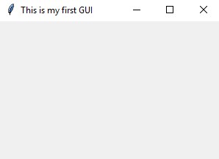
Create a Simple window
# Import the guizero module
from guizero import *
# Creates our window application using the App widget. Widgets are components that are shown on the GUI windows
app=App(title="This is my first GUI")
# Show the GUI on the screen and listen for events.
app.display()

Slide 5
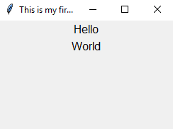
Text widgets – Add text to the window
from guizero import *
app=App(title="This is my first GUI“, width=200, height=200)
# Text widgets allow text to be added to the window. Add your own text. Add more text widgets.
m1=Text(app,text="Hello")
m2=Text(app,text="World")
app.display()

Slide 6
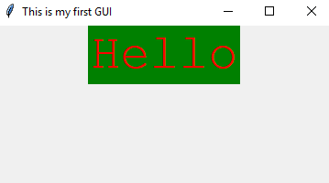
Modify Properties of Text widgets
from guizero import *
app=App(title="This is my first GUI")
m1=Text(app,text="Hello")
m2=Text(app,text=“World")
# Modify properties of text widget.
m1.text_size = 40
m1.bg="green“ # background colour
m1.font="Courier New"
m1.text_color="red"
app.display()

Slide 7
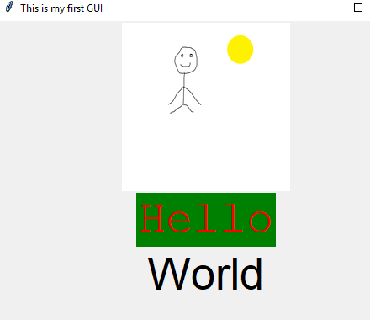
Add a Picture
from guizero import *
app=App(title="This is my first GUI“, width=500, height=500)
# Add a picture using picture widget
p=Picture(app,"pict.png", width=200, height=200)
m1=Text(app,text="Hello")
m1.text_size = 40
m1.bg="green"
m1.font="Courier New"
m1.text_color="red"
m2=Text(app,text="World")
m2.text_size = 40
app.display()
If you are having difficult getting the program to work, you can download a copy from: gui-text.py

Slide 8
Modify the code
Line 2: Change the title of the window
Line 2: Change the size of the window
Line 4 and 9: Change the text message
Lines 5-8 and Line 19: Change the font, size and colour
Line 3: Use a different picture
1 2 3 4 5 6 7 8 9 10 11 | from guizero import * app=App(title="This is my first GUI“, width=500, height=500) p=Picture(app,"pict.png", width=200, height=200) m1=Text(app,text="Hello") m1.text_size = 40 m1.bg="green" m1.font="Courier New" m1.text_color="red" m2=Text(app,text="World") m2.text_size = 40 app.display()

