Slide 1
Predict: What is output in each case?
def greeting():
print(“Hello”)
greeting()
def greeting(name):
print(“Hello”,name)
greeting(“Fred”)
def greeting(name,age):
print(“Hello”, name)
print(“You are", age)
greeting("Tom",14)
Hello
Hello Fred
Hello Tom
You are 14
81
49
-1
def sqaure(x):
x_sqaure=x*x
return x_square
x2=square(9)
print(x2)
print(square(7))
def add(x,y):
x_plus_y=x-y
return x_plus_y
total=add(3,4)
print(total)

Slide 2
Subroutines

Slide 3
Learning objectives
Explain how subroutines help to organise and structure code.
Explain the difference between procedures and functions.
Explain what variable scope is and the difference between local and global variables.

Slide 4
Subroutines
Subroutines run part of a program
They are a set of frequently use instructions normally related to a specific task
Subroutines are a way of managing and organising programs in a structured way.
Allows us to break up programs into smaller chunks. Can make the code more modular and more easy to read as each function performs a specific task.
Subroutines can be reused within the code without having to write the code multiple times.

Slide 5
Subroutines: Procedures and Functions
There are two types of subroutines: Procedures and functions
Procedures do not have return values
Functions must have return values
Functions appear in expressions as a set of terms combined using operations
y = root(square(3)+square(4))
Procedures are a statement on their own
menu()
Subroutines can have zero or more input parameters
Subroutines will contain one or more statements
We need to call a subroutine for it to be run
Subroutines
Procedures
Functions

Slide 6
Defining subroutines
Running code sequentially as it has written means statements near the top of the program are run before those at the bottom.
With subroutines by convention we define them at the top of the program and them call them within the main code towards the bottom.

Slide 7
Procedures
You have already been introduced to procedures, and we are going to explore them in some more depth here.

Slide 8
Investigate: procedure with 0 parameters
def greeting():
print(“Hello”)
greeting()
Identifier (ie the name of the procedure)
def greeting():
print(“Hello")
greeting()
Define a subroutine with 0 parameters
Indented procedure statement
Call the subroutine Note that we still include the bracket even though there are no parameters.

Slide 9
Investigate: Procedure with 1 parameter
def greeting(name):
print(“Hello”,name)
greeting(“Fred”)
Identifier (ie the name of the procedure)
def greeting(name):
print(“Hello”, name)
greeting(“Fred”)
Define a subroutine with 1 parameters
Indented procedure statement
Call the subroutine, with the parameter value inside the brackets.

Slide 10
Investigate: Procedure with 2 parameters
def greeting(name,age):
print(“Hello”, name)
print(“You are", age)
greeting("Tom",14)
Identifier (ie the name of the procedure)
def greeting(name,age):
print(“Hello”, name)
print(“You are”, age)
greeting(“Fred Flinstone”,30)
Define a subroutine with 2 parameters
Indented procedure statements
Call the subroutine, with the parameters value inside the brackets.

Slide 11
Download the code below and modify
1 2 3 4 | def greeting(name,age): print(“Hello”, name) print(“You are”, age) greeting(“Fred Flinstone”,30)
Remove line 4. What happens when you run the code? Replace line 4 when you have completed the experiment.
Line 1+4: Change the identifier from greeting to french_greeting
Line 2: Change the string “Hello” to “Bonjour”
Line 1 and 4: Add an additional parameter colour.
Line 4: Add the colour “red” as a parameter to greeting.
Add an additional statement that outputs “Your favourite colour is” and specifies the colour
Make another call to greeting wit the following parameters:
Name=“Darth Vader”
Age=“50”
Colour=”Pink”
Download the code from here: greeting.py

Slide 12
Functions

Slide 14
In pairs, predict what the following outputs
1 2 3 4 5 6 7 8 9 10 11 12 13 14 15 16 | import math def square(x): x=x*x return x def double(x): x=x*2 return x print(square(5)) print(double(8)) print(square(square(3))) print(double(double(8))) print((square(double(8))) print(double(square(4))) print(square(square(square(2)))) x=double(3) print(square(x))
25
16
81
63
256
32
256
36

Slide 15
Functions
Subroutines that do not return values and do not have to have input parameters are called procedures.
Subroutines that allow return values are called functions.
The features of a function are:
Has a name: identifier
Has zero or more input parameters
Returns 1 or more values
input → function → output
function_identifier(parameter1, parameter2, …)
return value

Slide 16
Function with 1 parameter and return value
Functions have to return values do not have to return values and do not have to have input parameters. A simple procedure with out input or input is given here.
def square(x):
x_square=x*x
return x_square
To call a function write its name with the value of the parameter in the brackets
square(9)
To set the output of the function to a variable we can assign the output to a variable
x2=square(9)

Slide 17
Function with 2 parameter and return value
The function below now has two input values:
def add(x,y):
x_plus_y=x+y
return x_plus_y
And to call we use:
total=add(3,4)
print(total)

Slide 18
In pairs, predict what the following code does
import math
def run_code():
print(“Enter num 1”)
x=int(input())
print(“Enter num 2”)
y=int(input())
z=math.sqrt(x**2+y**2)
return z
print(run_code())
Calculates Pythagoras theorem

Slide 19
Put the following code into a function
distance=int(input(“Enter distance: “))
time=int(input(“Enter time: ”))
speed = distance / time
print(speed)
Download this code from svt.py
Use the code below to help you
import math
def run_code():
print(“Enter num 1”)
x=int(input())
print(“Enter num 2”)
y=int(input())
z=math.sqrt(x**2+y**2)
return z
print(run_code())

Slide 20
Plenary
Procedure does not return variables, functions do
Which parts of the program can access a variable
Add
3
return
What is the difference between a procedure and a function?
What do we mean by the scope of a variable?
What is the name of the subroutine below?
How many parameters does this subroutine have?
What is missing from this function?
def add(x,y,z):
sum=x+y+z

Slide 21
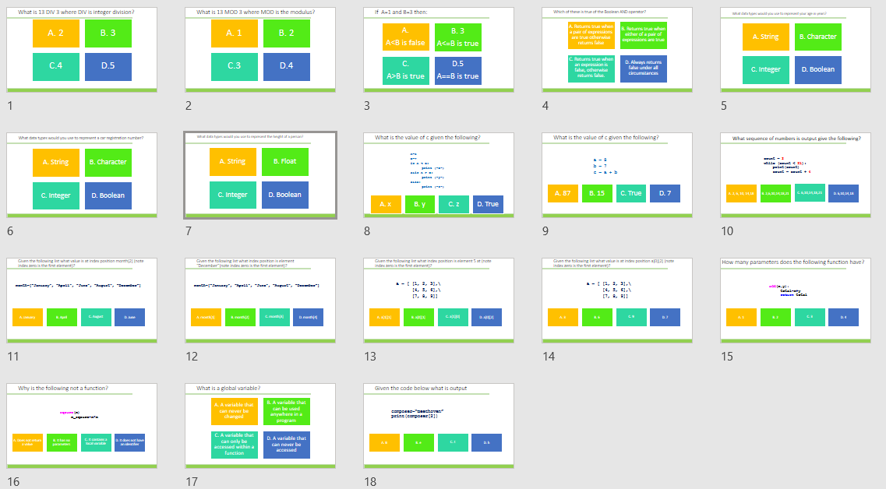
Homework
Complete task:
Python Programming
Alternatively use:
diagnostic-questions-python-set6.pptx

