Slide 1
Starter: Multiple the following binary numbers
a) 1 1 0
x 1 1
b) 1 1 0 0
x 1 0 0

Slide 2
Starter: Multiple the following binary numbers
a) 1 1 0
x 1 1
1 1 0
1 1 0 0
1 0 0 1 0
Check: 6 x 3 = 18
b) 1 1 0 0
x 1 1 0
0 0 0 0
1 1 0 0 0
1 1 0 0 0 0
1 0 0 1 0 0 0
Check: 12 x 6 = 72

Slide 3
Fixed point representation of real numbers in binary
:

Slide 4
Learning Objective
Represent fractional numbers using fixed point binary binary

Slide 5
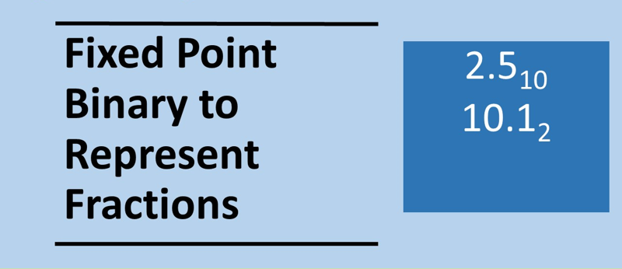

Slide 6
Fixed Point Representation
Fixed point binary is one method used to represent fractions in binary
An imaginary point is used to represent the fractional part of a number
The table below shows the corresponding decimal and binary representation of some fractions
 | 2¹ | 2⁰ | 2⁻¹ | 2⁻² | 2⁻³ | 2⁻⁴ | 2⁻⁵ | 2⁻⁶ | 2⁻⁷
Fraction | 2 | 1 | $$\frac{1}{2}$$ | $$\frac{1}{4}$$ | $$\frac{1}{8}$$ | $$\frac{1}{16}$$ | $$\frac{1}{32}$$ | $$\frac{1}{64}$$ | $$\frac{1}{128}$$
Decimal | 2 | 1 | 0.5 | 0.25 | 0.125 | 0.0625 | 0.03125 | 0.015625 | 0.0078125
Binary | 10 | 1 | 0.1 | 0.01 | 0.001 | 0.0001 | 0.00001 | 0.000001 | 0.0000001

Slide 7
Example: Fixed Point Representation
What is binary fraction 1001.1100₂ in denary?
8 | 4 | 2 | 1 |  | $$\frac{1}{2}$$ | $$\frac{1}{4}$$ | $$\frac{1}{8}$$ | $$\frac{1}{16}$$
1 | 0 | 0 | 1 | . | 1 | 1 | 0 | 0
We have 8 + 1 + 0.5 + 0.25, So the number represented here in denary will be 9.75.

Slide 8
Exercise: What are the decimal values of the following binary numbers
100.1₂
1010.11₂
1111.01₂
100.101₂
11.1001₂
100.0011₂

Slide 9
Exercise: What are the decimal values of the following binary numbers
100.1₂ 4.5₁₀
1010.11₂ 10.75₁₀
1111.01₂ 15.25₁₀
100.101₂ 4.625₁₀
11.1001₂ 3.5625₁₀
100.0011₂ 4.1875₁₀

Slide 10
Converting to Fixed point binary
Worked example: Convert the denary number 0.5625 into fixed point binary
binary representation so far
0 .
0.5625 x 2 = 1.125 0 . 1
0.125 x 2 = 0.25 0 . 1 0
0.25 x 2 = 0.5 0 . 1 0 0
2 x 0.5= 1.0 0 . 1 0 0 1
0
0.5625₁₀ = 0 . 1 0 0 1₂
Multiply the decimal part on the right hand side by 2
On the left hand-side the number is 0 in denary and binary
The integer part of the number is 1, so we put a 1 down for the binary representation.
Take only what is after the decimal point and multiply by 2 again
The integer part of the number is 0, so we put a 0 down for the binary representation.
Keep multiplying by 2
When the number reaches 0 we have got an exact representation.

Slide 11
Converting to Fixed point binary
Worked example: Convert the denary number 7.1875 into fixed point binary.
Separate into the integer and the fractional part of the number
Everything on the left side of the point we convert to binary : 7₁₀ = 1 1 1₂
On the right-hand side we
have the fraction part:
.1875 1 1 1.
.1875 x 2 = 0.375 1 1 1 . 0
0.375 x 2 = 0.75 1 1 1 . 0 0
0.75 x 2 = 1.5 1 1 1 . 0 0 1
0.5 x 2 = 1.0 1 1 1 . 0 0 1 1
0
7.1875₁₀ = 1 1 1 . 0 0 1 1₂

Slide 12
Exercise: Represent the following numbers in fixed point binary?
3.5₁₀
1.25₁₀
6.5625₁₀
3.1875₁₀
2.0625₁₀
1.0078125₁₀
$\frac{7}{32}$
$\frac{3}{16}$

Slide 13
Exercise: Represent the following numbers in fixed point binary?
11.1₂
1.01₂
110.1001₂
11.0011₂
10.0001₂
1.0000001₂
0.00111₂
0.0011₂
3.5₁₀
1.25₁₀
6.5625₁₀
3.1875₁₀
2.0625₁₀
1.0078125₁₀
$\frac{7}{32}$
$\frac{3}{16}$

Slide 14
Non-exact representation of fractions
There a fractions that we cannot represent exactly using fixed point representation. For instance, we cannot represent $\frac{1}{10}$ exactly.
How close can we get using? Use the steps as before for converting to fixed point binary but stop when you run out of bit not when you reach 0 (which will never happen)
4 bits
6 bits
8 bits
10 bits
0.001₂ = 0.125₁₀-0.1₁₀ = 0.025₁₀
0.00011₂ = 0.09375₁₀ - 0.1₁₀ = -0.00625₁₀
0.0001101₂ = 0.1015625₁₀ - 0.1₁₀ = 0.0015625₁₀
0.000110011₂ = 0.099609375₁₀ – 0.1₁₀ = 0.00041063₁₀

Slide 15
Non-exact representation of fractions II
The greater the number of bits the closer we can get to $\frac{1}{10}$ but we can never represent it exactly even if we can get very close. We say that the number of bits is asymptotic to the fraction we are trying to represent.
$$\frac{1}{10}$$
0 1 2 3 4 5 6 7 8
Number of bits

Slide 16
Exercise
Given 6 bits what is the closes you can represent the following number in fixed point binary
0.3₁₀
0.7₁₀

Slide 17
Exercise
Given 6 bits what is the closes you can represent the following number in fixed point binary
0.3₁₀ 0.01001₂
0.7₁₀ 0.10110₂

Slide 18
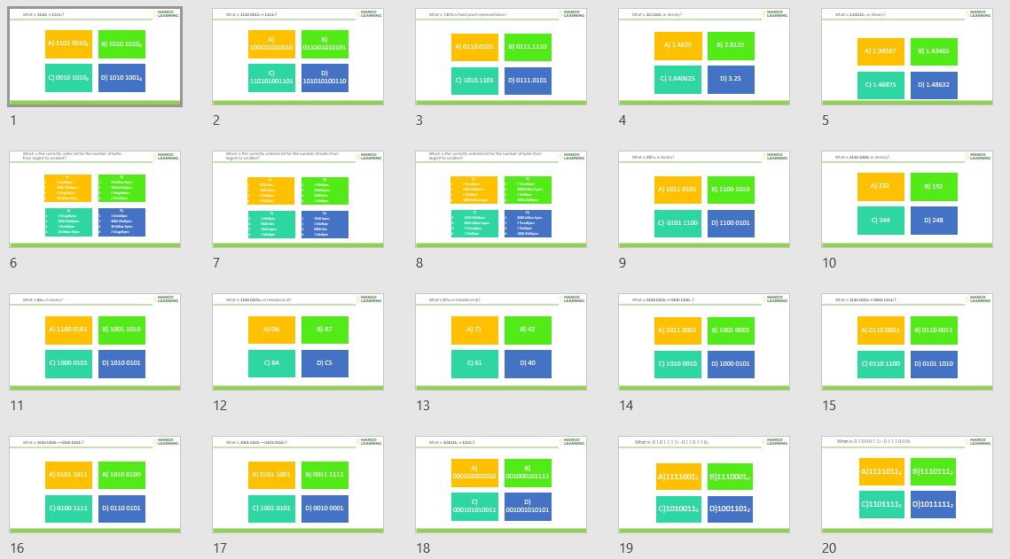
Plenary: Numbers Set 2 Diagnostic Questions
Search: Numbers Set 2 A level
dq-numbers-20-set-2.pptx

