Slide 1
Starter
1) What are the following in fixed point binary?
4.5
3.625
2) What are the following in denary
111.11
101.001

Slide 2
Starter
1) What are the following in fixed point binary?
4.5₁₀ 100.1₂
3.625₁₀ 11.101₂
2) What are the following in denary
111.11₂ 3.75₁₀
101.001₂ 5.125₁₀

Slide 3
Error checking and correction

Slide 4
Learning objectives
Use parity bits, majority voting, checksums, check digits as methods for error checking and correction

Slide 5
Error checking
When data are sent over a network between devices there needs to be a way to check that the bits have not been corrupted by interference during transmission and have been correctly received.
Corruption occurs when a bit transmitted as a 0 is converted to a 1 and vice versa.
Transmitted signal | 0 1 0 0 1 1 0 1
Received signal | 0 1 0 1 1 1 0 1

Slide 6
Parity bits
Parity bits allow us to check whether there is an error in a sequence of bits.
A parity bit is a check bit that is appended to a sequence of binary digits. The parity bit takes on a value of 0 or 1 according to whether the total number of 1s is odd or even.

Slide 7
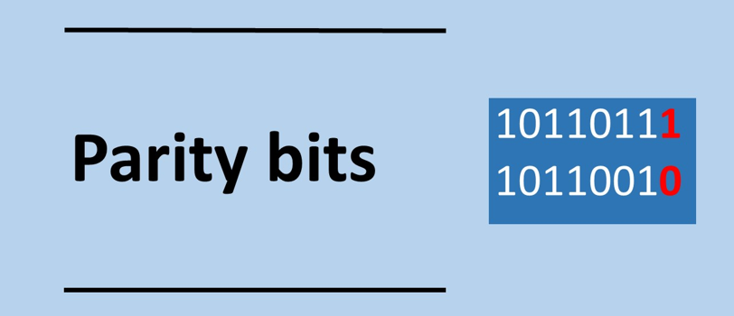

Slide 8
Even Parity
For even parity the total number of 1s in the sequence including the parity bit needs to be even.
In the following sequence we have 9 bits with a value of 1 therefore the parity bit is 1 for even parity giving is a total of 8 1s which is even.
Parity
bit
1 | 0 | 1 | 1 | 1 | 1 | 1 | 0

Slide 9
Even Parity
1 | 0 | 1 | 1 | 1 | 1 | 1 | 0
No error
1 | 0 | 0 | 1 | 1 | 1 | 1 | 0
Error
0 | 0 | 0 | 1 | 1 | 1 | 1 | 0
No error
0 | 0 | 1 | 1 | 1 | 1 | 1 | 0
Error

Slide 10
What is the check bit for the following sequence using even parity?
_ 0 1 0 1 0 1 0 0 1
_ 1 1 1 1 1 0 1 1 0
_ 1 1 0 1 0 1 0 1 0
_ 0 1 1 0 1 0 1 0 0
_ 0 1 0 1 1 1 0 1 0
_ 1 0 0 0 0 0 1 1 1

Slide 11
What is the check bit for the following sequence using even parity?
0 0 1 0 1 0 1 0 0 1
1 1 1 1 1 1 0 1 1 0
1 1 1 0 1 0 1 0 1 0
0 0 1 1 0 1 0 1 0 0
1 0 1 0 1 1 1 0 1 0
0 1 0 0 0 0 0 1 1 1

Slide 12
Odd Parity
For odd parity the total number of 1s in the sequence including the parity bit needs to be odd.
In the following sequence we have 7 bits with a value of 1 therefore the parity bit is 0 for odd parity giving is a total of 7 1s which is odd.
0 | 0 | 1 | 1 | 1 | 1 | 1 | 0 | 1 | 1
Parity
bit

Slide 13
What is the check bit for the following sequence using odd parity?
_ 1 1 1 0 1 0 1 0 0
_ 1 1 0 1 0 1 0 1 0
_ 0 1 1 0 1 1 0 0 1
_ 0 0 1 0 0 1 0 1 0
_ 1 0 1 1 1 0 0 1 1
_ 0 0 1 0 0 0 1 1 0

Slide 14
What is the check bit for the following sequence using odd parity?
0 1 1 1 0 1 0 1 0 0
0 1 1 0 1 0 1 0 1 0
0 0 1 1 0 1 1 0 0 1
0 0 0 1 0 0 1 0 1 0
1 1 0 1 1 1 0 0 1 1
0 0 0 1 0 0 0 1 1 0

Slide 15
Assuming no bits have been corrupted are the following sequences odd parity or even parity?
1 0 0 0 1 0 1 0 1
1 0 0 1 0 1 1 1 1
0 0 1 0 1 0 1 0 1
1 0 1 0 1 1 1 1 0
1 0 1 1 0 0 0 1 1
1 0 1 0 0 0 1 1 1

Slide 16
Assuming no bits have been corrupted are the following sequences odd parity or even parity?
1 0 0 0 1 0 1 0 1 Even parity
1 0 0 1 0 1 1 1 1 Even Parity
0 0 1 0 1 0 1 0 1 Even Parity
1 0 1 0 1 1 1 1 0 Even Parity
1 0 1 1 0 0 0 1 1 Odd Parity
1 0 1 0 0 0 1 1 1 Odd Parity

Slide 17
Consider this ….
What happens if two bits have been corrupted?
No error would be detected.
With parity checking we assume that it is extremely unlikely for more than 1 error to occur in a short sequence of bits.

Slide 18
Finding errors
If 1 bit in our sequence was corrupted during transmission, then the parity bit will be able to pick this up.
For instance in the following sequence of transmitted data we use even parity to check the bits. we have 6 bits with a value of 1 and the parity bit a 1. Clearly there is a problem. We have an odd number of 1s for even parity which is not right so one of the bits has been corrupted.
Only apply to a short sequence where it is less likely that more than one bit will be flipped compared to a much longer sequence
1 | 0 | 0 | 1 | 1 | 1 | 1 | 0 | 1 | 1

Slide 19
Given that the following are even parity which sequences have been corrupted?
0 1 0 0 1 0 1 0 1
0 1 0 1 0 0 1 0 0
1 0 1 1 1 0 0 1 1
1 0 1 0 1 0 0 1 0
1 0 0 1 0 1 0 1 1
1 0 0 1 0 0 1 0 1

Slide 20
Given that the following are even parity which sequences have been corrupted?
0 1 0 0 1 0 1 0 1 No
0 1 0 1 0 0 1 0 0 Yes
1 0 1 1 1 0 0 1 1 No
1 0 1 0 1 0 0 1 0 No
1 0 0 1 0 1 0 1 1 Yes
1 0 0 1 0 0 1 0 1 No

Slide 21
Limitation of parity bits
Parity bits do not work if an even number of bits have been corrupted.
Therefore only used for short sequences of bits where more that corrupted bit is unlikely.
We do not know which bit is in error so we cannot fix, so we have to discard the whole sequence.
Parity bits allow us to detect errors, but not to fix errors

Slide 22
Majority voting
With majority voting each bit is transmitted three times.
If one of the bits is corrupted, we take the majority as being the correct value for the bit.
Majority voting allows us to identify errors and also to fix errors
This approach means that 3 times the volume of data needs to be sent increasing bandwidth requirements

Slide 23
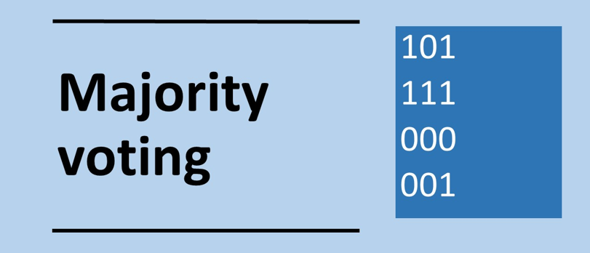

Slide 24
Majority voting
The sequence:
0 1 0 0 1 1 1
will be transmitted as
000 111 000 000 111 111 111
If one of the bits is corrupted we take the majority of the 3 bits as being the correct value for the bit. The values highlight below in red are the incorrect ones.
000 101 010 000 111 111 111
We interpret the correct sequence as:
0 1 0 0 1 1 1

Slide 25
The following data have been received. Using majority voting what is the correct sequence?
011 101 001 110 111 101 000
100 110 011 011 010 100 101
110 011 101 011 011 000 111

Slide 26
The following data have been received. Using majority voting what is the correct sequence?
011 101 001 110 111 101 000
1 1 0 1 1 1 0
b)100 110 011 011 010 100 101
0 1 1 1 0 0 1
110 011 101 011 011 000 111
1 1 1 1 1 0 1

Slide 27
Check digits
A check digit is a digit calculated from the characters in the input sequence
A check digit is an additional digit at the end of a sequence of digits to check for errors.
For instance, a bar code contains 12 digits plus a check digit and the purpose of the check digit here is to ensure the bar code has been input correctly.

Slide 28
Calculating the check digit for a bar code
Each bar code digit is multiplied by a weighting. The weighting alternates between 1 and 3 for each digit starting at 1.
The weighted values are then added up.
The sum is subtracted from equal to higher multiples of 10
Bar code | 9 |  | 7 |  | 8 |  | 0 |  | 1 |  | 9 |  | 8 |  | 7 |  | 7 |  | 6 |  | 2 |  | 6
Weighting | 1 |  | 3 |  | 1 |  | 3 |  | 1 |  | 3 |  | 1 |  | 3 |  | 1 |  | 3 |  | 1 |  | 3
Multiplication | 9 | + | 21 | + | 8 | + | 0 | + | 1 | + | 27 | + | 8 | + | 21 | + | 7 | + | 18 | + | 2 | + | 18
Add values = 140
Subtract the sum from equal or higher multiple of ten
140 - 140 = 0
Check digit = 0

Slide 29
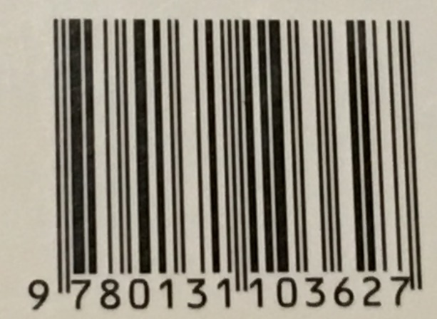
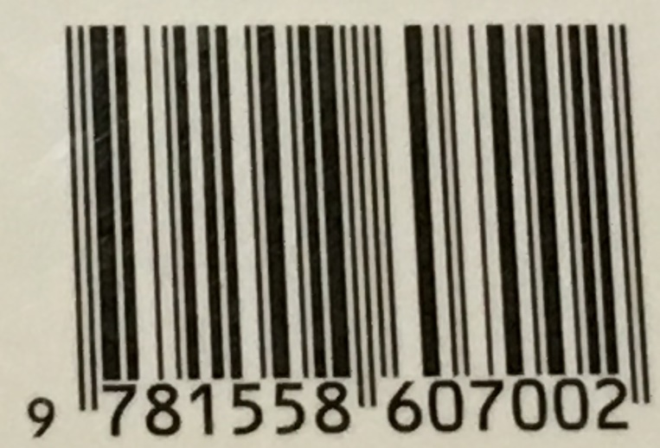
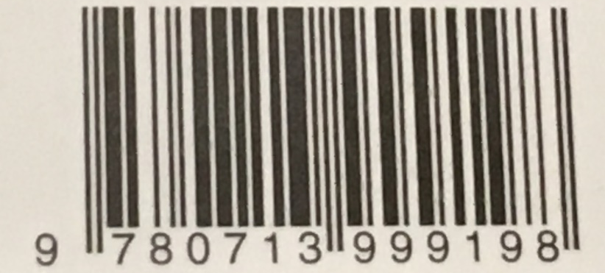
What is the check digit for the following barcodes:
a)
c)
b)

Slide 30
Checksums
A checksum is designed to check for errors in a block of data transmitted between computers over a network.
Often when you download a large file you can calculate its checksum and compare this against a separate checksum that is made available alongside the file to ensure the file has not been corrupted or tampered with during transmission.
If the checksums are the same then the file’s integrity can be ensured, otherwise the file has been corrupted.
A common checksum algorithm is MD5

Slide 31
A simple checksum algorithm
Let us take an example of the following sequence of numbers.
split into 8 bit blocks
add together
apply two’s complement
0 | 1 | 1 | 1 | 0 | 1 | 1 | 1 | 1 | 0 | 0 | 0 | 1 | 0 | 0 | 0 | 0 | 1 | 1 | 0 | 0 | 1 | 1 | 0
0 | 1 | 1 | 1 | 0 | 1 | 1 | 1 | 0 | 0 | 0 | 0 | 1 | 0 | 0 | 0 | 0 | 1 | 1 | 0 | 0 | 1 | 1 | 0
 | 0 | 1 | 1 | 1 | 0 | 1 | 1 | 1
 | 0 | 0 | 0 | 0 | 1 | 0 | 0 | 0
+ | 0 | 1 | 1 | 0 | 0 | 1 | 1 | 0
 | 1 | 1 | 1 | 0 | 0 | 1 | 0 | 1
 | 0 | 0 | 0 | 1 | 1 | 0 | 1 | 1
Checksum =

Slide 32
To validate the checksum
split into 8 bit blocks
add together all the sequences including the checksum
The result is zero if there is no transmission error
0 | 1 | 1 | 1 | 0 | 1 | 1 | 1 | 0 | 0 | 0 | 0 | 1 | 0 | 0 | 0 | 0 | 1 | 1 | 0 | 0 | 1 | 1 | 0
 | 0 | 1 | 1 | 1 | 0 | 1 | 1 | 1
 | 0 | 0 | 0 | 0 | 1 | 0 | 0 | 0
 | 0 | 1 | 1 | 0 | 0 | 1 | 1 | 0
+ | 0 | 0 | 0 | 1 | 1 | 0 | 1 | 1
(1) | 0 | 0 | 0 | 0 | 0 | 0 | 0 | 0
Checksum =

Slide 33
Plenary
Explain how majority voting works
Explain the advantages and disadvantages of majority voting versus parity bits.

Slide 34
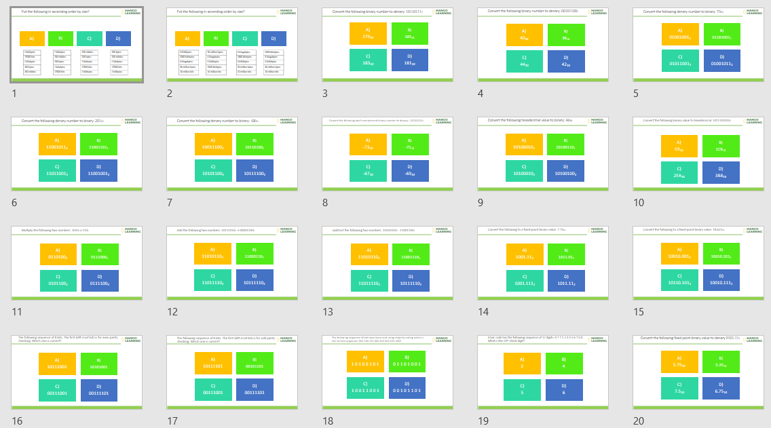
Homework: Numbers Set 1 Diagnostic Questions
Search: Numbers Set 1 A level
dq-numbers-20-set-1.pptx

