Slide 1
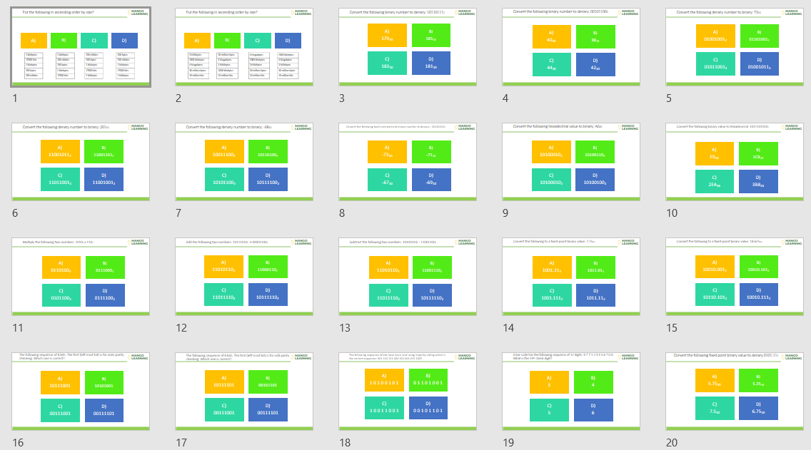
Numbers Set 1
Search: Numbers Set 1 A level
dq-numbers-20-set-1.pptx

Slide 2
Put the following in ascending order by size?
A)
C)
D)
B)
2 kibibytes
17000 bits
2 kilobytes
200 bytes
200 nibbles
2 kibibytes
200 nibbles
200 bytes
2 kilobytes
17000 bits
200 nibbles
200 bytes
2 kilobytes
17000 bits
2 kibibytes
200 bytes
200 nibbles
2 kilobytes
17000 bits
2 kibibytes

Slide 3
Put the following in ascending order by size?
A)
C)
D)
B)
3 Mibibytes
2000 kilobytes
4 Megabytes
30 million bytes
10 million bits
30 million bytes
4 Megabytes
3 Mibibytes
2000 kilobytes
10 million bits
4 Megabytes
2000 kilobytes
3 Mibibytes
30 million bytes
10 million bits
2000 kilobytes
4 Megabytes
3 Mibibytes
30 million bytes
10 million bits

Slide 4
Convert the following binary number to denary: 10110111₂
A)
179₁₀
C)
183₁₀
D)
181₁₀
B)
185₁₀

Slide 5
Convert the following binary number to denary: 00101100₂
A)
40₁₀
C)
44₁₀
D)
42₁₀
B)
38₁₀

Slide 6
Convert the following denary number to binary: 73₁₀
A)
01001001₂
C)
01011001₂
D)
01001011₂
B)
01101001₂

Slide 7
Convert the following denary number to binary: 201₁₀
A)
11001011₂
C)
11011001₂
D)
11001001₂
B)
11001101₂

Slide 8
Convert the following denary number to binary: -68₁₀
A)
10011100₂
C)
10101100₂
D)
10111100₂
B)
10110100₂

Slide 9
Convert the following two’s complement binary number to denary : 10110111₂
A)
-73₁₀
C)
-67₁₀
D)
-69₁₀
B)
-71₁₀

Slide 10
Convert the following hexadecimal value to binary: A6₁₆
A)
10100010₂
C)
10100010₂
D)
10100100₂
B)
10100110₂

Slide 11
Convert the following binary value to hexadecimal: 1011101010₂
A)
E9₁₆
C)
2EA₁₆
D)
3B8₁₆
B)
1CB₁₆

Slide 12
Multiply the following two numbers: 1010₂ x 110₂
A)
0110100₂
C)
0101100₂
D)
0111100₂
B)
0111000₂

Slide 13
Add the following two numbers: 10111010₂ + 00001100₂
A)
11010110₂
C)
11011110₂
D)
10111110₂
B)
11000110₂

Slide 14
Subtract the following two numbers: 10101010₂ - 11001100₂
A)
11010110₂
C)
11011110₂
D)
10111110₂
B)
11001110₂

Slide 15
Convert the following to a fixed-point binary value: 7.75₁₀
A)
1001.11₂
C)
1001.111₂
D)
1011.11₂
B)
1011.01₂

Slide 16
Convert the following to a fixed-point binary value: 18.625₁₀
A)
10010.001₂
C)
10110.101₂
D)
10010.111₂
B)
10010.101₂

Slide 17
The following sequence of 8 bits. The first (left most bit) is for even parity checking. Which one is correct?
A)
10111001
C)
00111001
D)
00111101
B)
10101001

Slide 18
The following sequence of 8 bits. The first (left most bit) is for odd parity checking. Which one is correct?
A)
10111101
C)
00111001
D)
00111101
B)
00101101

Slide 19
The following sequence of bits have been sent using majority voting which is the correct sequence: 001 110 111 000 101 001 011 100?
A)
1 0 1 0 0 1 0 1
C)
1 0 0 1 1 0 0 1
D)
0 0 1 0 1 1 0 1
B)
0 1 1 0 1 0 0 1

Slide 20
A bar code has the following sequence of 12 digits: 9 7 7 1 2 3 4 5 6 7 0 0. What is the 13th check digit?
A)
3
C)
5
D)
6
B)
4

Slide 21
Convert the following fixed point binary value to denary 0101.11₂
A)
5.75₁₀
C)
7.5₁₀
D)
6.75₁₀
B)
5.25₁₀

Slide 22
Answers by slide
A
B
C
C
A
D
D
A
B
C
D
B
C
A
B
A
D
B
A
A

