Slide 1
In pairs, predict what the following outputs
1 2 3 4 5 6 | def substitution_cypher(): sub={"Z":"i", "X":"s", "Y": "b", "V":"c", "W":"d"} sub["W"]="t" sub["R"]="u" print(sub["Y"]+sub["Z"]+sub["X"]+sub["V"]+sub["R"]+sub["Z"]+sub["W"]) substitution_cypher()

Slide 2
Copy the code and run
1 2 3 4 5 6 | def substitution_cypher(): sub={"Z":"i", "X":"s", "Y": "b", "V":"c", "W":"d"} sub["W"]="t" sub["R"]="u" print(sub["Y"]+sub["Z"]+sub["X"]+sub["V"]+sub["R"]+sub["Z"]+sub["W"]) substitution_cypher()
Does the code output what you expected?
Download the code from cypher.py

Slide 3
Data structures: Dictionaries

Slide 4
Learning Objectives
Explain what a dictionary is
Read and write programs that use dictionaries

Slide 5
What is a dictionary?
A dictionary is data structure
It contains a list of pairs of keys and values
Each key is associated with a value
We use the key to access a value
Keys need to be unique
Avoids the need to have two separate lists for linking values

Slide 6
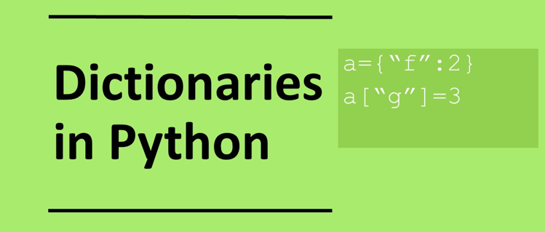

Slide 7
Anatomy of a dictionary
Curly Brackets
phone={"Plato":222, "Aristotle":911}
Name of dictionary
Key Value
Colon

Slide 8
Dictionaries can have any data type
Dictionary values can have any datatype: strings, integers, lists, other dictionaries for instance
Dictionary keys can be strings or numbers
d={"Plato":222, # integer value
"Russia":"Moscow", # string value
"A":["B","C"], # list value
1:{"name":"Fred", "dept":"HR"} # number key and
# dictionary value
}

Slide 9
Dictionary operations
Create empty dictionary phone={}
Create a dictionary phone={"Plato":222, "Aristotle":911, "Socrates":999}
access a value phone["Plato"]
associated with a key
Add a value phone["Pythagerous"] = 123
List values phone
Remove a value del phone["Plato"]
Access keys only phone.keys()
Remove a value phone.values()

Slide 10
Investigate and modify the code
1 2 3 4 5 6 | def substitution_cypher(): sub={"Z":"i", "X":"s", "Y": "b", "V":"c", "W":"d"} sub["W"]="t" sub["R"]="u" print(sub["Y"]+sub["Z"]+sub["X"]+sub["V"]+sub["R"]+sub["Z"]+sub["W"]) substitution_cypher()
Answer the following questions by adding comments to the code
How would you create an empty dictionary?
What is the difference between lines 3 and 4?
Using lists how would you achieve the same as for the dictionary?
Create your own substitution cypher combination to create the word “coffee”
Output all the keys and values separately.

Slide 11
Alternative code
sub = {"Z":"i","X":"s","Y":"b","V":"c","W":"t","R":"u"}
cyphertext="YZXVRZW"
plaintext=""
for i in cyphertext:
plaintext=plaintext+sub[i]
print(plaintext)

Slide 12
Make
Create an empty dictionary called cities, that has the country name as the key and the city as the value
Add the following values
Output all the keys and values seperately
Key | Value
UK | London
Japan | Tokyo
France | Paris
USA | New York
China | Beijing

Slide 13
Example code
countries = {
“UK”:”London”,
“Japan”:”Tokyo”,
“France”:”Paris”,
}
countries[“USA”]=”New York”,
countries[“China”]=”Beijing”
print(countries.keys())
print(countries.values())

Slide 14
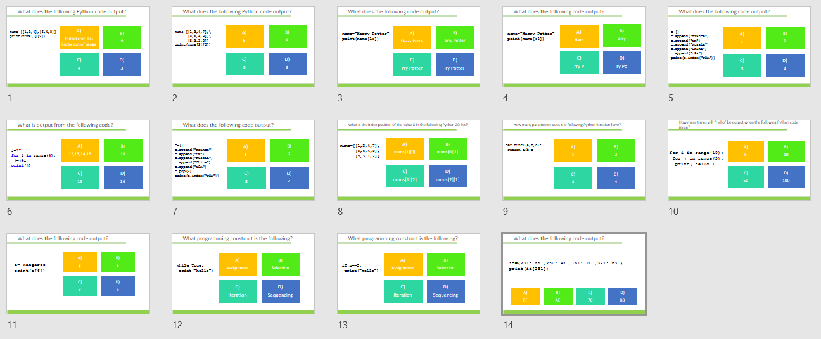
Homework
Complete task:
Python Coding: 2D lists, iterations GCSE
Alternatively use:
diagnostic-questions-python-set5.pptx

Slide 15
Extension: Get keys by value
# values do not need to be unique so multiple
# keys could be associates with a value
def get_keys(dictionary,value)
keys=[]
for item in dictionary.items():
if item[1] == value:
keys.append(item[0])
return keys

