Slide 1
Set 4 iteration, lists, string processing 2D lists

Slide 2
What is output from the following code?
item=“pear”
food=“fruit”
if food == “vegetable”:
if item=“spinach”:
print(“£0.70”)
if item=“potatoes”:
print(“£0.50”)
elif food==“fruit”:
if item=“apple”:
print(“£0.40”)
if item=“pear”:
print(“£0.60”)
A)
£0.70
C)
£0.50
D)
£0.40
B)
£0.60

Slide 3
What is output from the following code?
A)
21, 32, 43
C)
21, 32
D)
10, 21, 32, 43
B)
10, 21, 32
i=10
while i< 40:
i=i+11
print(i)

Slide 4
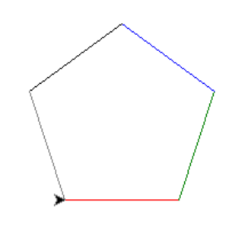
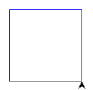
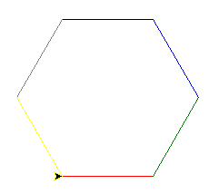
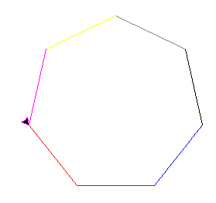
What is output from the following code?
A)
C)
D)
B)
from turtle import *
for colour in ["red",\
"green","blue", \
"black", "grey"]:
pencolor(colour)
forward(100)
left(360/5)

Slide 5
What does the Python built in function len()do?
A)
Converts a value to an integer
C)
Converts an integer value to a string
D)
Generates a random number
B)
Determines the number of elements in a list

Slide 6
What does the following code output?
A)
a
C)
y
D)
P
B)
r
name=“Harry Potter”
print(name[3])

Slide 7
What does the following code output?
A)
Harr
C)
rry P
D)
ry Po
B)
arry
name=“Harry Potter”
print(name[0:4])

Slide 8
What does the following code output?
A)
Harr
C)
rry P
D)
ry Po
B)
arry
name=“Harry Potter”
print(name[2:6])

Slide 9
What does the following code output?
A)
1
C)
4
D)
2
B)
3
nums=[1,3,4,2,9,8]
print(nums[2])

Slide 10
What does the following code output?
A)
France
C)
Russia
D)
China
B)
UK
countries=[]
countries.append("France")
countries.append(“UK")
countries.append("Russia")
countries.append("China")
countries.append("USA")
print(countries[3])

Slide 11
What does the following code output?
A)
2
C)
4
D)
5
B)
3
c=[]
c.append("France")
c.append("UK")
c.append("Russia")
c.append("China")
c.append("USA")
print(len(c))

Slide 12
What does the following Python code output?
nums1=[1,3,4]
nums2=[6,4,9]
nums=nums1+nums2
print(num)
A)
1,3,4,6,4,9
C)
1,3,4
D)
6,4,9
B)
7,7,13

Slide 13
What is the index position of the value 7 in the following Python list?
A)
5
C)
3
D)
2
B)
4
a=[1,3,4,7,8,6,4,9]

Slide 14
Answers by slide
B
A
A
B
B
A
C
C
D
D
A
C

