Slide 1
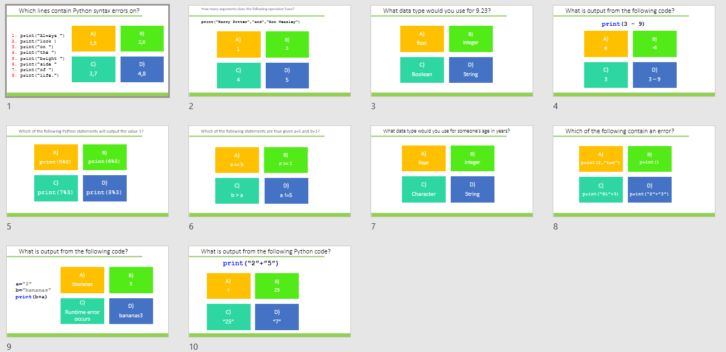
Starter
Complete task:
Python coding: Output, assignment, datatypes and operators GCSE
Alternatively use:
diagnostic-questions-python-set1.pptx

Slide 2
Data types and Casting

Slide 3
Learning objectives
Create constants and variables using assignment
Explain the different data types
Use casting to converting between different datatypes

Slide 4
Data types
Data can be stored variables as different types.
So far, we have looked at integer datatypes but there are others
 | Description | Example
Character | Single letter, digit or symbol | “A”, “b”, “7”, “?”
String | A string of characters | “Hello”, “pA55word$”
Boolean | two values | True, False
Integer | Whole number values | 1, 100, 123
Real/float | All numbers including decimals | 1.234

Slide 5
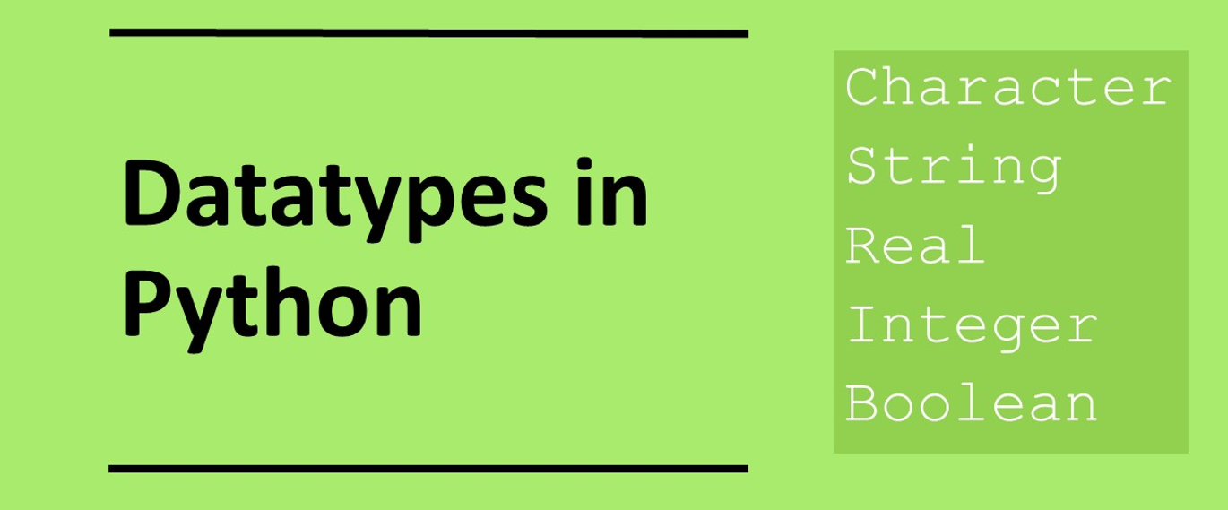

Slide 6
Named variables
When naming constants, variables and for that matter functions, arrays it is important to use meaningful identifier names. This allows the code to be more clearly documented and reduces the need to comment the code so thoroughly. Sensibly named identifiers will make the code far more readable and therefore easier to maintain than identifier that have been inappropriately names.

Slide 7
Assignment data types
We can use assignment to create variables and constants that can be of any data type. Variables are values that change during the running of a program and constants do not change values during the running of the program.
This is an integer data type
numberOfApples = 12
This is a float data type (in metres)
heightOfStudent = 1.52
This is a string data type; notice we use speech marks
nameOfStudent = “Bart Simpson”
This is a character data type; notice we use speech marks
grade = “A”

Slide 8
Constants and variables
Constants are values that do no change throughout the running of the program.
For variables, the values can change.
By convention and to avoid confusion we usually declare constants using upper case and variables using lower case, for instance:
PI = 3.14159265 # This is a constant
a=3 # This is a variable
a=a+3 # and the value can change

Slide 9
What data types would you use to represent the following?
name=“Fred Flintstone”
age=15
height=1.83
form=“9V”
school_year=10
grade=“B”
attendance=True

Slide 10
What data types would you use to represent the following?
name=“Fred Flintstone” String
age=15 Integer
height=1.83 Float
form=“9V” String
school_year=10 Integer
grade=“B” String
attendance=True Boolean

Slide 11
Assignment with the + operator
For numeric datatypes if:
a = 2
b = 3
c = a + b
The value of C will be 5
For string datatypes if:
a = “Hello”
b = “World”
c = a + b
The value of C will be “HelloWorld”
It is important to understand the distinction because numeric values will return the sum whereas for strings the second string will be appended to the first.

Slide 12
What value will be output in each case?
a) firstname=“Fred”
secondname=“Flinstone”
name=firstname+secondname
print(name)
b) num1=2
num2=4
total=num1 + num2
print(total)
c) X=“3”
Y=“4”
Z=X+Y
print(Z)
a) FredFlintstone
b) 6
c) 34

Slide 13
Casting
Casting is used so that we can convert between different data types. There are a range of functions that allow us to do this:
int() | a=int(“7”)
str() | a=str(7)
float() | a=float(“7.7”)

Slide 14
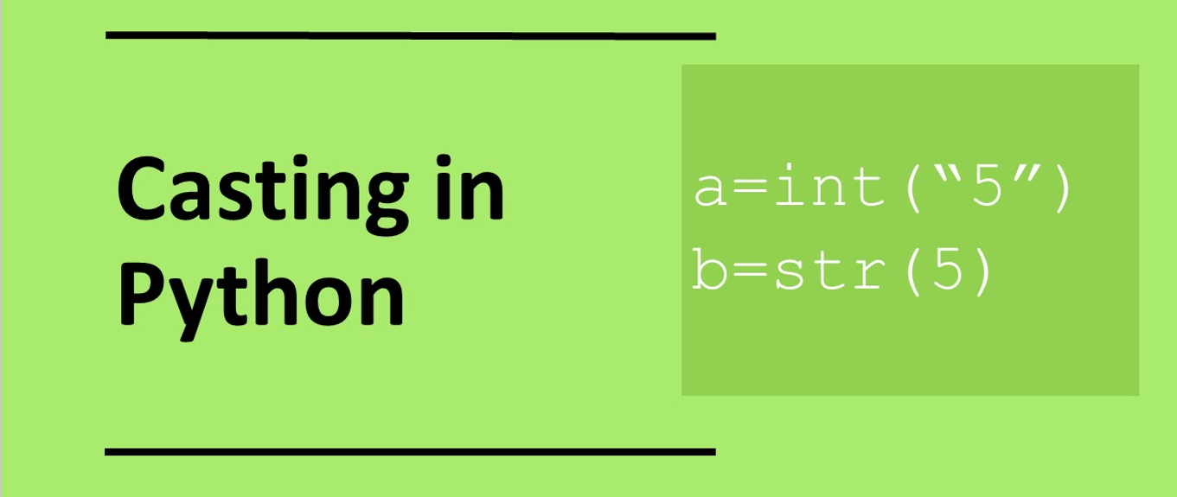

Slide 15
Casting - Input
By default the input function returns a string so we need to cast them as numeric values if we wish to perform calculations. This is done by wrapping an int() or float() cast around the input function.
print(“What is your age?”)
age=int(input())
print(“What is your height?”)
age=float(input())

Slide 16
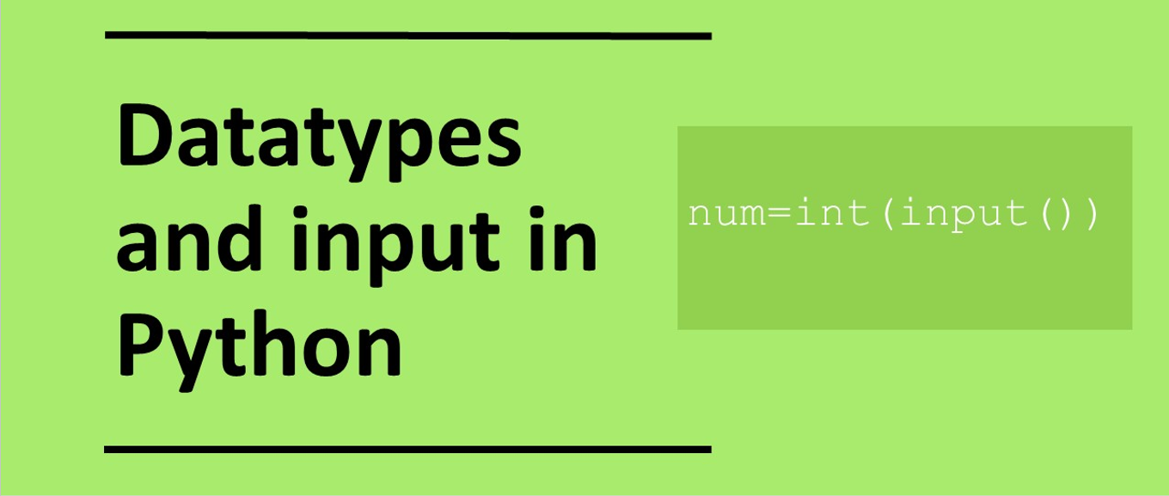

Slide 17
In pairs, predict what the following code is doing
1 2 3 4 5 6 7 8 | print(“Enter width”) w = int(input()) print(“Enter height”) h = int(input()) print(“Enter length”) l = int(input()) v = w * l * h print(“Volume of cuboid:”,v)

Slide 18
Copy the code and run. Does it do as you as expected?
1 2 3 4 5 6 7 8 | print(“Enter width”) w = int(input()) print(“Enter height”) h = int(input()) print(“Enter length”) l = int(input()) v = w * l * h print(“Volume of cuboid:”,v)
You can download a copy of the code from:
datatypes.py

Slide 19
Investigate the code
1 2 3 4 5 6 7 8 | print(“Enter width”) w = int(input()) print(“Enter height”) h = int(input()) print(“Enter length”) l = int(input()) v = w * l * h print(“Volume of cuboid:”,v)
Add comments on to the code:
Identify the variables
Why is there a double bracket at the end of each casting statement?
What will happen if the user enters 2.2, 1.1 and 3.3 for the width, height and length respectively?
What casting should the program use so that it can handle non whole numbers?
Modify the program to a more suitable casting
What happens if the user enters letter instead of numbers? Why?

Slide 20
Investigate the code
1 2 3 4 5 6 7 8 | print(“Enter width”) w = int(input()) print(“Enter height”) h = int(input()) print(“Enter length”) l = int(input()) v = w * l * h print(“Volume of cuboid:”,v)
Because we have a function inside a function you need to remember to add the double bracket at the end
All castings should be changed to float so we can handle non integer values.
w, h, l and v are all variables
If the user enters letters instead of numbers the program crashes because the cannot be converted to numeric values

Slide 21
Plenary: what is output in each case?
print(7+3)
print(“7”+”3”)
a=int(“9.3”)
print(a)
4) x=float(“10.7”)
print(x)
5) a=int(“Aardvark”)
print(a)
6) a=7
b=10
print(a+b)
7) x=“5”
y=“3”
print(x+y)
8) a=“4”
b=3
print(a+b)
9) firstname=“Danger”
surname=“Mouse”
print(firstname+” “+surname)

