Slide 1
Common Gateway Interface (CGI)

Slide 2
Learning Objectives
Describe what CGI is
Use HTML, CSS and Python to create a calculator Web app
Create a quiz all

Slide 3
Common Gateway Interface (CGI)
CGI allows us to run server-side scripts.
Server-side means that the processing is run on the server as opposed to client-side where the processing occurs on local machine.
Javascript is used to run client-side scripts, but server-side scripts can use Python among other languages.
We are going to use Python server-side scripts to create calculator and quiz apps.

Slide 4
Calculator App
Create a simple calculator app that has two pages
There will be one html file and one Python script

Slide 5
Webserver
To start with we need to get a webserver running.
Copy the code below into a file called webserver.py and then run the code.
1 2 3 4 5 6 | from http.server import HTTPServer, CGIHTTPRequestHandler class Handler(CGIHTTPRequestHandler): cgi_directories = ["/cgi-bin"] print("Webserver running") HTTPServer(("", 8080), Handler).serve_forever()

Slide 6
calculator.html – Template Skeleton
In the same folder as webserver.py create a HTML file called calculator.html
<html> <head> <title> A simple calculator </title> </head> <body> <h1>Calculator</h1> <p> Form goes here </p> </body> </html>

Slide 7
calculator.html - Form
<form method="POST" action="cgi-bin/calculator.pyw"> Value 1 <input type="text" name="num1"> <br><br> <select name="operator"> <option value="add">Add</option> <option value="subtract">Subtract</option> </select> <br><br> Value 2 <input type="text" name="num2"> <br><br> <input type="submit" value="Calculate"> </form>
This form executes the Python script calculator.pyw that is in a directory called cgi-bin. We are going to create the script next.
Add in options for divide and multiply

Slide 8
calculator.html - Form
<form method="POST" action="cgi-bin/calculator.pyw"> Value 1 <input type="text" name="num1"> <br><br> <select name="operator"> <option value="add">Add</option> <option value="subtract">Subtract</option> <option value="divide">Divide</option> <option value="multiply">Multiply</option> </select> <br><br> Value 2 <input type="text" name="num2"> <br><br> <input type="submit" value="Calculate"> </form>

Slide 9
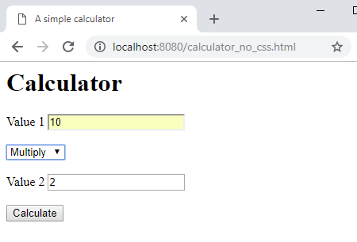
calculator.html
You can access the web page via http://localhost:8080/calculator.html

Slide 10
calculator.pyw
In a subfolder called cgi-bin create a Python file called calculator.pyw
We use the extension pyw because we do not wish the console to appear
The pyw extension supresses the console
This code will be executed when the calculate button in calculator.html is pressed.

Slide 11
calculator.pyw I
1 2 3 4 5 6 7 8 9 10 11 12 | import cgi, cgitb form = cgi.FieldStorage() # This passes the values from # the form into Python variables num1=form.getvalue('num1’) num2=form.getvalue('num2’) operator=form.getvalue('operator’) # This is the html code # Generated by Python print statements print ("Content-type:text/html\n\n") print ("<html>") print ("<head>") print ("<title>Simple calculator</title>") print ("</head>") print ("<body>") print ("<h1>Result</h1>")

Slide 12
calculator.pyw II
Add in the elif clauses for divide and multiply
13 14 15 16 17 18 19 20 21 | if operator=="add": result=int(num1)+int(num2) print ("<h2>%s + %s = %s</h2>" % (num1, num2, str(result))) elif operator=="subtract": result=int(num1)-int(num2) print ("<h2>%s - %s = %s</h2>" % (num1, num2, str(result))) print ("<a href='../calculator.html'>Calculator<a>") print ("</body>") print ("</html>")

Slide 13
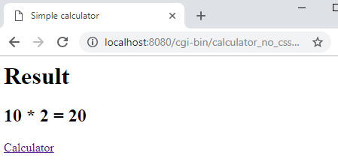
calculator.pyw II
13 14 15 16 17 18 19 20 21 22 23 24 25 26 27 | if operator=="add": result=int(num1)+int(num2) print ("<h2>%s + %s = %s</h2>" % (num1, num2, str(result))) elif operator=="subtract": result=int(num1)-int(num2) print ("<h2>%s - %s = %s</h2>" % (num1, num2, str(result))) elif operator=="divide": result=float(num1)/ float(num2) print ("<h2>%s / %s = %s</h2>" % (num1, num2, str(result))) elif operator=="multiply": result=int(num1)*int(num2) print ("<h2>%s * %s = %s</h2>" % (num1, num2, str(result))) print ("<a href='../calculator.html'>Calculator<a>") print ("</body>") print ("</html>")

Slide 14
Running
We are now in a position to run the calculator app.
We can use web address http://localhost:8080/calculator.html

Slide 15
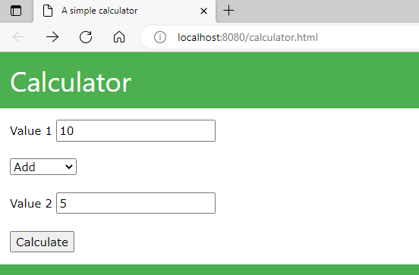
calculator.html with CSS
So far our pages look quite bland so we are going to jazz them up using CSS by making changes to calculator.html and calculator.pyw.
<html> <head> <title> A simple calculator </title> <link rel="stylesheet“ href=“https://www.w3schools.com/w3css/4/w3.css”> </head> <body> <header class="w3-container w3-green"> <h1>Calculator</h1> </header> <div class="w3-container"> <p> Form goes here </p> </div> <footer class="w3-container w3-green"> </footer> </body> </html>

Slide 16
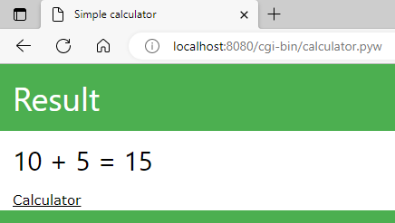
calculator.pyw with CSS
print ("<head>") print ("<title>Simple calculator</title>") print ("<link rel='stylesheet' href='https://www.w3schools.com/w3css/4/w3.css'>") print ("</head>") print ("<body>") print ("<header class='w3-container w3-green'>") print ("<h1>Result</h1>") print ("</header>") print ("<div class='w3-container'>") if operator=="add": # code continues print ("<a href='../calculator.html'>Calculator<a>") print ("</div>") print ("<footer class='w3-container w3-green'>") print ("</footer>") print ("</body>") print ("</html>")

Slide 17
Create QUIZ App

Slide 18
Create Quiz App
We are going to create a simple quiz app that has two pages.
There will be one html file and one Python script.

Slide 19
quiz.html – Template skeleton
<html>
<head>
<title>
A simple quiz
</title>
</head>
<body>
<h1>Quiz</h1>
<p>
Form goes here
</p>
</body>
</html>

Slide 20
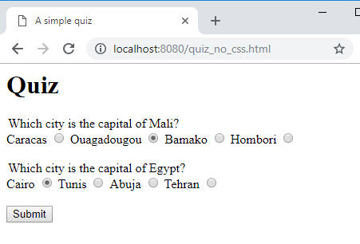
quiz.html form
<form method="POST" action="cgi-bin/quiz.pyw">
<legend>Which city is the capital of Mali?</legend>
Caracas <input type="radio" name="q1" value="Caracas">
Ouagadougou <input type="radio" name="q1" value="Ouagadougou">
Bamako <input type="radio" name="q1" value="Bamako">
Hombori <input type="radio" name="q1" value="Hombori">
<br> <br>
<legend>Which city is the capital of Egypt?</legend>
Cairo <input type="radio" name="q2" value="Cairo">
Tunis <input type="radio" name="q2" value="Tunis">
Abuja <input type="radio" name="q2" value="Abudja">
Tehran <input type="radio" name="q2" value="Tehran">
<br> <br>
<input type="submit" value="Submit">
</form>
This form executes the script quiz.pyw that is in a directory called cgi-bin. We are going to create the script next.

Slide 21
quiz.pyw I
import cgi, cgitb
form = cgi.FieldStorage()
q1=form.getvalue('q1’)
q2=form.getvalue('q2’)
operator=form.getvalue('operator’)
print ("Content-type:text/html\n\n")
print ("<html>")
print ("<head>")
print ("<title>Quiz</title>")
print ("</head>")
print ("<body>")
print ("<h1>Results</h1>")

Slide 22
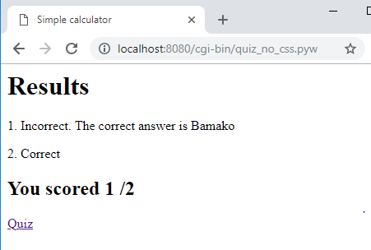
quiz.pyw II
correct=0
if q1 == "Bamako":
print ("<p>1. Correct</p>")
correct=correct+1
else:
print ("<p>1. Incorrect. The correct answer is Bamako</p>")
if q2 == "Cairo":
print ("<p>2. Correct</p>")
correct=correct+1
else:
print ("<p>2. Incorrect. The correct answer is Cairo</p>")
print ("<h2>You scored %s /2</h2>" % (str(correct)))
print ("<a href='../quiz.html'>Quiz<a>")
print ("</body>")
print ("</html>")

Slide 23
Modify
Modify the quiz so that it has 10 questions
Add CSS

Slide 24
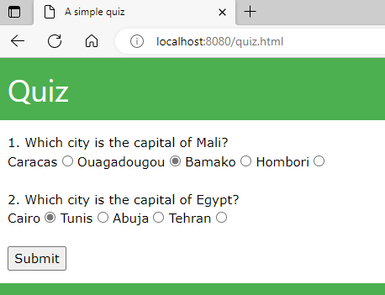
quiz.html with CSS
<html>
<head>
<title> A simple quiz </title>
<link rel="stylesheet" href=“https://www.w3schools.com/w3css/4/w3.css">
</head>
<body>
<header class="w3-container w3-green">
<h1>Quiz</h1>
</header>
<div class="w3-container">
<p> Form goes here </p>
</div>
<footer class="w3-container w3-green">
<h5>Grey, 2018</h5>
</footer>
</body>
</html>

Slide 25
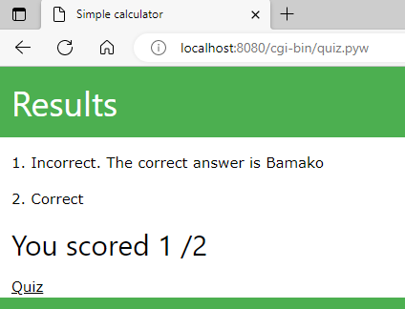
quiz.pyw with CSS
print ("<head>")
print ("<title>Simple calculator</title>")
print ("<link rel='stylesheet' href='https://www.w3schools.com/w3css/4/w3.css'>")
print ("</head>")
print ("<body>")
print ("<header class='w3-container w3-green'>")
print ("<h1>Results</h1>")
print ("</header>")
print ("<div class='w3-container'>")
correct=0
# code continues
print ("<a href='../quiz.html'>Quiz<a>")
print ("</div>")
print ("<footer class='w3-container w3-green'>")
print (" <h5>Grey, 2018</h5>")
print ("</footer>")
print ("</body>")
print ("</html>")

