Slide 1
Convert the following two’s complement number to denary
Starter activity and recap of previous learning
Convert the following number to two’s complement binary using 8 bits to represent the number
e) -43₁₀
f) -18₁₀
g) -27₁₀
h) -91₁₀
11110101₂
10101110₂
11000101₂
11010111₂

Slide 2
Convert the following two’s complement number to denary
Starter activity and recap of previous learning
Convert the following number to two’s complement binary using 8 bits to represent the number
11110101₂ -11₁₀
10101110₂ -82₁₀
11000101₂ -59₁₀
11010111₂ -41₁₀
e) -43₁₀ 11010101₂
f) -18₁₀ 11101110₂
g) -27₁₀ 11100101₂
h) -91₁₀ 10100101₂

Slide 3
Binary subtraction

Slide 4
Learning Objectives
Perform subtraction on binary numbers

Slide 5
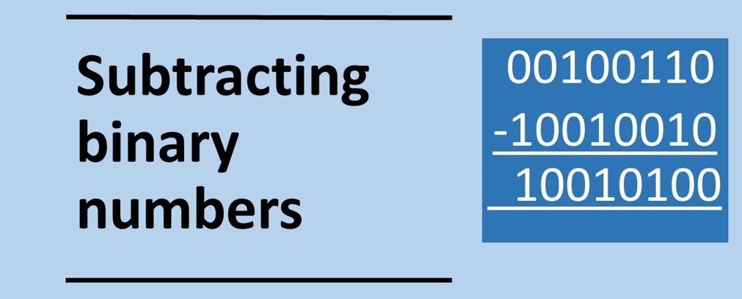

Slide 6
Subtracting numbers in binary
To subtract two numbers in binary:
Apply two’s complement to the second binary number
Add the two numbers together
We know how to perform both steps based on what we have learned so far.

Slide 7
The principles
When we subtract numbers in binary we make one of the numbers negative and them add them together.
For instance in denary
45 – 33 = 45 + (-33)

Slide 8
Example binary subtraction 1
Subtract the following two numbers:
0 1 1 1 0₂ 14₁₀
- 0 1 1 0 0₂ 12₁₀
1. Apply two’s complement to the bottom binary number (flip bits and add 1)
0 1 1 0 0₂
1 0 1 0 0₂
2. Add the two numbers together
0 1 1 1 0₂
+ 1 0 1 0 0₂
(1) 0 0 0 1 0₂ 2₁₀
The 1 is disregarded, it wil overflow as it exceeds the number of bits we have to represent the numbers

Slide 9
Example binary subtraction 2
Subtract the following two numbers:
0 0 1 0 1 0 1 1₂ 43₁₀
- 0 0 0 1 0 0 0 1₂ 17₁₀
1. Apply two’s complement to the second binary number (flip bits and add 1)
0 0 1 0 1 0 1 1₂
1 1 1 0 1 1 1 1₂
2. Add the two numbers together
0 0 1 0 1 0 1 1₂
+ 1 1 1 0 1 1 1 1₂
(1) 0 0 0 1 1 0 1 0₂ 26₁₀
The 1 is disregarded

Slide 10
Subtract the following binary numbers
a) 0 0 1 1 1 0 0 1₂
- 0 0 0 1 0 0 0 0₂
b) 0 1 1 1 1 1 1 1₂
- 0 1 0 0 1 0 0 1₂
c) 0 1 0 1 0 1 0 0₂
- 0 1 0 1 0 0 0 0₂
d) 0 1 0 0 0 0 1 1₂
- 0 0 0 0 1 1 0 1 ₂
0 0 0 1 1 0 0 1₂
- 0 0 1 1 0 0 1 0₂

Slide 11
Subtract the following numbers: answers
a) 0 0 1 1 1 0 0 1₂ 57₁₀
- 0 0 0 1 0 0 0 0₂ 16₁₀
0 0 1 0 1 0 0 1 ₂ 41₁₀
b) 0 1 1 1 1 1 1 1₂ 127₁₀
- 0 1 0 0 1 0 0 1₂ 73₁₀
0 0 1 1 0 1 1 0₂ 54₁₀
c) 0 1 0 1 0 1 0 0₂ 84₁₀
- 0 1 0 1 0 0 0 0₂ 80₁₀
0 0 0 0 0 1 0 0₂ 4₁₀
d) 0 1 0 0 0 0 1 1₂ 67₁₀
- 0 0 0 0 1 1 0 1 ₂ 13₁₀
0 0 1 1 0 1 1 0 ₂ 54₁₀
e) 0 0 0 1 1 0 0 1₂ 25₁₀
- 0 0 1 1 0 0 1 0₂ 50₁₀
1 1 1 0 0 1 1 1₂ -25₁₀

Slide 12
Plenary
Convert from binary to denary
a) 10001001₂
b) 111111₂
c) 000010₂
2) Convert from denary to binary
57₁₀
19₁₀
275₁₀
3) Convert from denary to hexadecimal
89₁₀
21₁₀
67₁₀
4) Convert from hexadecimal to denary
a) ED₁₆
b) F0₁₆
C) A1₁₆
5) What is 56 in ASCII in 8 bits per character
6) What is 56₁₀ in binary
7) Convert the following two’s complement number to denary
a) 10001001₂
b) 111111₂
c) 11101011₂
8) Convert the following denary number to two’s complement in 8 bits
-57₁₀
-19₁₀
-27₁₀
9) Multiply the following binary numbers together:
10101₂ x 11101₂
10111₂ x 10100₂
11110₂ x 01101₂
10) Subtract the following binary numbers
11000111₂ – 00011000₂
11000111₂ – 10110111₂
11011100₂ – 01111011₂

Slide 13
Plenary
Convert from binary to denary
a) 10001001₂ 137₁₀
b) 111111₂ 63₁₀
c) 000010₂ 2₁₀
2) Convert from denary to binary
57₁₀ 00111001₂
19₁₀ 00010011₂
275₁₀ 100010011₂
3) Convert from denary to hexadecimal
89₁₀ 59₁₆
21₁₀ 15₁₆
67₁₀ 43₁₆
4) Convert from hexadecimal to denary
a) ) ED₁₆ 237₁₀
b) F0₁₆ 240₁₀
C) A1₁₆ 161₁₀
5) What is 56 in ASCII in 8 bits per character
00110101 00110110
6) What is 56₁₀ in binary
00111000₂
7) Convert the following two’s complement number to denary
a) 10001001₂ -119₂
b) 111111₂ -1₂
c) 11101011₂ -21₂
8) Convert the following denary number to two’s complement in 8 bits
-57₁₀ 11000111₂
-19₁₀ 11101101₂
-27₁₀ 11100101₂
9) Multiply the following binary numbers together:
10101₂ x 11101₂ 1001100001₂
10111₂ x 10100₂ 111001100₂
11110₂ x 01101₂ 110000110₂
10) Subtract the following binary numbers
11000111₂ – 00011000₂ 010101111₂
11000111₂ – 10110111₂ 010000₂
11011100₂ – 01111011₂ 01100001₂

