Slide 1
Starter:
What is the difference between a rational and irrational number
What is the difference between a natural number and an integer
Convert the following denary numbers to 8-bit binary
93
47
125
202
Convert the following binary numbers to denary
11001100
10101010
11110101
11101111

Slide 2
Starter:
What is the difference between a rational and irrational number. Rational has terminating digits, can be represented as a fraction, no exact value, infinite series
What is the difference between a natural number and an integer can negative, natural numbers positive whole numbers
Convert the following denary numbers to 8-bit binary
93 0 1 0 1 1 1 0 1
47 0 0 1 0 1 1 1 1
125 0 1 1 1 1 1 0 1
202 1 1 0 0 1 0 1 0
Convert the following binary numbers to denary
11001100 204
10101010 170
11110101 245
11101111 239

Slide 3
Binary multiplication

Slide 4
Learning objectives
Multiply binary numbers

Slide 5
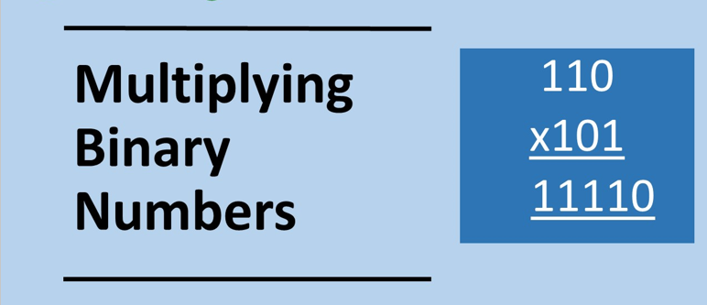

Slide 6
Multiplication binary Rules
Multiplication in binary is the same as it is in denary
0₂ x 0₂ = 0₂
1₂ x 0₂ = 0₂
0₂ x 1₂ = 0₂
1₂ x 1₂ = 1₂
0₁₀ x 0₁₀ = 0₁₀
1₁₀ x 0₁₀ = 0₁₀
0₁₀ x 1₁₀ = 0₁₀
1₁₀ x 1₁₀ = 1₁₀

Slide 7
Worked Example: Multiply the following two binary numbers
 |  |  | 1 | 1 | 1 | 0₂
 |  | x |  | 1 | 0 | 1₂
 |  |  | 1 | 1 | 1 | 0₂
 |  | x |  | 1 | 0 | 1₂
 |  |  | 1 | 1 | 1 | 0₂
 |  |  | 1 | 1 | 1 | 0₂
 |  | x |  | 1 | 0 | 1₂
 |  |  | 1 | 1 | 1 | 0₂
 |  | 0 | 0 | 0 | 0 | 0₂
 |  |  | 1 | 1 | 1 | 0₂
 |  | x |  | 1 | 0 | 1₂
 |  |  | 1 | 1 | 1 | 0₂
 |  | 0 | 0 | 0 | 0 | 0₂
+ | 1 | 1 | 1 | 0 | 0 | 0₂
 |  |  | 1 | 1 | 1 | 0₂
 |  | x |  | 1 | 0 | 1₂
 |  |  | 1 | 1 | 1 | 0₂
 |  | 0 | 0 | 0 | 0 | 0₂
+ | 1 | 1 | 1 | 0 | 0 | 0₂
1 | 0 | 0 | 0 | 1 | 1 | 0₂
We can check by converting to denary:
1 1 1 0₂ = 14₁₀
1 0 1₂ = 5₁₀
1 0 0 0 1 1 0₂ = 14₁₀ x 5₁₀ = 70₁₀

Slide 8
Worked Example: Multiply the following two binary numbers
 |  |  |  | 1 | 1 | 1 | 1 | 0 | 1₂
 |  |  | x |  |  | 1 | 0 | 0 | 1₂
 |  |  |  | 1 | 1 | 1 | 1 | 0 | 1₂
 |  |  | 0 | 0 | 0 | 0 | 0 | 0 | 0₂
 |  |  |  | 1 | 1 | 1 | 1 | 0 | 1₂
 |  |  | x |  |  | 1 | 0 | 0 | 1₂
 |  |  |  | 1 | 1 | 1 | 1 | 0 | 1₂
 |  |  | x |  |  | 1 | 0 | 0 | 1₂
 |  |  |  | 1 | 1 | 1 | 1 | 0 | 1₂
 |  |  |  | 1 | 1 | 1 | 1 | 0 | 1₂
 |  |  | x |  |  | 1 | 0 | 0 | 1₂
 |  |  |  | 1 | 1 | 1 | 1 | 0 | 1₂
 |  |  | 0 | 0 | 0 | 0 | 0 | 0 | 0₂
 |  | 0 | 0 | 0 | 0 | 0 | 0 | 0 | 0₂
 |  |  |  | 1 | 1 | 1 | 1 | 0 | 1₂
 |  |  | x |  |  | 1 | 0 | 0 | 1₂
 |  |  |  | 1 | 1 | 1 | 1 | 0 | 1₂
 |  |  | 0 | 0 | 0 | 0 | 0 | 0 | 0₂
 |  | 0 | 0 | 0 | 0 | 0 | 0 | 0 | 0₂
+ | 1 | 1 | 1 | 1 | 0 | 1 | 0 | 0 | 0₂
1 | 0 | 0 | 0 | 1 | 0 | 0 | 1 | 0 | 1₂
 |  |  |  | 1 | 1 | 1 | 1 | 0 | 1₂
 |  |  | x |  |  | 1 | 0 | 0 | 1₂
 |  |  |  | 1 | 1 | 1 | 1 | 0 | 1₂
 |  |  | 0 | 0 | 0 | 0 | 0 | 0 | 0₂
 |  | 0 | 0 | 0 | 0 | 0 | 0 | 0 | 0₂
+ | 1 | 1 | 1 | 1 | 0 | 1 | 0 | 0 | 0₂
We can check by converting to denary:
1 1 1 1 0 1₂ = 61₁₀
1 0 0 1₂ = 9₁₀
1 0 0 0 1 0 0 1 0 1₂ = 61₁₀ x 9₁₀ = 549₁₀

Slide 9
Multiply the following binary numbers: Questions
a) |  |  |  |  |  | 1 | 1 | 1₂
 |  |  |  |  | x | 1 | 0 | 1₂
b) |  |  |  |  | 1 | 1 | 1 | 0₂
 |  |  |  | x |  | 1 | 1 | 0₂
c) |  |  |  |  | 1 | 1 | 1 | 0₂
 |  |  |  | x |  | 1 | 1 | 1₂
d) |  |  |  |  | 0 | 1 | 1 | 1₂
 |  |  |  | x | 1 | 0 | 1 | 1₂
e) |  |  |  |  | 1 | 1 | 1 | 1₂
 |  |  |  | X |  | 1 | 0 | 0₂

Slide 10
Multiply the following binary numbers: Answers
a) |  |  |  |  |  | 1 | 1 | 1₂
 |  |  |  |  | x | 1 | 0 | 1₂
 |  |  | 1 | 0 | 0 | 0 | 1 | 1₂
b) |  |  |  |  | 1 | 1 | 1 | 0₂
 |  |  |  | x |  | 1 | 1 | 0₂
 |  | 1 | 0 | 1 | 0 | 1 | 0 | 0₂
c) |  |  |  |  | 1 | 1 | 1 | 0₂
 |  |  |  | x |  | 1 | 1 | 1₂
 |  | 1 | 1 | 0 | 0 | 0 | 1 | 0₂
d) |  |  |  |  | 0 | 1 | 1 | 1₂
 |  |  |  | x | 1 | 0 | 1 | 1₂
 |  | 1 | 0 | 0 | 1 | 1 | 0 | 1₂
e) |  |  |  |  | 1 | 1 | 1 | 1₂
 |  |  |  | x |  | 1 | 0 | 0₂
 |  |  |  | 1 | 1 | 1 | 0 | 0₂

