Slide 1
Starter
1) Convert the following to denary
01001001
11001010
11000101
2) Convert the following to binary
81
54
157
3) How many different values can I represent with 7 bits

Slide 2
Starter
1) Convert the following to denary
01001001 - 73
11001010 - 202
11000101 - 197
2) Convert the following to binary
81 - 01010001
54 - 00110110
157 - 10011101
3) How many different values can I represent with 7 bits 128

Slide 3
Binary Addition

Slide 4
Learning objectives
Know the binary addition rules
Perform binary addition

Slide 5
Binary addition rules
To carry out binary addition first we need to know the rules:
0 + 0 = 0
0 + 1 = 1
1 + 0 = 1
1 + 1 = 10 (carry 1)
1+1+1=11 (carry 1)

Slide 6
Binary addition demonstration
https://youtu.be/131P40j8gF8

Slide 7
Example
Carry | 1 | 1
28₁₀ | 0 | 1 | 1 | 1 | 0 | 0
26₁₀ | 0 | 1 | 1 | 0 | 1 | 0
54₁₀ | 1 | 1 | 0 | 1 | 1 | 0
0 1 1 1 0 0
+ 0 1 1 0 1 0
1 1 0 1 1 0
carry 1 1
To check we can convert the numbers back to denary:
11100 = 28
10010 = 26
110000 = 54

Slide 8
Binary addition questions
0 0 1 1 0 0
+ 0 0 1 0 1 0
b) 0 1 1 0 0 1
+ 0 0 1 0 1 0
c) 0 1 0 1 0 0
+ 1 0 1 0 0 1
d) 1 1 1 0 0 1
+ 0 0 0 1 1 0
e) 1 0 1 0 1 0
+ 0 0 0 0 1 1
f) 1 0 0 0 0 1
+ 0 1 0 0 1 1
Check you answers by converting to denary

Slide 9
Questions (check you answers by converting to denary)
0 0 1 1 0 0
+ 0 0 1 0 1 0
0 1 0 1 1 0
b) 0 1 1 0 0 1
+ 0 0 1 0 1 0
1 0 0 0 1 1
c) 0 1 0 1 0 0
+ 1 0 1 0 0 1
1 1 1 1 0 1
d) 1 1 1 0 0 1
+ 0 0 0 1 1 0
1 1 1 1 1 1
e) 1 0 1 0 1 0
+ 0 0 0 0 1 1
1 0 1 1 0 1
f) 1 0 0 0 0 1
+ 0 1 0 0 1 1
1 1 0 1 0 0

Slide 10
Binary addition task
0 0 1 0 1 1 1 1 0
0 0 0 1 0 0 1 0 0
+ 0 1 0 1 0 0 0 1 0
b) 0 0 1 0 0 1 1 1 0
0 0 0 1 0 0 0 0 1
+ 1 1 0 0 0 1 0 1 0
c) 0 0 0 1 1 0 0 1 1
0 1 0 0 1 0 1 0 0
+ 0 0 0 1 0 1 0 0 1
d) 0 1 0 0 1 0 1 1 1
0 0 0 1 1 1 0 0 1
+ 0 0 1 1 0 0 1 1 0
e) 0 1 0 0 1 1 0 0 1
0 0 1 1 0 0 1 1 0
+ 0 0 0 1 0 0 0 1 1
f) 0 0 0 1 0 1 0 0 1
0 0 1 1 0 0 1 0 1
+ 1 0 1 0 1 1 0 1 0
check you answers by converting to denary

Slide 11
Binary addition task
0 0 1 0 1 1 1 1 0
0 0 0 1 0 0 1 0 0
+ 0 1 0 1 0 0 0 1 0
1 0 0 1 0 0 1 0 0
b) 0 0 1 0 0 1 1 1 0
0 0 0 1 0 0 0 0 1
+ 1 1 0 0 0 1 0 1 0
1 1 1 1 1 1 0 0 1
c) 0 0 0 1 1 0 0 1 1
0 1 0 0 1 0 1 0 0
+ 0 0 0 1 0 1 0 0 1
0 1 1 1 1 0 0 0 0
d) 0 1 0 0 1 0 1 1 1
0 0 0 1 1 1 0 0 1
+ 0 0 1 1 0 0 1 1 0
1 0 0 1 1 0 1 1 0
e) 0 1 0 0 1 1 0 0 1
0 0 1 1 0 0 1 1 0
+ 0 0 0 1 0 0 0 1 1
1 0 0 1 0 0 0 1 0
f) 0 0 0 1 0 1 0 0 1
0 0 1 1 0 0 1 0 1
+ 1 0 1 0 1 1 0 1 0
1 1 1 1 0 1 0 0 0
check you answers by converting to denary

Slide 12
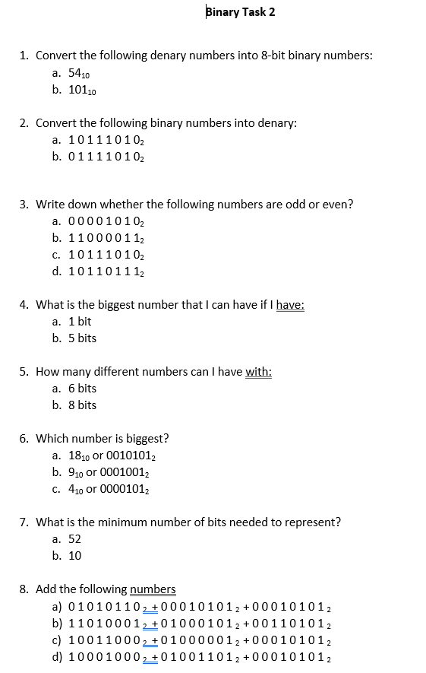
Plenary
Complete the binary task sheet
binary-task-set-2.docx

