Slide 1
What value will be output in each case?
a) num1=21
num2=42
total=num1 + num2
print(total)
b) p=16
q=4
result = p / q
print(result)
c) a=12
b=13
ans=a-b
print(ans)
d) X=3
Y=4
z=x*y
print(z)
e) one=5
two=3
three=one*two
print(three)
63
4
-1
12
15

Slide 2
Assignment, variables and arithmetic operators

Slide 3
Learning objectives
Use a range of arithmetic operators
Explain what variables are
Use assignment to store variables and constants

Slide 4


Slide 5
Arithmetic Operators
Operation | Operator | Example | Result
Add | + | a=4+2 a=b+c | 6
Subtract | - | a=4-2 a=b-c | 2
Divide | / | a=5/2 a=b/c | 2.5
Multiply | * | a=4*2 a=b*c | 8
Modulus (remainder) | % | a=7%3 a=b%c | 1
Integer division (rounds down) | // | a=5//2 a=b//c | 2
Power / exponentiation | ** | 4**2 | 4*4=16

Slide 6
Evaluate the following
11 % 3
15 % 4
20 % 5
19 % 6
2 % 4
9 // 2
17 // 3
21 // 4
2
3
0
1
0
4
5
5

Slide 7
BODMAS
When evaluating expressions, we apply operations in the following order:
  Brackets
  Order
  Division
  Multiplication
  Addition
  Subtraction

Slide 8
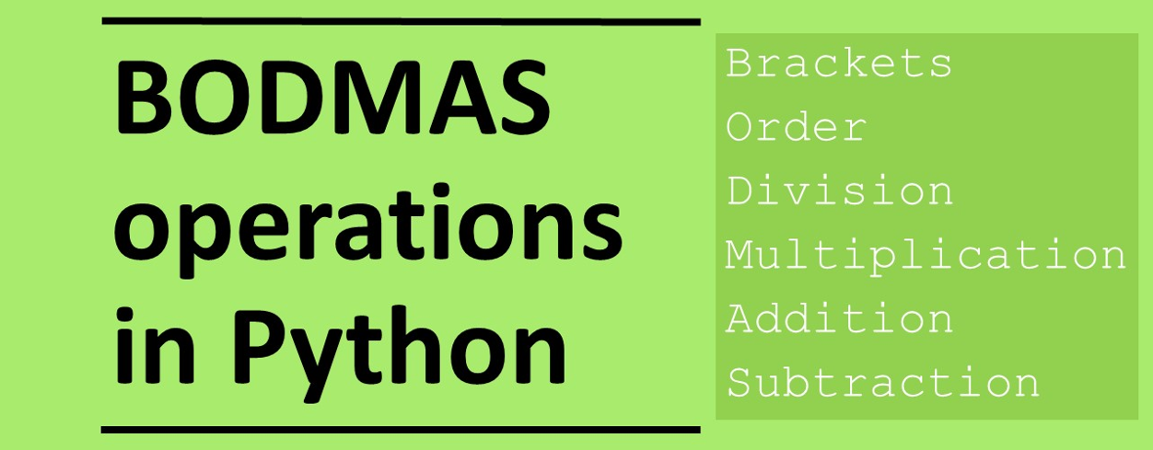

Slide 9
What do the following expressions evaluate to?
25
29
5
5.5
7
1
4.2
3
2
(15 / 3) * 5
3+ 5**2 + 2 - 1
(3**2 + 2)// 2
(2*4+3) / 2
(8+7) // 2
(10 / 2) % 2
((6+1)*3) / 5
((1+1)*8) // 5
17 % 5

Slide 10

Variables and Assignment
You can assign values so that they can be stored in the computer’s memory.
These are called variables
We can think of variables as values that are stored in a box
Instead of referring directly to data value you are referring to the name of the box which points to location where the data are stored in the computer’s memory
Variables are values that can be varied.

Slide 11
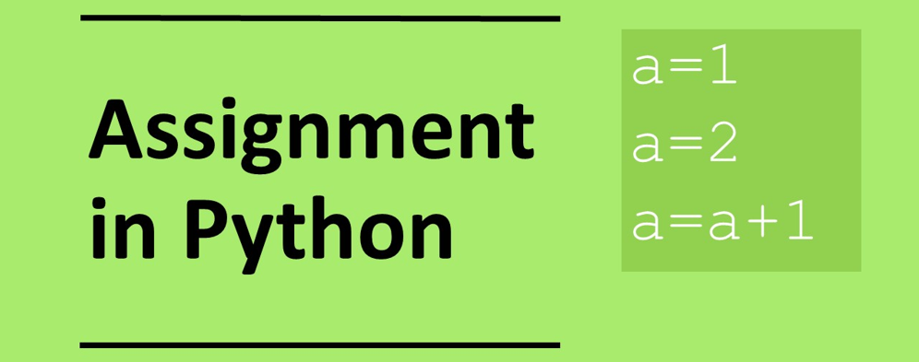

Slide 12
Variables and assignment
We are going to assign a value of 1 to a variable called a
a=1
We can change the value of a variable
a=2
We add 1 to the value stored in a and store the result in a
a=a+1
name of box: a
1
2
3

Slide 13
What value will be output in each case
3) x=0
x=x-1
x=x-1
print(x)
1) y=1
y=y+2
print(y)
2) x=2
x=x+2
print(x)
5) a=10
a=a+1
a=a+2
a=a+3
print(a)
6) score=0
score=score+1
score=score+2
score=score+3
print(score)
4) x=5
x=x*2
x=x*2
x=x*2
print(x)

Slide 14
What value will be output in each case
3) x=0
x=x-1
x=x-1
print(x)
-2
1) y=1
y=y+2
print(y)
3
2) x=2
x=x+2
print(x)
4
5) a=10
a=a+1
a=a+2
a=a+3
print(a)
16
6) score=0
score=score+1
score=score+2
score=score+3
print(score)
6
4) x=5
x=x*2
x=x*2
x=x*2
print(x)
40

Slide 15
What does the following code output?
1 2 3 4 5 6 7 8 9 | num1 = 11 num2 = 3 num3 = num1 // num2 num4 = (num1 % num2) * 2 num5 = num3**(3 – 1) num6 = num3 * (num4 + 1) num7 = num4 + num5 + num6 num7 = num7 * 2 print(num7)
num1
num2
num3
num4
num5
num6
num7

Slide 16
What does the following code output?
1 2 3 4 5 6 7 8 9 | num1 = 11 num2 = 3 num3 = num1 // num2 num4 = (num1 % num2) * 2 num5 = num3**(3 – 1) num6 = num3 * (num4 + 1) num7 = num4 + num5 + num6 num7 = num7 * 2 print(num7)
num1 | 11
num2 | 3
num3 | 3
num4 | 4
num5 | 9
num6 | 15
num7 | 56

Slide 17
Download the code and run the program
1 2 3 4 5 6 7 8 9 | num1 = 11 num2 = 3 num3 = num1 // num2 num4 = (num1 % num2) * 2 num5 = num3**(3 – 1) num6 = num3 * (num4 + 1) num7 = num4 + num5 + num6 num7 = num7 * 2 print(num7)
Get the code from:
assignment.py
Does the code do as you predicted?

Slide 18
Investigate the code
1 2 3 4 5 6 7 8 9 | num1 = 11 num2 = 3 num3 = num1 // num2 num4 = (num1 % num2) * 2 num5 = num3**(3 – 1) num6 = num3 * (num4 + 1) num7 = num4 + num5 + num6 num7 = num7 * 2 print(num7)
Add comments into the code
Identify the variables used in the program
Identify and explain the operators used in the program

Slide 19
Investigate the code - variables
1 2 3 4 5 6 7 8 9 | num1 = 11 num2 = 3 num3 = num1 // num2 num4 = (num1 % num2) * 2 num5 = num3**(3 – 1) num6 = num3 * (num4 + 1) num7 = num4 + num5 + num6 num7 = num7 * 2 print(num7)
Add comments into the code
Identify the variables used in the program
Identify and explain the operators used in the program

Slide 20
Investigate the code - oerators
1 2 3 4 5 6 7 8 9 | num1 = 11 num2 = 3 num3 = num1 // num2 num4 = (num1 % num2) * 2 num5 = num3**(3 – 1) num6 = num3 * (num4 + 1) num7 = num4 + num5 + num6 num7 = num7 * 2 print(num7)
Add comments into the code
Identify the variables used in the program
Identify and explain the operators used in the program

Slide 21
Make: Countdown numbers game.
Given the following numbers 50, 6, 7, 2, 5, 3 try to get the target 423 using only the multiply (*), divide (/), plus and subtract operator.
You can only use each number once.
To start with set each of the numbers to variables eg:
num1=50
num2=6
…
Extension: Now try to get the target using only the modulus and power operators

Slide 22
Countdown answer - example
1 2 3 4 5 6 7 8 9 10 | num1=50 num2=6 num3=7 num4=2 num5=5 num6=3 num7=num1*(num3+num4) # 450 num8=num7-(num2*num5) #420 num9=num8+num3 # 423

Slide 23
Plenary: What does the following code output?
1 2 3 4 5 6 7 8 9 | a = 2 b = 3 c = a + b d = a * 2 e = d + c f = b**2 f=f+2 g = (f + e) // 3 print(g)
a
b
c
d
e
f
g
bit.ly/assignment

Slide 24
Plenary: What does the following code output?
1 2 3 4 5 6 7 8 9 | a = 2 b = 3 c = a + b d = a * 2 e = d + c f = b**2 f=f+2 g = (f + e) // 3 print(g)
a | 2
b | 3
c | 5
d | 4
e | 9
f | 11
g | (11+9)//3 = 6

