Slide 1
Artificial Intelligence

Slide 2
Learning objectives
Explain and code up three artificial intelligence approaches:
Linear Regression
Minimax
Genetic Algorithm
Artificial Neural Network

Slide 3
Linear Regression

Slide 4
Machine Learning
Machine learning is a branch of AI that uses data to make predictions and classifications.
Linear regression is probably the simplest machine learning approach
Deep learning with neural networks are the most complex
With machine learning there is a need to train a model on an existing set of data.

Slide 5
Carbon Dioxide versus Temperature
We will use linear regression to explore the correlation between global mean temperature anomalies (deviation from a long term mean) and concentration of Carbon Dioxide in the atmosphere.
The Carbon Dioxide data come from https://gml.noaa.gov/ccgg/trends/data.html
They show mean global annual concentrations of Carbon Dioxide in PPMV (Parts Per Million by Volume) in the atmosphere from 1959 to 2022.
The temperature anomalies come from https://data.giss.nasa.gov/gistemp/graphs/graph_data/Global_Mean_Estimates_based_on_Land_and_Ocean_Data/graph.txt

Slide 6
Predict, Run and Investigate
The code can be downloaded from here linear_regression/linear_regression.py

Slide 7
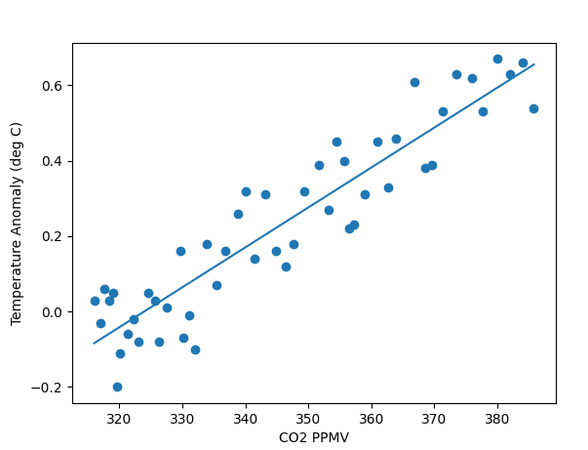
Plot the predictor and the predictand
Split the data into a training and testing set.
We will use 80% of the data for training and 20% for testing
We will plot the predictor CO₂ against the predictand (the variable that we wish to predict) temperature anomaly
We will fit a linear regression model to the training data. This is the learning phase.
The important point to note is that correlations do not presuppose causality. You will need to use other evidence to demonstrate that (eg an understanding of the radiative properties of CO₂)

Slide 8
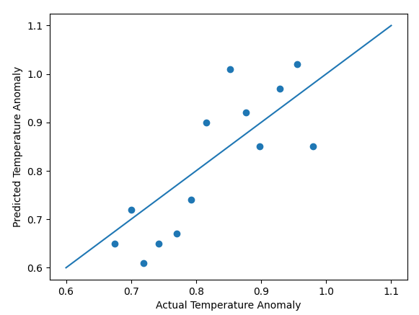
Plot the predictor and the predictand
Use the testing data to evaluate our model.
Plot the observed temperature anomalies against the modelled values

Slide 9
Modify the code
Find your own pair of variables that have high correlation and experiment. eg
sales of ice cream versus temperature
A countries GDP versus happiness index
Student attendance versus exam mark

Slide 10
Minimax

Slide 11
Minimax for noughts and crosses
The Minimax algorithm is used for looking ahead in a 2 player game like in chess. In fact it was the minimax algorithm running on Deep Blue that defeated Chess Grand Master Gary Kasparov in 1997.
We are going to apply it to the noughts and crosses game which is much simpler.
We will explore an AI that will be impossible to beat, although you will still be able to draw if you use the same strategy.
The minimax algorithm is recursive and is similar in some ways to the depth first tree search algorithm.

Slide 12
Closing state game play
It is the turn of X and there are three places where it can go. If X goes in position (2,1) that X wins.
If X goes in (1,2) then X could still win but it would depend where O goes.
If X goes in 2,3 then there is a chance that O will win.
So based on the minimax strategy the best move for X is to go in (2,1)

Slide 13
Predict, Run and Investigate
Download the code from minimax/minimax.py

Slide 14
Genetic Algorithms

Slide 15
Genetic algorithm for solving the travelling salesman problem
We know that the travelling salesman problem is intractable for even a small number of towns and it will take a long time to check out all possible combinations.
We can use a genetic algorithm, which is a heuristic that gives is a good solution even if it is not necessarily the best solution in a sensible amount of time.
Genetic algorithms are based on Darwinian evolutionary principles of survival of the fittest.
Fitness is determined by some criteria. In the travelling salesman problem fitter solutions are those which have a shorter journey.

Slide 16
Genetic algorithm for solving the travelling salesman problem: How it works
Select multiple routes visiting the cities in a random order
Calculate the fitness (distance) for each route
Rank the routes by fitness
Reject half the routes with the worst fitness (longest distance) and duplicate the routes with the best fitness
Mutate a small percentage of routes, by swapping the order of two of the towns along the journey
Crossover a pair of routes, by mixing together
Go back to step 3 and repeat until you find a route with a acceptable fitness

Slide 17
Select multiple routes visiting the cities in a random order.
Calculate the fitness (distance) for each route
Rank the routes by fitness
2 | 4 | 5 | 1 | 3
1 | 4 | 3 | 2 | 5
3 | 5 | 1 | 2 | 4
3 | 1 | 2 | 5 | 4
4 | 2 | 1 | 3 | 5
5 | 1 | 2 | 3 | 4
2 | 4 | 5 | 1 | 3
1 | 4 | 3 | 2 | 5
3 | 5 | 1 | 2 | 4
3 | 1 | 2 | 5 | 4
4 | 2 | 1 | 3 | 5
5 | 1 | 2 | 3 | 4
103
5 | 1 | 2 | 3 | 4
4 | 2 | 1 | 3 | 5
1 | 4 | 3 | 2 | 5
3 | 1 | 2 | 5 | 4
2 | 4 | 5 | 1 | 3
3 | 5 | 1 | 2 | 4
57
87
63
Genetic algorithm
121
87
91
91
63
103
57
121
Reject half the routes with the worst fit (longest distance) and duplicate the routes with the best fitness.
Mutate a small percentage of routes, by swapping the order of two of the towns along the journey.
Crossover a pair of routes, by mixing together
5 | 1 | 2 | 3 | 4
4 | 2 | 1 | 3 | 5
1 | 4 | 3 | 2 | 5
5 | 1 | 2 | 3 | 4
4 | 2 | 1 | 3 | 5
1 | 4 | 3 | 2 | 5
57
5 | 1 | 2 | 3 | 4
4 | 2 | 1 | 3 | 5
5 | 4 | 3 | 2 | 1
5 | 1 | 2 | 3 | 4
4 | 3 | 1 | 2 | 5
1 | 4 | 3 | 2 | 5
5 | 1 | 2 | 3 | 4
4 | 2 | 1 | 3 | 5
5 | 4 | 3 | 2 | 1
1 | 4 | 2 | 3 | 5
4 | 3 | 1 | 2 | 5
5 | 1 | 3 | 2 | 4
63
87
57
63
87

Slide 18
Travelling salesman problem

Slide 19
Things To Try
Predict, run and investigate ga/GA.py, the Genetic Algorithm to solve the travelling salesman problem.
Modify the code to used a different sorting algorithm, eg use Merge sort, insertion sort
Use a different crossover algorithm, there are lots so you will need to do some research.

Slide 20
Artificial Neural Networks

Slide 21
Single output node ANN
Input 1
Weight 1
Output node
Weight 2
$$x=Σ_{i}W_{i}I_{i}$$
Input 3
Weight 3
Input 3

Slide 22
ANN
Before we can use an ANN we need to train it with existing input and output data in order to determine the weights.
We do this by comparing the calculated output with our desired output. We continue to tweak the weights until we are happy with the output from the ANN using a technique called back propagation.
The sigmoid function is used because it has nice mathematical properties because we it is differentiated as a function of itself which makes minimising the error much simpler that it would be otherwise

Slide 23
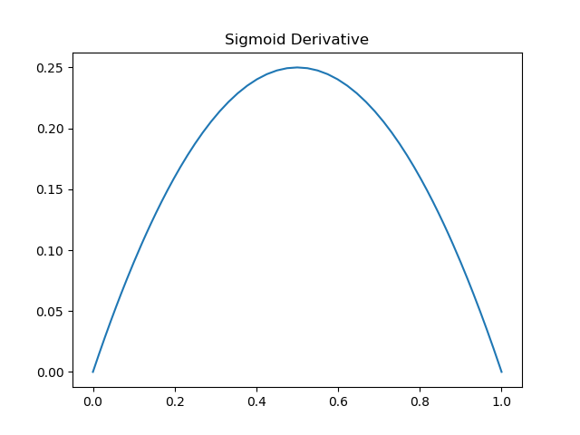
Sigmoid Function
$$y=\frac{1}{1+ⅇ^{−x}}$$
$$\frac{dy}{dx}=y(1−y)$$

Slide 24
Simple one node ANN back propogation
import math
def sigmoid(x):
return 1/(1+math.exp(-x))
def sigmoid_deriv(x):
return x * (1 - x)
def ann():
x=[[0,0,1],[1,1,1],[1,0,1],[0,1,1]]
y=[0,1,1,0]
w=[0.1,0.1,0.1]
output=[0,0,0,0]
error=[0,0,0,0]
delta=[0,0,0,0]
for k in range(10000):
s=[0,0,0,0]
for j in range(4):
for i in range(3):
s[j] = s[j] + w[i]*x[j][i]
for j in range(4):
output[j]=sigmoid(s[j])
error[j] = y[j] - output[j]
delta[j] = error[j] * sigmoid_deriv(output[j])
for i in range(3):
d=0
for j in range(4):
d=d+delta[j]*x[j][i]
w[i]=w[i]+d
print(w,output)
Predict, run and investigate the code
Download the code from ann/ann_1_node.py

Slide 25
Muiti-Layer ANN
Predict, run and investigate the ANN code ann/ann_3_layer.py with a hidden layer that can it to recognise different numbers and/or letters.
0 | 0 | 0 | 0 | 0 | 0 | 0 | 0
0 | 0 | 0 | 0 | 0 | 0 | 0 | 0
0 | 0 | 1 | 0 | 0 | 0 | 0 | 0
0 | 0 | 1 | 0 | 0 | 0 | 0 | 0
0 | 0 | 1 | 0 | 1 | 0 | 0 | 0
0 | 0 | 1 | 1 | 1 | 1 | 0 | 0
0 | 0 | 0 | 0 | 1 | 0 | 0 | 0
0 | 0 | 0 | 0 | 0 | 0 | 0 | 0

