Slide 1
In pairs, predict what the following code does
1 2 3 4 5 6 7 8 9 10 11 12 13 | import requests import matplotlib.pyplot as plt lat="52.52" long="13.41" start_date="2023-02-02" end_date="2023-02-03" path="https://api.open-meteo.com/v1/forecast\ ?latitude="+lat+"&longitude="+long+"&hourly=\ temperature_2m&start_date="+start_date+"&end_date="+end_date r=requests.get(path) data_time=r.json()['hourly']['time'] data_temp=r.json()['hourly']['temperature_2m'] plt.xticks(rotation=90) plt.plot(data_time,data_temp) plt.show()

Slide 2
Application Programming Interfaces

Slide 3
Learning objectives
Know how to use Web Application Programming Interface to get data off the internet
Use json formats
Plot the data

Slide 4
APIs
Web APIs are designed for large quantities of data to be downloaded over the internet normally in JSON format.
The best way to learn about APIs is to use examples from a wide variety of applications. We are going to use APIs for three applications:
Collecting weather data
Collecting financial data
Collecting football data

Slide 5
Collecting weather data

Slide 6
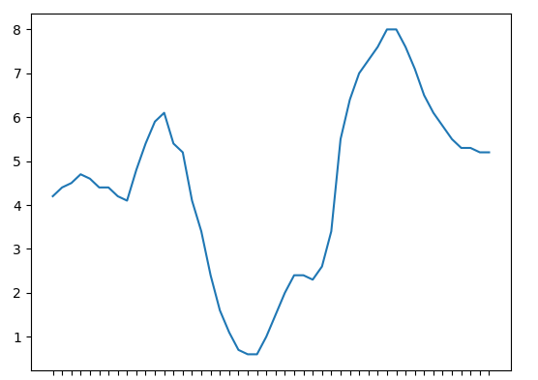
Collecting weather data
We are going to collect our weather data from Open Meteo API: https://open-meteo.com/en/docs
You can collect all sorts of weather data and you can read through the API documentation.
We are going to collect data for a 2 day forecast of temperature at hourly intervals

Slide 7
Download, Run and Investigate the code
Download the code from code/met-data-api-open.py
To run the code you will need to update the start_date to today’s date and stop_date to tomorrow’s date
Add comments to the code explaining what each line does

Slide 8
Investigate the code
1 2 3 4 5 6 7 8 9 10 11 12 13 | import requests import matplotlib.pyplot as plt # latitude and longitude of site # where we wish to get the data lat="52.52" long="13.41“ # Start date should be today’s date # End date should be tomorrow’s date start_date="2023-02-02" end_date="2023-02-03" # Path where the data are path="https://api.open-meteo.com/v1/forecast\ ?latitude="+lat+"&longitude="+long+"&hourly=\ temperature_2m&start_date="+start_date+"&end_date="+end_date # Request the data r=requests.get(path) # extract the data that we want data_time=r.json()['hourly']['time'] data_temp=r.json()['hourly']['temperature_2m'] # Plot the data plt.xticks(rotation=90) plt.plot(data_time,data_temp) plt.show()

Slide 9
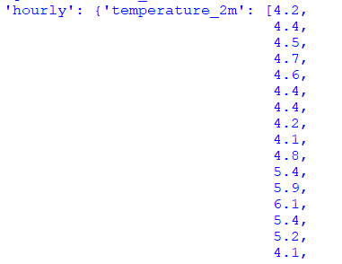
Extracting data from json
To extract the temperature data we need to follow the tree:
hourly >
temperature_2m
r.json()['hourly']['temperature_2m']

Slide 10
Modify the code
Choose a different location to get weather data for
Look at the API documentation to get the hourly forecast rain data for the next 7 days.
Format the output plots (eg add labels and title)

Slide 11
Get Bitcoin data

Slide 12
In pairs predict what the following code does
1 2 3 4 5 6 7 8 9 | import time import requests while True: api="https://api.coindesk.com/v1/bpi/currentprice.json" r=requests.get(api) t=r.json()["time"]["updatedISO"] bitcoin=r.json()["bpi"]["GBP"]["rate"] print(t + " Bitcoin Price in GBP =", bitcoin) time.sleep(60)

Slide 13
Download, Run and Investigate the code
Download the code from code/bitcoin-ticker-api-open.py
Run the code. Does it do as you expected?
Add comments to the code explaining what each line does

Slide 14
Example output
This is a Bitcoin ticker and shows the current value of the Bitcoin.
Example output of Bitcoin price against GBP every 60 seconds from Coindesk.

Slide 15
Modify: Things to try
Collect data over a period of time (eg 30 mins) and plot
Try a different cryptocurrency
Collect data on the price of bitcoin in US Dollars.

Slide 16
Get football data

Slide 17
API Key
Often, you will need to register with a site to collect data and you will be issued with an API key.
For the football data that we are collecting you will need to get an API key from: api.football-data.org
You will need this API key before you run the code: code/football-data-api-open.py

Slide 18
Get football data from: api.football-data.org
import http.client
import json
import pprint
api_key="Put your API Key here“
def get_data(path):
connection = http.client.HTTPConnection('api.football-data.org’)
headers = { 'X-Auth-Token': api_key }
connection.request('GET', path, None, headers )
response = json.loads(connection.getresponse().read().decode())
return response

Slide 19
Get football data from: api.football-data.org
# Get list of teams
response=get_data('/v2/competitions/PL/teams’)
for r in response['teams’]:
print (r['name'],r['id’])
# Get list of matches for Arsenal FC.
response=get_data('/v2/teams/57/matches?status=FINISHED’)
pprint.pprint(response)
# Current standings
response=get_data('/v2/competitions/PL/standings’)
pprint.pprint(response)
# Current standings for home games only
response=get_data('/v2/competitions/PL/standings?standingType=HOME’)
pprint.pprint(response)

Slide 20
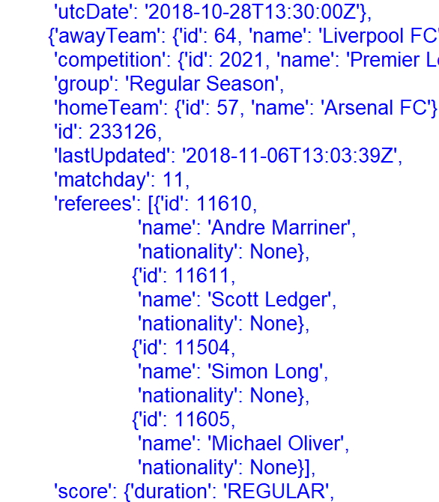
Example output

Slide 21
Things to try
Get the current form for each team in the Premier League, by calculating the number of points teams have gained in the last 4 or 6 games.
Devise a system of predicting scores for next weekends games based on previous data.

