Slide 1
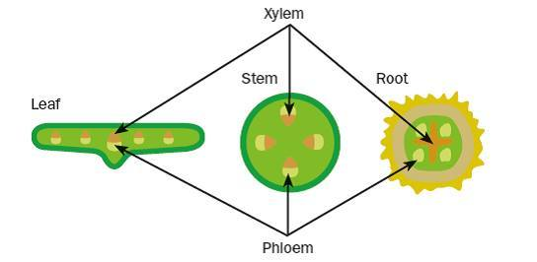
Knowledge retrieval question
https://pollev.com/science1s478
From memory, draw three diagrams to show the shape and location of the xylem and phloem in the roots, stem and leaves (3 marks)

Slide 2
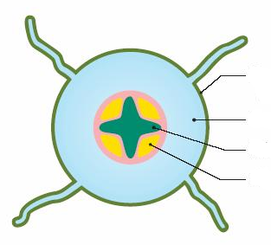
The roots
Endodermis
Epidermis
Vascular bundle found in the middle to help the plant withstand the tugging strains as the stem and leaves are blown in the wind.
Exodermis
Cortex – filled with parenchyma cells (packing/supporting tissue)
Xylem
Vascular bundle in the roots
Phloem
Cross shape helps with strength

Slide 3
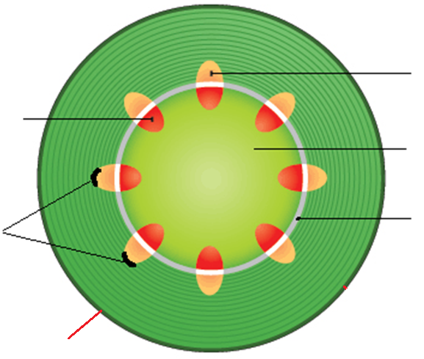
The stem
Vascular bundles arrange around the edge to give the stem structure and support
Phloem (outer edge)
Xylem (inner edge)
Parenchyma
Called the Pith (central packing tissue)
Sclerenchyma fibres
Fibrous cap on the outside of the vascular bundles
Contain lignin (impermeable)
Provides structure/support to the stem
Pith
Z
Cambium central line
(meristem cells)
Responsible for secondary growth
Epidermis (inside)
Exodermis (outside)
contain high cellulose levels
For structure and support
Meristem tissue
Notes:
Having the stronger xylem vessels in the centre provides strength to the stem and acts like an internal ‘scaffolding’ to support the stem and prevent it from breaking in the wind.

Slide 4
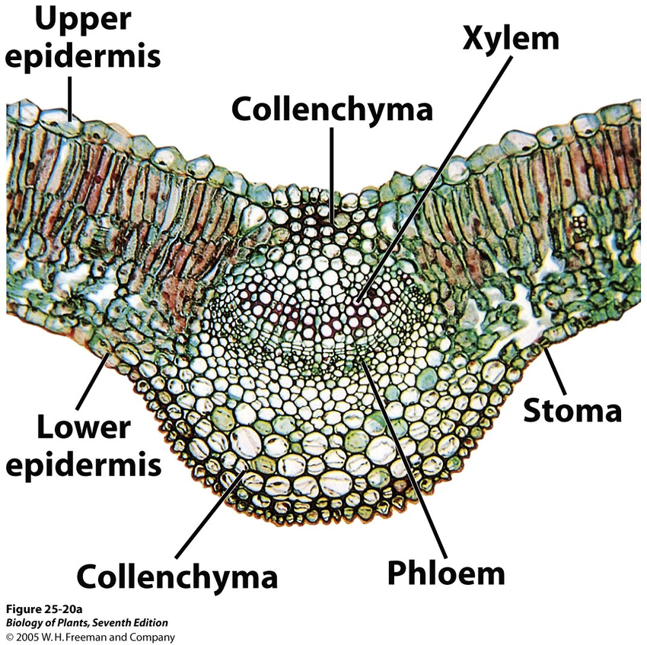

Slide 5
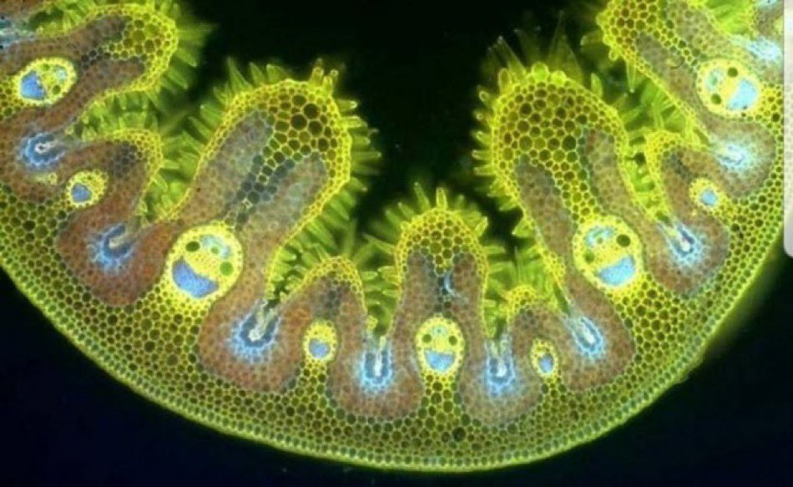
Notes:
Vascular bundles in grass!!

Slide 6

https://pollev.com/science1s478

Slide 7
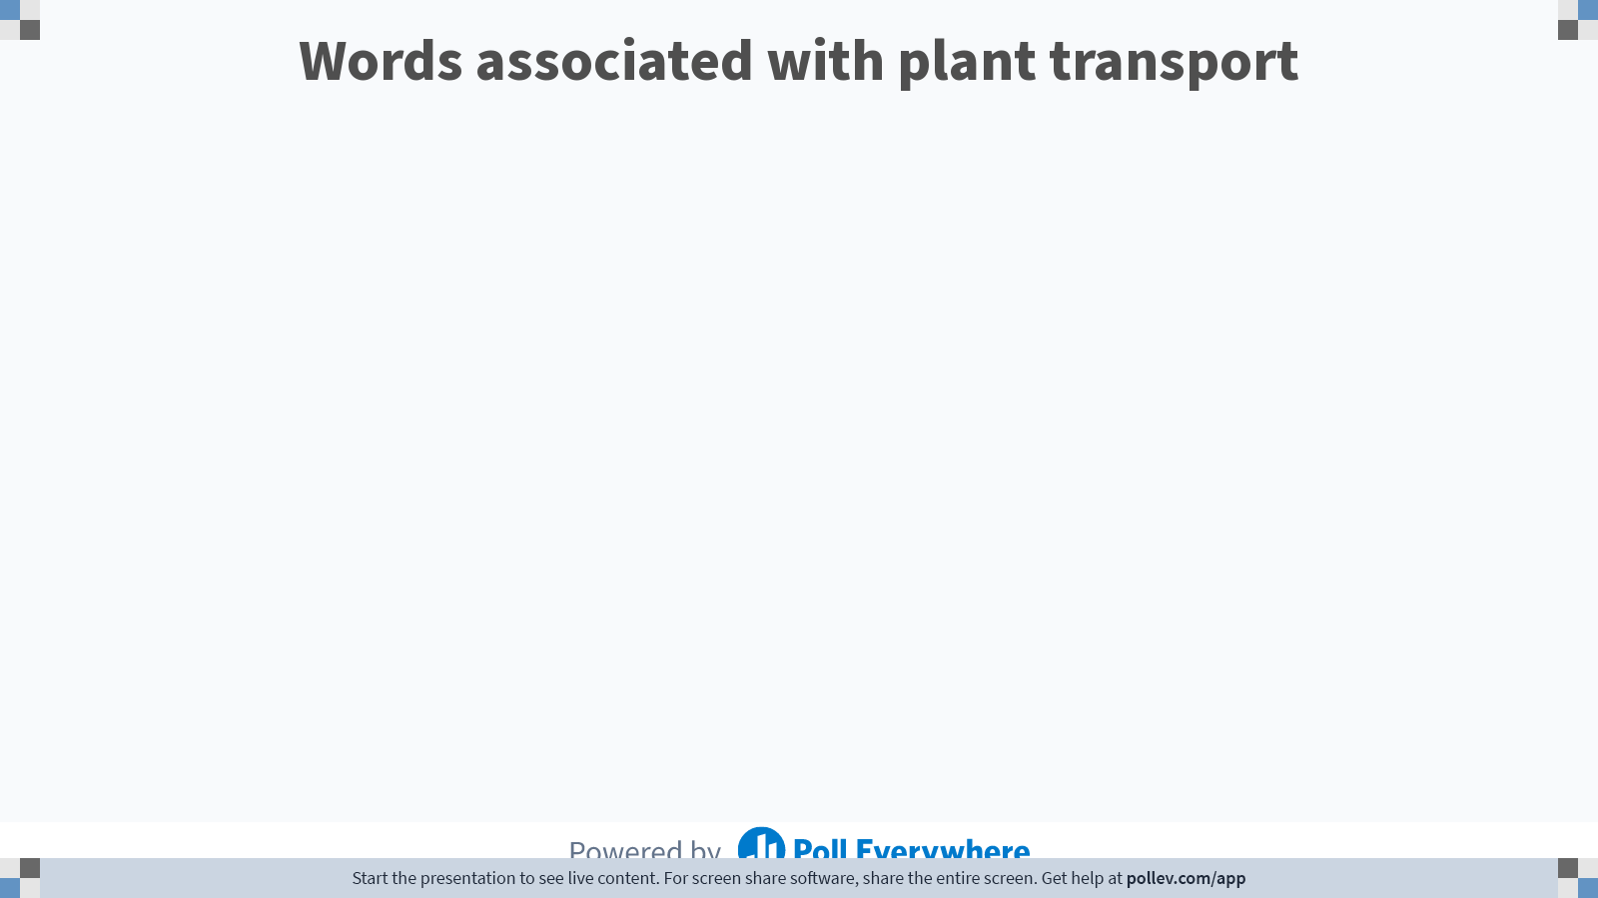
Notes:
Poll Title: Do not modify the notes in this section to avoid tampering with the Poll Everywhere activity.
More info at polleverywhere.com/support
Words associated with plant transport
https://www.polleverywhere.com/free_text_polls/qYLHTlGAWuF8o8ysBpMxD

Slide 8
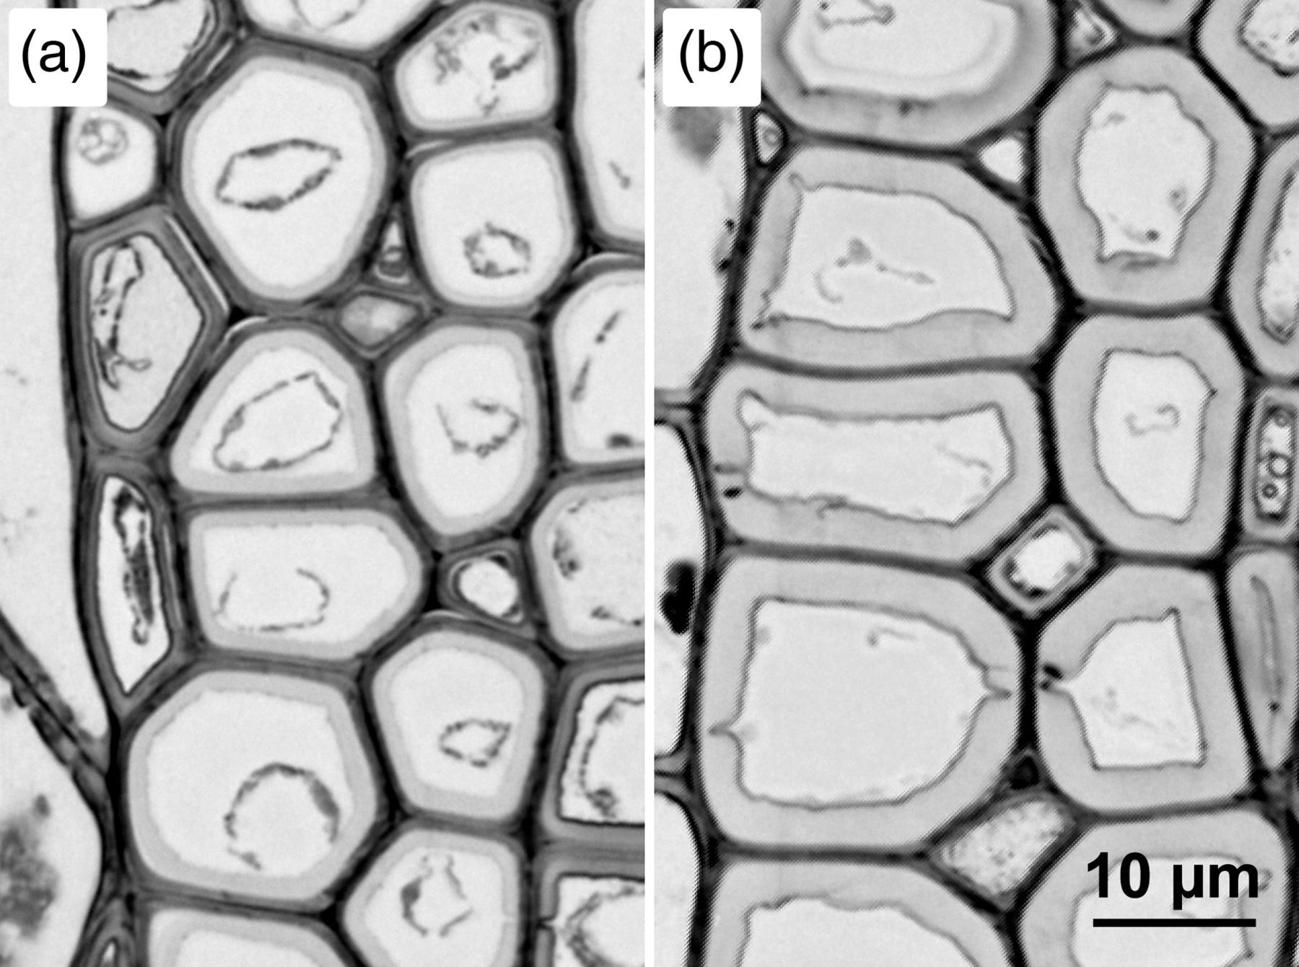
Lignin
While cellulose is the main component of the primary plant cell wall.
lignin is produced to thicken secondary cell walls, fibres and vessels of vascular tissue.

Slide 9
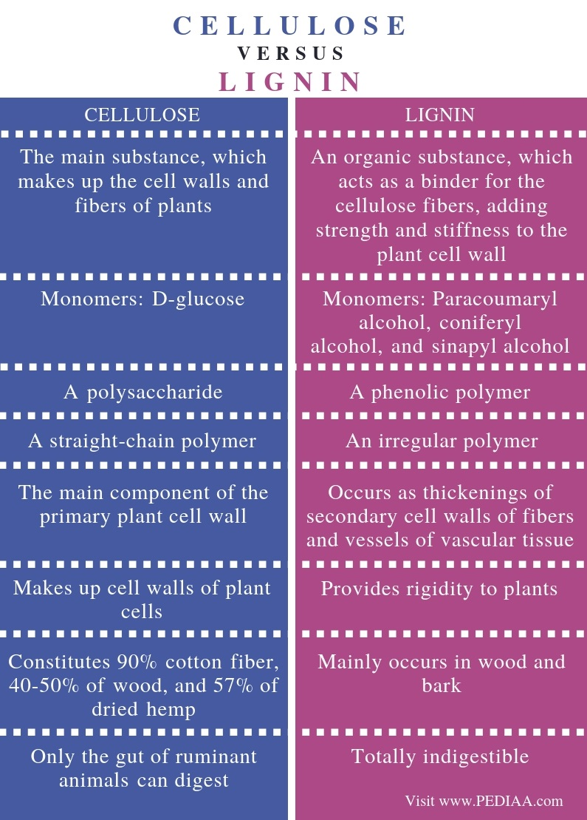
Some comparative information

Slide 10
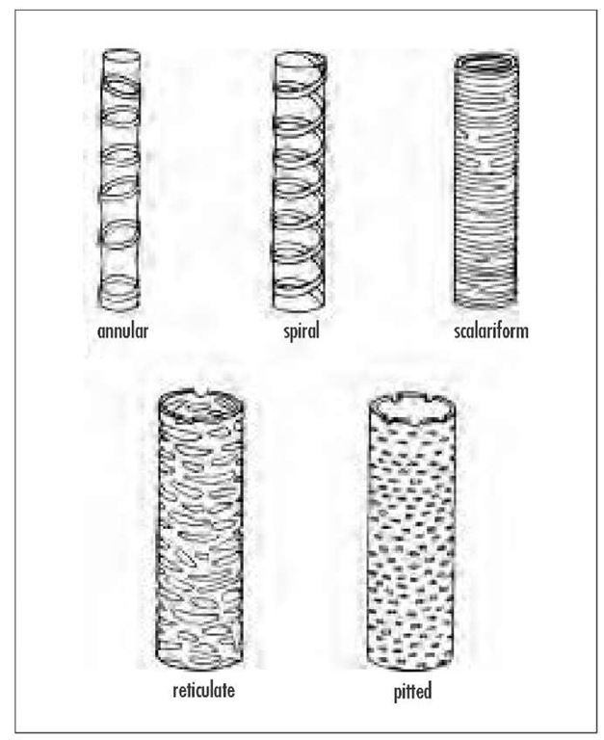
Lignin formation
SPIRAL - arranged in a spiralling shape
ANNULAR - arranged in discrete rings across the xylem vessel
RETICULATE - arranged in a network of broken rings

Slide 11
https://pollev.com/science1s478

Slide 12
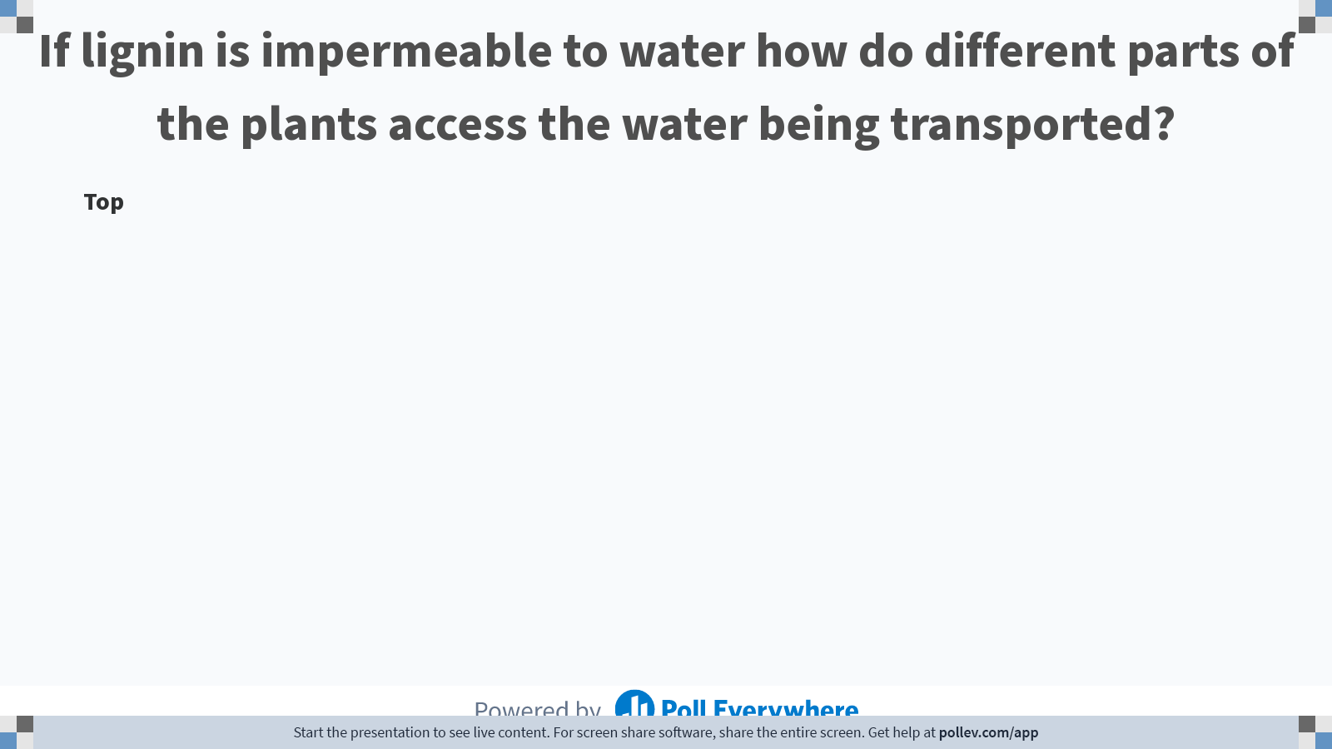
Notes:
Poll Title: Do not modify the notes in this section to avoid tampering with the Poll Everywhere activity.
More info at polleverywhere.com/support
If lignin is impermeable to water how do different parts of the plants access the water being transported?
https://www.polleverywhere.com/discourses/Yo2Qy2yAZOFuIbpWXWDoM

Slide 13
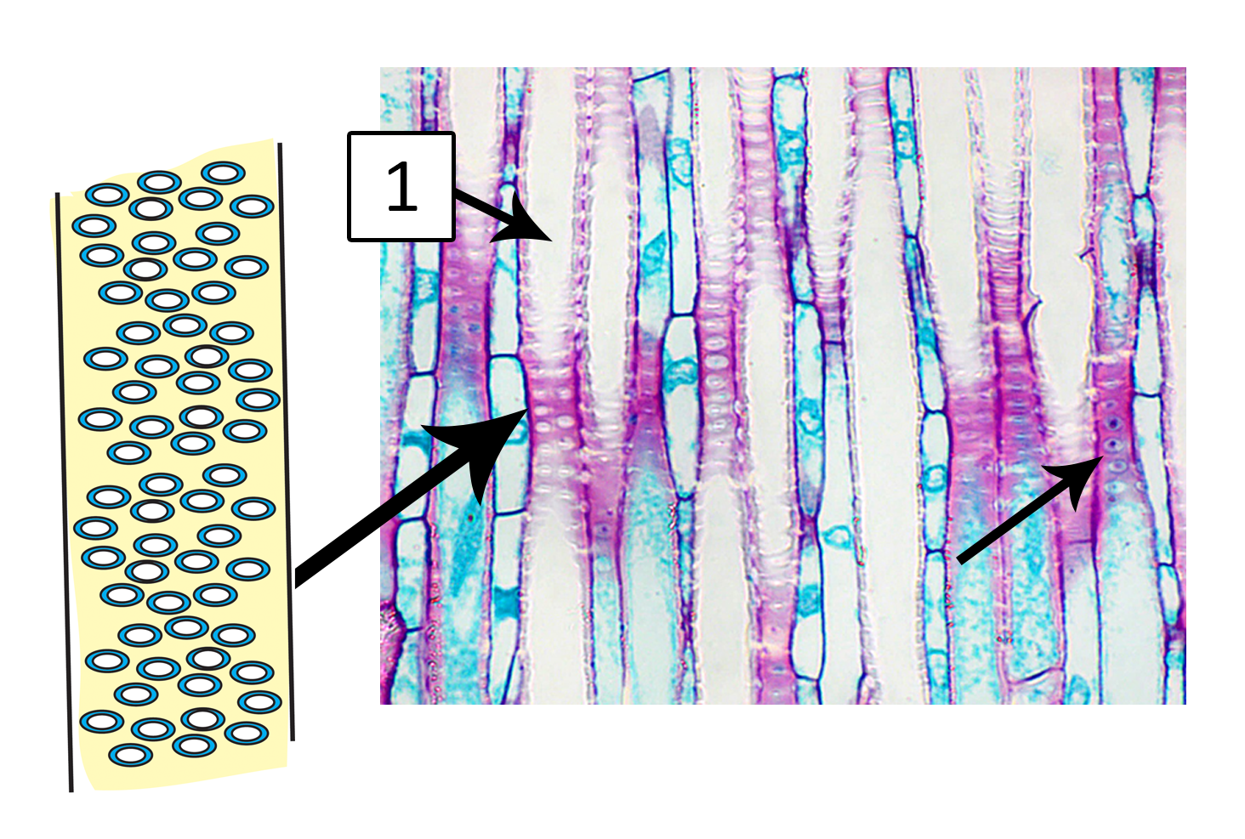
Pits
Pits are cavities in the lignified cell walls of xylem, which act as a channel for water and mineral ions into the adjacent cells.
Does the amount of lignin vary throughout the plant?

Slide 14
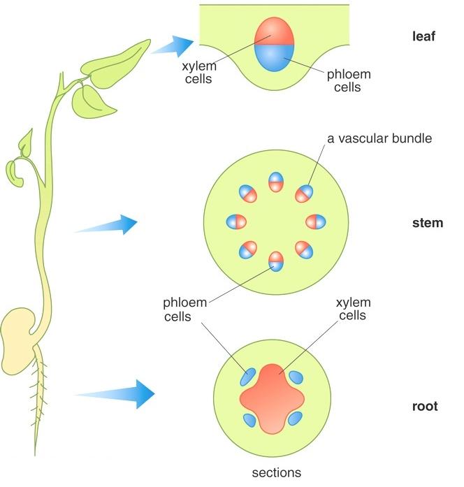
Pits – allow water in and out
Lignin also varies throughout the plant:
Very little lignin in the leaves because water is required for photosynthesis
More in stem - water not required as much and more structure needed

Slide 15
Water and water transport

Slide 16
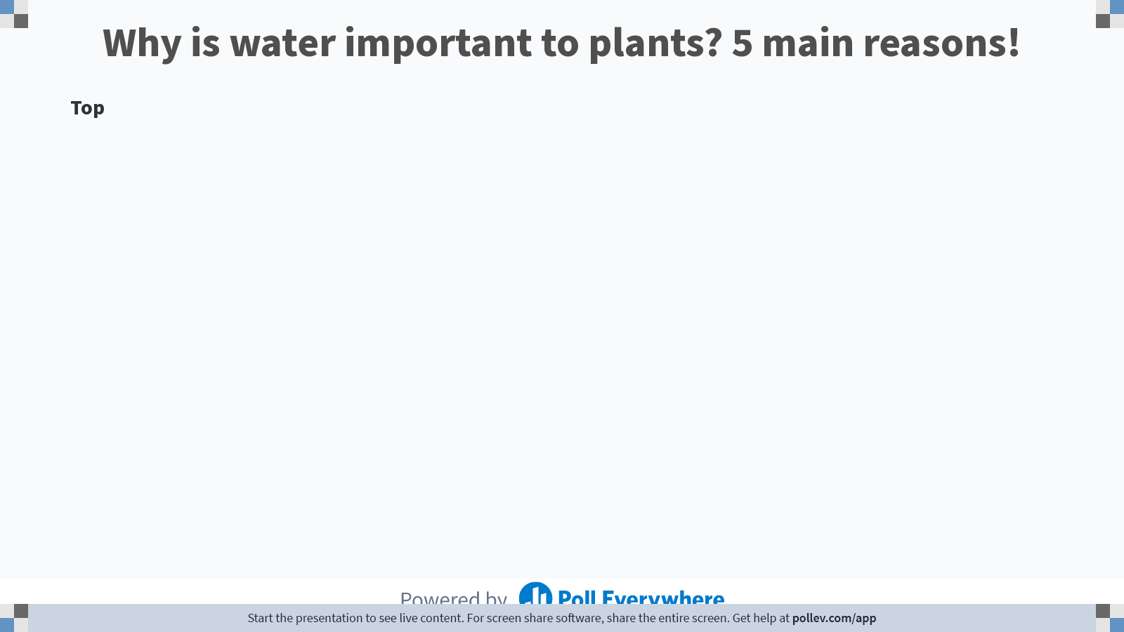
Notes:
Poll Title: Do not modify the notes in this section to avoid tampering with the Poll Everywhere activity.
More info at polleverywhere.com/support
Why is water important to plants? 5 main reasons!
https://www.polleverywhere.com/discourses/4ilMxsdDQvxToHyPKDScm

Slide 17

List five reasons water is important in plants

Slide 18
Water is key to both structure and metabolism in plants:
Finish the sentences
Turgor pressure (or hydrostatic pressure) is the force exerted by stored water against a c….. w…... This provides a hydrostatic skeleton to s………….. the stem and leaves
Turgor pressure also drives cell e……………..
Loss of water helps keep the plant ………….
Mineral ions and products of photosynthesis are t…………… in aqueous solutions
Water is a raw material for p………………….
Notes:
Transpiration keeps plant cool.Cooling effect:
The leaves absorb the radiant energy. Some of the light energy is utilised in photosynthesis, rest is converted into heat energy resulting in an increase in leaf temperature. However, rapid loss of water in the form of water vapour from the aerial parts of the plant through transpiration brings down their temperature. Transpiration thus provides a significant cooling effect which keeps the plant from being over heated.

Slide 19
Water is key to both structure and metabolism in plants:
Finish the sentences
Turgor pressure (or hydrostatic pressure) is the force exerted by stored water against a cell wall. This provides a hydrostatic skeleton to support the stem and leaves
Turgor pressure also drives cell expansion
Loss of water helps keep the plant cool
Mineral ions and products of photosynthesis are transported in aqueous solutions
Water is a raw material for photosynthesis
Notes:
Transpiration keeps plant cool.Cooling effect:
The leaves absorb the radiant energy. Some of the light energy is utilised in photosynthesis, rest is converted into heat energy resulting in an increase in leaf temperature. However, rapid loss of water in the form of water vapour from the aerial parts of the plant through transpiration brings down their temperature. Transpiration thus provides a significant cooling effect which keeps the plant from being over heated.

Slide 20
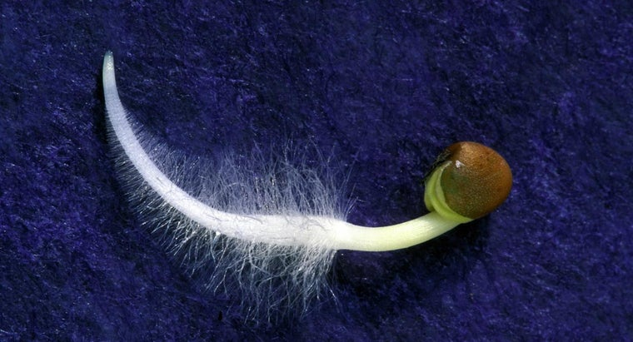
Root hair cell
Movement of water into the root
State and explain four adaptations of a root hair cell
Large SA:V ratio – efficient exchange surface
Thin surface layer – short diffusion pathway
Many mitochondria (produce ATP) to actively pumped ions into cell - maintain the water potential gradient between the soil and the cell.
Microscopic – can penetrate easily between soil particles
Notes:
Soil has a very high water potential (low concentration of dissolved minerals)
The cytoplasm and vacuole sap of the root hair cell contains sugar, mineral ions, amino acids – low water potential
Water moves in via osmosis

Slide 21
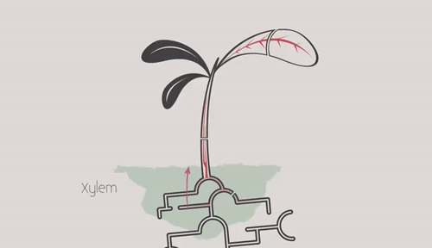
Why is it harder to transport substances around a plant compared to animals?

Slide 22
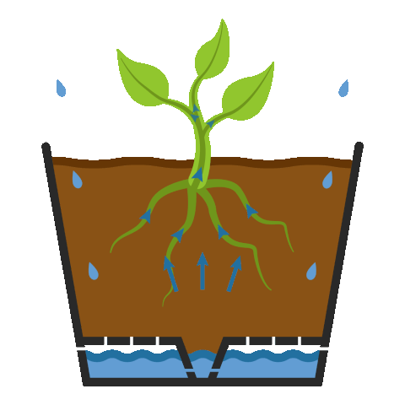
Pathway of water in plants

Slide 23
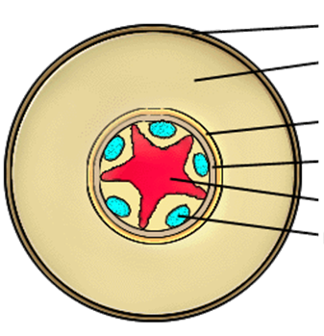
Cross section Dicotyledonous root
*Pericycle = thin layer of parenchyma and sclerenchyma tissue. Found between the endodermis and the vascular bundle
Label your root and then complete the pathway of the water to the xylem
Water moves up through the plant by the process of transpiration.
Pathway taken by water into the xylem in the root:
Soil → …….……… → …….…. → ………….. → ………… → …………..

Slide 24
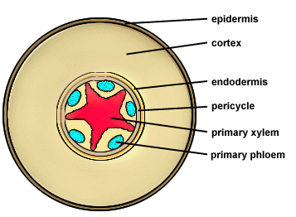
Cross section Dicotyledonous root
Water moves up through the plant by the process of transpiration.
Pathway taken by water into the xylem in the root:
Soil → Epidermis → Cortex → Endodermis → pericycle → Xylem
c…………….
e…………
p……………..
x……………..

Slide 25
Cross section Dicotyledonous root
*Pericycle = thin layer of parenchyma and sclerenchyma tissue. Found between the endodermis and the vascular bundle. Sometimes called the stele.
Water moves up through the plant by the process of transpiration.
Pathway taken by Water:
Soil → Epidermis → Cortex → Endodermis → pericycle → Xylem

Slide 26
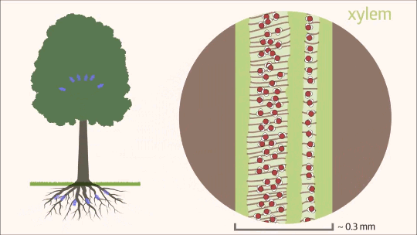
Water can travel though two pathways along this journey from soil → Xylem

Slide 27
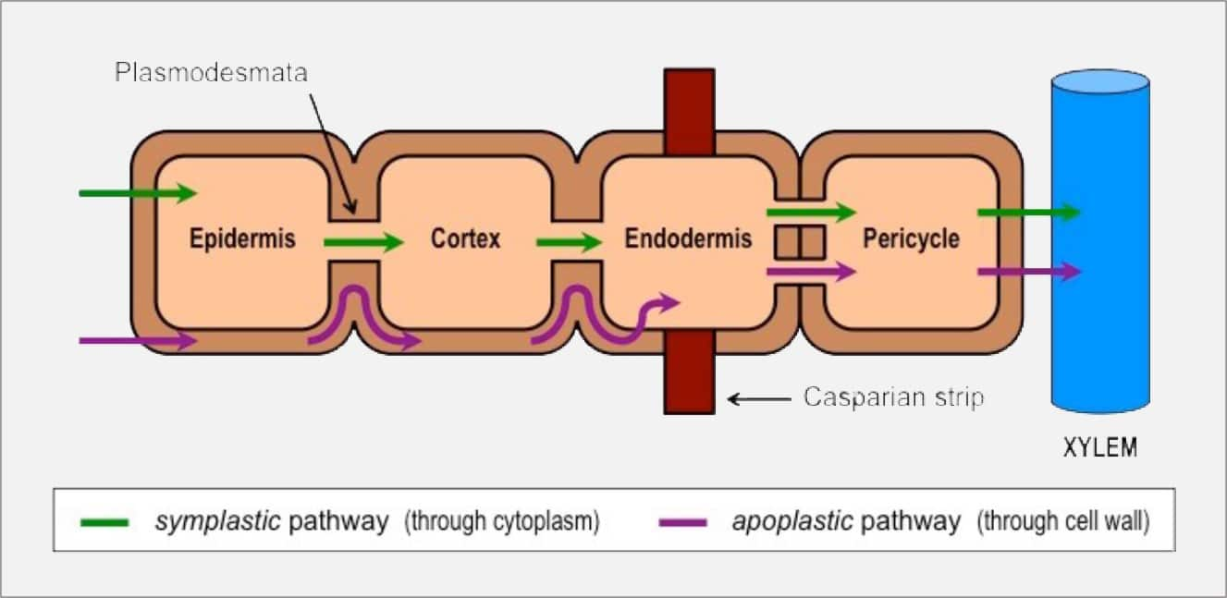
Water takes two routes through the plant cells in the roots to the xylem
Symplast pathway (through cytoplasm)
Apoplast pathway (between and through cell walls, intercellular faces)
*You may also see a vacuolar pathway through the vacuole in some diagrams

Slide 28
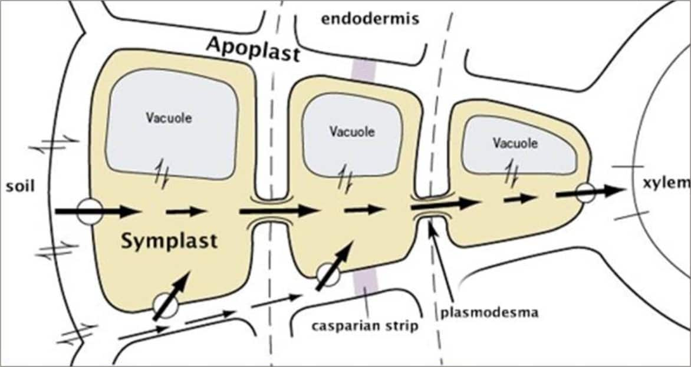
Discuss what you think the role of The Casparian Strip plays in the movement of water towards the xylem.
We will share our thoughts on the board in 2 minutes.

Slide 29
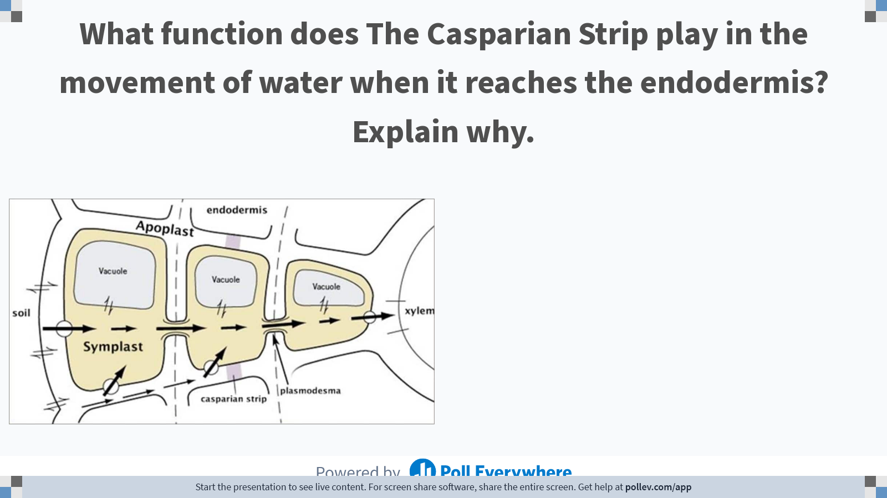
Notes:
Poll Title: Do not modify the notes in this section to avoid tampering with the Poll Everywhere activity.
More info at polleverywhere.com/support
What function does The Casparian Strip play in the movement of water when it reaches the endodermis? Explain why.
https://www.polleverywhere.com/free_text_polls/bO8wJMCGzBm8CnjLZAQeV

Slide 30
The Casparian strip
Made from a waxy, impermeable material called suberin located in the apoplast pathway in the endodermis.
Upon reaching the endodermis water in the apoplast pathway is forced into the cytoplasm joining the symplast pathway.
As water passes through the selectively permeable cell surface membrane into the cytoplasm, it removes any toxic solutes/pathogens. This is because no carrier proteins are present to admit them.
Notes:
Robert Caspary – discovered the thickening of the cell wall and called it schulchzsyed – then later called caspey strip – then Caspian strip later on

Slide 31
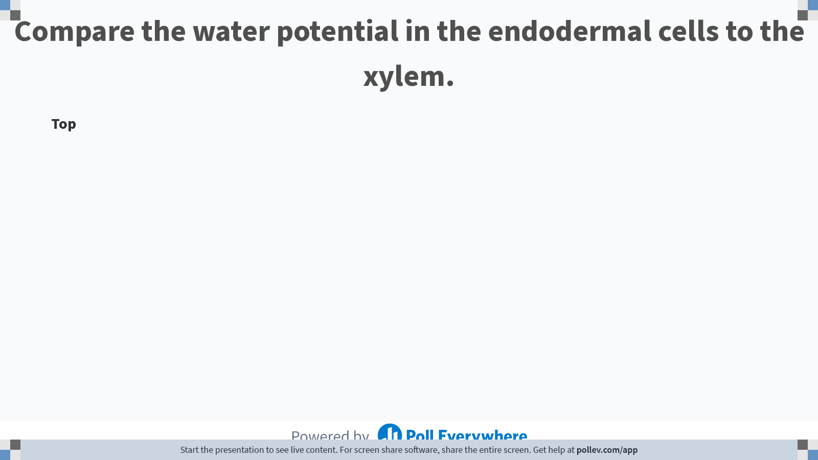
Notes:
Poll Title: Do not modify the notes in this section to avoid tampering with the Poll Everywhere activity.
More info at polleverywhere.com/support
Compare the water potential in the endodermal cells to the xylem.
https://www.polleverywhere.com/discourses/ZUx0rAVvZQARMXscLUGpK

Slide 32
Find good apoplast and symplast videos here

Slide 33
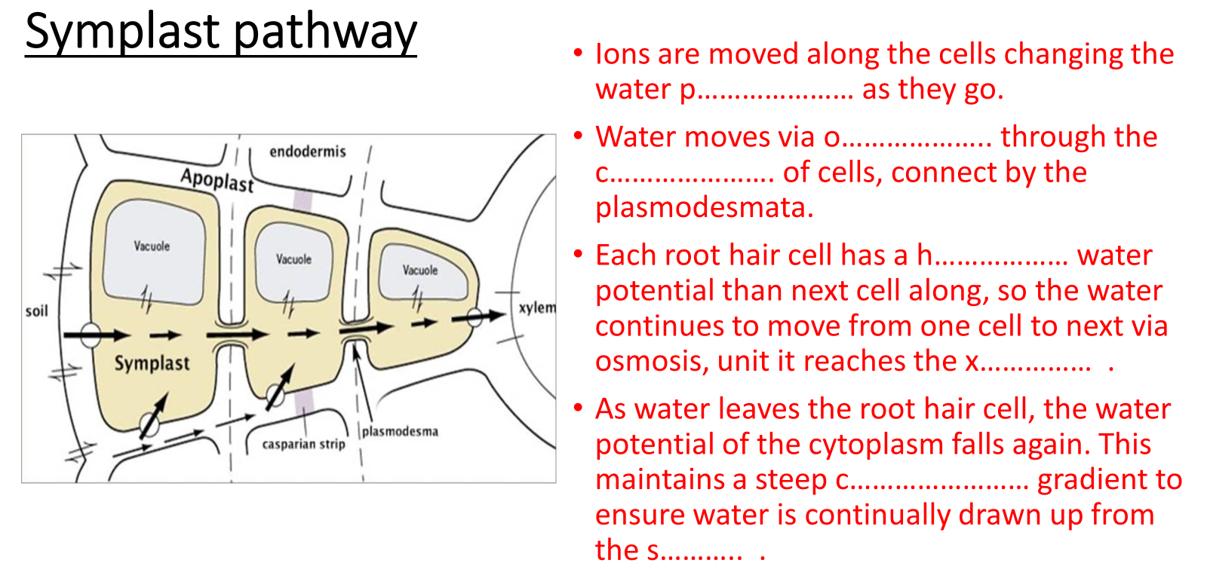
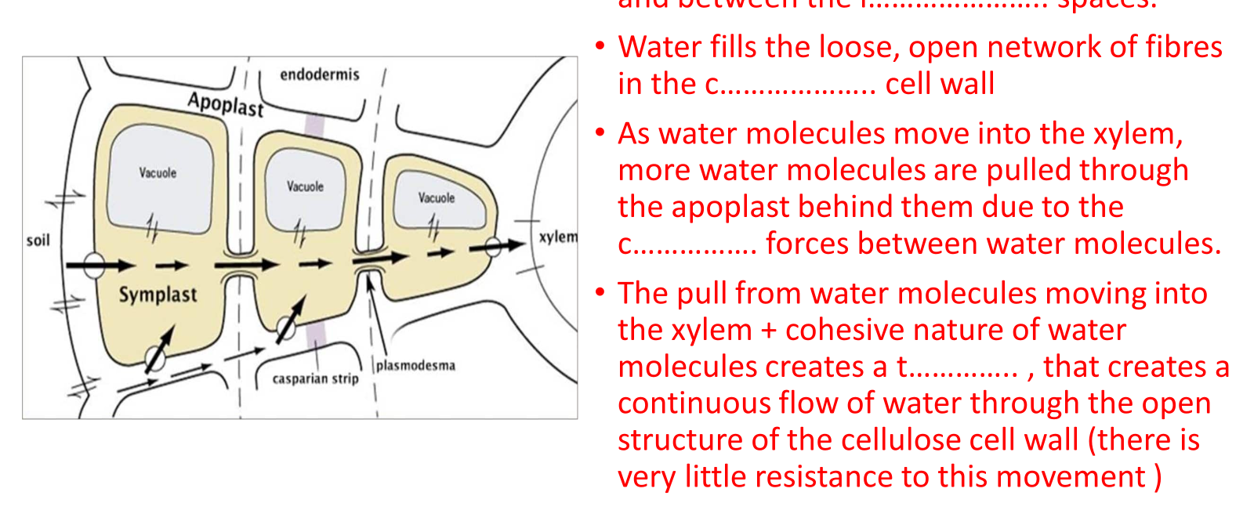
Complete the gap fills

Slide 34
Symplast pathway
Ions are moved along the cells changing the water p………………… as they go.
Water moves via o……………….. through the c…………………. of cells, connect by the plasmodesmata.
Each root hair cell has a h……………… water potential than next cell along, so the water continues to move from one cell to next via osmosis, unit it reaches the x…………… .
As water leaves the root hair cell, the water potential of the cytoplasm falls again. This maintains a steep c…………………… gradient to ensure water is continually drawn up from the s……….. .

Slide 35
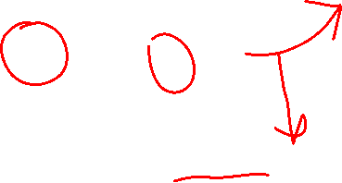
Symplast pathway
Ions are moved along the cells changing the water potential as they go.
Water moves via osmosis through the cytoplasm of cells, connect by the plasmodesmata.
Each root hair cell has a higher water potential than next cell along, so the water continues to move from one cell to next via osmosis, unit it reaches the xylem.
As water leaves the root hair cell, the water potential of the cytoplasm falls again. This maintains a steep concentration gradient to ensure water is continually drawn up from the soil.

Slide 36
Apoplast pathway
Water moves through the c……….. w………… and between the i………………….. spaces.
Water fills the loose, open network of fibres in the c……………….. cell wall
As water molecules move into the xylem, more water molecules are pulled through the apoplast behind them due to the c……………. forces between water molecules.
The pull from water molecules moving into the xylem + cohesive nature of water molecules creates a t………….. , that creates a continuous flow of water through the open structure of the cellulose cell wall (there is very little resistance to this movement )

Slide 37
Apoplast pathway
Water moves through the cell walls and between the intercellular spaces.
Water fills the loose, open network of fibres in cellulose cell wall
As water molecules move into the xylem, more water molecules are pulled through the apoplast behind them due to the cohesive forces between water molecules.
The pull from water molecules moving into the xylem + cohesive nature of water molecules creates a tension , that creates a continuous flow of water through the open structure of the cellulose cell wall (there is very little resistance to this movement )

Slide 38
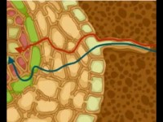

Slide 39
Root Pressure
Not a major factor for movement up the xylem
Active pumping of minerals into the xylem to enable movement of water by osmosis results in root pressure.
Root pressure gives water a ‘push’ up the xylem, but is not a major factor in moving water up to leaves.
Notes:
Root pressure and capillary action – minor factors
Cohesion tension the major factor

Slide 40
Xylem transport
Water travels into the xylem through the s……………. pathway
The water potential in the xylem is l……………. than in the endodermal cells
Endodermal cells a…………….. pump ions into the x……………. to maintain the water potential gradient
This creates root pressure
*Root pressure gives water a small push up the xylem, but is not the major factor of moving water from the roots → leaves

Slide 41
Xylem transport
Water travels into the xylem through the symplast pathway
The water potential in the xylem is lower than in the endodermal cells
Endodermal cells actively pump ions into the xylem to maintain the water potential gradient
This creates root pressure

Slide 42
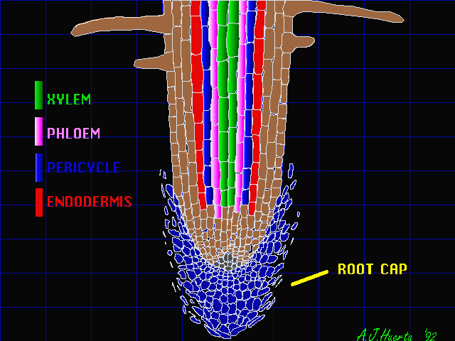
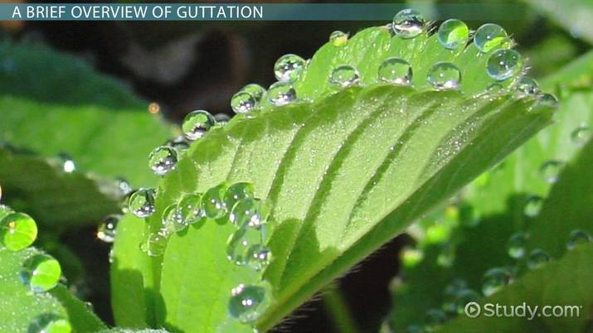
Evidence of active transport in the roots
How might the following be used as evidence of root pressure?
Temperature
O2 / Glucose concentration
Poison / cyanide (poison mitochondria)
Stem sap

Slide 43
Evidence of active transport in the roots
Root pressure increases with a rise in temperature – suggesting chemical reactions are taking place
When oxygen/glucose levels fall the root pressure falls – less respiration = less ATP for active transport
Cyanide prevent production of ATP. If cyanide is applied to root cells, root pressure disappears – unable to produce ATP for active transport
Xylem sap may exude from cut end of stems at certain times (guttation)

Slide 44
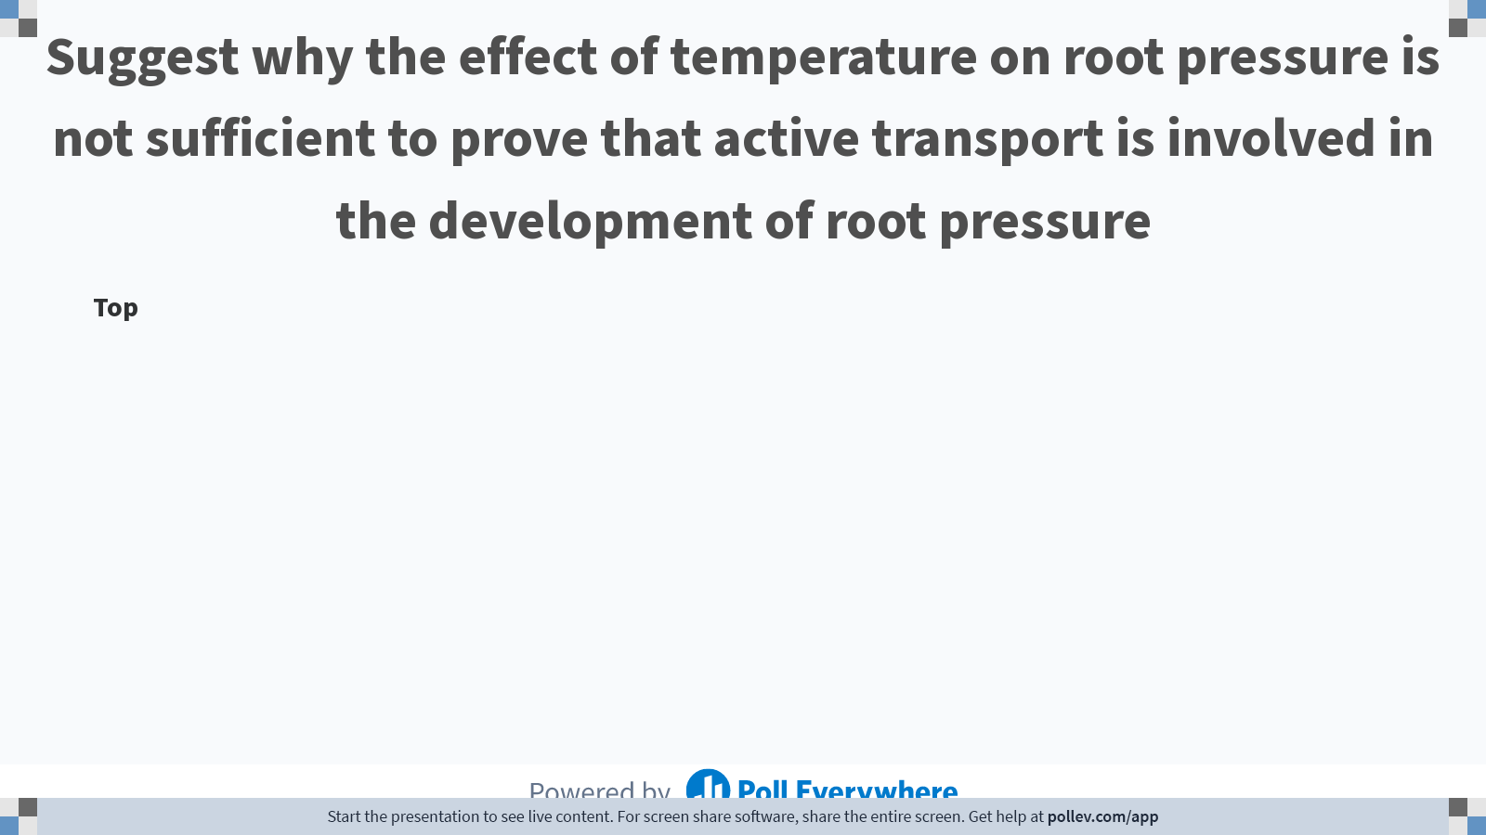
Notes:
Poll Title: Do not modify the notes in this section to avoid tampering with the Poll Everywhere activity.
More info at polleverywhere.com/support
Suggest why the effect of temperature on root pressure is not sufficient to prove that active transport is involved in the development of root pressure
https://www.polleverywhere.com/discourses/Sf8N3qYwuwDHqfNSqF9PI

Slide 45
Limitations of temperature as evidence of root pressure
Temperature also increases the rate of passive processes like osmosis and diffusion.

Slide 46
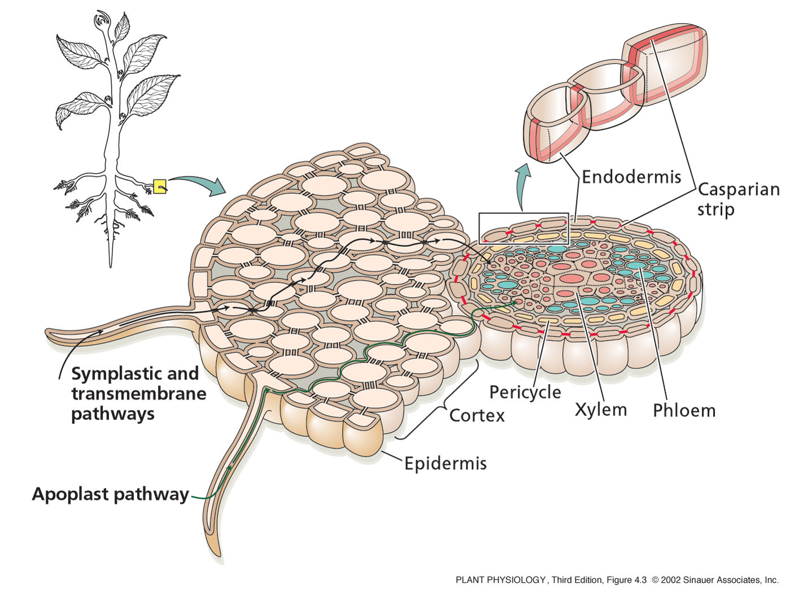
Annotation your diagram as I explained
1. Ions are actively pumped from the soil into the root hair cells. This ……………
3.Ions continue to diffuse down the concentration gradient, changing water potential as they move. Water follows by ………………………….
2. Water enters the root hair cells by osmosis because …………………..

Slide 47
Add annotation to your diagram as I explain
4. The Casparian strip in the endodermis is …………………
5. The Casparian strip prevents easy access of ……………………………………

Slide 48
Add annotation to your diagram as I explain
1. Ions are actively pumped from the soil into the root hair cells. This lowers the water potential inside the cells.
3.Ions continue to diffuse down the concentration gradient, changing water potential as they move. Water follows by osmosis across the parenchyma cells in the cortex to the xylem cells in the stem
2. Water enters the root hair cells by osmosis because of the difference in water potential

Slide 49
Add annotation to your diagram as I explain
4. The Casparian strip in the endodermis is impermeable. Water is forced to move through the symplastic pathway into the steele.
5. The Casparian strip prevents easy access of pathogens/toxins and stops water from flowing in the wrong direction.

Slide 50
Complete key definitions table in folder

Slide 51
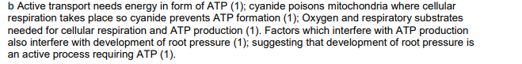
Exam style question
Explain why the effects of cyanide, oxygen levels and respiratory substrates on root pressure are taken as evidence that active transport is involved in the development of root pressure (5 marks).

Slide 52
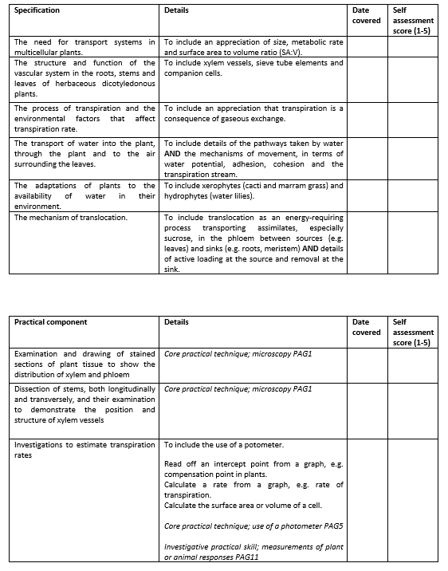
Learning Outcomes
Describe the role of xylem vessels in the movement of water through a plant
Explain why the properties of water allow this to occur
Compare the structures, position in the stem and function of sclerenchyma fibres (support) and xylem vessels (support and transport of water and mineral ions).

Slide 53
Define the water transport terms
KEY TERM: | MEANING:
Cortex
Parenchyma cell
Plasmodesmata
Middle Lamella
Cellulose
Lignin
Xylem
Sclerenchyma
Evaporation
Stomata
Cohesive
Apoplast pathway
Symplast pathway
Casparian strip

Slide 54


Slide 55
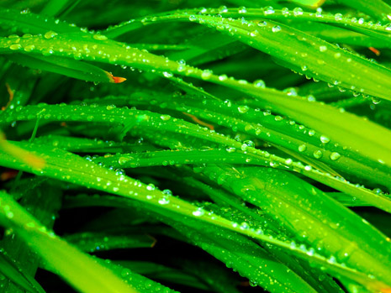
Quick 10:
What type of tissue transports the products of photosynthesis around the plant?
What is the process of thickening the cell walls?
Which tissue provides the plant with extra support?
Draw a stem vascular bundle and label 3 areas of different tissue.
What structure allows movement of cytoplasm between cells?
What structure is formed when the microfibrils are very thin?
Name 2 types of dead cells.
Which organelles are mostly involved in the storage of starch?
What essential quality does lignin bring to xylem cells?
Which feature is found between interconnecting phloem cells?

Slide 56
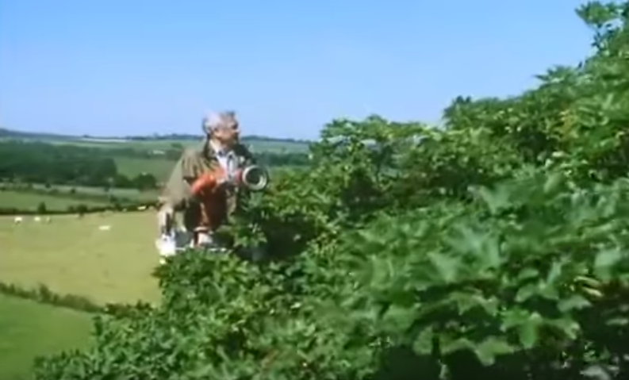
Transpiration is the loss of water from the surface of a leaf
https://www.youtube.com/watch?v=tk5IwL2iNgU

