Slide 1
Paper 1 biology edexcel igcse (9-1) revision notes
PJG

Slide 2
Define the following terms
1. Alleles –
2. Denaturing –
3. Diffusion –
4. Lymphocyte –
5.Osmoregulation -
6. Phototropism –
7. Pollination –

Slide 3
Define the following terms
1. Alleles – different forms of a gene
2. Denaturing – process where the structure of a protein eg enzyme is damaged by high temperatures of extreme values of pH
3. Diffusion – passive movement of substances down a concentration gradient
4. Lymphocyte – type of white blood cell that produces antibodies
5.Osmoregulation - maintenance of water balance
6. Phototropism – growth movement of a plant in response to light
7. Pollination – transfer of pollen from anther to stigma

Slide 4
Topic List
2c Biological molecules , food tests, enzyme pH practical
2d Movement in and out of cells, diffusion and osmosis (includes practicals)
2g Gas exchange
2h Transport
2i Excretion
2j Coordination and response
3a Reproduction
3b Inheritance (includes protein synthesis and natural selection)
Some topics from Topics 4 and 5 will be in the Summer actual exams but not in the mock

Slide 5
2c Food tests – Matching exercise
Biological molecule | Food test
1. Glucose | A. Biuret, blue to purple
2. Starch | B. Iodine, orange to black
3. Proteins | C. Emulsion test, ethanol + water
4. Lipids | D. Benedicts, heat, blue to green to orange to brick red

Slide 6
Food test – Matching exercise
Biological molecule | Food test
1. Glucose | D. Benedicts, heat, blue to brick red
2. Starch | B. Iodine, orange to black
3. Proteins | A. Biuret, blue to purple
4. Lipids | C. Emulsion test, ethanol + water

Slide 7
2c Biological molceules Enzyme Lock and Key video clip
Watch clip

Slide 8
Enzymes
Explain how and why each of the following effect the rate of an enzyme controlled reaction:
A) Temperature
B) pH
C) Enzyme concentration

Slide 9
Enzymes key words
A) Temperature –kinetic energy, active site, denatured
B) pH - active site, denatured
C) enzyme concentration - active site and substrate molecules, more ES complexes, more chance of collisions

Slide 10
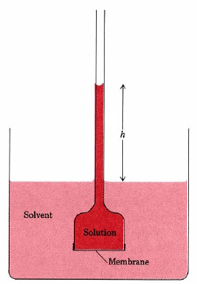
2d Movement in and out of cells
Watch clip
Define Osmosis
If the solution = sugar solution and the solvent = water, explain why the liquid rises in the capillary tube and h increases

Slide 11
2d Movement in and out of cells
Diffusion = passive movement of substances form an area of high concentration to an area of low concentration
Osmosis = diffusion of water
Water moves by osmosis from the beaker where it is in a high concentration, across the membrane, to the solution where there is a lower concentration of water, so increasing the volume in the funnel and moving the solution up the capillary tube

Slide 12
2d Movement in and out of cells
List some factors which affect the rate of movement in and out of cells

Slide 13
2d Movement in and out of cells
List some factors which affect the rate of movement in and out of cells:
Surface area:volume, distance, temperature, concentration gradient

Slide 14
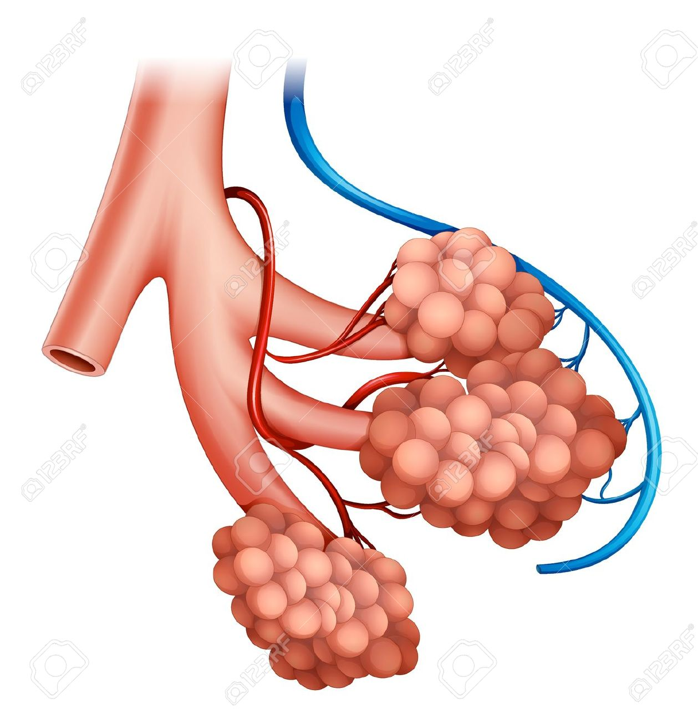
2g Gas Exchange
List the features of the alveoli which increase gas exchange

Slide 15
2g Gas Exchange
List the features of the alveoli which increase gas exchange
Many – large surface area
Thin wall – short diffusion pathway
Good blood supply to take away oxygen and maintain concentration gradient
Moist so gases can dissolve and then diffuse

Slide 16
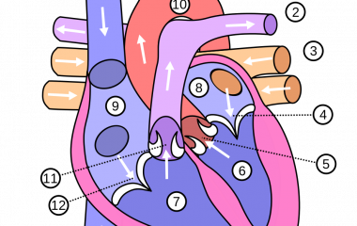
2h Transport
The heart, watch clip:
https://www.youtube.com/watch?v=jBt5jZSWhMI

Slide 17
2H Transport
List some risk factors associated with developing coronary heart disease

Slide 18
2H Transport
List some risk factors associated with developing coronary heart disease
Obesity, high blood pressure, cholesterol, cigarette smoking

Slide 19
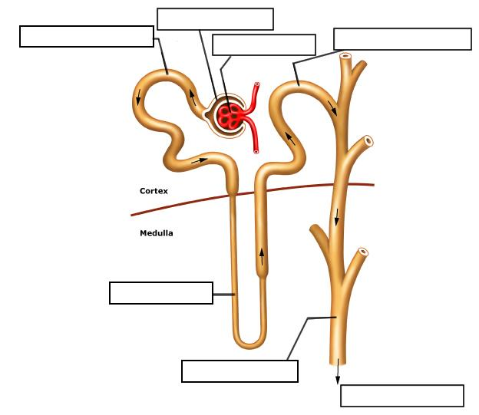
2i Excretion
2
3
5
1
4
6
7

Slide 20
2i Excretion
2
1 = Glomerulus
2 = Bowmans Capsule
3 = Proximal Convoluted Tubule
4 = Loop of Henle
5 = Distal Convoluted tubule
6 = Collecting duct
7 = to bladder
3
5
1
4
6
7

Slide 21
Kidney – key terms
Ultrafiltration
Reabsorption
Antidiuretic hormone

Slide 22
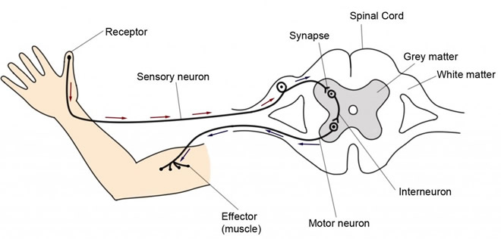
2j Coordination and Response

Slide 23
2j Response
Starting at the receptor, list the structures in the withdrawal reflex in the correct order.

Slide 24
2j Coordination and Response
Receptor
Sensory neuron
Interneuron (relay)
Motor neuron
Effector (muscle)

Slide 25
2j Response
Define Homeostasis

Slide 26
2j Response
Define Homeostasis
the maintenance of a constant internal environment eg temperature, body water content

Slide 27
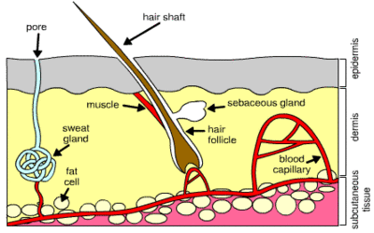
2j Response
Homeostasis = the control of an organism’s internal environment
How will the structures of the skin respond in cold conditions?

Slide 28
2j Response
How will the structures of the skin respond in cold conditions?
Less sweat, vasoconstriction = less blood flow near the surface, hair muscles contract so hair rises and traps insulating air

Slide 29
2j Response
Also includes plant responses and the eye

Slide 30
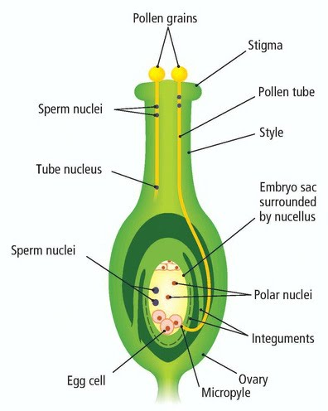
3a Reproduction Plants
Put these in the correct order, starting with the Flower:
Pollination
Fruit formation
Flower
Germination
Seed dispersal
Fertilisation

Slide 31
3a Reproduction Plants
Flower
Pollination
Fertilisation
Fruit formation
Seed dispersal
Germination

Slide 32
Reproductive Hormones - matching exercise
Hormone | Function
1. oestrogen | D Maintains lining of uterus, prepares body for pregnancy
2. progesterone | B Stimulates follicle growth
3. FSH | A Repairs uterus lining
4. LH | C Causes ovulation

Slide 33
Reproductive Hormones - matching exercise
Hormone | Function
1. oestrogen | A Repairs uterus lining
2. progesterone | D Maintains lining of uterus, prepares body for pregnancy
3. FSH | B Stimulates follicle growth
4. LH | C Causes ovulation

Slide 34
3b Inheritance - matching exercise
Term | Meaning
1. heterozygous | A Chromosomes found in a human male
2. XY | B Two different alleles in the genotype
3. RR | C The characteristic determined by the genotype
4. Phenotype | D A genotype which will give the organism a phenotype determined by the dominant allele

Slide 35
3b Inheritance - matching exercise
Term | Meaning
1. heterozygous | B Two different alleles in the genotype
2. XY | A Chromosomes found in a human male
3. RR | D A genotype which will give the organism a phenotype determined by the dominant allele
4. Phenotype | C The characteristic determined by the genotype

Slide 36
3b Inheritance
A genetic cross:
Draw a Punnett square to illustrate the results of the following cross. Let B = the dominant allele for black furred mice and b= the recessive allele for white furred mice. Two heterozygous black furred mice were crossed. Using your diagram deduce the expected phenotypic ratio in the offspring.

Slide 37
3b Inheritance
Draw a Punnett square to illustrate the results of the following cross. Let B = the dominant allele for black furred mice and b= the recessive allele for white furred mice. Two heterozygous black furred mice were crossed. Using your diagram deduce the expected phenotypic ratio in the offspring.
The cross is Bb x Bb
The ratio is 3:1
Black fur to white fur
 | B | b
B | BB | Bb
b | Bb | bb

Slide 38
Sex determination
Draw a diagram to show how a man and a woman having a baby have a 50% chance of having a girl.

Slide 39
Sex determination
Draw a diagram to show how a man and a woman having a baby have a 50% chance of having a girl.
 | X | Y
X | XX Girl | XY Boy
X | XX Girl | XY Boy

Slide 40
3b Inheritance
Also includes protein synthesis, mutations, cell division, natural selection and evolution

Slide 41
Topic List
2c Biological molecules , food tests, enzyme pH practical
2d Movement in and out of cells, diffusion and osmosis practicals
2g Gas exchange
2h Transport
2i Excretion
2j Coordination and response
3a Reproduction
3b Inheritance

Slide 42
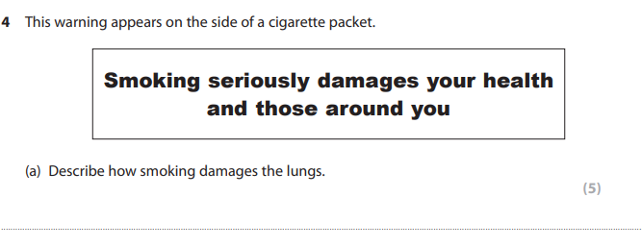
Exam Question
Edexcel Biology IGCSE June 2015 Paper 1B Question 4

Slide 43
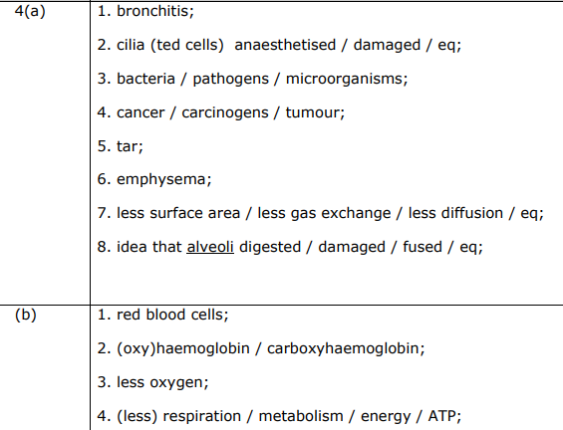
Exam Question
Edexcel Biology IGCSE June 2015 Paper 1B Question 4

