Slide 1
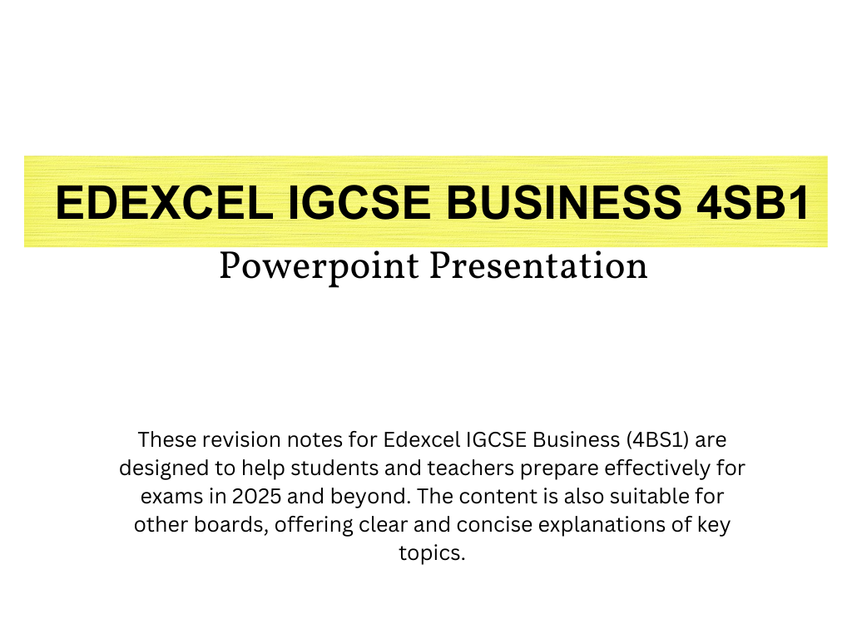

For more help, please visit our website www.exampaperspractice.co.uk

Slide 2
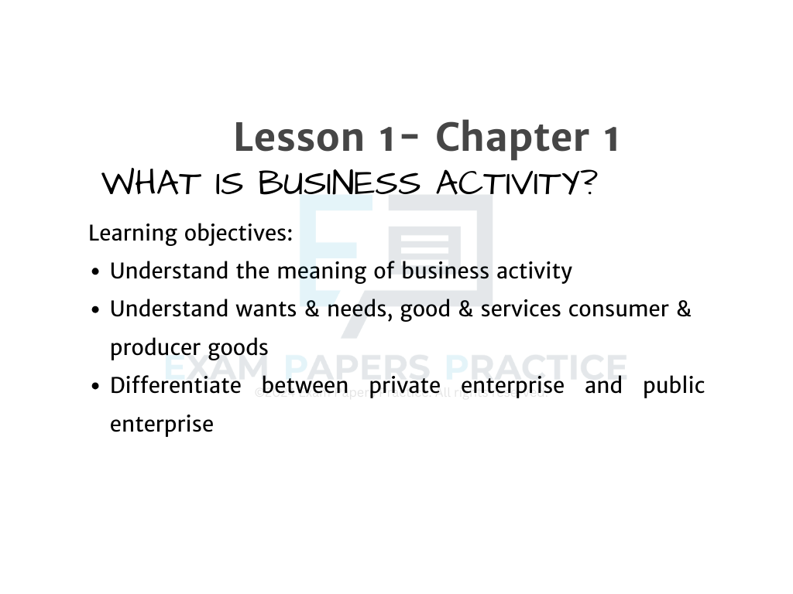
For more help, please visit our website www.exampaperspractice.co.uk

Slide 3
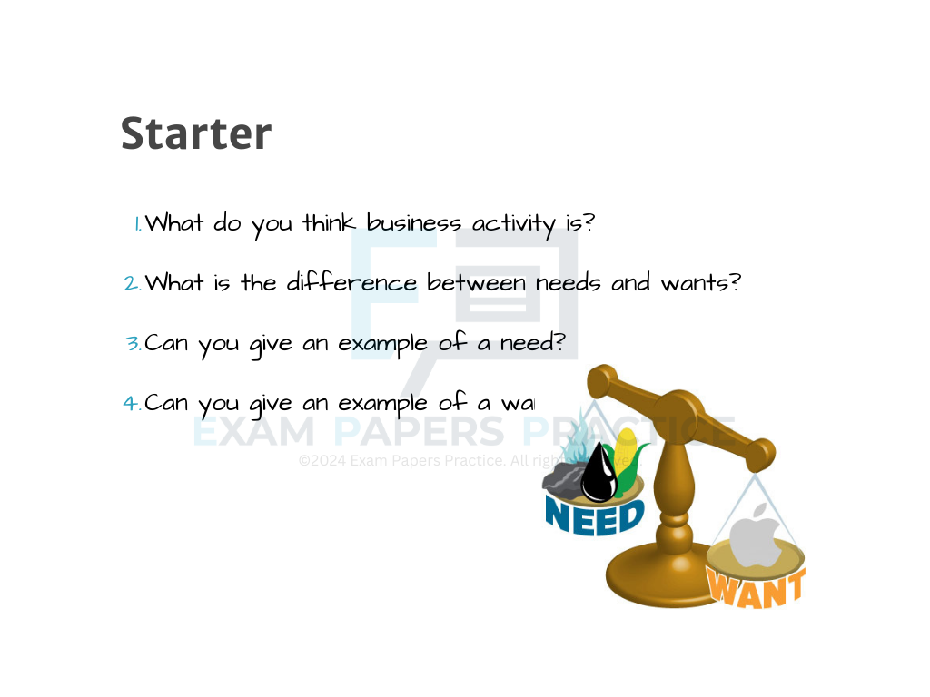
For more help, please visit our website www.exampaperspractice.co.uk

Slide 4

For more help, please visit our website www.exampaperspractice.co.uk

Slide 5
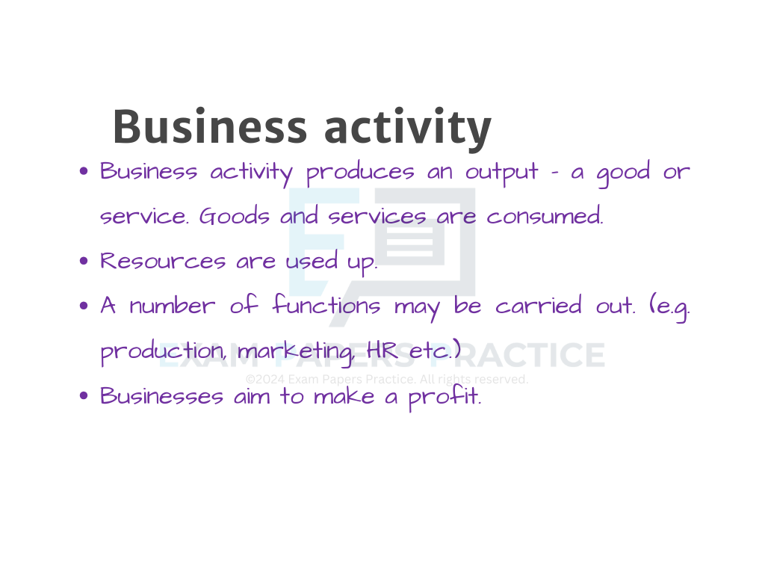
For more help, please visit our website www.exampaperspractice.co.uk

Slide 6
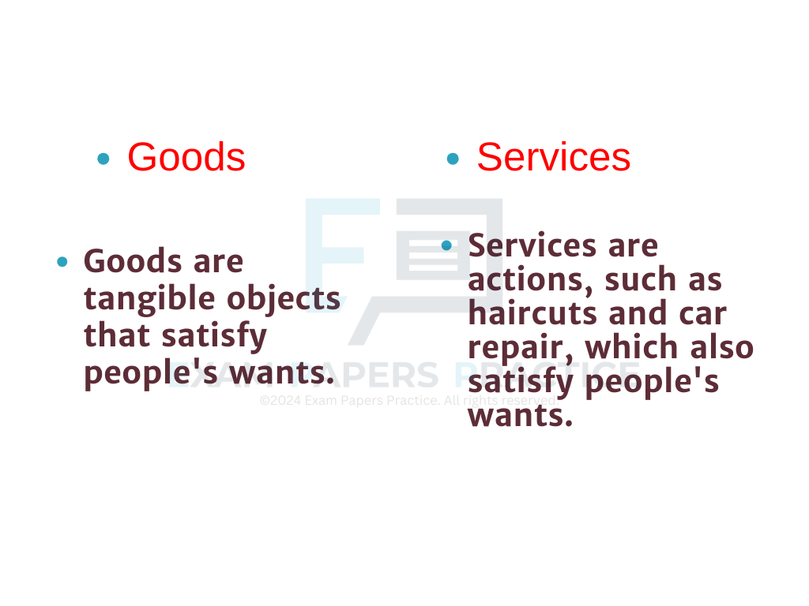
For more help, please visit our website www.exampaperspractice.co.uk

Slide 7

For more help, please visit our website www.exampaperspractice.co.uk

Slide 8
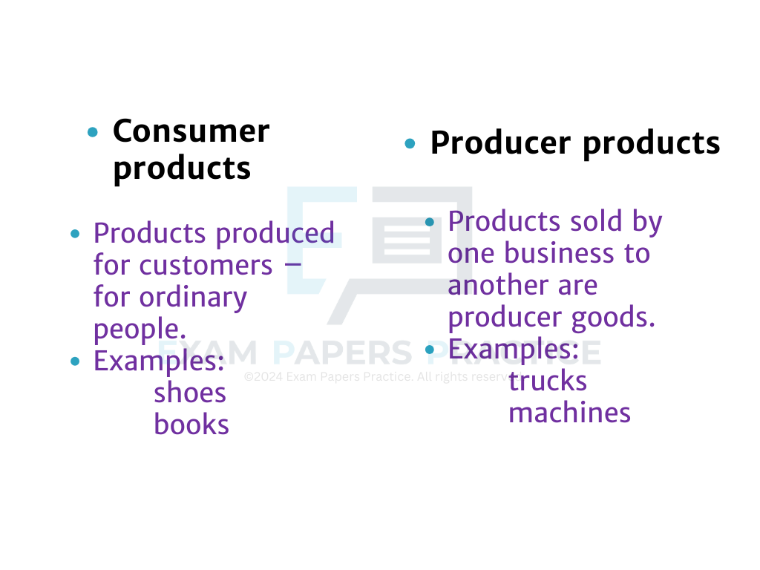
For more help, please visit our website www.exampaperspractice.co.uk

Slide 9
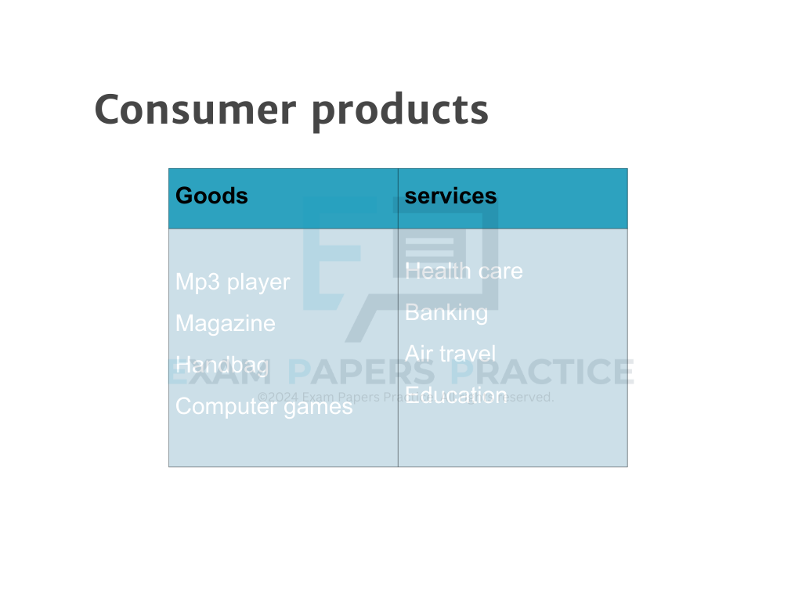
For more help, please visit our website www.exampaperspractice.co.uk

Slide 10
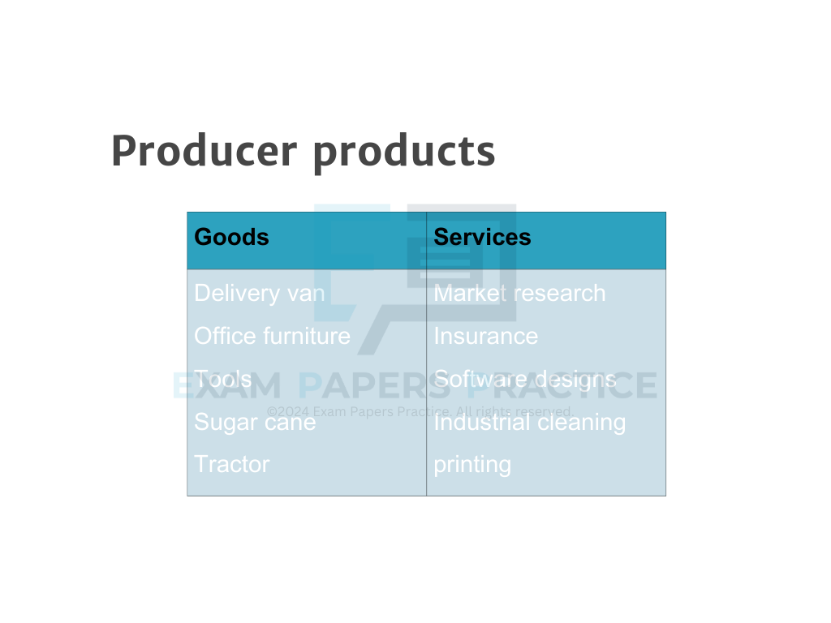
For more help, please visit our website www.exampaperspractice.co.uk

Slide 11
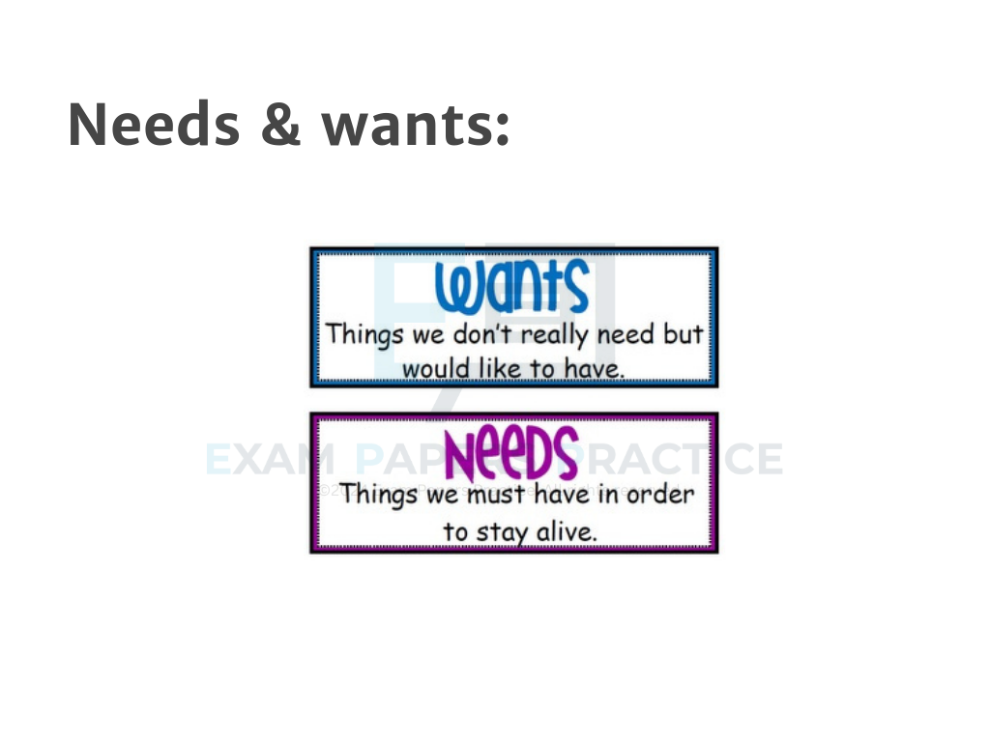
For more help, please visit our website www.exampaperspractice.co.uk

Slide 12

For more help, please visit our website www.exampaperspractice.co.uk

Slide 13
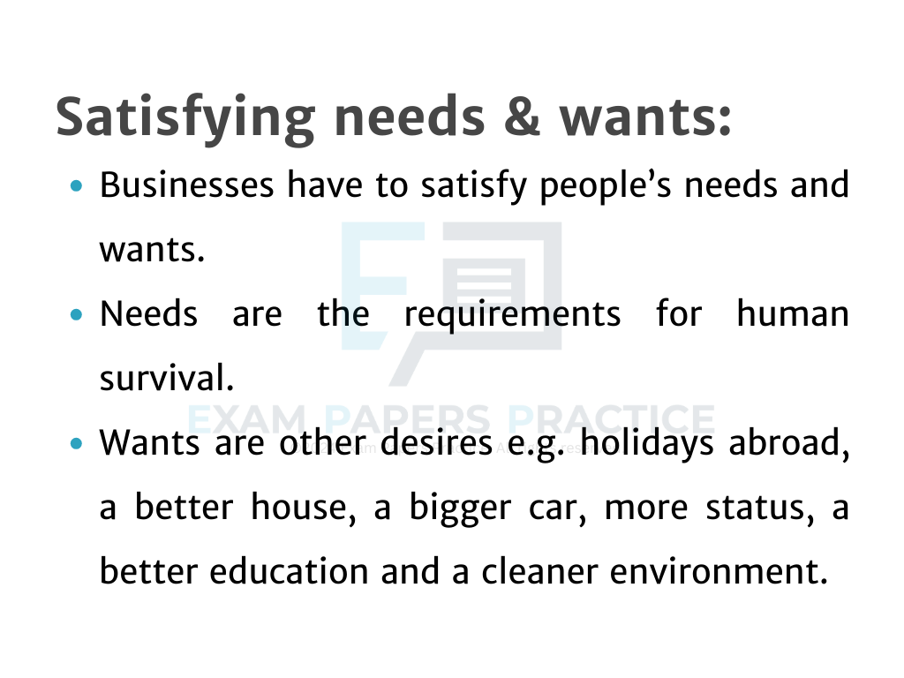
For more help, please visit our website www.exampaperspractice.co.uk

Slide 14
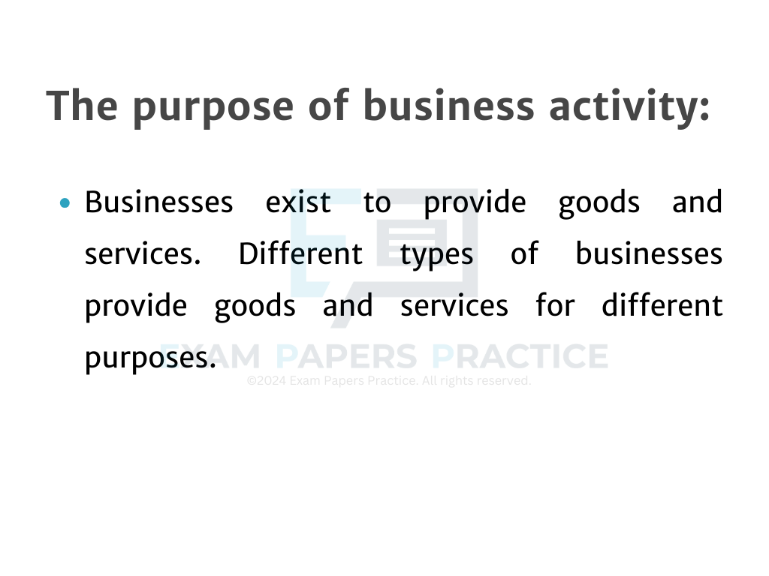
For more help, please visit our website www.exampaperspractice.co.uk

Slide 15
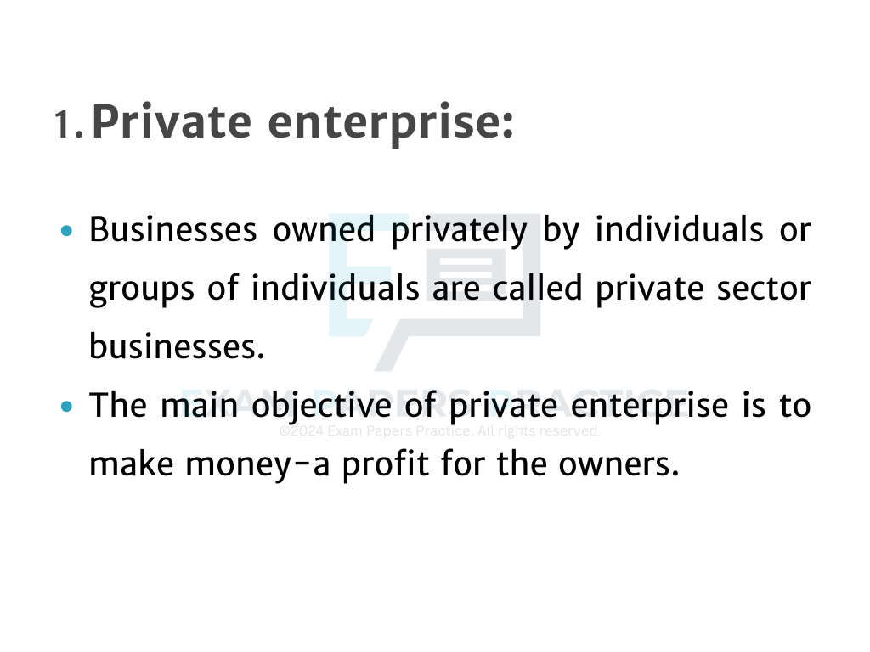
For more help, please visit our website www.exampaperspractice.co.uk

Slide 16
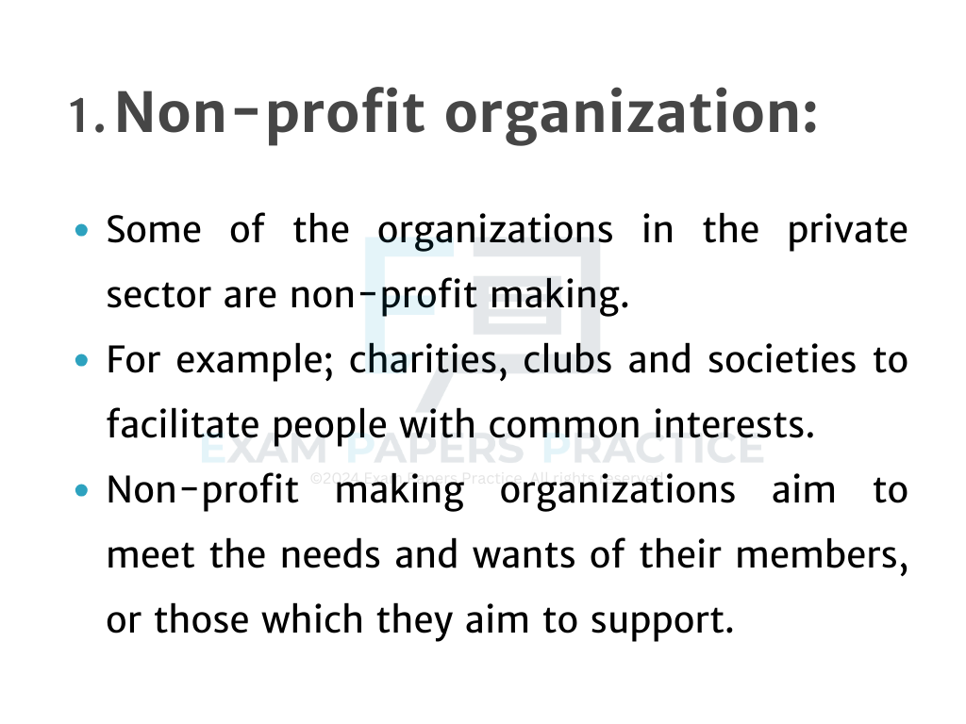
For more help, please visit our website www.exampaperspractice.co.uk

Slide 17

For more help, please visit our website www.exampaperspractice.co.uk

Slide 18
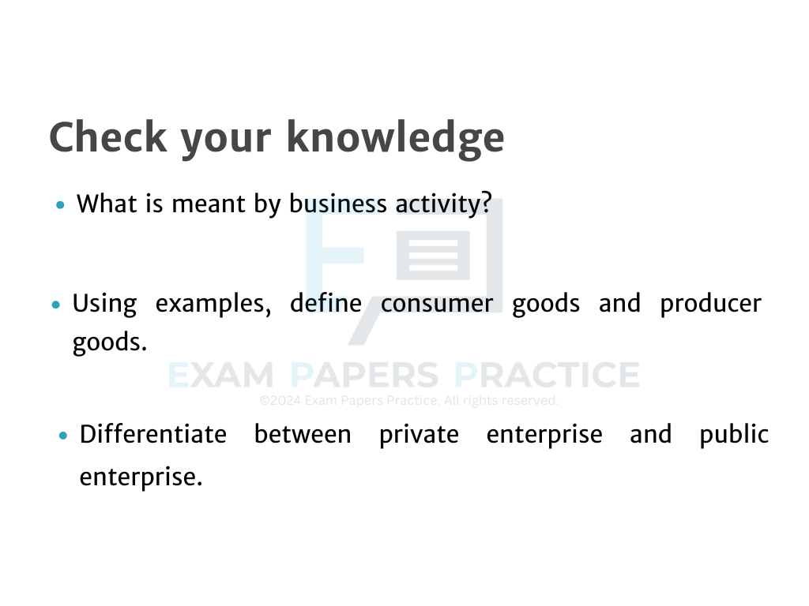
For more help, please visit our website www.exampaperspractice.co.uk

Slide 19

For more help, please visit our website www.exampaperspractice.co.uk

Slide 20
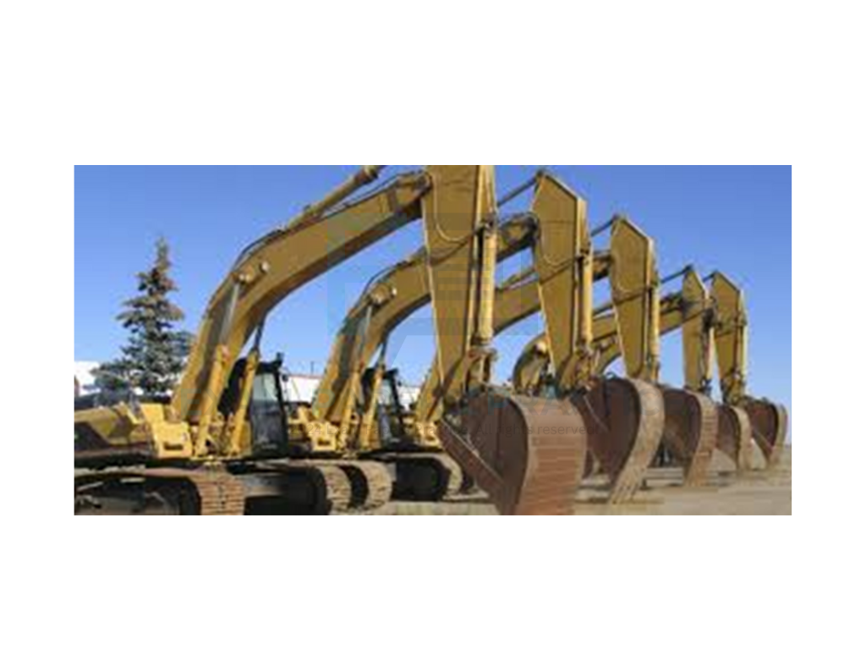
For more help, please visit our website www.exampaperspractice.co.uk

Slide 21

For more help, please visit our website www.exampaperspractice.co.uk

Slide 22

For more help, please visit our website www.exampaperspractice.co.uk

Slide 23

For more help, please visit our website www.exampaperspractice.co.uk

Slide 24

For more help, please visit our website www.exampaperspractice.co.uk

Slide 25

For more help, please visit our website www.exampaperspractice.co.uk

Slide 26

For more help, please visit our website www.exampaperspractice.co.uk

Slide 27

For more help, please visit our website www.exampaperspractice.co.uk

