Slide 1
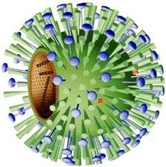
Influenza Virus, why does it cause us such problems?
Use your knowledge of viruses to deduce as many reasons as possible

Slide 2
Developing immunity
Understand how individuals may develop
immunity (natural, artificial, active, passive).

Slide 3
Types of immunity:
Natural – active, passive
Artificial – active, passive
Use 4 pieces of paper. Rotate around and write down your ideas as to what each type is and how it could be obtained.
Include:
​Description of the 4 types of immunity
What they are
How they are acquired
If they involve an immune response
If they involve memory cells
Whether they are short term or long term.
Complete the card sort on your worksheet to match the type of immunity with the picture and correct description

Slide 4
Complete the table
Explanation must include:
Type of immunity | Explanation and or example
Natural passive | Antibodies passed to the foetus across the placenta or to a baby through breast feeding. No immune response. Short term
Natural active | Stimulation of specific immune response by infection to create memory cells. Long term
Artificial passive | Injection of specific antibodies. Pathogen destroyed, no immune response, short term.
Artificial active | Injection of dead or attenuated pathogens to activate the primary specific response. Antibodies and memory cells created. Long lasting.
What they are
How they are acquired
If they involve an immune response
If they involve memory cells
Whether they are short term or long term.

Slide 5
Use your table to identify if these statements apply to active or passive immunity:
α
1. Exposure to antigen.
2. Protection/immunity is short term.
3. Protection/immunity is immediate.
4. Memory cells aren’t produced.
5. Protection/immunity is long term.
6. No exposure to antigen.
7. Memory cells are produced.
8. Takes a while for protection/immunity to develop.
p
p
p
α
p
α
α

Slide 6
When things go wrong - what are autoimmune diseases?
Where immune system attacks self antigens using antibodies and T cells.
Auto-reactive T helper cells, T cytotoxic killer cells and B cells are involved
E.g. Lupus, arthritis, coeliac disease, multiple sclerosis
Causes are not well known – genetic? Environmental factors?
T regulator cells inhibit the other lymphocytes (inhibit the body's immune response)

Slide 7
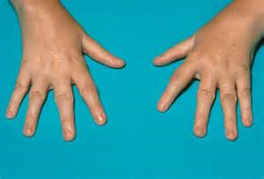
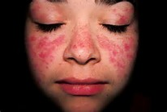
Autoimmune diseases
Lupus
Rheumatoid arthritis

Slide 8
Why do you not get sick (or less likely to) the second time you are exposed to a particular pathogen?
What type of immunity is this?

Slide 9
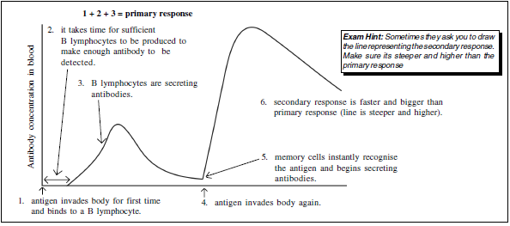
Describe the graph
Annotate the graph
Write a paragraph to explain why you do not get sick when you are infected with a pathogen for the second time.
Describe how you can become immune through vaccination.
What factors influence the effectiveness of a vaccination?
CH - Explain what is meant by the term herd immunity and why it is so important for some individuals in the population.

Slide 10
Most memory cells
Clonal expansion
Most T-helper activity
Antigen presentation and clonal selection
Clonal expansion
Most T-helper activity
Remember clonal selection – matching antigens on APC's to antigen receptors on B and T lymphocytes.
Clonal expansion – mitosis of activated T or B lymphocytes to produce many genetically identical daughter cells after clonal selection.

Slide 11
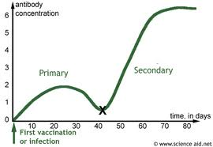
How Do Vaccines Work?
Spot two differences between primary and secondary response!

Slide 12
How Do Vaccines Work?
What type of immunity is this?
1. What is in a vaccine?
2. How does a vaccine work?
3. Why is it good?
4. How are vaccines administered?
5. Why are booster vaccines needed?
6. Does everyone need to be vaccinated?
Higher concentration of antibodies produced
As a team produce a flow diagram on the board to show the stages of producing immunity via vaccination
Faster (steeper gradient)

Slide 13
Vaccination flow diagram:
1. Dead or attenuated pathogen introduced
2. Non-self antigens recognised by B cells.
3. Primary response initiated.
4. B memory cells created.
5. If pathogen is encountered in the future secondary response will be initiated immediately.

Slide 14
The problems with vaccines: Antigenic Drift vs Antigenic Shift
Because (retro) viruses eg. HIV and Influenza have RNA not DNA, they mutate more often, causing their surface antigens to change shape.
Drift – antigens change slowly and only slightly
Shift – antigens change completely and suddenly = chaos, e.g. swine flu, bird flu
Cross-breeding - different strains of viruses invade same cell which aids the formation of new viruses with antigens from different strains
CH: name a virus that only experiences antigenic drift
Influenza B mutates frequently but only gradually. Type A viruses that undergo shift can cause pandemics. There has only been 4 flu pandemics in the last 100 years.

Slide 15
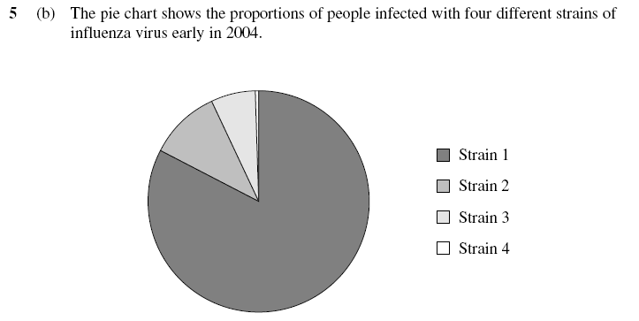
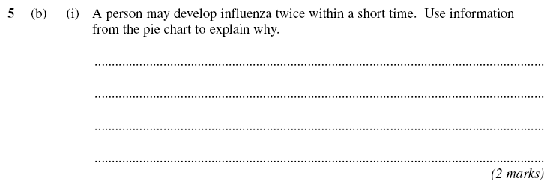
Exam question

Slide 16
Self mark it.

Slide 17
Explain why the production of antibodies is faster when the same antigen enters the body on a second occasion. (4)

Slide 18
Explain why the production of antibodies is faster when the same antigen enters the body on a second occasion. (4)

Slide 19
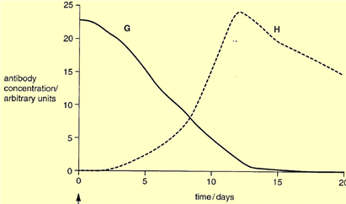
Challenge Question!
The graph shows the concentration of antibodies following 2 different
types of vaccination.
Both patients were injected on day 0.
G
H
State what each person was injected with and explain why
Patient G must have been injected with antibodies, because the antibody concentration is highest at the time of injection and then slowly decreases
Patient H must have been injected with antigens, because there was a delay of several days, during which the processes of antigen presentation, clonal selection and clonal expansion occurred before antibodies were secreted and began to increase in concentration.

