Slide 1
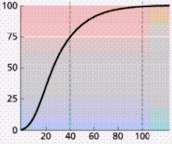
Knowledge retrieval question
Complete the following sentences:
% saturation
The steepest part of the oxygen dissociation curve corresponds to ……
Rapid loading of O₂ – cooperative nature of oxygen
Increased respiration of cells causes the oxygen concentration in the tissues to fall.
In response to this, haemoglobin ………
Releases/offloads more oxygen
pO₂
As the oxygen concentration (pO₂) falls, haemoglobin’s affinity for oxygen ……
decreases
affinity = strength of binding (of haemoglobin to oxygen)

Slide 2
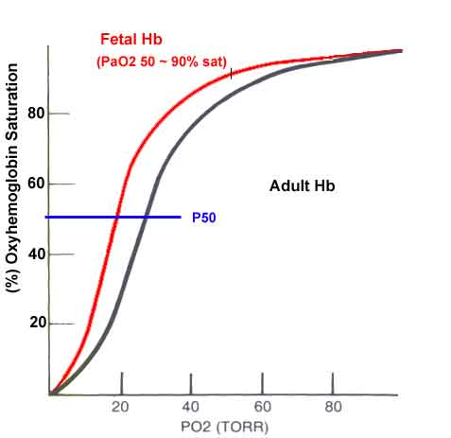
Complete the following:
During pregnancy in mammals, the foetus obtains its oxygen from the blood
of its mother across the placenta.
Suggest how the oxygen affinity of fetal haemoglobin must compare with that of adult haemoglobin.
Fetal haemoglobin has a higher affinity for oxygen than adult haemoglobin.
Explain why this is necessary
This ensures that at the oxygen concentration found in the placenta, adult haemoglobin will release oxygen and fetal haemoglobin will load with oxygen – which is then delivered to the cells of the growing foetus.
Fetal Hb can load more oxygen at the same and lower levels of pO2

Slide 3
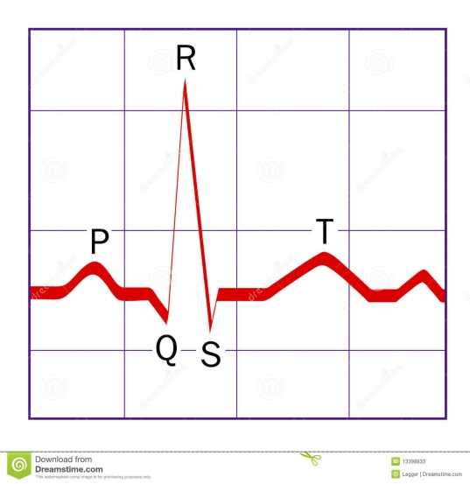
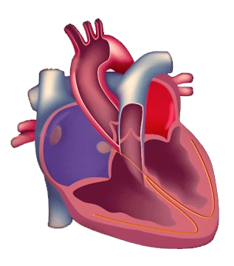
RECAP – ECG/Electrical control
Potential difference (v)
Time (s)

Slide 4
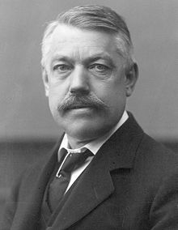
Transporting carbon dioxide
Explain how carbon dioxide is transported in the blood
Describe and explain the significance of the dissociation curves of adult oxyhaemoglobin at different carbon dioxide levels (the Bohr effect).
Christian Harald Lauritz Peter Emil Bohr (1855–1911)

Slide 5
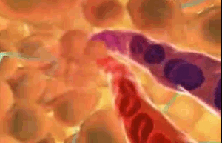
How is CO₂ transported around the body?

Slide 6
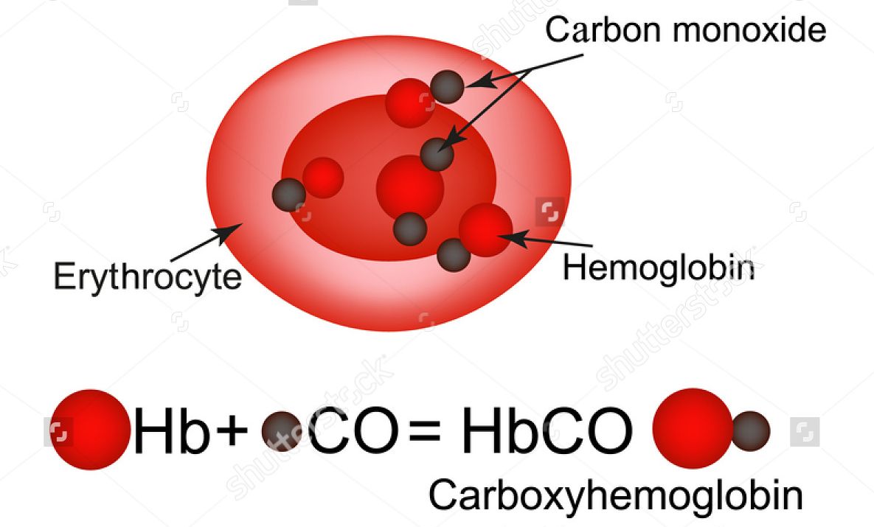
Carbon dioxide is transported 3 ways :
5% dissolved in the blood plasma
10% combined with haemoglobin to form carbaminohaemoglobin (see diagram below)
85% transported as hydrogencarbonate ions HCO₃⁻

Slide 7
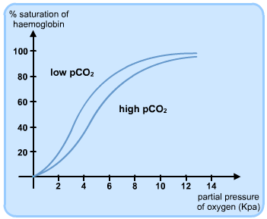

RECAP
What locations are we likely to find A and B in the body?
A: Respiring tissue – low Hb affinity to O₂
B: Lungs – high Hb affinity to O₂
B
A
How does CO₂ effect the Hb affinity for O₂?

Slide 8
Bohr effect
As the partial pressure of CO₂ rises, haemoglobin gives up oxygen more easily.
In the lungs where there is a low pCO₂, O₂ binds to the Hb molecules more readily. Curve shifts left.
Active tissue has a high pCO₂ due to respiring cells. So, Hb offloads as its O₂ more readily.
At low pCO₂ = Hb has a higher affinity to O₂
At the same pO₂ we have different Hb affinities
WHY DOES HIGH pCO₂ cause Hb to unload O₂?
At high pCO₂ = Hb has a low affinity to O₂

Slide 9
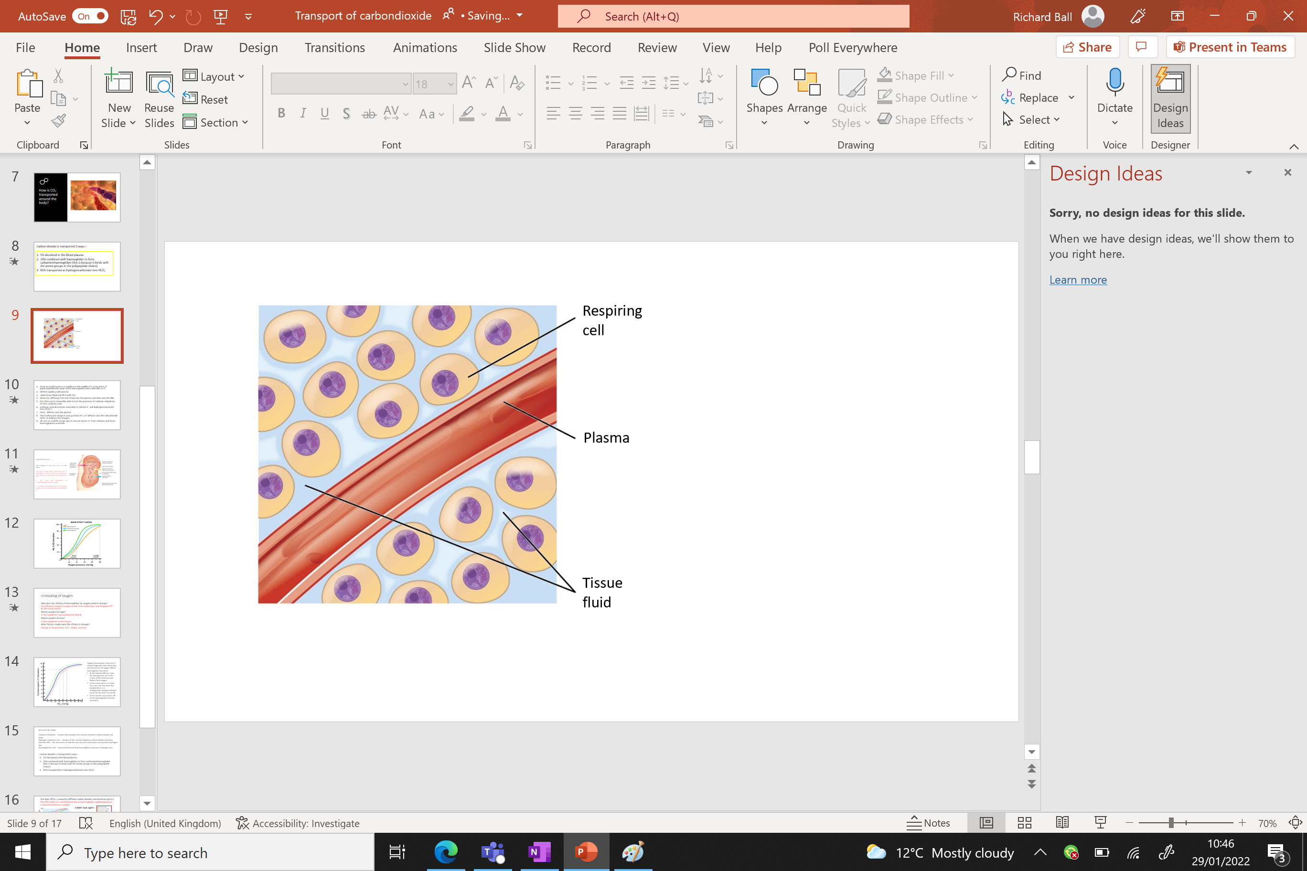
How is CO₂ transported from respiring cells to the lungs?

Slide 10
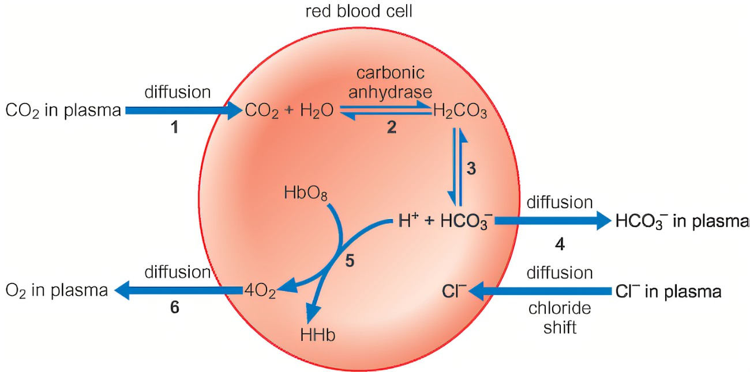

Slide 11
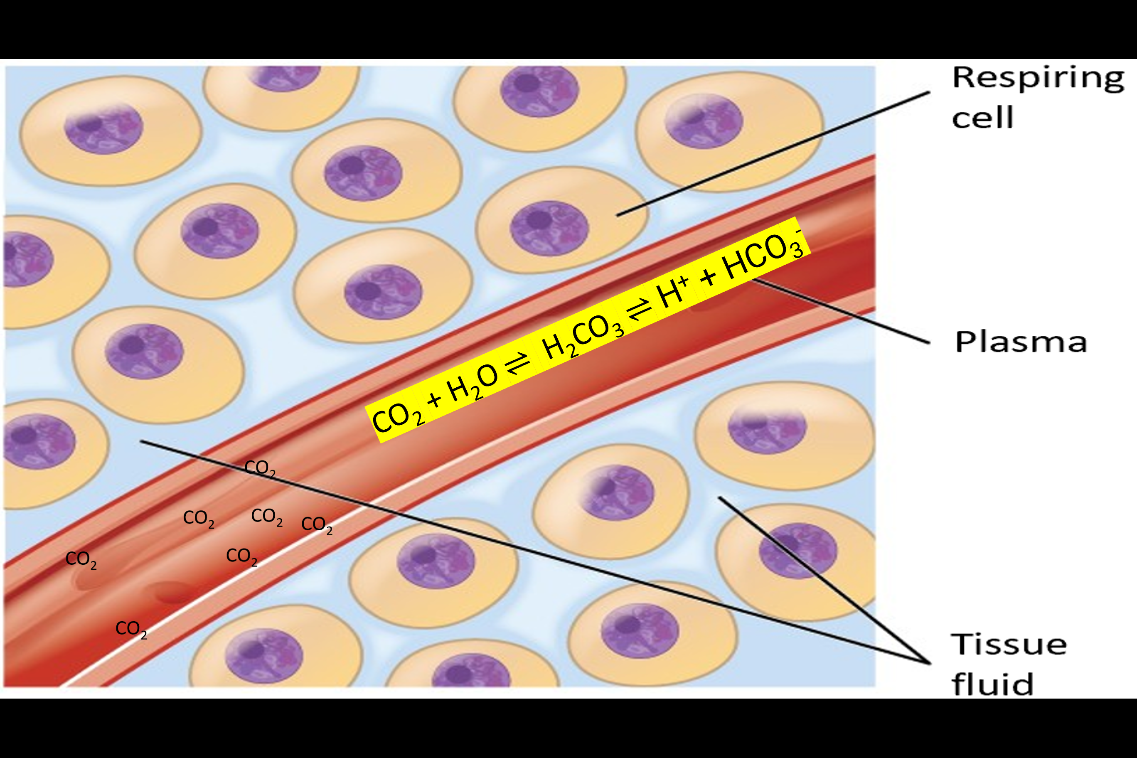
RECAP
Most of the CO₂ that diffuses into the blood from the cells is transported to the lungs in the form of hydrogen carbonate ions (HCO₃⁻)
To form these ions, CO₂ reacts with water to form carbonic acid (H₂CO₃)
The carbonic acids then dissociates to form H⁺ and HCO₃⁻ ions
HCO₃⁻ ions then diffuse back into the blood plasma from rbc
Important
The reactions are reversible
The reaction between CO₂ and water in the blood plasma is very slow.
However, the cytoplasm of the red blood cells contains carbonic anhydrase. This enzyme catalyses the reaction between CO₂ and water to form carbonic acid
Which then dissociates into H+ and HCO₃⁻ ions

Slide 12
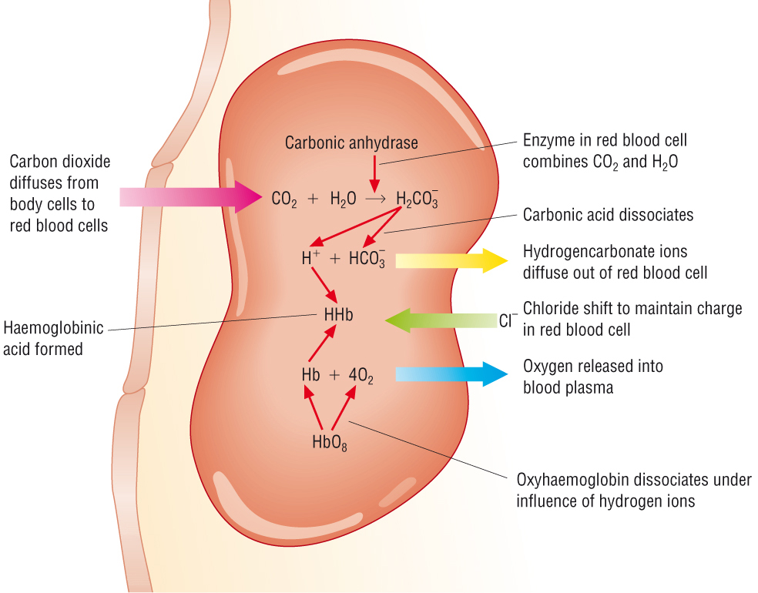
What happens to the HCO₃⁻ and H⁺ in the blood?
CO₂ + H₂O ⇌ H₂CO₃ ⇌ H⁺ + HCO₃⁻
H⁺ bind to oxyhaemoglobin to form HHB Haemoglobinic acid which causes the unloading of O₂ molecules
Moreover, H⁺ is acidic. The change in pH causes a shape change of Hb(O₂)₄, reducing affinity and releasing O₂.
The formation Haemoglobinic acid reduces the free H⁺ ions, increasing pH (maintaining the 7.4pH in the blood)

Slide 13
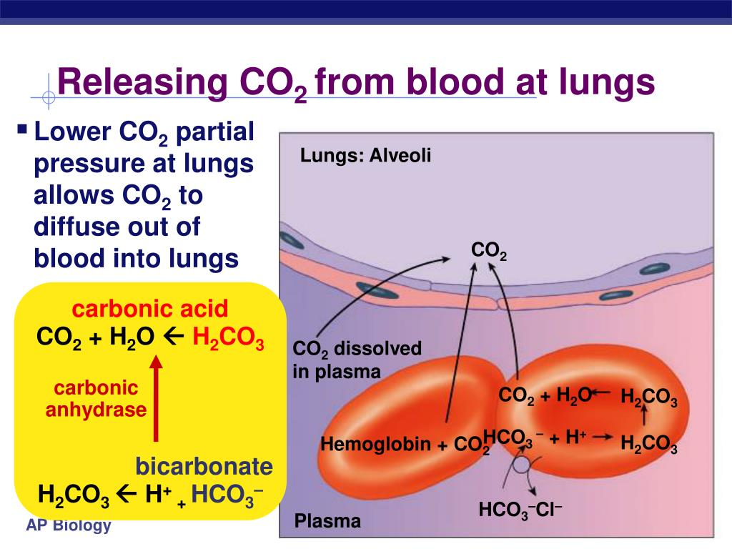
What happens to the HCO₃⁻ and H⁺ back at the lungs?
Low pCO₂ in the lungs causes the ions to recombine to form CO₂ and H₂O
Which can then diffuse into the alveoli and be breathed out. Again catalysed by carbonic catalase.
LaChateliers principle!
CO₂ + H₂O ⇌ H₂CO₃ ⇌ H⁺ + HCO₃⁻

Slide 14

Why is converting CO₂ into HCO₃⁻ inside the RBC important around respiring cells?
It maintains the steep concentration gradient with the CO₂ being produced by the respiring cells.
Therefore, CO₂ keeps diffusion into the red blood cell

Slide 15
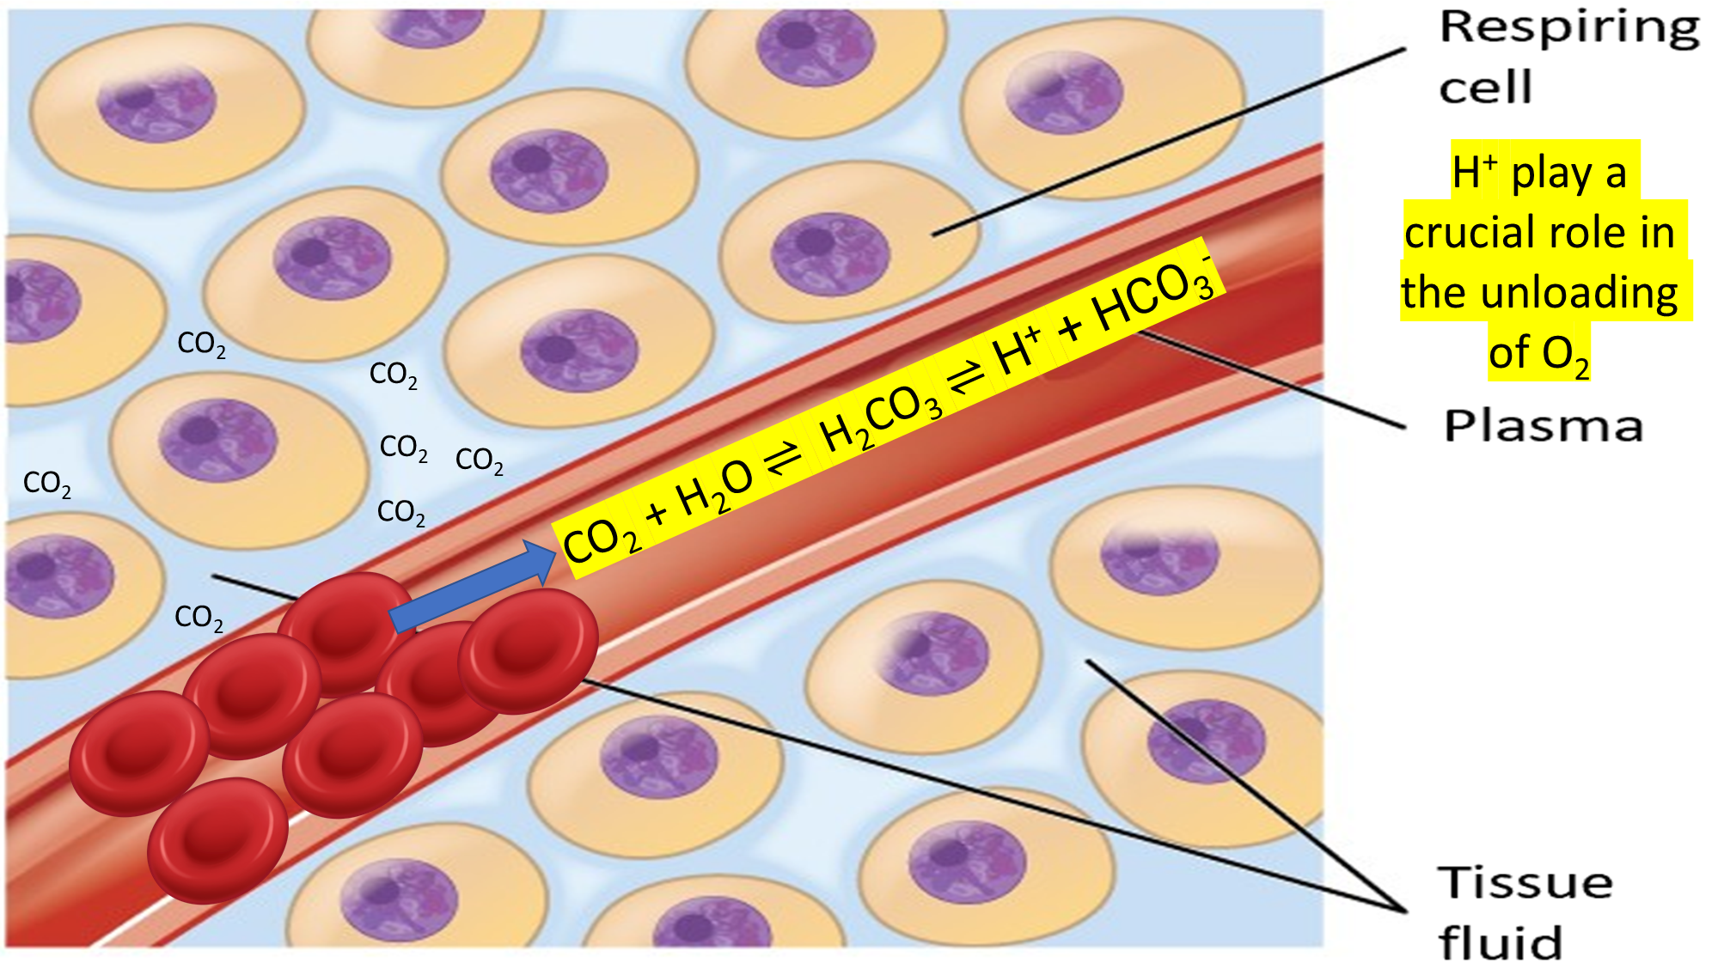

Slide 16
Recap questions
What does CO₂ react with inside the red blood cell and what is produced?
CO₂ + water → Carbonic acid
What happens to the acid that is produced?
It dissociates producing H+ and HCO₃-
How are the HCO₃- ions transported back to the lungs?
It diffuses out of the RBC and is transported in the plasma.
How do the H+ ions reduce haemoglobins affinity for oxygen?
Binds to haemoglobin (forming haemoglobinic acid) – haemoglobin unloads O₂
Changes to pH – changes the shape of haemoglobin causing O₂ to unload
The reaction between O2 and water is slow. What speeds up this reaction?
Enzyme – carbonic anhydrase

Slide 17
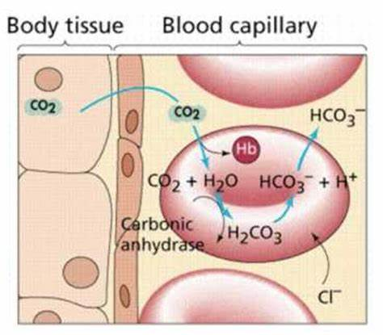
Chloride shift
When HCO₃⁻ diffuses into the plasma
The erythrocyte charge becomes positive (H⁺).
Cl⁻ diffuses into the cell (chloride shift), to maintain the electrical balance of the cell.
Exam tip: be sure to learn the differences between the Bohr shift and chloride shift.
The Bohr shift occurs when a high partial pressure of carbon dioxide causes haemoglobin to release oxygen into respiring tissues.

Slide 18
Fill in the gaps!

Slide 21
NL BELOW PRINT

Slide 22
Taboo.

Slide 23
Ready..

Slide 24
Hemoglobin

Slide 25
Carbonic acid

Slide 26
Bohr

Slide 27
Low pO₂

Slide 28
Arrythmia

Slide 29
fHb / foetal hemoglobin

Slide 30
HHB / haemoglobinic acid

Slide 31
HCO₃⁻

Slide 32
Placenta

Slide 33
Chloride shift

Slide 34
P-R segment

Slide 35
Ectopic

Slide 36
T wave

Slide 37
Bradycardia

Slide 38
SA node

Slide 39
Fibrillation

Slide 40
ECG

Slide 41
Semi lunar

Slide 42
Systole

Slide 43
AV node

Slide 44
QRS

Slide 45
Diastole

Slide 46
Purkinje / Purkyne

Slide 47
P wave

Slide 48
Bundle of His

Slide 49
Arteriole

Slide 50
Lymph

Slide 51
Vital capacity

Slide 52
Spiracles

Slide 53


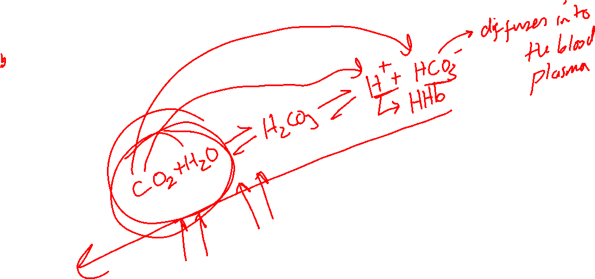


Slide 54
No notes – annotate as much as you can!

Slide 56
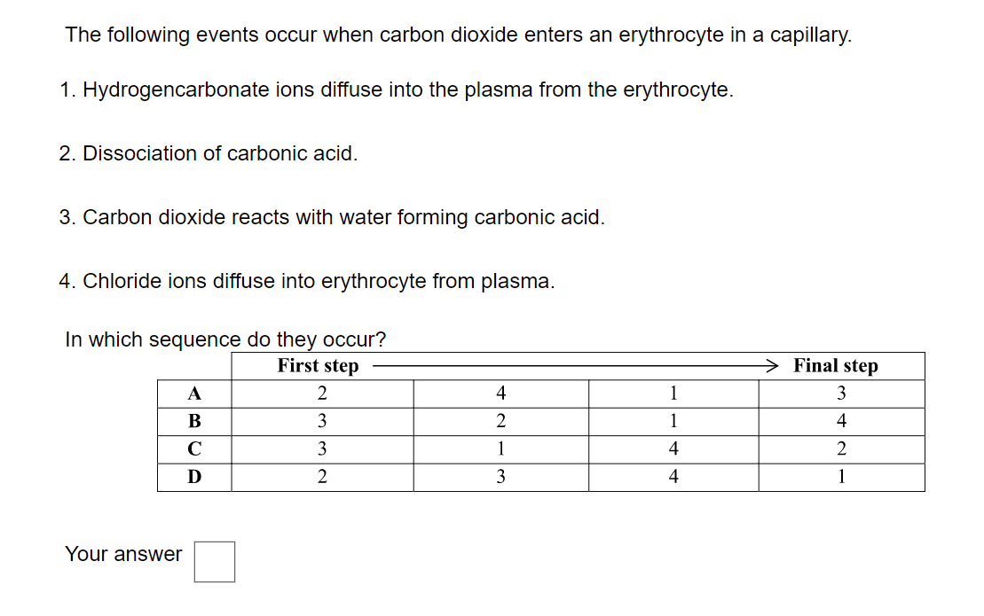
DISCUSS AND ANSWER

Slide 57
DISCUSS AND ANSWER
B

Slide 58
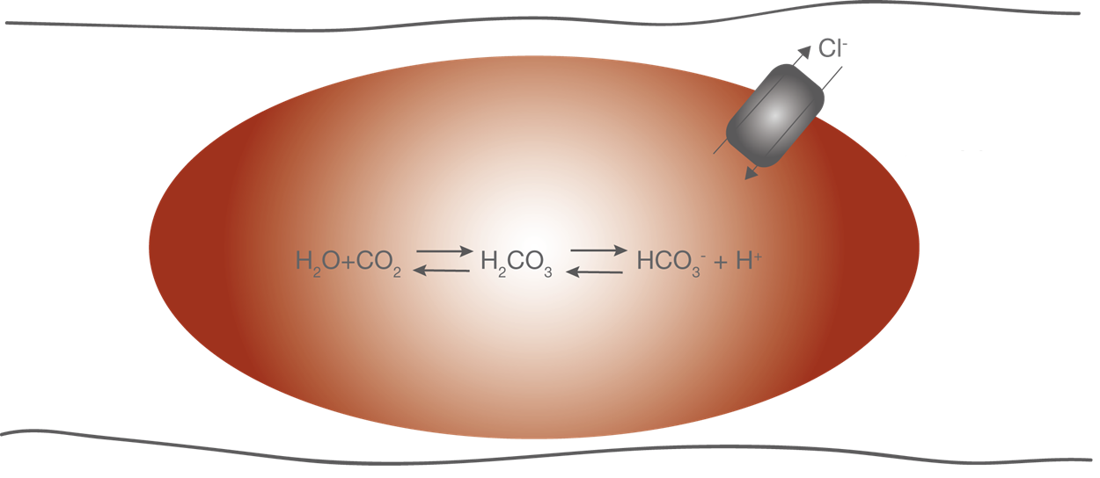

Slide 59
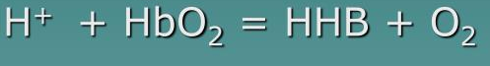
Blood pH
........................... in the erythrocytes accepts free ........................ ions in a ……………….. reaction to form …………………….. acid. This prevents the blood form becoming too ……………...

Slide 60
Blood pH
Oxyhaemoglobin in the erythrocytes accepts free hydrogen ions in a reversible reaction to form haemoglobinic acid. This prevents the blood form becoming too acidic

Slide 61
Explaining right and left shifts on dissociation curves

Slide 62
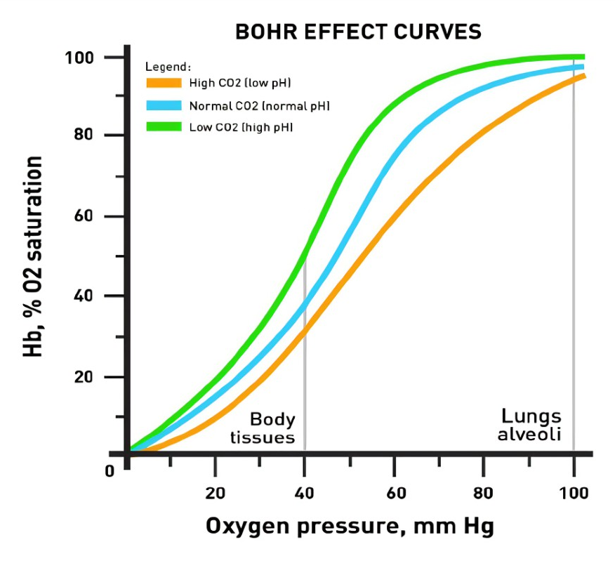
Use the key to explain both shifts on the graph
A → C = right shift will ……
A → B = left shift will …….
B
A
C
Remember that the curve furthest to the left represents when haemoglobin has the highest affinity for oxygen.
Notes:
In order to achieve the same saturation level as B – you need a higher pO₂ k due to increase in acidity H+ ions

Slide 63
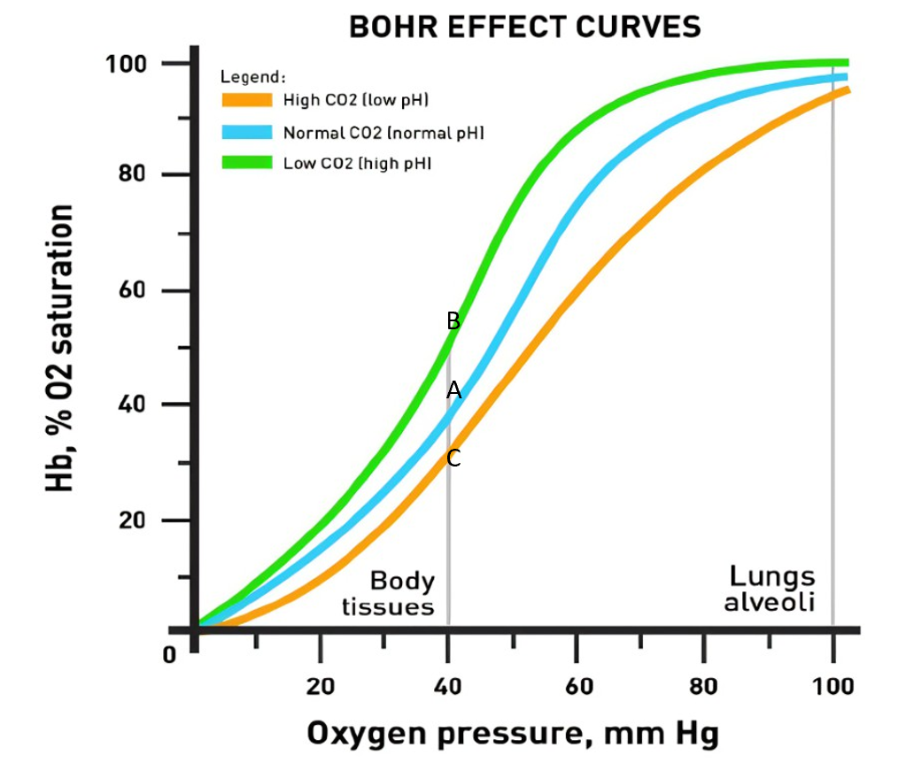
A → C = right shift
Increase in CO₂
Lowers the pH
Reducing Hb affinity to O₂
Increase in O₂ unloading
A → B = left shift
Decrease in CO₂
Increases the pH
Increases Hb affinity to O₂
Increase in O₂ loading
Remember that the curve furthest to the left represents when haemoglobin has the highest affinity for oxygen.
Notes:
In order to achieve the same saturation level as B – you need a higher pO₂ k due to increase in acidity H+ ions

Slide 64
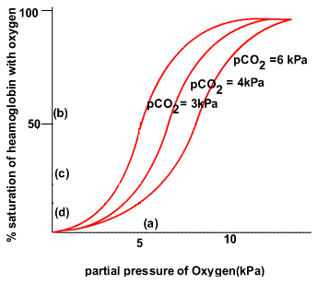
CO2 effect on O2 Dissociation
In a CO₂ - rich environment (i.e. at respiring tissue), more oxygen unloads from oxyhaemoglobin
Oxygen dissociation curve shifts to the right
This is known as the Bohr effect
Remember that the curve furthest to the left represents when haemoglobin has the highest affinity for oxygen.
Notes:
(requires higher pO₂ to saturate Hb due to H⁺ competition)

Slide 65
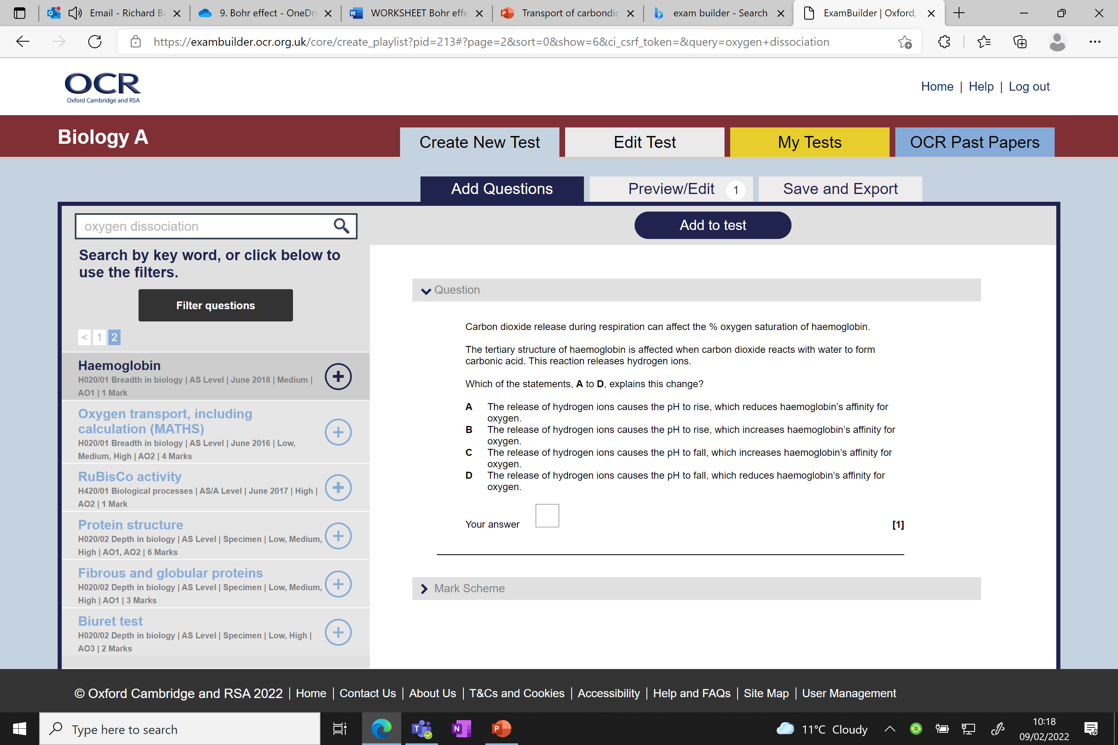
Discuss and answer
D

Slide 66
Does anything else change the Hb affinity for oxygen?
Temperature

Slide 67
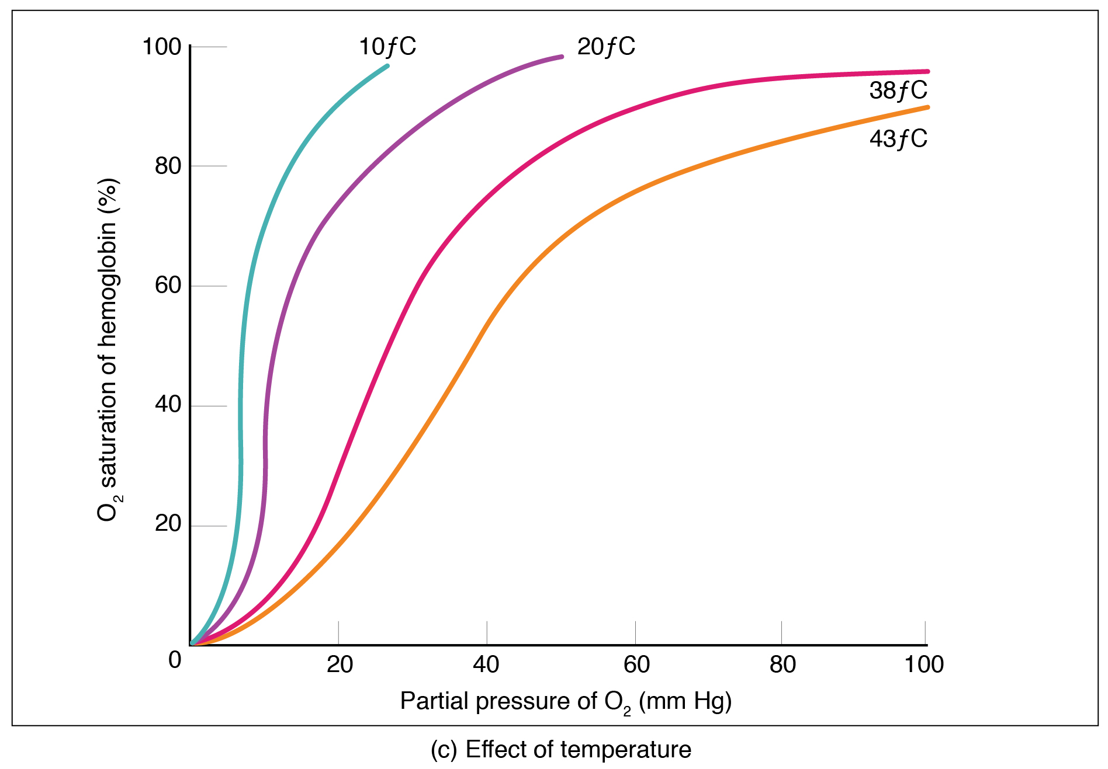
Temperature and Hb affinity for O₂
Explain how temperature effects Hb affinity to O₂ (2 marks)
Explain why this might be beneficial (3 marks)
Why does this occur? (1 marks)

Slide 69

Explain how temperature effects Hb affinity to O₂ (2 marks)
Increased temperatures of blood result in a reduced affinity of haemoglobin to O2
Causing enhanced unloading of oxygen by haemoglobin, thus a right shift
Explain why this might be beneficial? (3 marks)
Metabolically-active tissues often have high temperatures.
Because of this increased temperature, oxygen unloading by haemoglobin is enhanced,
thus improving oxygen transport to areas which require it most for respiration.
Why does this occur? (1 mark)
Increasing the temperature denatures the bond between oxygen and haemoglobin

Slide 70


Slide 71
The ………….. effect is a phenomenon resulting from the relationship between pCO₂, blood pH and the affinity of …………………… for …………………
Where we see …………… pCO₂ we also have a low pH due to the increase in carbonic acid, causing Hb to have a ……………. affinity to O₂ (in the respiring tissue)
Conversely, low pCO₂ have …………………. pH levels which ………………… the Hb affinity to O₂ (in the ………………)

Slide 72
The Bohr effect is a phenomenon resulting from the relationship between pCO₂, blood pH and the affinity of haemoglobin for oxygen
Where we see high pCO₂ we also have a low pH due to the increase in carbonic acid, causing Hb to have a lower affinity to O₂ (in the respiring tissue)
Conversely low pCO₂ have higher pH levels which increases the Hb affinity to O₂ (in the lungs)

Slide 73
Recap key terms for today:
Carbonic anhydrase – enzyme that catalyses the reaction between carbon dioxide and water
Hydrogen carbonate ions – product of the reaction between carbon dioxide and water
Chloride shift – the movement of chloride ions into the erythrocytes to neutralise hydrogen ions
Haemoglobinic acid – compound formed from haemoglobin and excess hydrogen ions.

Slide 74

Animal transport

Slide 75
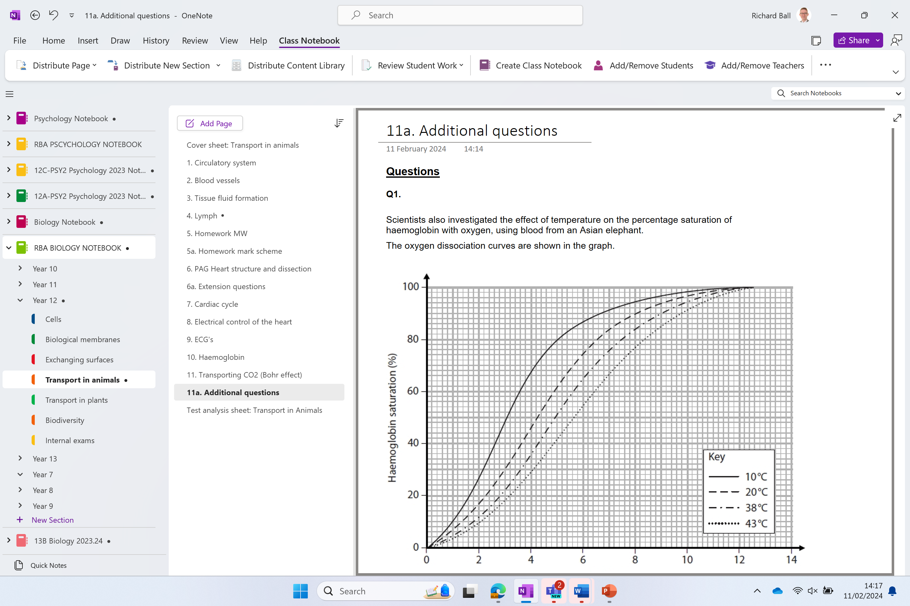
Additional questions
QUIZ
https://lovebiology.co.uk/test-quiz_gce.php?topic=12

Slide 76
TRY THE QUIZ
Post on Teams
Love Biology A Level Quiz | Transport in animals

Slide 77
Recap questions: Unloading of oxygen
Why does the affinity of haemoglobin for oxygen need to change?
For efficient transport oxygen needs to be ‘loaded’ and ‘unloaded’ by the erythrocytes.
Where would Hb affinity for O₂ be high?
In the capillaries surrounding the alveoli
Where would Hb affinity for O₂ be low?
In the capillaries in the tissues
What factors could cause the affinity to change?
pCO₂ , acidity , exercise, temperature

Slide 78
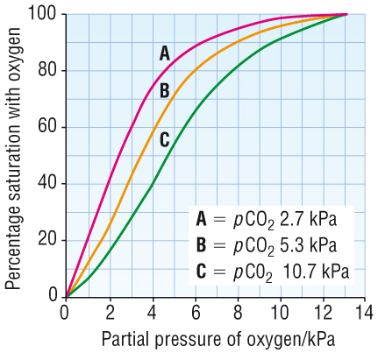
The Bohr effect – caused by different carbon dioxide concentrations (pCO₂)
The effect that CO₂ concentration has on haemoglobin, explaining how O₂ is released where it is needed.
Active muscles need more energy and more oxygen
Increased pCO₂ , reduces affinity and releases O₂
Bohr effect
Left shift = decrease
O₂ dissociation increases at high pCO₂, in order to get more O₂ into respiring cells – look back at your original erythrocyte drawing. More CO₂ = more H⁺ = more dissociation of haemoglobin to release O_{2.}
A – low CO₂ concentration (lungs)
B – mid CO₂ concentration (respiring tissue at rest)
C – high CO₂ concentration (respiring tissue exercise)

Slide 79
