Slide 1
Transmission of pathogens
Lesson 3 - Animal and plant communicable pathogens

Slide 2
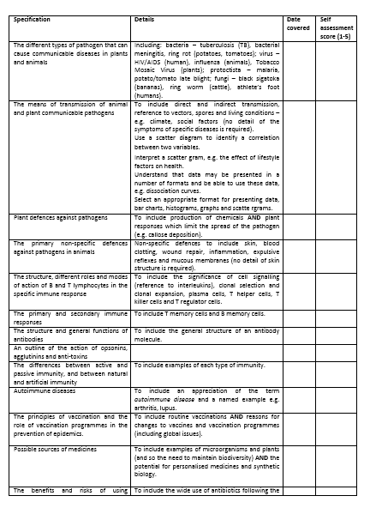
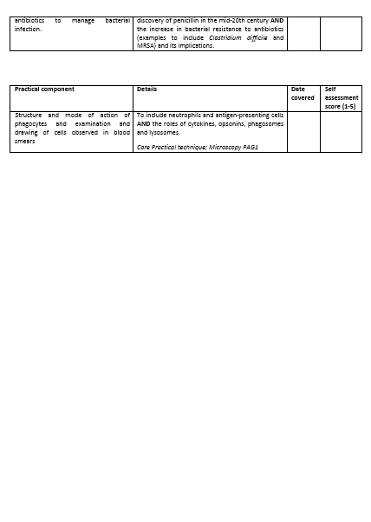
Learning Outcomes
The different types of pathogen that can cause communicable diseases in plants and animals
The means of transmission of animal and plant communicable pathogens, including direct and indirect transmission, reference to vectors, spores and living conditions – e.g. climate, social factors (no detail of the symptoms of specific diseases is required).

Slide 3
Starter: A Recap from your presentations.
What is a pathogen and name 4 different types
Name the bacteria which causes TB
Which disease are bananas most susceptible to?
How is HIV transmitted?
What type of pathogen causes athlete's foot?
Which disease could have caused the death of thousands of Irish people in 1845?
Where are the two parts of the life cycle of Plasmodium completed?
What disease causes an itchy red ring on the skins surface?
Which term describes a disease that lays dormant until a host is immunocompromised?
How could a glass save your life?

Slide 4
Watch the video and make notes on your whiteboard…
What methods of transmission are covered in the video? (5 minutes)
https://www.youtube.com/watch?v=g09BQes-B7E

Slide 5
Disease versus pathogen
Disease is a disorder of function or structure affecting an organism. Disease can be infectious, genetic, lack of nutrients.
Communicable disease is about disease caused by pathogens.
THE PATHOGEN IS TRANSMITTED, NOT THE DISEASE!

Slide 6
Transmission of pathogens
Definitions:
Direct transmission – passing pathogen from host to new host, no intermediary, there must be contact
Indirect transmission – passing pathogen from host to new host via something else
Transmission – passing pathogen from infected to uninfected individual
Vector – organism that carries a pathogen from one host to another
Fomite – an inanimate object that can transfer pathogens e.g. bedding, socks, cosmetics

Slide 7
Pathogen life cycle
Transmission
Leave host’s tissues
Enter host’s tissues
Reproduce
Lyse (burst) cells
Toxins
This life cycle usually damages the host.

Slide 8
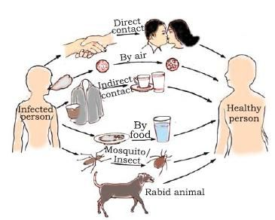
Transmission between animals
Direct transmission:
1. Physical contact – e.g. HIV, bacterial meningitis, ringworm
2. Inoculation – a break in the skin for any reason, during sex, an animal bite, needle sharing
3. Ingestion – taking in contaminated food, drink or fecal matter

Slide 9
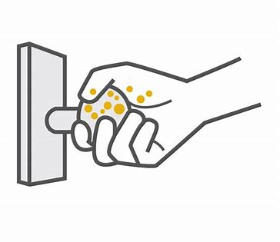
Indirect transmission
Droplet infection – e.g. TB, influenza, pathogens carried in tiny water droplets – catch it, bin it, kill it.
Spores (the resistant stage of a pathogen) – e.g. anthrax, tetanus – mask, wash hands after contact with soil
Vectors - often animals e.g. mosquitoes, dogs, rat fleas
Fomites - inanimate objects, socks

Slide 10
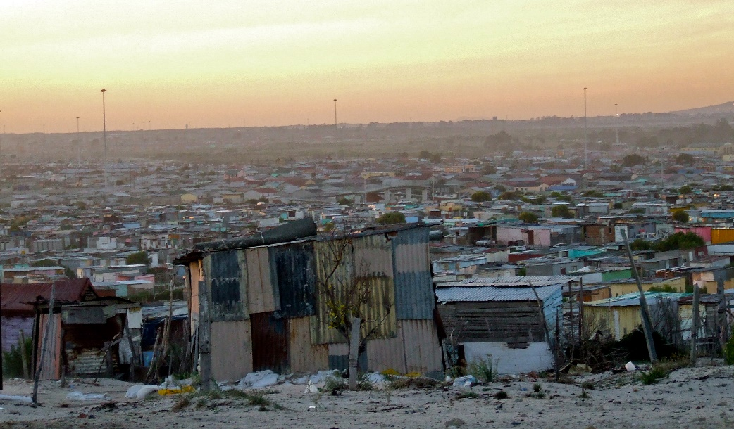
Social factors affecting direct transmission
Overcrowding
Poor ventilation
Poor health
Poor diet
Homelessness
Living / working with migrants from areas where disease is more common

Slide 11
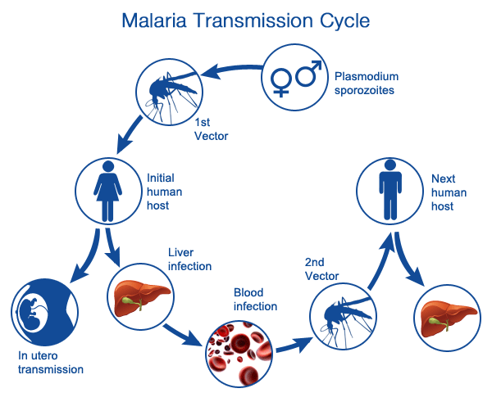
Transmission between animals
Indirect transmission
Vector = another organism that may be used by the pathogen to gain entry to the primary host, usually animals
Plasmodium

Slide 12
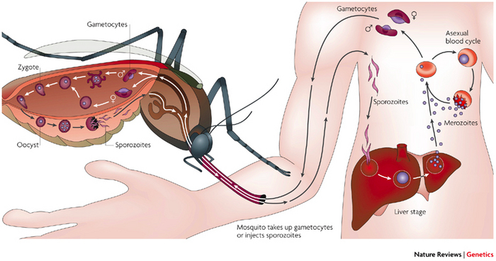
Indirect transmission – vector – e.g. Plasmodium (malaria)

Slide 13
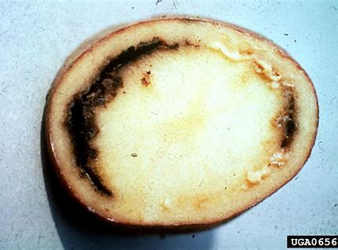
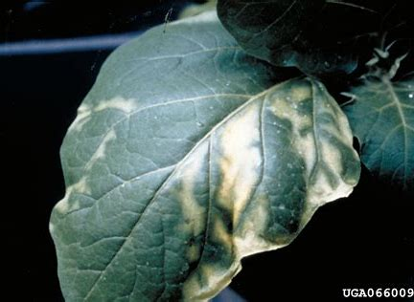
Transmission between plants
Direct transmission
Direct contact of part of a healthy plant with another diseased one. E.g. ring rot, tobacco mosaic

Slide 14
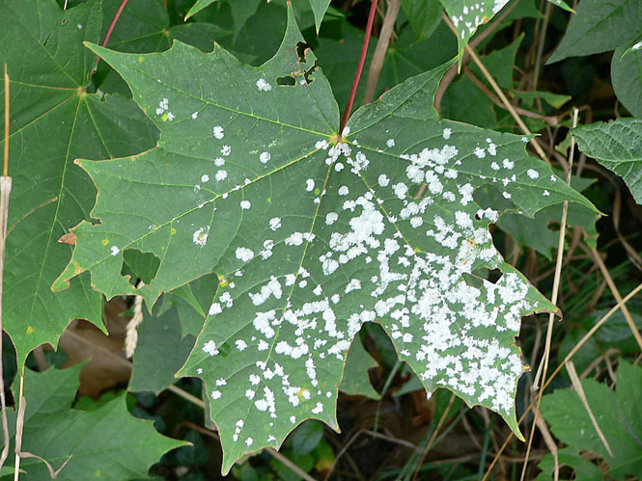
Transmission between plants
Indirect transmission
Present in soil, enter roots (especially if damaged)
Spores (fungi) – airborne
Inside a plant all vascular tissue may be infected. Often many / all offspring are also affected.

Slide 15
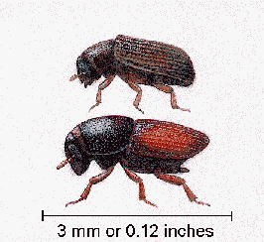
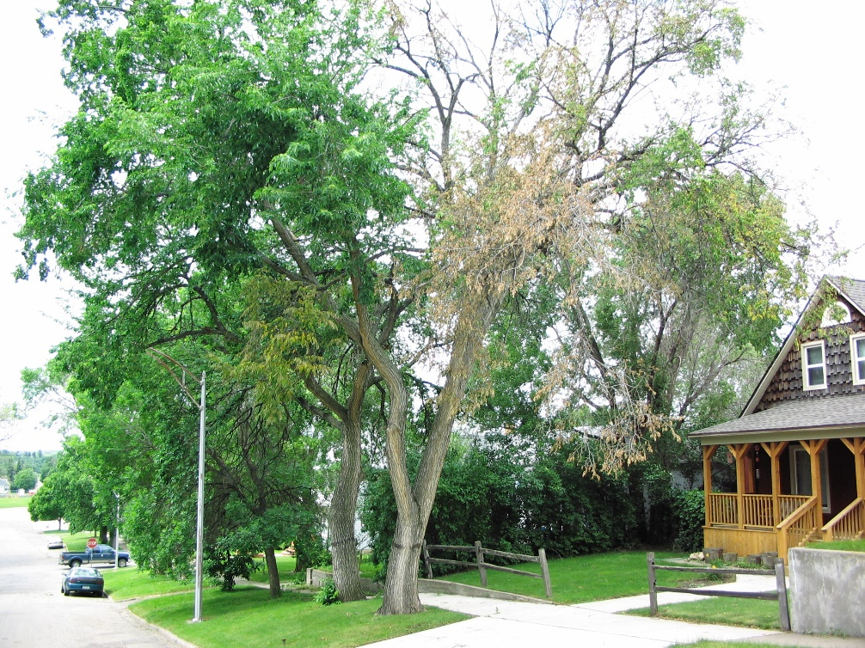
Transmission between plants
Indirect transmission
Insect attack (insects act as vectors) e.g. Dutch elm disease is caused by a fungus transmitted by a beetle Scolytus multistriatus

Slide 16
Factors affecting transmission in plants
Planting crop varieties that are susceptible to disease
Overcrowding – planting very close together
Poor mineral soil content reduces resistance
Damp, warm conditions increase survival and spread of pathogens and spores
Climate change – increased rainfall and wind promote spread, changing conditions cause movement of animal vectors into new areas.

Slide 17
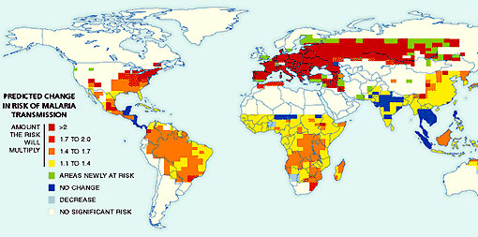
Disease transmission and Climate
Warmer climate = more pathogens = more disease transmission.
Pathogens are more likely to survive and can reproduce more quickly.

Slide 18
A* thinking
Pathogens survive better when the temperature is warm, however more people seem to suffer from illness in the winter. Suggest a reason for this.
Many hand gels claim to kill 99.9% of bacteria, is this effective against disease transmission?
Suggest why it is disadvantageous to destroy 99.9% of bacteria on your hands.
Quick 10

Slide 19
Learning Outcomes
The different types of pathogen that can cause communicable diseases in plants and animals
The means of transmission of animal and plant communicable pathogens, including direct and indirect transmission, reference to vectors, spores and living conditions – e.g. climate, social factors (no detail of the symptoms of specific diseases is required).

