Slide 1
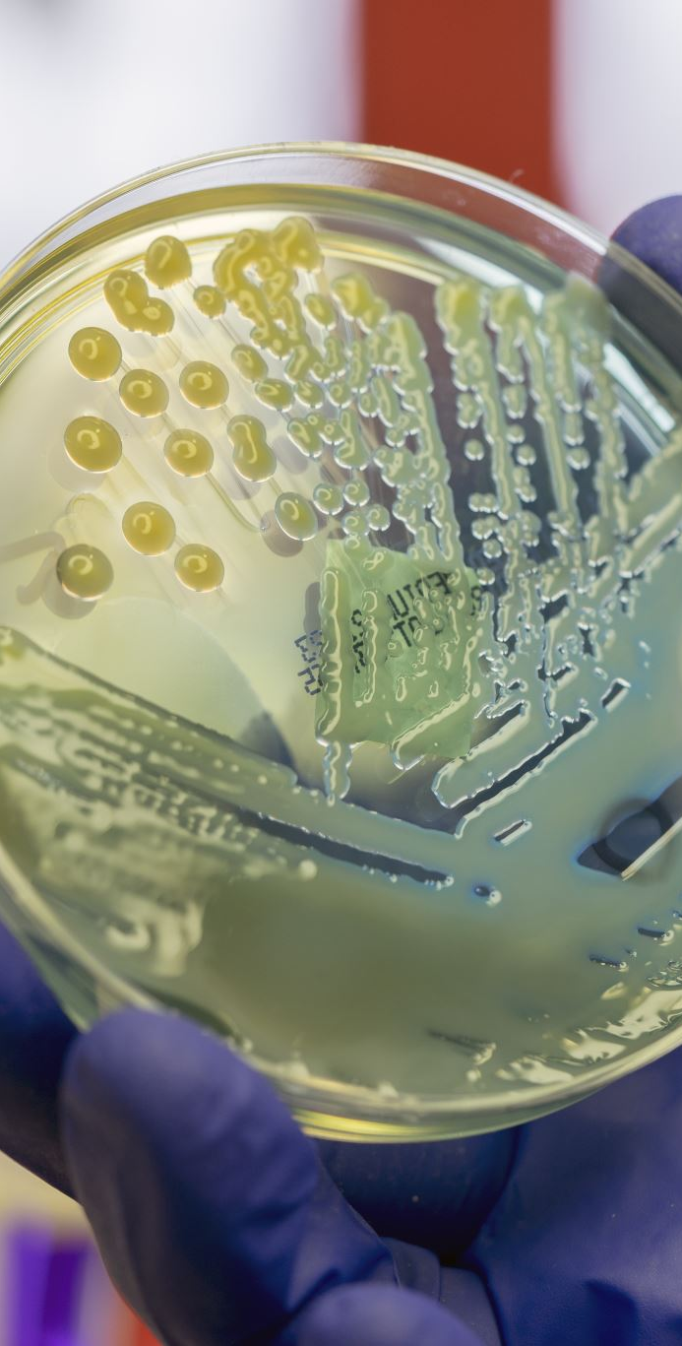
The specific immune response
The structure and general functions of antibodies.
The structure, different roles and modes of action of B and T lymphocytes in the primary and secondary specific immune response.
The action of opsonins, agglutinins and anti-toxins

Slide 2
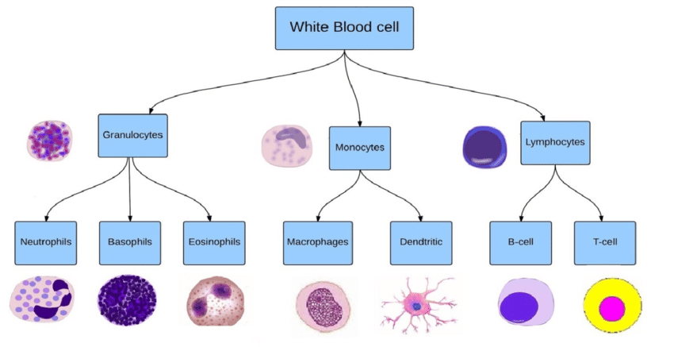
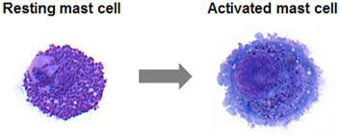
The white blood cell family tree.
Draw this out and keep it on the desk in front of you so that you can keep referring to it as you go.
In the blood
Histamines
Cytokines – interleukin, interferon
Tissue and lymph
Bone marrow - humoral
B effectors
B memory
Plasma cells
Thymus, cell-mediated
T killer - perforin
T helper – CD4, interleukins
T memory – secondary response
T regulator – ends response

Slide 3
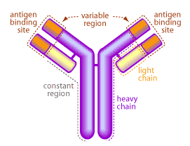
Stage 1: phagocytosis assisted by B lymphocytes
Di-sulphide bonds connect the polypeptide chains, one heavy and one light, and maintain shape
Variable region:
Amino acid sequence can be hugely varied causing different folding and over 1 million different shaped binding sites.
Constant region:
Amino acid sequence remains unchanged allowing binding to receptors on phagocytes.
Hinge region:
Provides flexibility and binding to 2 different antigens
1. Draw and label an antibody
hinge region allows
flexibility
This often comes up as a 2-mark question
AntiBodies are released by B cells

Slide 4
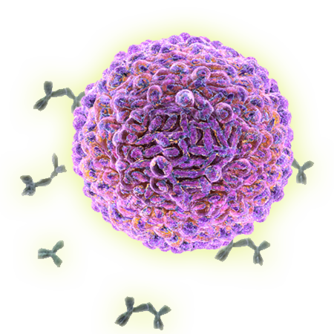
The role of the antibody – humoral response
Binds to a specific antigen on a pathogen and a phagocyte receptor, forming an antigen-antibody complex, so that it can be engulfed.
As an anti-toxin by direct neutralization of bacterial toxins.
Agglutination- antibodies clump bacteria together by using both binding sites. This allows more to be destroyed by each phagocyte and prevents pathogens from entering host cells.
Opsonisation – antibody binds to antigen leading to a cascade reaction releasing the protein opsonin. This coats the bacteria making it easier for a phagocyte to bind. Opsonins can be both specific and non-specific
Colour and annotate the first page.

Slide 5
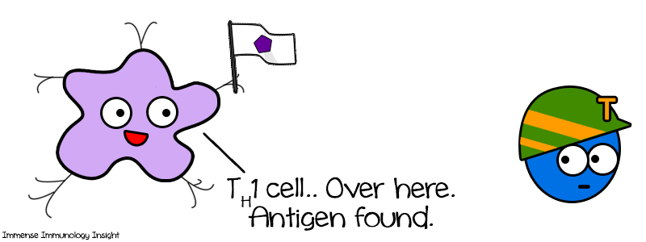
Stage 2: Activation of T helper cells
Macrophage destroys pathogen then combines the antigens with the major histocompatibility complex and moves them to the cell surface membrane. They become antigen presenting cells (APC).
APC binds to a T helper cell at the complementary CD4 receptor. This activates the T cell which then divides by mitosis into active T helpers and T memory cells.
Active T helpers release interleukins which stimulate clonal expansion and differentiation of B and T cells.
Now colour and annotate stage 2.

Slide 6
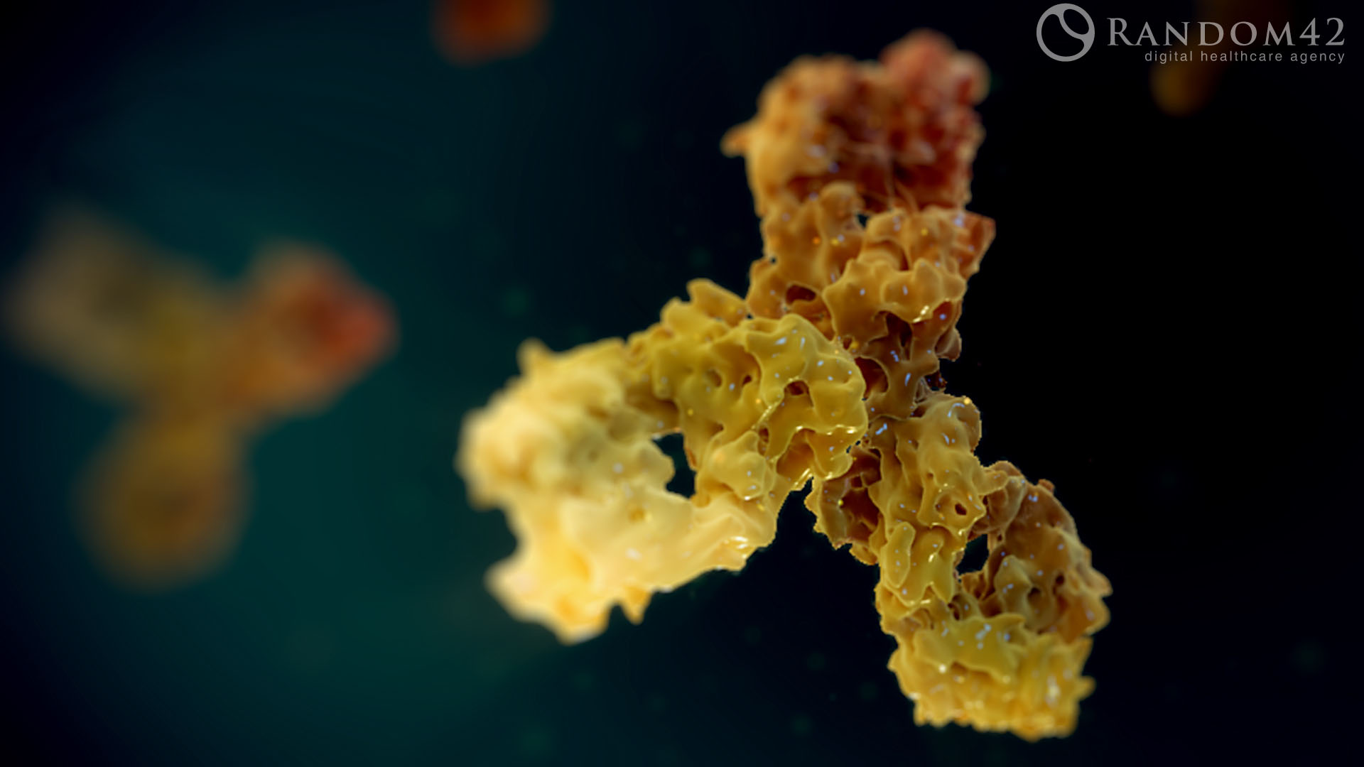
Stage 3: Clonal selection (B cell division) the primary immune response
1. B cells (not a phagocyte) become APC’s, displaying bacterial antigens on the plasma membrane.
2. APC’s bond to and activate T helpers – clonal selection, the recognition of antigens on APC's, by antigen binding sites on activated T and B lymphocytes. Release of interleukins
3. Interleukins cause differentiation of B APC into B memory and B effector – clonal expansion, mitosis leading to numerous genetically identical daughter cells.
4. B effectors differentiate into plasma cells
5. Plasma cells release antibodies
Colour and annotate stage 3
If the same pathogen invades again this initiates the SECONDARY RESPONSE carried out by the memory cells.

Slide 7
Secondary response
(bottom of stage 3)
Memory cells in the lymph
Antibodies on surface bind to specific antigen
Clonal selection initiated immediately
Differentiation into plasma cells and antibody release.
Pathogen destroyed before any symptoms experienced

Slide 8
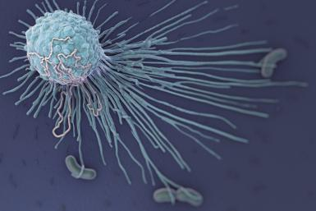
Stage 4: Killer T’s - cell mediated response
Infected body cell acts as APC presenting viral antigens on plasma membrane.
Releases interferons causing nearby cells to heighten anti-viral defences.
T helper binds to infected body cell (clonal selection)
T cell differentiates into T killer, active T and memory T.
Killer T divides by mitosis (clonal expansion)
Active T binds to infected APC and releases perforin.
Enzymes puncture membrane of APC, lysis caused
Pathogen released to be dealt with by macrophages.
And finally, T regulators stop the process from happening once the pathogen has been eliminated and prevents an autoimmune response.
Now go back to your cell family tree and annotate each cell with specific functions

