Slide 1
SET MW ASSIGNMENT

Slide 2

Notes:
Negatively marked

Slide 3
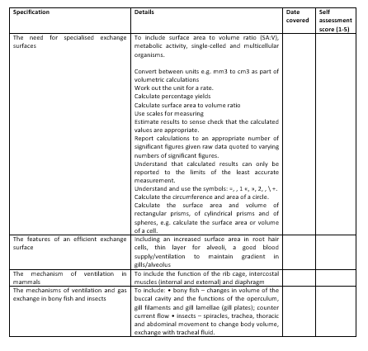
Learning Outcomes
Identify the main structures of the respiratory system
Use a model to explain how the respiratory system functions
Justify how changes in pressure in the thorax allow breathing to occur

Slide 4
The Respiratory System
Wednesday, 23 July 2025

Slide 5
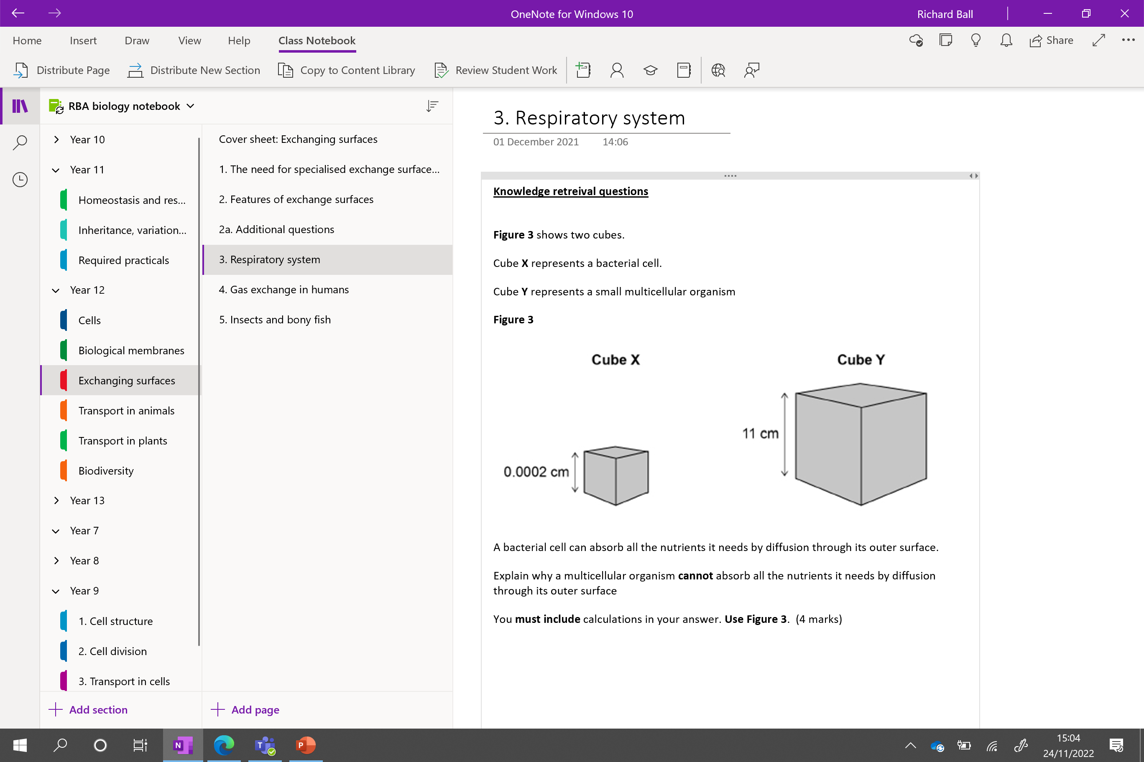

Slide 6
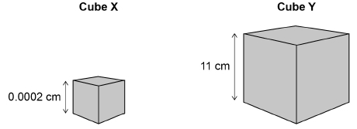
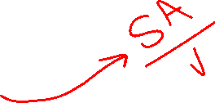
Knowledge retrieval question Respiratory system
Figure 3 shows two cubes.
Cube X represents a bacterial cell.
Cube Y represents a small multicellular organism
Figure 3
SA: vol ratio of X:
2.4 × 10-7 : 8 × 10⁻¹²
or
0.000 000 24 : 0.000 000 000 008
SA: vol ratio of Y:
726:1331
conversion to same scale:
Cube x: 30 000:1
Cube Y: 0.55:1
A ratio of 30 000:1 for X and 0.55:1 for Y scores 3 marks
(so) diffusion distance is longer in multicellular organism
allow converse (1)
OR
(so) diffusion rate per unit volume is slower in a multicellular organism
allow converse (1)
A bacterial cell can absorb all the nutrients it needs by diffusion through its outer surface.
Explain why a multicellular organism cannot absorb all the nutrients it needs by diffusion through its outer surface (4 marks)
You must include calculations in your answer. Use Figure 3.

Slide 7
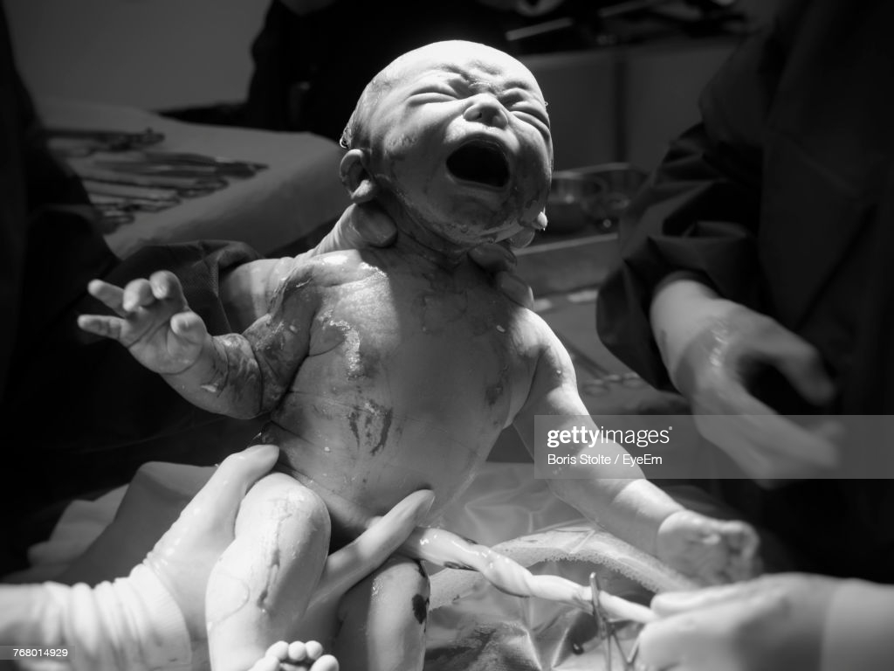

Why is taking your first breath so difficult?
It takes 20x the force of a normal breath to expand your lungs for the first time
Special chemicals called lung surfactants are produced around 24 weeks of pregnancy to stop the alveoli collapsing and sticking together after your first breath
Without these chemicals, the second breath would be just as difficult.

Slide 8
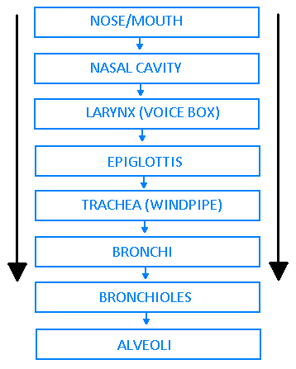
The passage of air – rearrange these terms into the correct order:
Larynx
Bronchioles
Nose/mouth
Alveoli
Trachea
Nasal cavity
Epiglottis
Bronchi

Slide 9
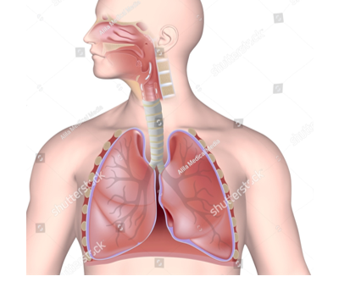
Can you label your diagrams of the respiratory system?
Include STRUCTURE and FUNCTION
Add any detail to your diagram in a different colour!

Slide 10
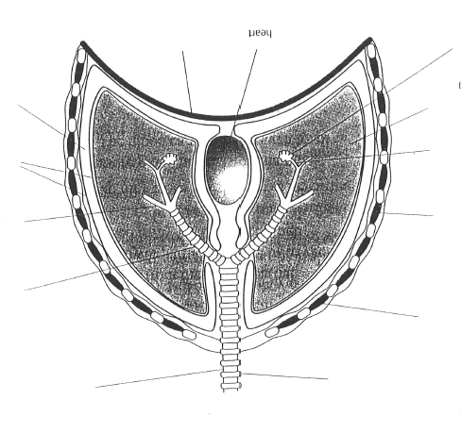
The diagram has small and large bronchiole
Ex……….. i……………. M………….
In…………. i……………. M………….
Lung
P……….. C…………..

Slide 11

Trachea
Lined with columnar epithelial cells. These cells have cilia covered in a layer of mucus. The cilia beat upwards to move mucus and bacteria up to the mouth
Cartilage
C shaped pieces of cartilage line the trachea and prevent it from collapsing
External intercostal muscles
Contraction of these large muscles pulls the ribcage up and out during breathing. They are antagonistic with the internal intercostals.
Bronchus
Each bronchus enters a lung. Rings of cartilage keep the tube open during pressure changes.
Internal intercostal muscles
On contraction, these muscles pull the ribcage down and in when we are breathing out
Larger bronchiole
If greater than 1mm diameter, rings of cartilage are present
Smaller Bronchiole
These tiny branching <1mm tubes carry air to and from the alveoli
Pleural membranes
These surround the lungs and make the thorax airtight
Pleural cavity
Surrounded by serous fluid to allow lungs to expand and recoil
Lung
Alveolus
These tiny airsacs are the main site of gas exchange in mammals. They are thin, permeable and moist with a large surface area for efficient gas exchange. They are closely surrounded by blood capillaries.
Diaphragm
This muscle separates the thorax from the abdomen. Movements of the diaphragm change the volume and pressure in the thorax to cause breathing or ventilation movements

Slide 12
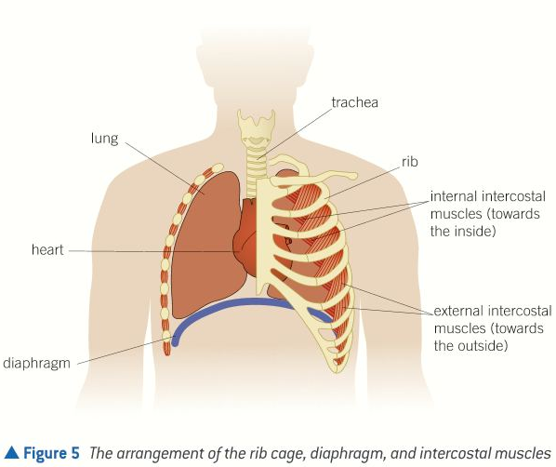
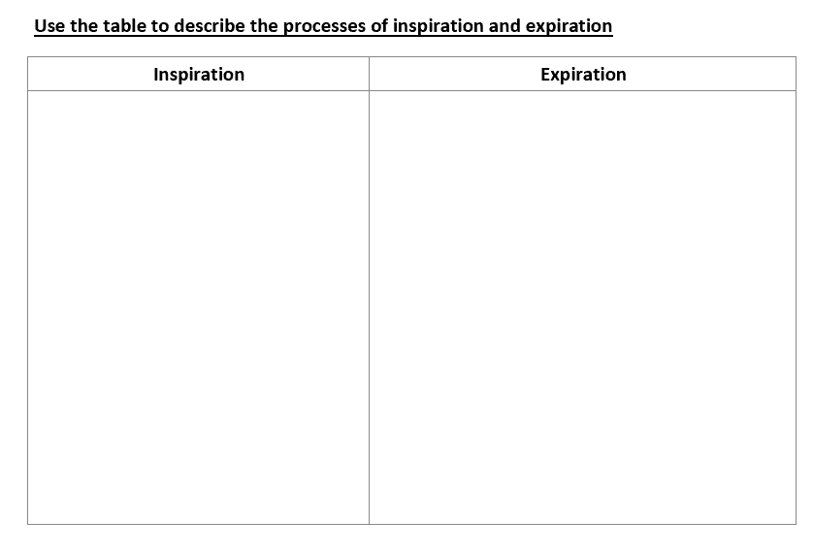
Ventilation
Pressure changes in the thoracic cavity bring about ventilation
The rib cage provides a cage in which pressure and volume changes to facilitate breathing
Task:
Complete your inspiration/expiration table to describe the change that occur during breathing. Include:
Diaphragm
Intercostal muscles
Thoracic volume
Thoracic pressure
Air flow

Slide 13
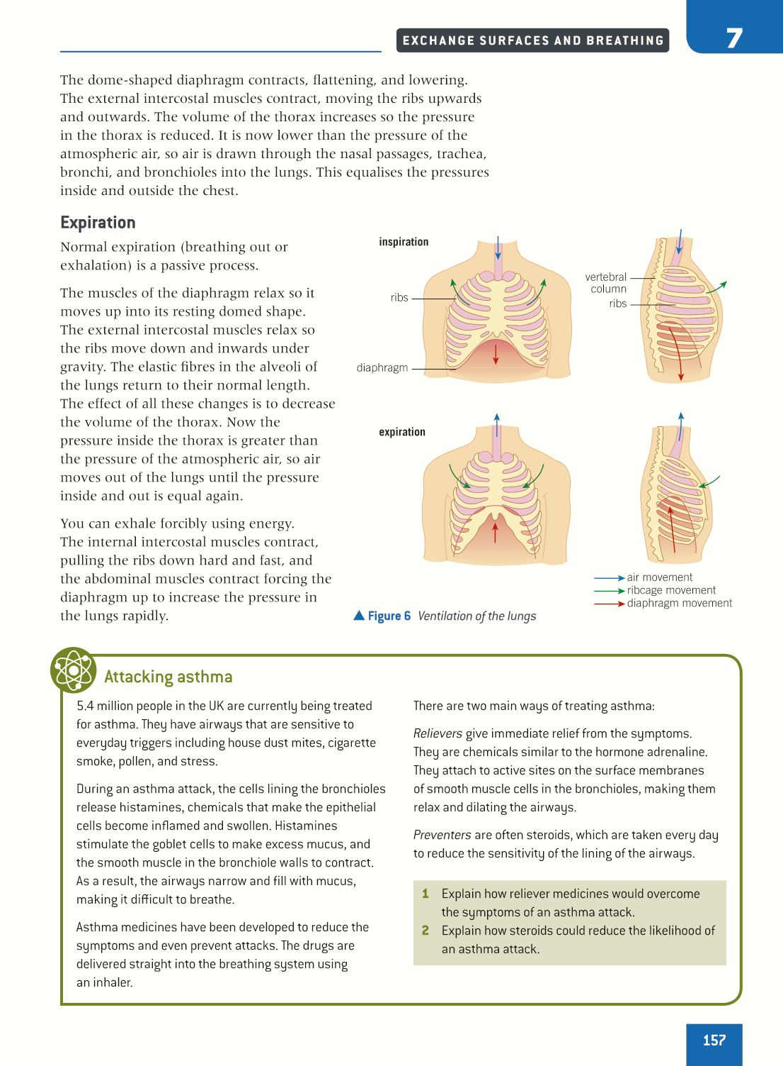
Inspiration
This is an energy using (active) process:
Diaphragm – Contracts and flattens
Intercostal Muscles – (external) contract
Thoracic Volume – Increases
Thoracic Pressure – Decreases
Air Flow – Into lungs (to equalise the pressure difference)

Slide 14
Expiration
This is a largely passive process:
Diaphragm – relaxes/ moves up
Intercostal Muscles – (external) relax
Thoracic Volume – decreases
Thoracic Pressure – increases
Air Flow – out the lungs (to equalise the pressure difference)

Slide 15
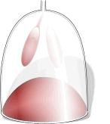
Does this model have any limitations?

Slide 16
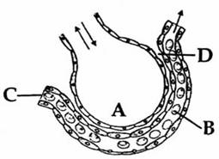
Annotate four ways in which the lungs are adapted for efficient gas exchange

Slide 17
State and explain!
Large Surface Area – provides a large area over which the exchange of materials can occur. Alveoli are about 300 – 500 million in the average adult. Covering a surface are of 50 – 75m² (Nearly half a tennis court!)
One cell thick – this creates a short diffusion distance for gases, increasing the speed of exchange. Moist lining dissolves gases, giving a short aqueous pathway
Good blood supply – good, constant blood supply maintains a large diffusion gradient and ensure the exchanged substances are constantly moving to the area needed. There are around 280 million capillaries.
Good ventilation – maintains the diffusion gradient, this makes the process faster and more efficient.

Slide 18
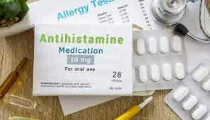
Why do we take a antihistamine?
What is a histamine and why do I need to anti it !?!?

Slide 19

Immune system
Histamine is a signalling molecule that sends messages between cells in the immune system.
Allergies
When the body encounters a foreign protein, or allergen, the immune system releases histamine to protect the body. This causes allergy symptoms like sneezing and a runny nose.
People that suffer with bad hay fever produce too many histamines / an overreaction to the pollen

Slide 20
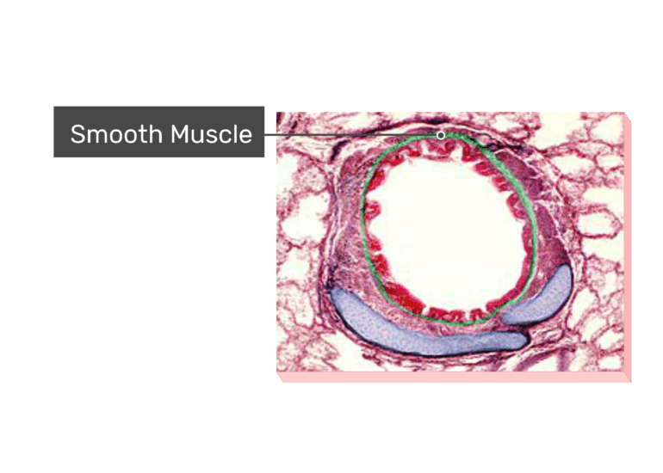
EM image of bronchiole
Explain why the bronchioles has smooth muscle (3 marks)
When allergens enter the bronchioles, immune cells release histamine
This causes smooth muscles of the bronchioles to contract.
This prevents / reduces the entry of the allergens

Slide 21
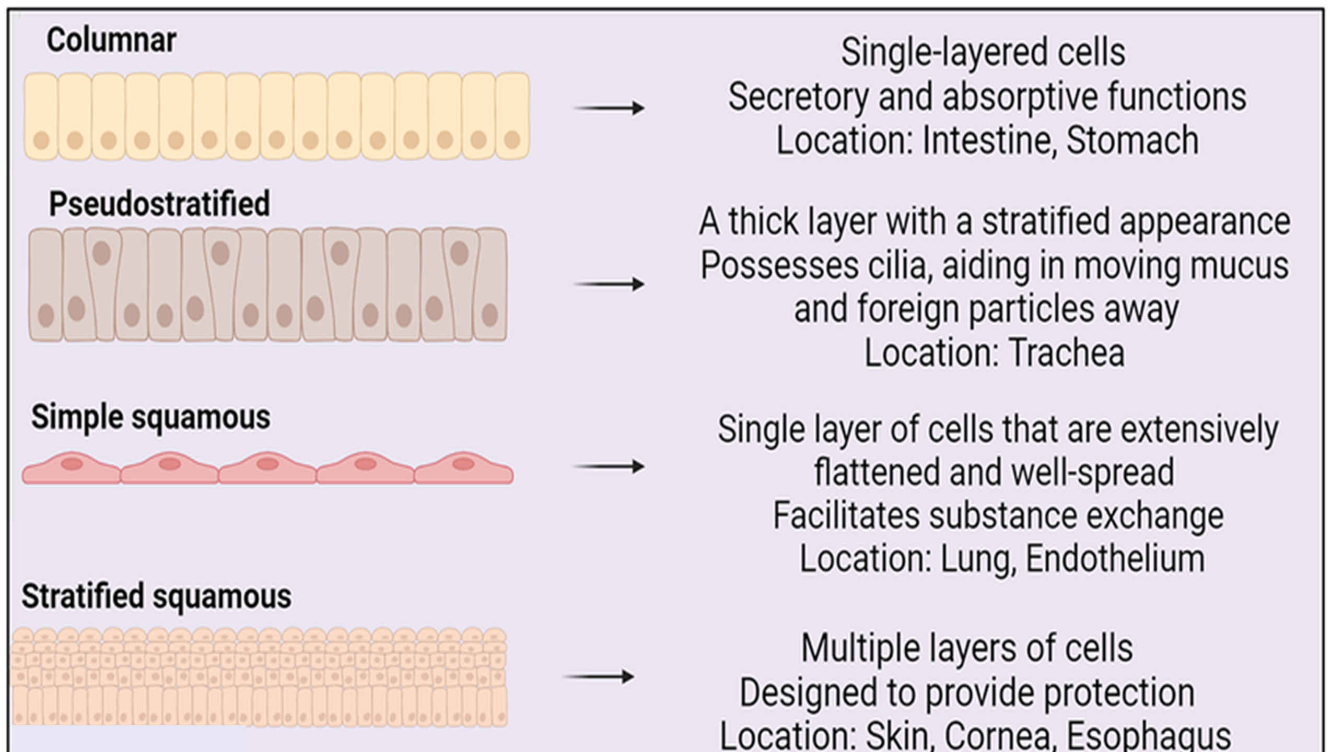
Where might we find the following layers of epithelial tissue in the body?

Slide 22
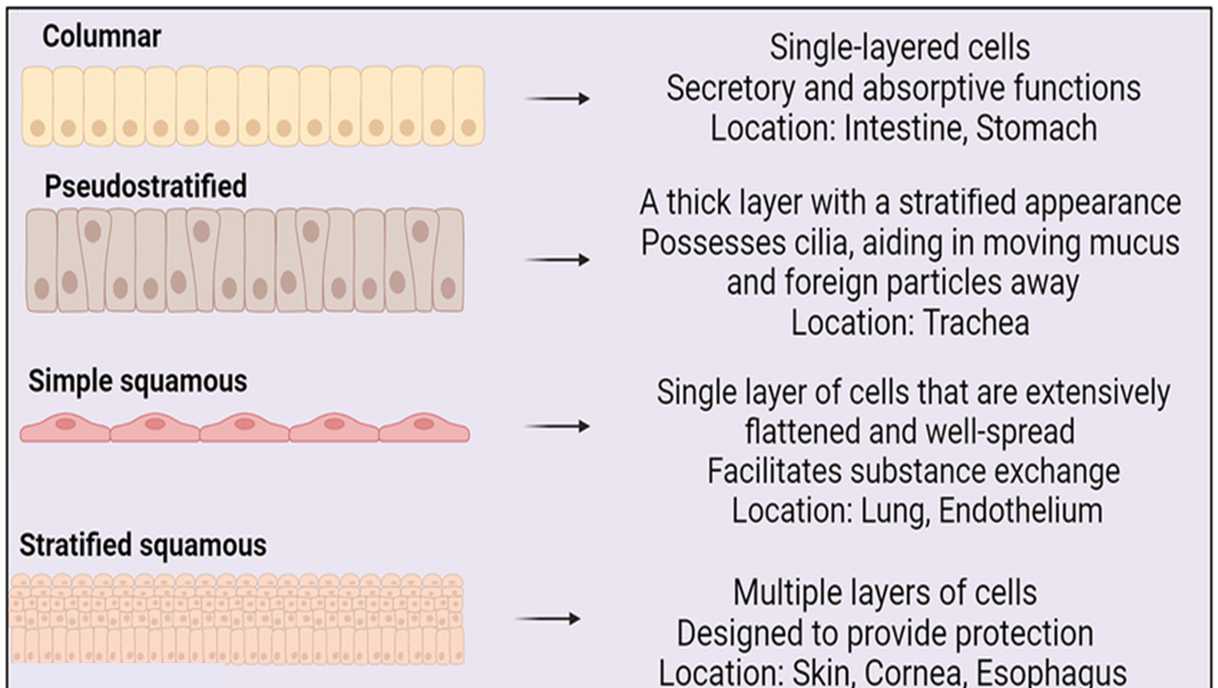

Slide 23
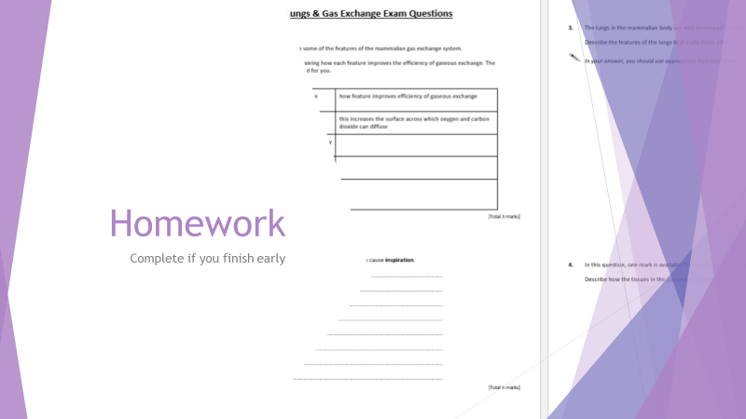
Task: Around the room
The key structures you have already learned have additional features you need to know!
Use the posters around the room to find the following additional features
Mini test next lesson on the additional features!
Any information missing will be set at homework

Slide 24
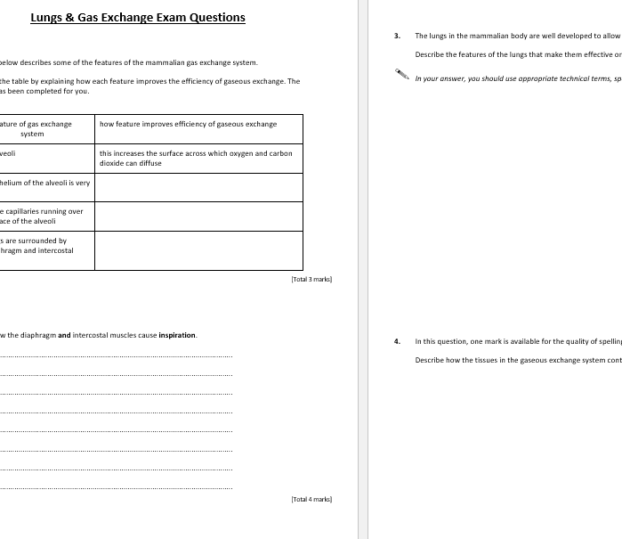
Homework
Complete if you finish early

Slide 25
Learning Outcomes
Identify the main structures of the respiratory system
Use a model to explain how the respiratory system functions
Justify how changes in pressure in the thorax allow breathing to occur

Slide 26
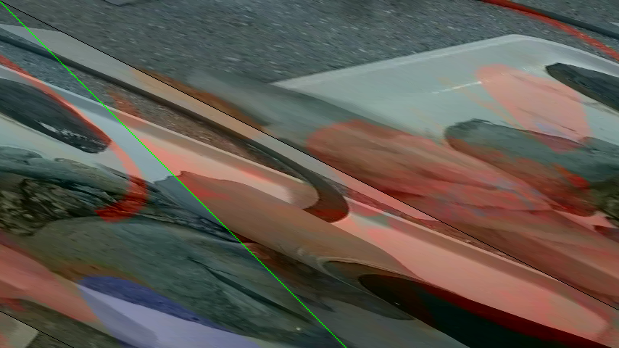
Inflation and elastic recoil of lungs

Slide 27
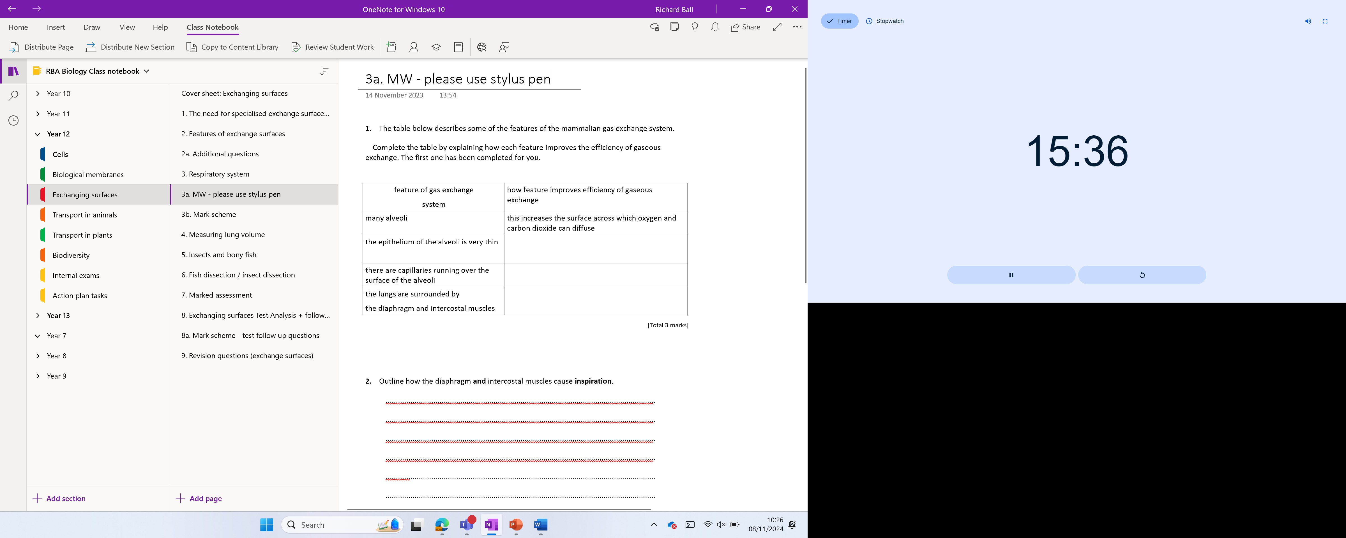

Slide 28


Slide 29
Ready…..

Slide 30
ooibserm
Ribosome

Slide 31
Lamsap nebrmeam
Plasma membrane

Slide 32
yceeeeiyp eglcuarit
Eyepiece graticule

Slide 33
gincanns treconel rocecimsop
Scanning electron microscope

Slide 34
eiveslc
Vesicle

Slide 35
dntharmooiic
Mitochondria

Slide 36
Isc acfe
Cis face

Slide 37
ltaoptnos
Tonoplast

Slide 38
nmaoimtoaarsticlepnt
Compartmentalisation

Slide 39
aeaelllm
Lamellae

Slide 40
elolcsuloe
Cellulose

Slide 41
FINAL SLIDE
DOUBLE POINTS!

Slide 42
yoldilgipc
Glycolipid

